Slide 1
Testers are from Mars, Developers are from Venus
Sunav Sodhani
Notes:
relate to book title
NEXT Slide is INTRODUCE MYSELF

Slide 2


Hello, my name is
Sunav Sodhani
Senior Android QA engineer
8.5 years of testing experience with a focus on mobile
Equally comfortable in a five-person startup & a 350+ employee company

Slide 3

About
350m
Messages per day
386m
Registered users worldwide
60m
Monthly active users
300k
New daily sign ups
Notes:
DONT Say : we are hiring

Slide 4



Slide 5

Notes:
NOT SO SMOOTH PAIR but
we CANT AFFORD IT To BECOME A HURDLE
- SO LETS Understand the GOAL

Slide 6
OUR GOAL:
To ship features at speed to our beloved users

Slide 7
OUR GOAL:
To ship QUALITY features at speed to our beloved users
Notes:
But when these both teams try to work towards it , there are always confrontation
traditional mindset of passing the ball

Slide 8

Notes:
- we keep hearing such comments like : ( next slide)

Slide 9

“I cannot reproduce this bug! “

Slide 10

“I cannot reproduce this bug! “
“Even the happy path is failing :D”

Slide 11
The score is 1-1!

Slide 12
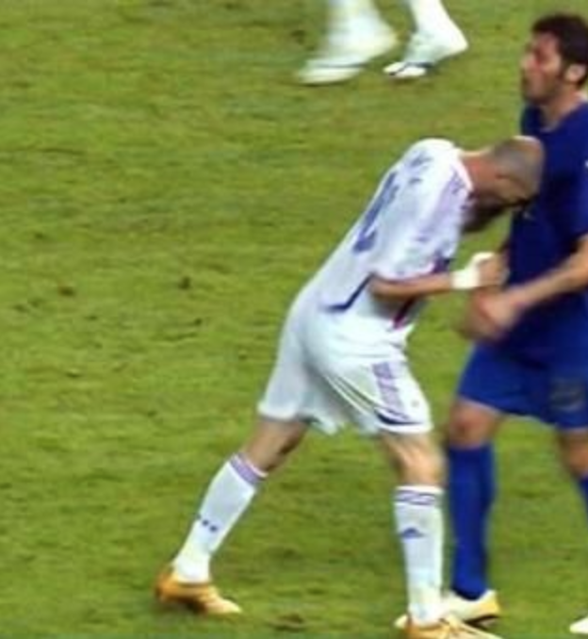
Perhaps you wanna do this….

Slide 13
  Approaches that work for us

Slide 14
Branch-based development & testing

Slide 15
Branch-based development & testing
Weekly releases of mobile apps

Slide 16
What does a QA usually do?
Feature kick-offs
Product Requirement Document (PRD) reviews
QA estimates

Slide 17
1) Talking technical to developers
Make sure to do a technical root cause analysis of the problem

Slide 18
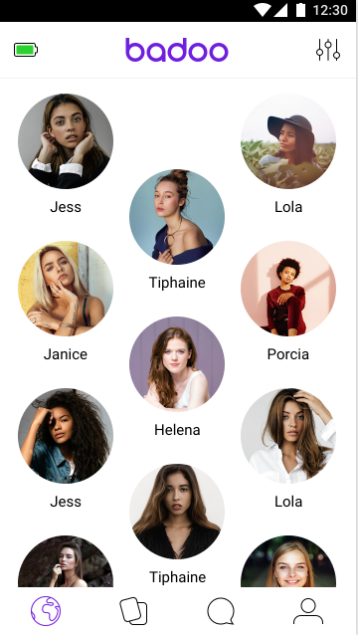

  Example: a memory leak in People Nearby

Slide 19
Method 1: “After using the app for a couple of minutes, I can see an OutOfMemoryError in logs.”

Slide 20
Method 1: “After using the app for a couple of minutes, I can see an OutOfMemoryError in logs.”
  Method 2 : “I got an OutOfMemoryError and here is the memory dump for you to analyse.”

Slide 21
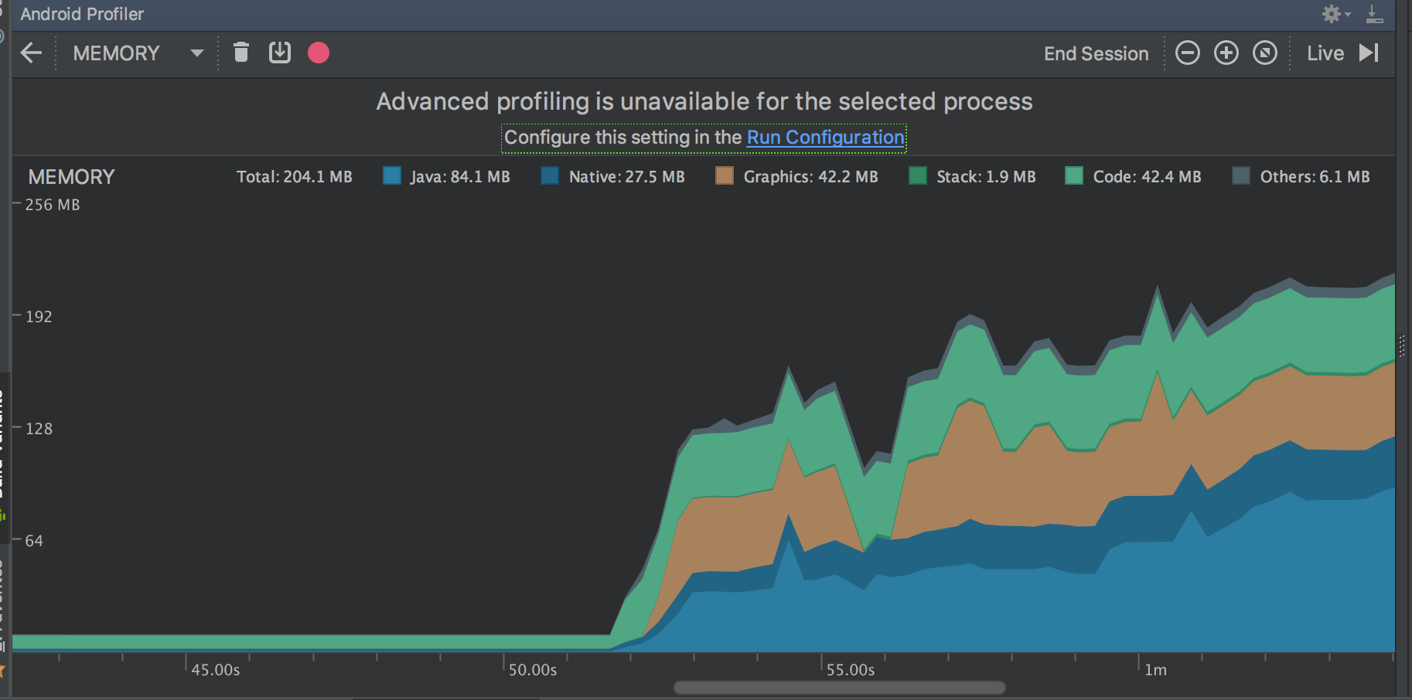
Make the best use of your toolsets
Android Studio shows you the memory graph

Slide 22

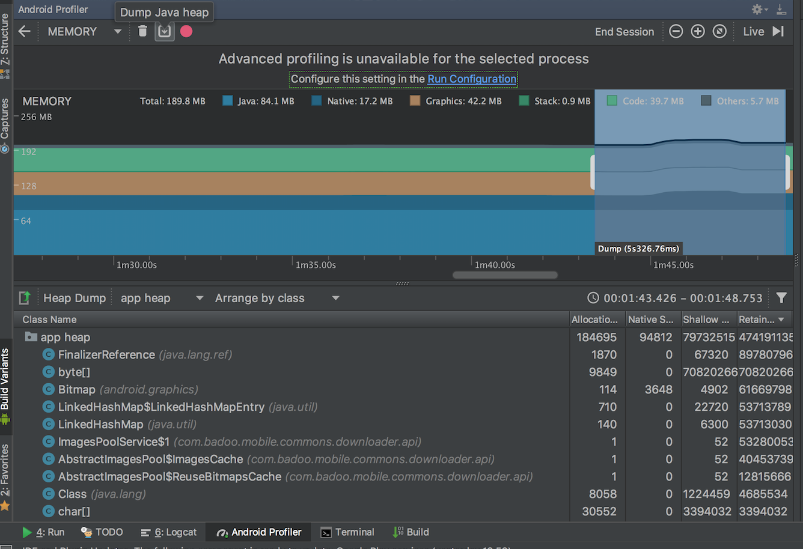
Go to Android Device Monitor/
Android Studio
Dump a HPROF file

Slide 23
1) Talking technical to developers
Make sure to do a technical root cause analysis of the problem
Give the developers a starting point to investigate

Slide 24
1) Talking technical to developers
Make sure to do a technical root cause analysis of the problem
Give the developers a starting point to investigate
Help them to engage with the issue

Slide 25
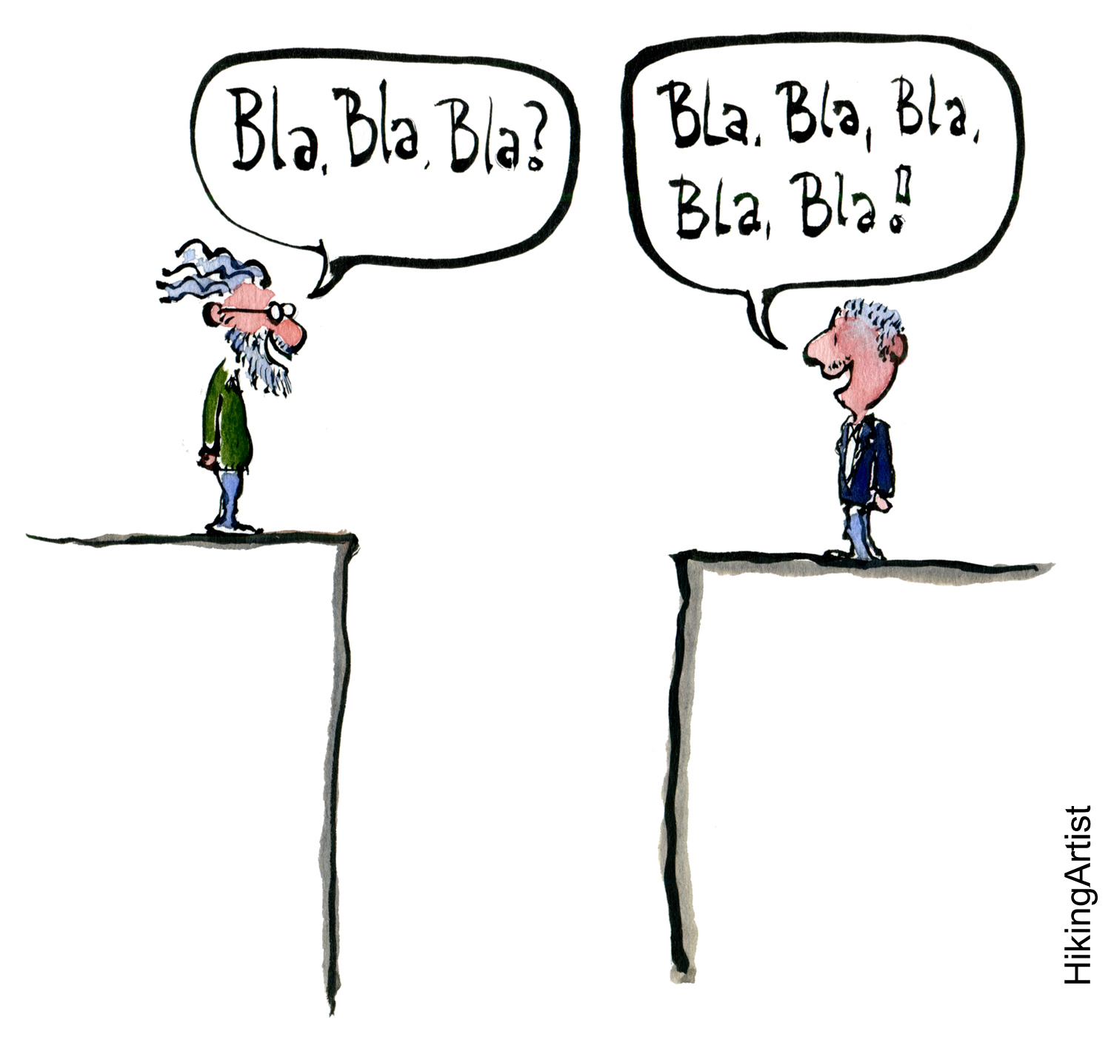
We collaborated, and now we’re speaking the same language!

Slide 26
  2) Shifting the responsibility for quality towards developers

Slide 27
We started to use QA=NO

Slide 28


Slide 29
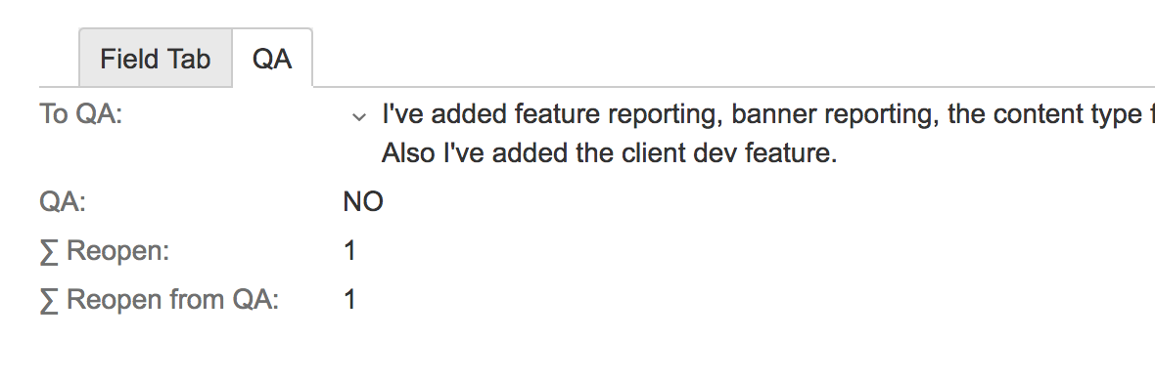

We started to use QA=NO
Notes:
business wanted a very urgent feature in the same week
the developer decided to do this ticket as a release ticket for previous release
He also did this with QA=NO.
This approach by the developer allowed us to do only basic checks for already submitted release and not do a full regression

Slide 30
  This doesn’t mean that we abandon our teammates
  We provide them with
  checklists, hints, mind maps and Wiki pages
Notes:
- we have 1300 cal tests

Slide 31
Features and bug fixes are rolled out much more quickly

Slide 32
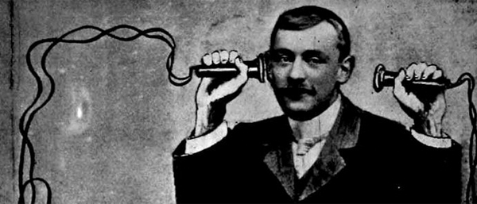
3) Asking the Testing team to stop being a Client-Server communication channel
Notes:
this is not the good approach to follow in the longer run.
A communication which could have happened quite fast between these two people, takes a lot of time when a tester acts as a middle man
- reasons here was to improve the communication between client and server developers

Slide 33
This just speeds things up sometimes!

Slide 34
  Not every approach we tried was a success

Slide 35
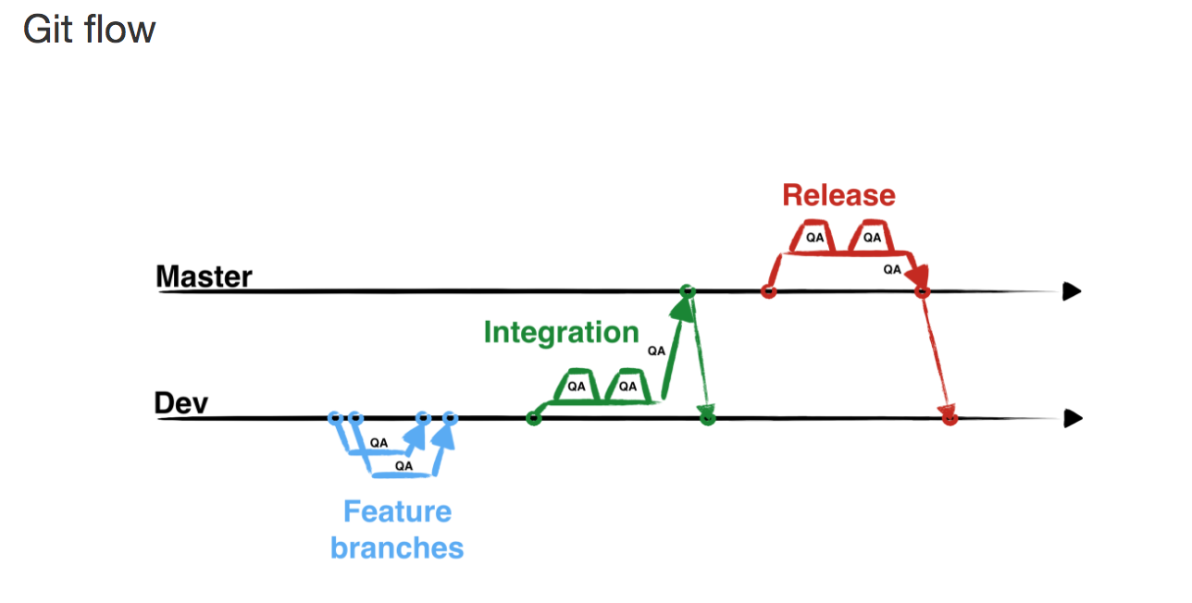

4) Implementing a big feature using the umbrella branch strategy

Slide 36
The umbrella branch strategy
Master
Dev
Umbrella branch
Dev1
Dev3
Dev2

Slide 37
We learned how to divide tasks properly
Developers were no longer blocking or breaking each other’s work

Slide 38
Retrospect your approach

Slide 39

“Mountains are scaled when everybody walks in line - one behind the other"
Notes:
Similarly, Whats the point in orbiting like two different planets - Mars and Venus? Lets get onto the same orbit

Slide 40

Testers & developers need to find a common orbit
Notes:
Something like being in the same orbit.

Slide 41
References
Article on Testers are from mars , Developers are from venus
https://badootech.badoo.com/testers-are-from-mars-and-developers-are-from-venus-ffb04e2c371b
Testing at Badoo in broad strokes
https://badootech.badoo.com/testing-at-badoo-in-broad-strokes-1ff1144b1585
3.How we saved time by teaching developers to test their own code https://www.slideshare.net/ktkellytran/how-we-saved-time-by-teaching-developers-to-test-their-own-code-by-kateryna-sprinsian

Slide 42



Thank you!
@sunav_sshhh
@sunavsodhani
sunav123t@gmail.com

