Slide 1

Artificial Intelligence
Testing Software
the future of
Johan Steyn

Slide 2


Slide 3
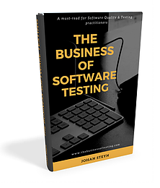
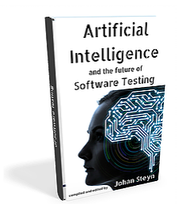
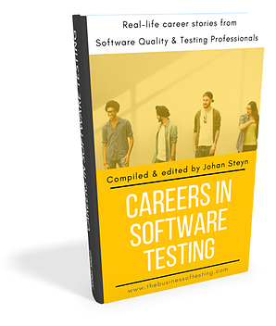


Slide 4


Who works for a bank?

Slide 5
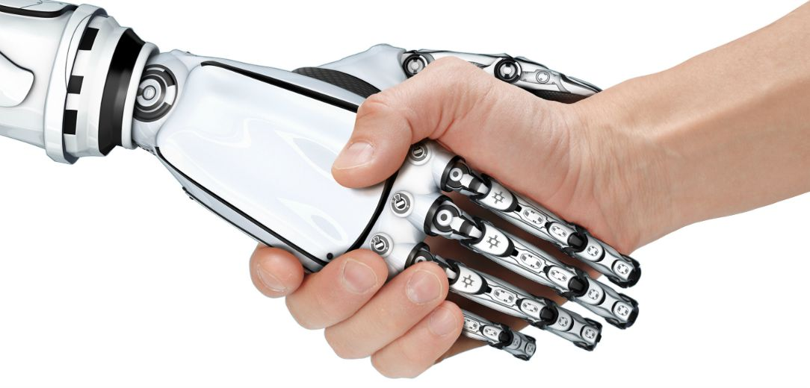
Who used AI today?

Slide 6


Slide 7
Testing

Slide 8
Testing
Functionality

Slide 9
Testing
Quality Engineering
Functionality

Slide 10
Testing
Quality Engineering
Functionality
Customer Experience

Slide 11

Who is your customer?
Have you met him/her?

Slide 12
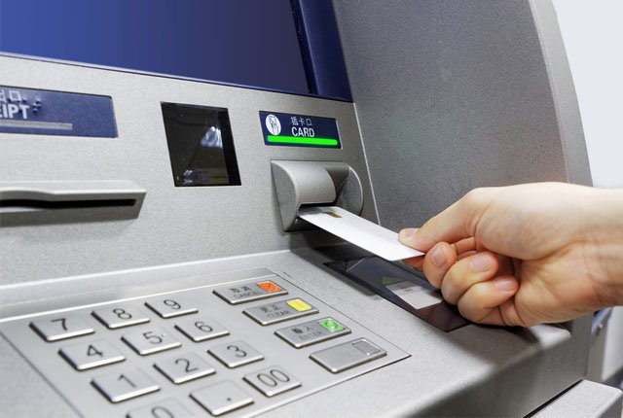
The ATM story

Slide 13
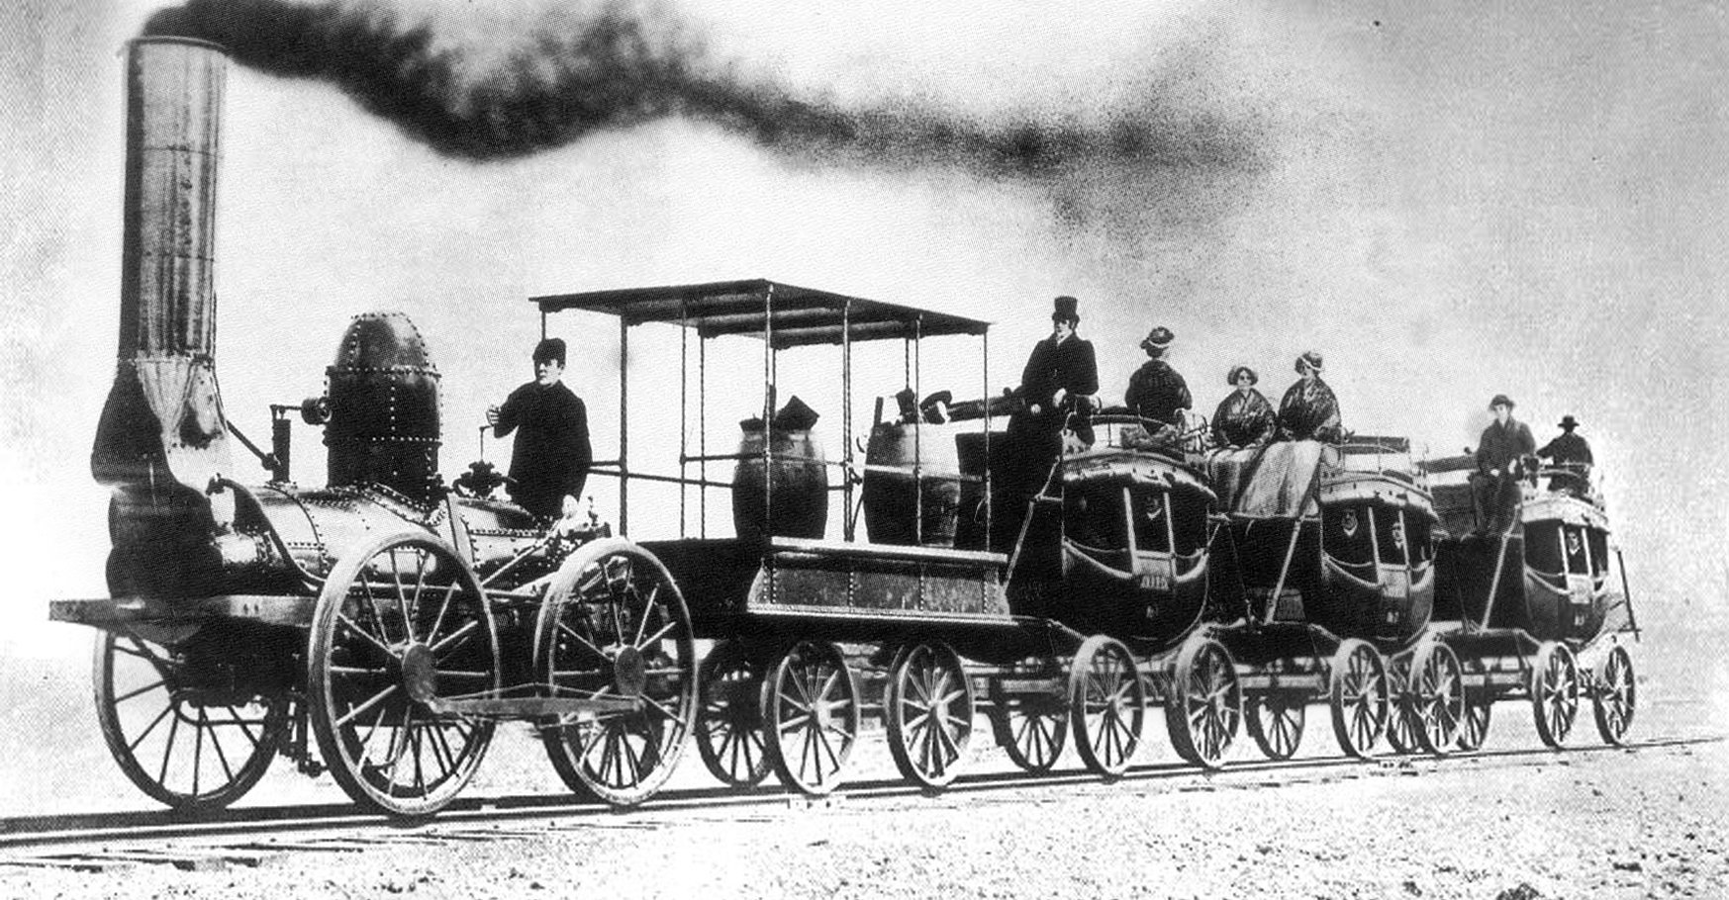
1840

Slide 14
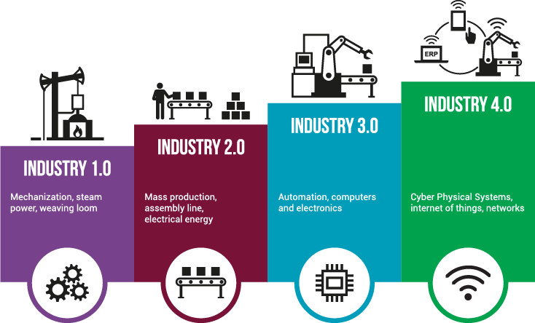

Slide 15
Industrial Revolution
5.0

Slide 16
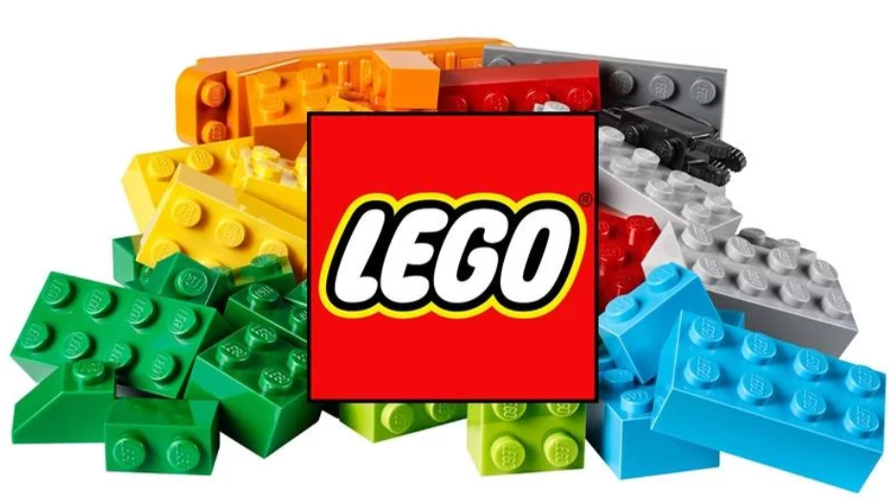

Slide 17

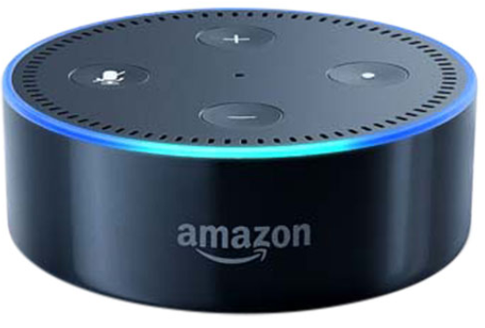

Slide 18


Slide 19
NATURAL LANGUAGE PROCESSING
ARTIFICIAL EMPATHY
INTONATION & PACING
TEXT-TO-SPEECH / SPEECH-TO-TEXT
LEGO MINDSTORMS &
LEGO BOOST
PROGRAMABLE ROBOTS
VISION SENSORS
INFRARED DISTANCE DETECTION
CONTENT MODERATION
VOICE DATA UPLOADED
MACHINE VISION
HUMAN/MACHINE MODERATION
AR Kit 2 (APPLE)
AUGMENTED REALITY
CONVERSATIONAL AI
CHATBOTS
LEGO LIFE APP
MACHINE LEARNING
ANONYMISED, NON-PERSONAL DATA
ANTI-TRAFFICING
PORNOGRAPHY

Slide 20
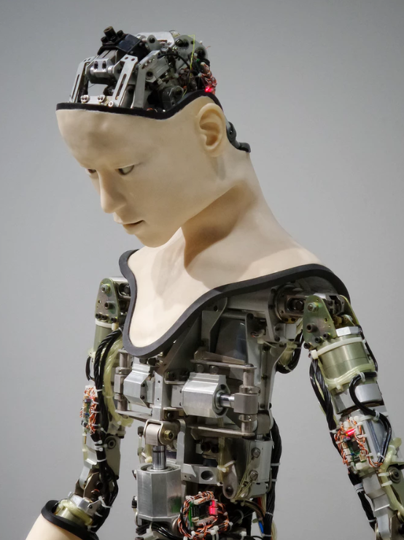

What is your view of
Artificial Intelligence
Picture credit: Franck V. on Unsplash

Slide 21
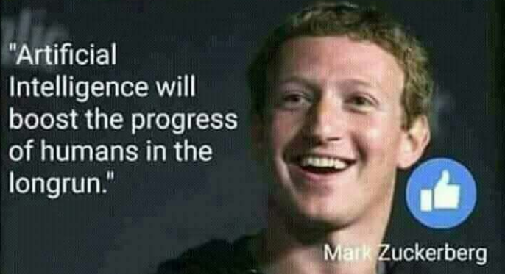
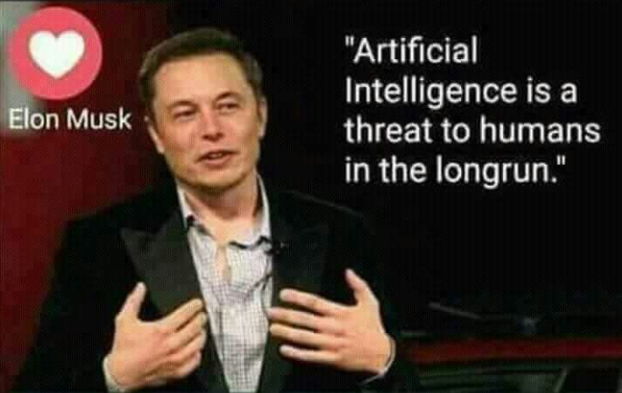
Hype
Hysteria

Slide 22


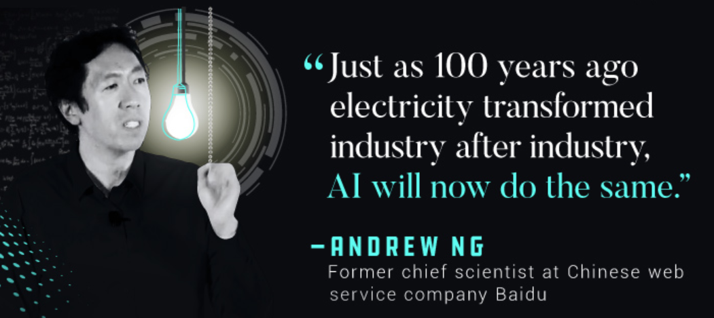
2030

Slide 23
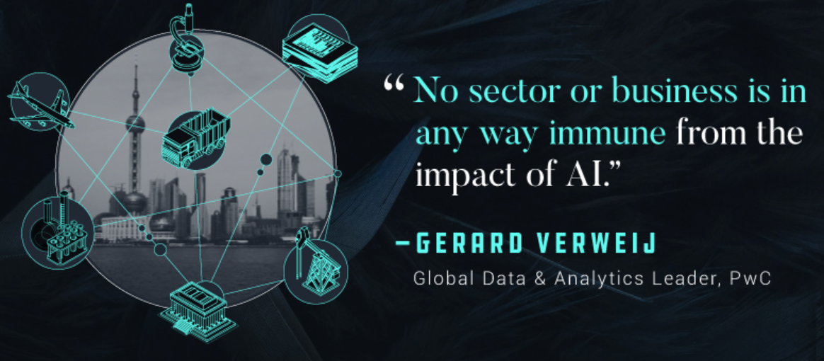

Slide 24
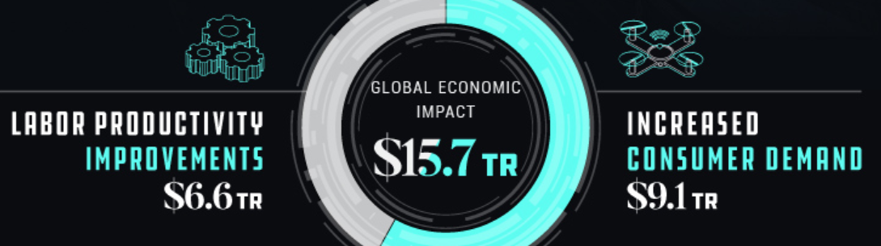

Slide 25
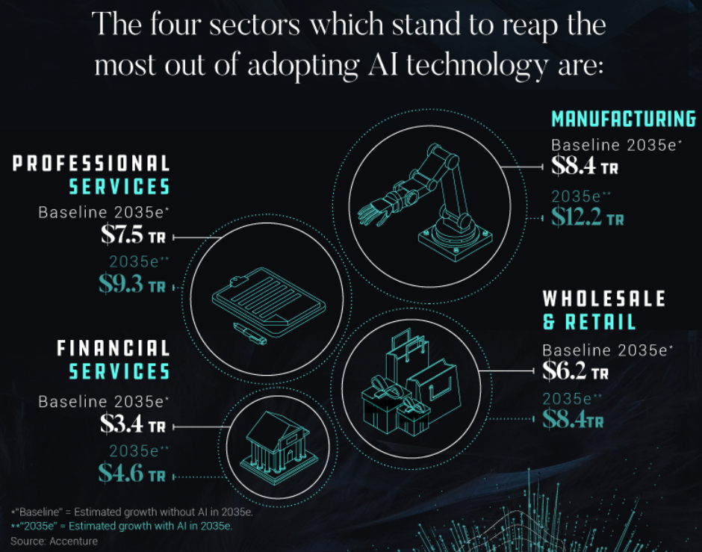

Slide 26


Slide 27
2018-2020 dominated by
global high-speed mobile internet
artificial intelligence
widespread adoption of big data analytics
cloud technology

Slide 28
Accelerated technology adoption: 2020
85% of companies adopt big data analytics
IoT, Cloud computing
Machine learning
Augmented and virtual reality

Slide 29
Trends in robotization: 2018–2022
Stationary robots
Non-humanoid land robots
Fully automated aerial drones

Slide 30
Changing employment types: 2022
50% of companies expect that automation will lead to reduction in their full-time workforce
38% of businesses expect to extend their workforce to new productivity-enhancing roles
More than a quarter expect automation to lead to the creation of new roles in their enterprise

Slide 31
New human-machine frontier within existing tasks
2018: 71% humans, 29% machines
2022: 58% humans, 42% machines

Slide 32
Emerging in-demand roles: 2022
AI and Machine Learning Specialists
Big Data Specialists
Process Automation Experts
Human-Machine Interaction Designers
Robotics Engineers

Slide 33
A reskilling imperative: 2022
54% of all employees will require significant re- and upskilling.
35% are expected to require additional training of up to six months
9% will require reskilling lasting six to 12 months
while 10% will require additional skills training of more than a year

Slide 34

How will all this impact Software Quality & Testing?
How will all this impact YOU?

Slide 35
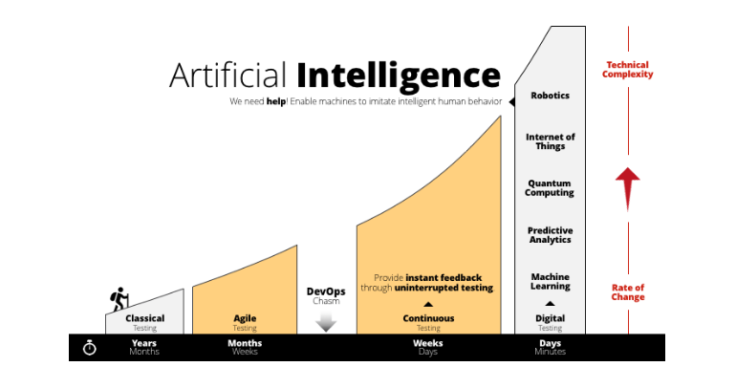
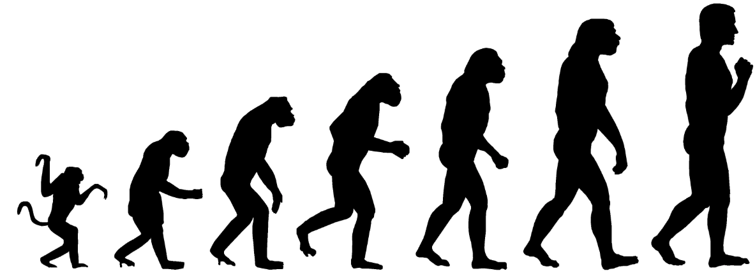
Source: https://www.tricentis.com/artificial-intelligence-software-testing/

Slide 36

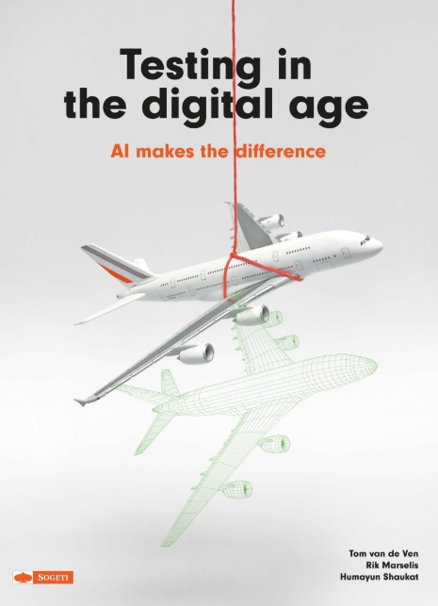
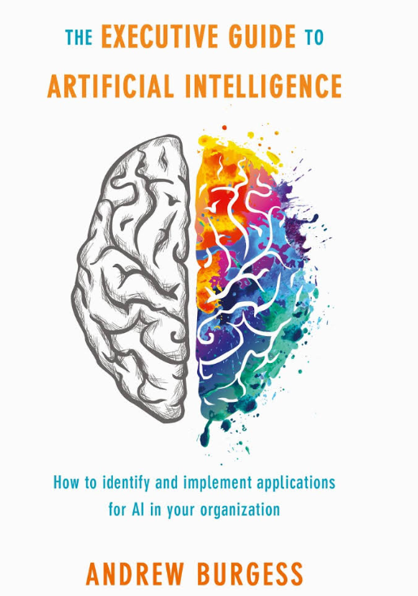

Slide 37
Key recommendation: Invest in intelligent self-learning QA and Testing platforms for all areas of the application landscape.
"Intelligence-driven QA" - invest and experiment with tools that will
analyse the root cause of defects, analyse coverage and efficiency of test sets; analyse utilisation of resources and environments; predict test estimation based on requirements; predict risk areas and risk levels in projects; plan the priority of test cases.
Robotics will bring down the headcount in the QA and testing function as these machines take on the more repetitive analysis and execution tasks and routine jobs currently undertaken by humans.

Slide 38
The convergence of physical with the cyber has added another layer of complexity to the testing activity. Product strategy is shifting from building discrete products to building connected eco-systems.
In the digital age, we need to test for experience rather than functions or features.
As we enter the realm of early AI testing it is critical to building knowledge based on artefacts we already collect like defect log data, life cycle information, fields defects, and production events to improve effectiveness.
The book concludes with an interesting perspective on the digital quality engineering skills that an AI quality engineer needs. This can be used as a ready reckoner when setting up cross-functional testing teams armed with the right digital test engineering skills.

Slide 39
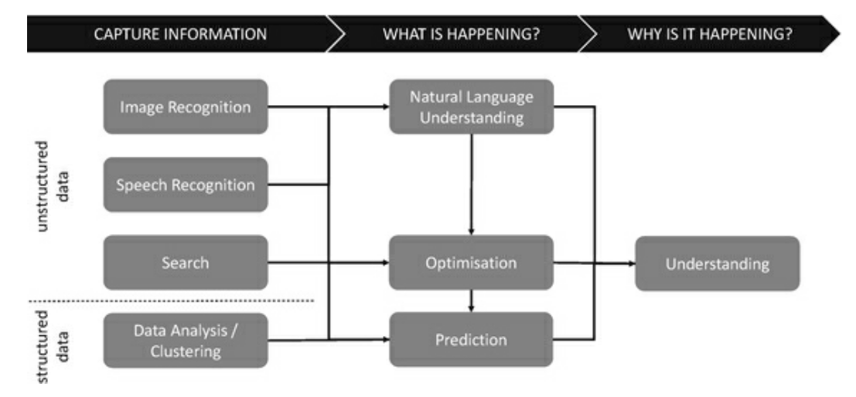

Slide 40
Terminology
Robotic Process Automation
Artificial Narrow Intelligence
An emerging form of business process automation technology based on the notion of software robots.
AI that specializes in one narrow task like coming up with driving routes or playing chess.
Natural Language Processing
Artificial General Intelligence
When an AI is trained to interpret human communication. This is useful for chat bots and translation services, but it’s also represented by AI assistants like Alexa and Siri.
The intelligence of a machine that could successfully perform any intellectual task that a human being can.
Machine Learning
Artificial Superintelligence
Statistical techniques to give computer systems the ability to "learn" with data, without being explicitly programmed. A way of achieving AI.
A hypothetical agent that possesses intelligence far surpassing that of the brightest and most gifted human minds. An intellect that greatly exceeds the cognitive performance of humans in virtually all domains of interest.

Slide 41
Andrew Williams - IBM
4 challenges to finding the right data for AI ingestion
Requirements (Opportunity)
Defects (Strong opportunity)
Test Cases (Opportunity)
Test Results (Difficult)
TOP three ways you can predict and protect your future in test
Defect classification (Reduce defect turnaround)
Defect prediction (Improve resource pipeline)
Quality transformation (Improve quality)

Slide 42






AI: Test Practitioners to follow
Andrew Williams
Geoff Meyer
Global Test Executive, IBM IGNITE Quality & Test
Test Architect at Dell EMC
Rik Marselis
Jason Arbon
Management Consultant Digital Assurance & Testing at Sogeti
CEO @ test.ai
Tom van de Ven
Jeremias Rößler, Ph.D
Senior Test Consultant High Tech at Sogeti
Founder at ReTest

Slide 43
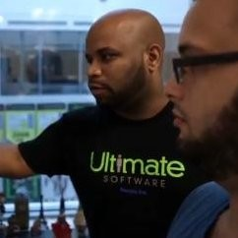



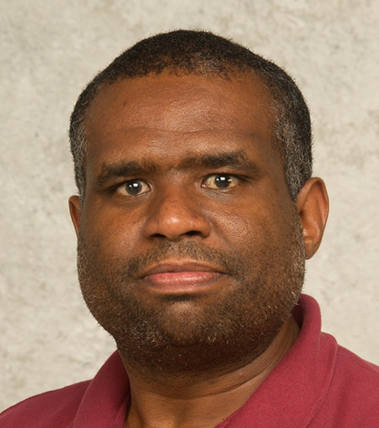

AI: Test Practitioners to follow
Tariq M. King, Ph.D
Paul Mowat
Director, Quality Engineering at Ultimate Software
Accenture Global Quality Engineering SME
Dionny Santiago
Alexander Andelkovic
Test Architect at Ultimate Software
Senior Agile Testing Lead at King
Peter J. Clarke, Ph.D
Angie Jones
Associate Professor at Florida International University
Snr Software Engineer in Test at Twitter

Slide 44

Nick Bostrom, Superintelligence
“In this book, I try to understand the challenge presented by the prospect of superintelligence, and how we might best respond. This is quite possibly the most important and most daunting challenge humanity has ever faced. And - whether we succeed or fail - it is probably the last challenge we will ever face.”

Slide 45


Slide 46
The Tester of Tomorrow

