Slide 1
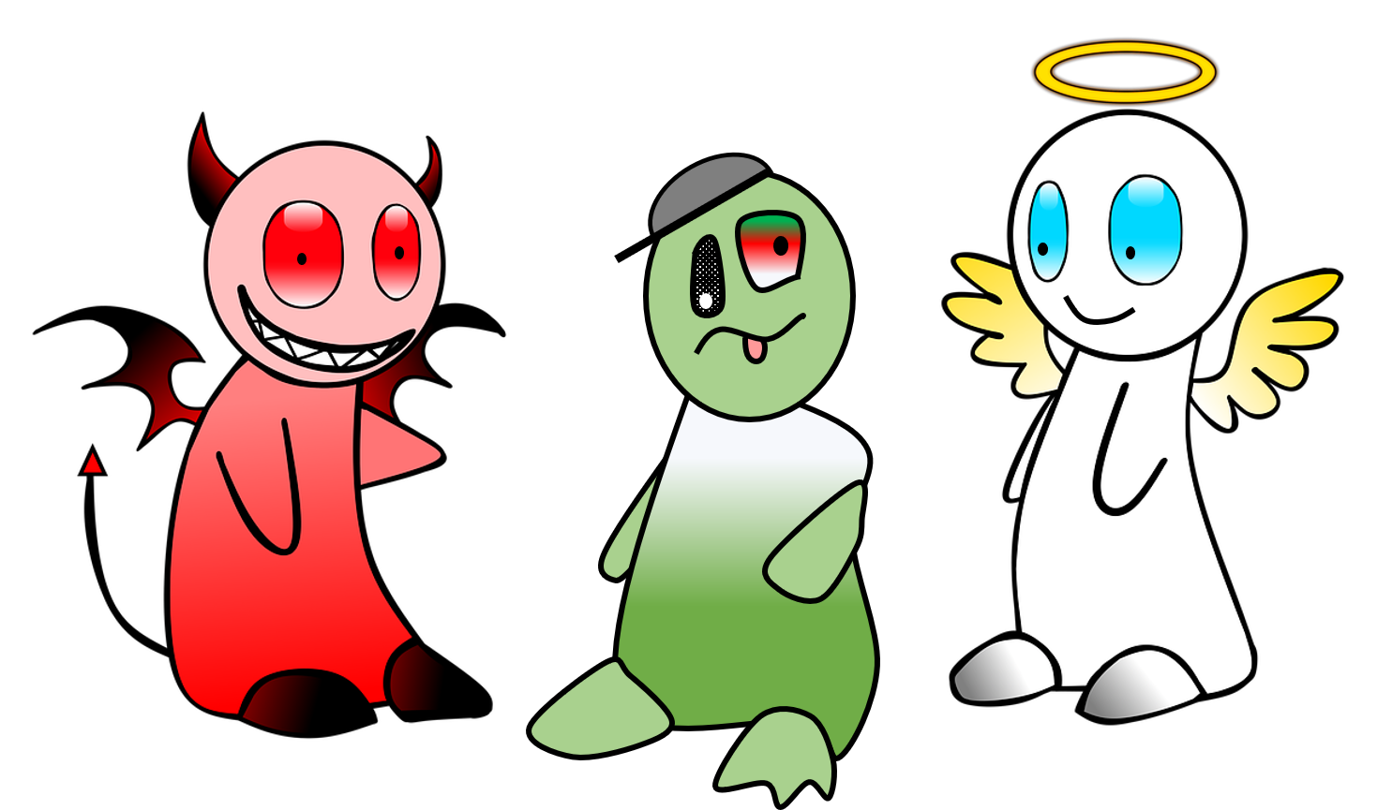
The Good, the Bad and the Ugly
why requirements matter

Slide 2



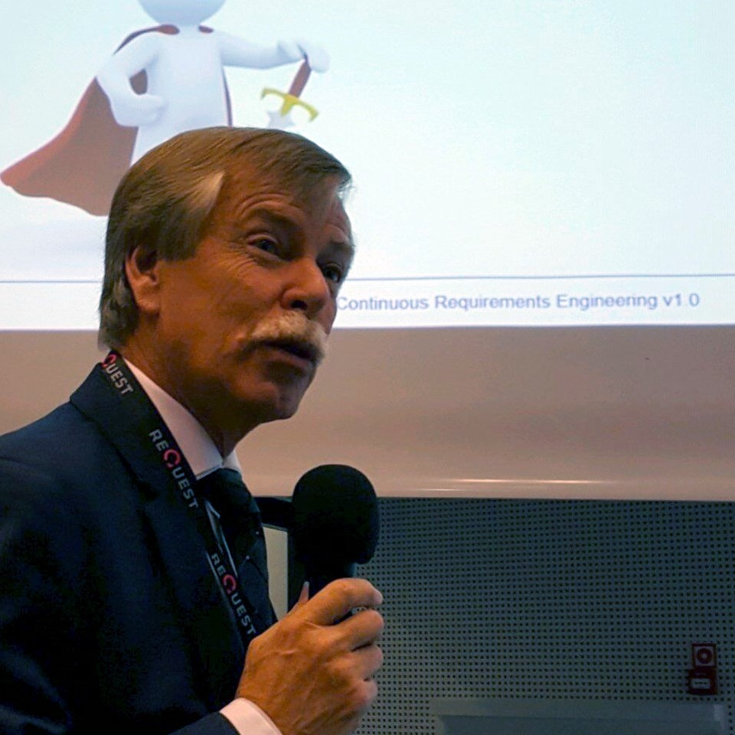

Pleased to meet you: Hans van Loenhoud

Slide 3

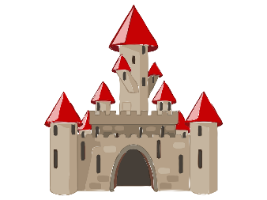


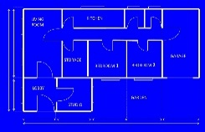

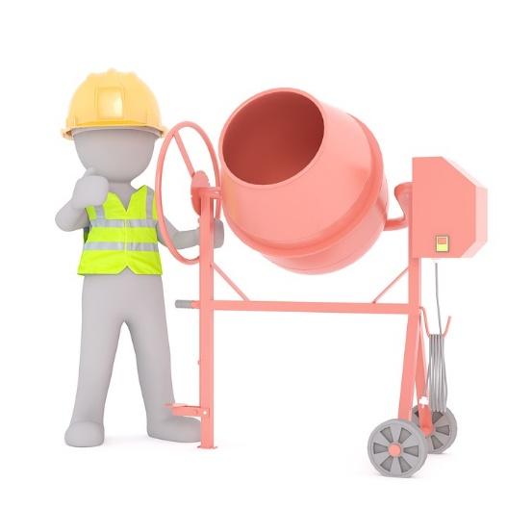

We all have requirements

Slide 4
Route
Ugly requirements?
The bad guys
The saints
Go get them!
The end …

Slide 5

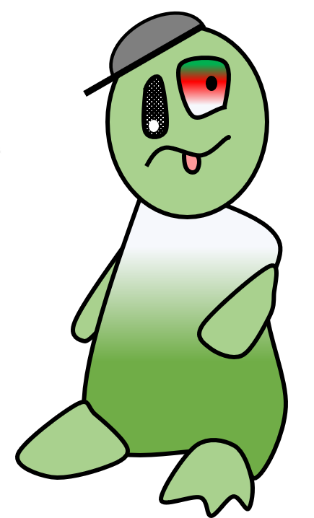


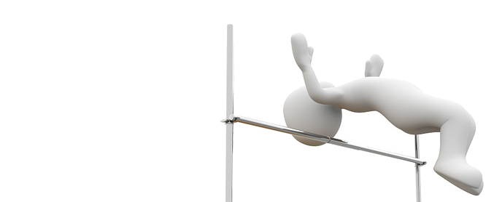

A big jump …

Slide 6

Inconsistency

Slide 7


Where is the money?

Slide 8
Look for Kano
Excitement factors
Delight!
high satisfaction
feature present
feature absent
Performance factors
Explicit
Basic factors
Implicit
low satisfaction

Slide 9


What are you looking for?

Slide 10

Don’t forget a stakeholder

Slide 11
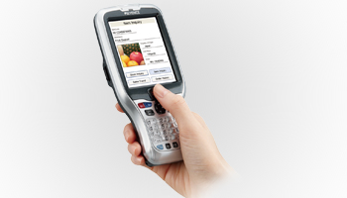
More light, please!

Slide 12
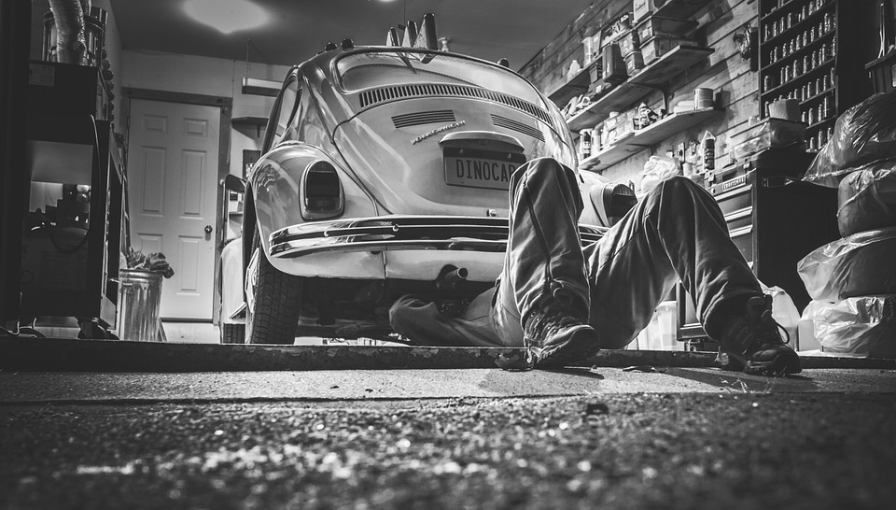
Real life is the reference

Slide 13

Ugly requirements
No (or late) detection in testing
Common causes
Hidden inconsistencies
Unmentioned basic factors
Forgotten stakeholders
Wrong context of use

Slide 14

Your story?
Discuss own experience in small groups
Think about …
Some serious issue found in acceptance testing or in production
What was the (root) cause? One of these?
Share & win!
00
00
01
02
03
04
05
06
07
08
09
10
10

Slide 15
Route
Ugly requirements?
The bad guys
The saints
Go get them!
The end …

Slide 16
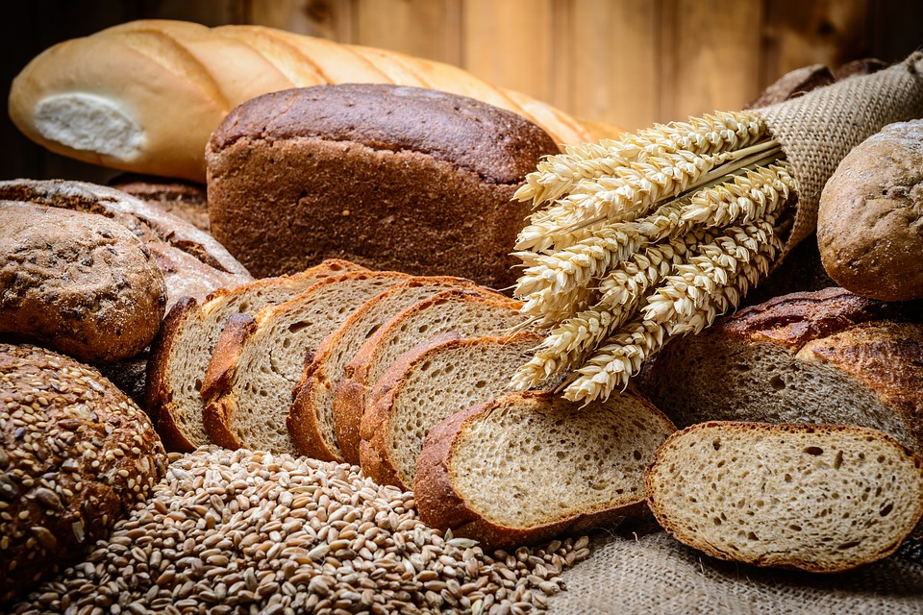


How to bake good requirements?
Elicitation
Management
Documentation
Validation
FundamentalRE process

Slide 17
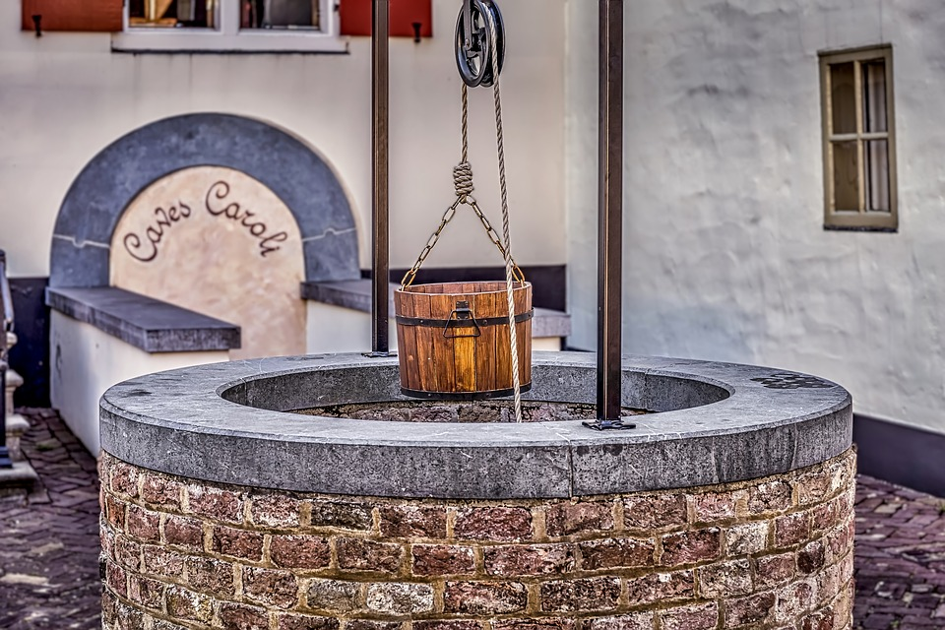








Elicitation

Slide 18



Documentation

Slide 19




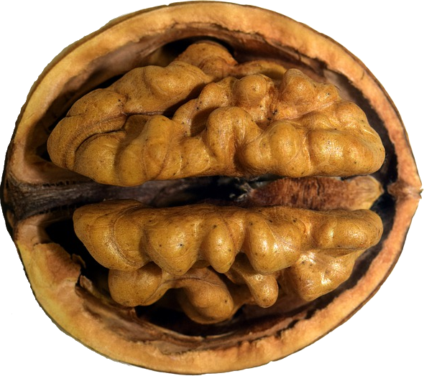

Validation

Slide 20

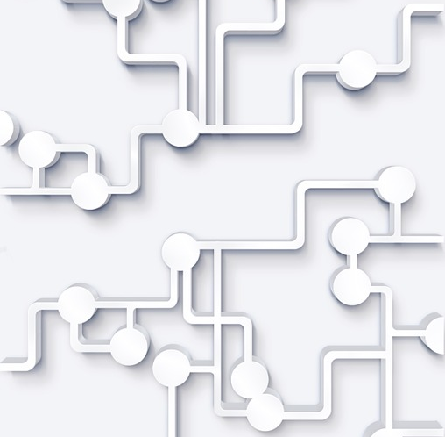
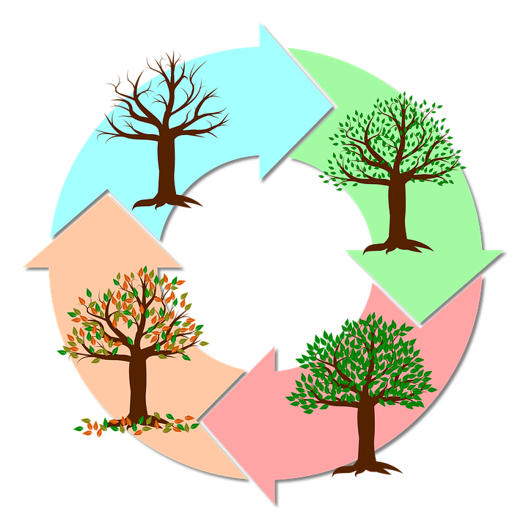

Management

Slide 21
Route
Ugly requirements?
The bad guys
The saints
Go get them!
The end …

Slide 22
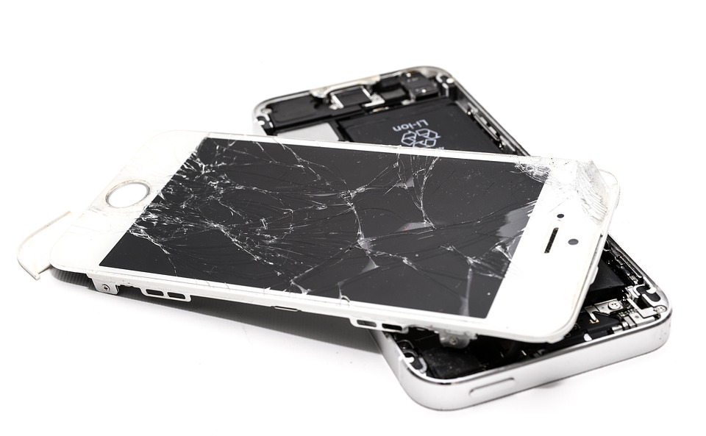

What can go wrong?

Slide 23

Elicitation
Sources
Forgotten
Contradictory
Improper stakeholder management
Techniques
Improper choice
Incorrect application
Difficult to detect
Tend to become UGLY…

Slide 24

Documentation
Natural language
Fuzzy, messy, vague
Not elementary
Not SMART
No glossary
…
Model-based
Improper choice
Incorrect application
…
Overall level:
INCONSISTENCIES Detectable in input

Slide 25

Validation
Bad validation may mean
Bad requirements can escape
Look for proof
What?
How?
When?
Who?
In case of bad validation DIY

Slide 26
Management
Bad management may mean
Confusion
Delay
Working with wrong
Versions
Priorities
Relations
Impacts
…
Waste!

Slide 27
Route
Ugly requirements?
The bad guys
The saints
Go get them!
The end …

Slide 28
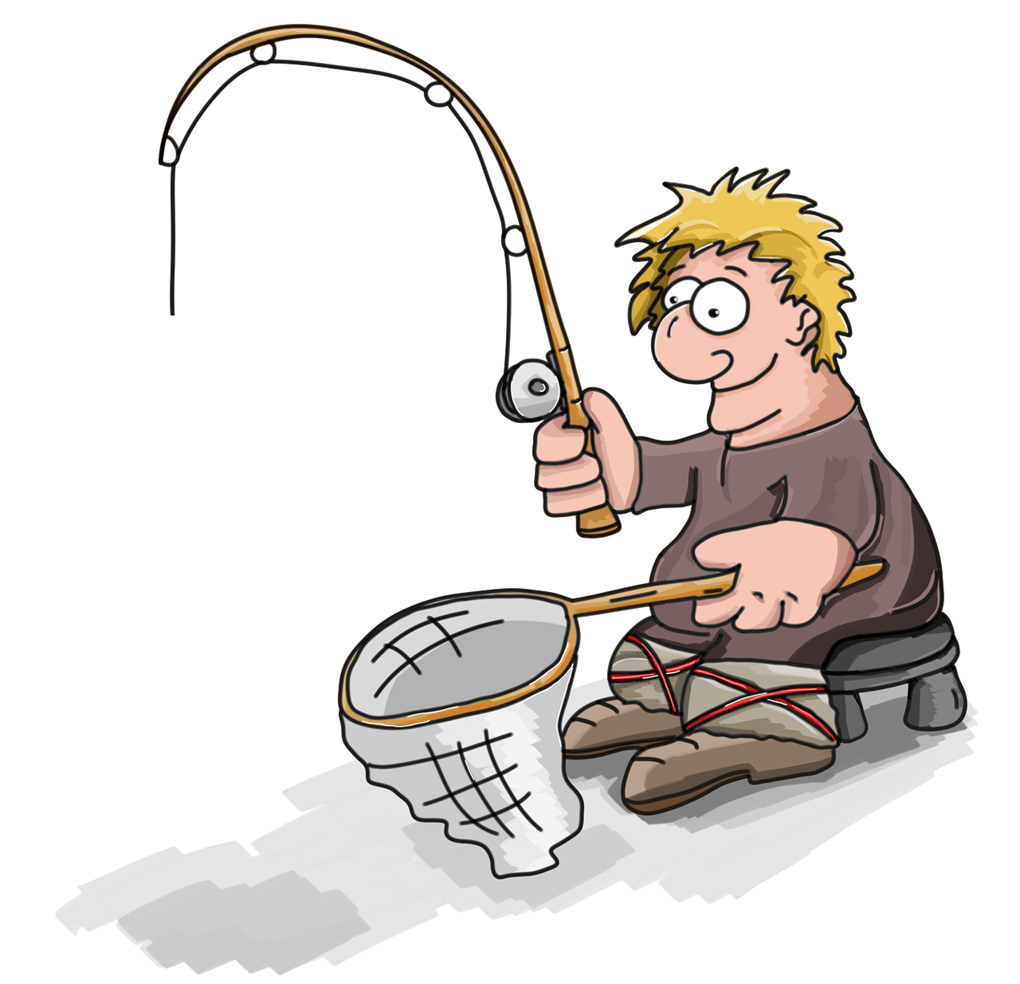

How to get them?
Bad & ugly are part of your input
Catch them before they do any harm

Slide 29
Bad elicitation
Forgotten /
contradictory sources
Wrong (application of) techniques
Your weapons:
Domain knowledge Checklists

Slide 30
Bad documentation
Violation of standards, norms, templates
Your weapons:
Intakes
Checklists

Slide 31
Bad validation
Don’t bother!
DIY!

Slide 32

Bad management
Confusion
Frustration
Waste
Usually, no bad or ugly requirements
Your weapons:
Involvement
Communication Reporting

Slide 33


Your multitool
then
when
given
BDD-map

Slide 34



An example of B&U
What exactly is a ‘purchase’ and when is it ‘made’?
How soon is ‘soon’?
1 min, 1 hr, 1 d?
the ONLINE bookstore
Functional & quality requirements mixed
As soon as a purchase is made, the system shall print an invoice at the warehouse printer with all items present in the shopping cart
Is there only one printer?
An invoice or a packing list or both?
How about e-books?

Slide 35
GIVEN requirements WHEN in doubt THEN apply GivenWhenThen
the ONLINE bookstore
GIVEN the shopping cart contains books
AND the purchase has been acknowledged
WHEN the amount due is received
THEN a packing list is printed at the ‘work order’-printer of the warehouse within 1 minute
GIVEN the purchase containing book(s) has been acknowledged
WHEN the package with these books has been shipped
THEN an email is sent to the customer with the invoice of all (e)books within 1 hour
GIVEN the ebook(s) only purchase has been acknowledged
WHEN the email with the link(s) has been sent
THEN an email is sent to the customer with the invoice of all ebooks within 1 minute
GIVEN the shopping cart contains ebooks
AND the purchase has been acknowledged
WHEN the amount due is received
THEN an email is sent to the customer with the link(s) to the ebook(s) within 1 minute

Slide 36
And now?
Suppose you find requirements issues during the intake of your work
Think about … (based on own examples)
Why is it a problem?
Who are involved?
What will you do?
Share & win!
00
00
01
02
03
04
05
06
07
08
09
10
10

Slide 37
Three approaches
It’s a DEFECT
Treat it like any other defect
Redo the intake when the defect has been solved
It’s a RISK
Report the risk and let the customer decide
It’s an OPPORTUNITY
Use GWT to re(de)fine
Report your redefinition and let the customer approve

Slide 38
The Good, the Bad and the Ugly
hans.vanloenhoud@taraxacum.nl hans.vanloenhoud@ireb.org
www.taraxacum.nl www.ireb.org
You can handle them!

