Slide 1
Recognizing and understanding Human Behaviour helps QA to do a better job
Niels Malotaux
niels@malotaux.eu www.malotaux.eu/conferences
Notes:
In my work as a project/team/organizational coach, and sometimes as a ‘flying QA person’, I found that recognizing and understanding human behaviour is important to do a better job.
Better than trying to change the behaviour, I accept it, as we cannot change the genes, and try to see what we still can do to mitigate the risks that some human behaviour traits can pose for the successful result of our work.
In this session I want to share some of my findings with you, expecting that it can help you in your work as well.

Slide 2

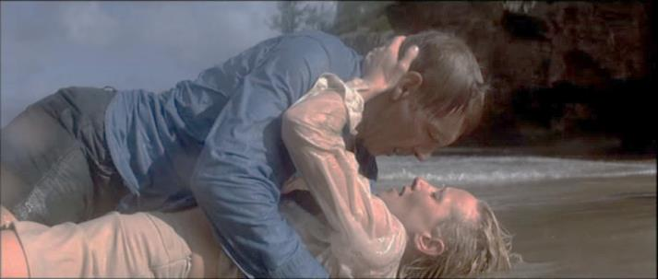
Human Behaviour
Systems are conceived, designed, implemented, maintained, used, and tolerated (or not) by people
People react quite predictably
However, often differently from what we intuitively think
Often, we
ignore human behaviour,
incorrectly assume behaviour,
or decide how people should behave (ha ha)
To be successful, we must study and adapt to real behaviour rather than assumed behaviour
Even if we don’t agree with that behaviour Hey, they shouldn't behave like that ! Well if they do, they do. They’re only human.
Movie: Six Days, Seven Nights
Notes:
As a development team, developers and testers, together we are responsible for delivering a successful system. All people in the team are also responsible to understand the behaviour of themselves and others, and adapt to this behaviour to make sure that things that can go wrong don't go wrong.
Before understanding the particularities of other people's behaviour, it's good to start with understanding our own behaviour, and from there extrapolate and extend our understanding of various types of behaviour. On the following slides we'll discuss some elements of human behaviour which may pose risks for the successful and timely delivery of the systems our work is supposed to produce.
QA people can help the developers by recognizing and understanding typical human behaviour, and seeing what we can do to cope better with it.

Slide 3

Discipline
Control of wrong inclinations
Even if we know how it should be done … (if nobody is watching …)
Discipline is very difficult
Romans 7:19
The good that I want to do, I do not ...
Things we can do:
Helping each other (watching over the shoulder)
Rapid success (do it 3 weeks for me…)
Making mistakes (provides short window of opportunity)
Notes:
I found as a definition of Discipline: Control of wrong inclinations.
With discipline I do not mean what others impose on us. I mean the discipline of doing things how we ourselves know they should be done.
We know how we should do it, but if nobody is watching, we tend to take a short-cut. Don't we? This creates a risk of getting problems with quality later (if it doesn't create a risk, it's not a discipline problem, but a potential better way of working). Even while we know that not keeping discipline is a risk, easy now easily prevails over problems later.
Discipline is difficult. When in a lecture I suggested that the Bible as well as other religious books probably talk about discipline, someone in the audience immediately replied: "Yes, it's written in chapter Romans 7-19:
For the good that I would, I do not - but the evil which I would not, that I do.”“
He didn't convert me, but this event taught me that the discipline problem in humans is known for thousands of years, and who are we to think that we can suddenly change that? We won't. We cannot fight the genes! Instead of wasting time fighting the genes, is there still something we can do to decrease the risk of lack of discipline, without asking for it?
Because I assume that people want to do the right things, I didn’t write the latter part of that sentence on my slide.
Some more, see: https://malotaux.eu/discipline

Slide 4
Intuition
Makes us react on every situation
Intuition is fed by experience (before birth it’s instinct)
It is free, we always carry it with us
We cannot even turn it off
Sometimes intuition shows us the wrong direction
Sleeping on it may help us to make better decisions
Coaching is about redirecting intuition
Notes:
Intuition makes us react automatically on common situations. Our sub-consciousness provides the solutions for these situations the moment we need them. We live intuitively. When we are hungry, do we first collect all the possible solutions of alleviating our hunger, evaluating which solution provides the best Return on Investment, and then choose which option to use, based on documented criteria? By the time we are done with our analysis we may be starved to death. In practice we simply find something to eat, and eat it.
If intuition would be perfect, everything we do would be perfect. Not everything we do is perfect, so apparently our intuition sometimes points us into the wrong direction. Probably we don't have the right experience for all of the situations we encounter in our work. Many things we should do to make our work a success are counter-intuitive. That's why they don't automatically happen.
In many cases the head knows, but the heart not (yet). We think that we make decisions logically with our mind. However, we mostly decide with our hart (or call it gut-feeling or emotions, fed by our sub-consciousness). If you think that this is wrong, it actually proves the point. Logically we think that people should decide with their mind, but in practice we see people react emotionally, with their intuition, fed by their perceived experiences. All we can do is feeding the intuition with our thinking, and trying to move our intuitive decision process into the right direction.
Sleeping on it. Recent research (Dijksterhuis) indicates that with complex problems, logical thinking produces worse decisions than 'decisions' made by intuition, because our mind isn't capable of balancing more than a few elements at the time. With logical thinking we often focus on less relevant factors, 'forgetting' some more important factors. However, we can make an even better decision if we first think logically, set a deadline to decide, in the meantime do something entirely different and then decide. Apparently our sub-consciousness continues processing while we do the other thing, and then presents us a better solution. Sub-conscious processing proves to be much more powerful and more capable of complex correlations than our conscious thinking. Hence the saying that we should "sleep a night on it".

Slide 5
Is intuition wrong, or is the design wrong ?
Sleeping pills
Activation pills
Notes:
A pharmacist told me the story of a pharmacy, where sleeping pills and activation pills (whatever that is) were sold. The sleeping pills were in a red box, and the activation pills were in a blue box. Sometimes the pharmacist gave the patient the wrong box.
Once the colours were changed (sleeping pills now in a blue box, and activation pills in a red box), there was never a mistake anymore.
Apparently for humans ‘red’ feels like active, and ‘blue’ feels like quiet.
Was the pharmacist wrong, or was it the designer of the box?

Slide 6
Mantra
The user is always right …
even if he’s not
Notes:
When coaching teams I often use mantras
Mantra: A word or phrase that is repeated often, to aid focus.
One of the mantras is: “The user is always right, even if he’s not.”

Slide 7
Case at demo: Parking system
Please fill in your credit card number …
20% of the software is there to make the computer do what it should do
80% of the software is there to make the computer not do what it should not do
Notes:
At a demo at the end of a Sprint, showing a payment screen for a parking system, the R&D manager asked: “May I also do something?”
They said: “This is a demo, where WE show how it works.”
I suggested: “Why not let the R&D manager do something, this would probably provide much better feedback.”
So, reluctantly, they said: “OK. Can you fill in your credit card number here?”
He typed his name in the box.
Result: system crash.
“You should have typed your credit card number. Not your name!.”
I suggested: “The user is always right, even if he’s not.
20% of the software is there to make the computer do what it should do
80% of the software is there to make the computer not do what it should not do”
Did we develop and check that 80% well?

Slide 8
Communication
Traffic accident: witnesses tell their truth
Same words, different concepts
Human brains contain rather fuzzy concepts
Try to explain to a colleague
Writing it down is explaining it to paper
If it’s written it can be discussed and changed
Vocal communication evaporates immediately
E-mail communication evaporates in a few days
Notes:
Witnesses tell a story they made up in their mind.
We hear a bang behind us, we turn around, and we see the scene of a traffic accident. That very moment, our grey cells start constructing a story of this accident. It is based on the basic concept of traffic accident, which was constructed earlier based on what we saw on television, or on earlier experienced accidents. We make up how the accident came about. We didn't even see it happen, but we assume how it may have happened, and what will happen afterwards. We mold the standard concept of ‘traffic accident’ in our mind with what we see, hear, and smell, into an instance of this particular accident. Because different people start with different concepts of accident, and see different elements of the scene, every witness tells a different story (men may notice that there is a garage at the corner, women may notice that there is a fashion shop right behind the demolished car). Witnesses don't lie about it, it's just that every person has a different history to start with, and sees different details, and hence composes a different story in his mind.
That’s just a reminder for what happens with words we use when we try to communicate: we throw sounds to each other and hope that in the mind of the other person the same concepts emerge as we have in our own mind. Because we all have different histories and different interest in details, the concepts we try to activate in the minds of others are probably different from the concepts we think we are conveying.
"But I told you!"... Well, did the other person 'receive' the sounds we threw? Was he really paying attention or was he dreaming? If he received the sounds, how were these interpreted?
"You nodded in agreement!"... Well, may-be he just moved his head to look into another direction, and we only assumed that this movement was an acknowledgement.
Perhaps the other person lacks some concepts in his mind, so that he even cannot imagine what we want to say.
The more distance in descent, the more difference we may expect from the interpretation of the sounds we exchange. In one family we may already have differences in interpreting the same word. In our work environment the differences are probably greater, and if we try to communicate between people from different cultures (think about off-shoring) the differences in concepts in our minds caused by the sounds we exchange are even greater, especially if we try to communicate in a non-native language
More at: https://malotaux.eu/communication

Slide 9
Communication
Talking as near as possible past each other
Don’t assume we understand: check !
To each other
Past each other
Notes:
My father told me: “Communication is talking as near as possible past each other.”
Different people have different starting concepts in their mind

Slide 10

Case: Agreement ?
When I have time …
Deliver in two weeks ?
Mantra: “We’d better assume our assumptions are wrong”
Deliver in two weeks ?
Use a date !
Notes:
I was in a meeting with a customer and a supplier. After a lot of discussion, they decided to leave back to work, after agreeing that they would meet again in two weeks.
I was just observing, and in my mind I saw ‘text balloons’ above each of them, with in each balloon something different.
So, when they were about to leave, I asked the supplier: “So, in two weeks you will deliver …?”
The supplier said: “What? In two weeks? That’s impossible, I have so much to do!”
Then the customer said: “What? Not in two weeks? I thought we agreed …”
Communication is difficult. We assume that we understood what the other said. But did we really?
They spent another 20 min to check every point they thought they agreed, with some phone calls to check with colleagues to check and make things possible, and then they left.
Two weeks later, the customer was happy, which made the supplier happy as well.
Never agree on “two weeks”, as after two weeks it still may be two weeks. The reflex should always be: “What date?”

Slide 11
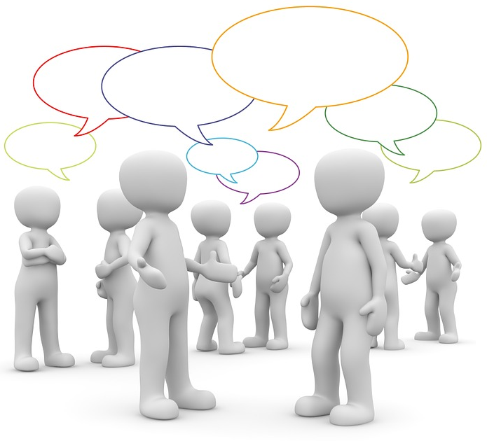
Our team (developers, testers, …)
Notes:
Now guess if we have even more minds who think they understand each other …

Slide 12


Perception
Quick, acute, and intuitive cognition (www.M-W.com)
Intuitive understanding and insight (www.oxforddictionaries.com)
What people say and what they do is not always the same
The head knows, but the heart decides
Hidden emotions are often the drivers of behaviour
“Customers who said they wanted lots of different ice cream flavours from which to choose, still tended to buy those that were fundamentally vanilla”
Trying to find out what the real value to the customer is, can show many paradoxes
Don’t believe what (you think) they say: check!
Notes:
What we think people say and do probably isn't the same as what they think they say and do. It's both about their perception, and ours.
Different people perceive the 'same' things differently (remember the traffic accident). Because of this, we may even wonder whether we then still can speak of the 'same' things ...
Perception is what we intuitively, sub-consciously observe and notice. These silent observations influence our interpretations, decisions and actions. We don't even realize that we logically (with the conscious mind) think one thing, and still with our emotions decide another thing: the head knows, but the heart decides.
Asking the customer to produce the requirements of the system will usually not produce the real requirements. Customers usually aren't even users of the system, which makes specifying the correct requirements of the system even more difficult. For customers, writing requirements isn't a core business. For developers and testers it is, because the success of their work is on the line. The problem with requirements engineering is, however, that it's not well taught in education, and that it's even partly a craft that has to be mastered by attitude and experience.
In a scientific study (Åfors, Cristina and Zuckerman, Marilyn, 2001: “A Quick, Accurate Way To Determine Customer Needs”. Quality Progress, Vol. 34, No. 7, July 2001, pp. 82-87. ASQ. www.culturalimprint.com/resources/customer_needs.pdf I found sentences like:
Hidden emotions are often the drivers of behaviour
Customers who said they wanted lots of different ice cream flavours from which to choose, still tended to buy those that were fundamentally vanilla
This made me call this the ‘Vanilla ice-cream effect.”

Slide 13
It can’t be done, they won’t allow it
Case: Did you ever observe users of your software ?
They’re in another country
Yes, did you ever go there ?
The boss won’t allow us to travel that far
Did you ask ?
Don’t assume … Check !
Testers: Did you ever observe users of the software ?
Remember: The user is always right, even if he’s not !
Notes:
If people think “It can’t be done”, did they really check?
When I asked the boss: “Shouldn’t we suggest them to travel to customers and see how our software is used?” his immediate answer was: “Of course!”
Often people assume that something isn’t allowed, or possible.
Often it is.
Assumptions, assumptions … we better assume that some of our assumptions are wrong. We have to find out which.

Slide 14

Excuses, excuses, excuses …
We have been thoroughly trained to make excuses
We always downplay our failures
It’s always ‘them’ – How about ‘us’ ?
At a Fatal Day, any excuse is in vain: we failed
Even if we “really couldn’t do anything about it”
Every day we see a problem earlier, we have a day more to do something about it
Failure is a very hard word. That’s why we are using it !
No pain, no gain
We never say: “You failed” - Always use: “We failed”
Because we didn’t help the person not to fail
Notes:
Since childhood we have been thoroughly trained in making excuses, haven't we? We're so good at it. We always downplay our failures and try to convince ourselves that we couldn't do anything about it. It's always them who made us fail, right?
Wrong! If we run a project, we took the responsibility to deliver, and if we don't deliver at the FatalDay, any excuse is in vain: we failed. Even if we "couldn't do anything about it", because probably we could have done much more about it than we admit. Anyway, we could have predicted our failure way earlier, and every day we see a problem earlier, we have a day more to do something about it. We could escalate to let others do something about it. We could explain why it is simply impossible, and what we could do about that. Ultimately, we can give back our responsibility early.
Failure is a very hard word and most people don't like it. That's exactly why we use it! No pain, no gain. If people don't feel any pain, there is no reason to do something about it. In our work it's important never to say "You failed". Always use "We failed". After all, if someone fails, we didn't help the person enough not to fail (note: this advice is also meant for management!). The person himself of course may feel "I failed", which can help him to learn to improve.

Slide 15
The aim of Testing
Being done as soon as the development is done
Well, almost
Excuses, excuses, excuses
The developers are always late (Developers should live up to their promises)
The developers don’t take us seriously (Developers should ask testers for help)
The developers don’t inject enough defects (Now testing becomes a real challenge)
We are the bearers of bad news (find out what you’re really supposed to do)
Helping development to be successful
Notes:
Don’t let the product rot on the shelf when it is ready, only because testing is still testing. It is quite possible to have testing be done almost immediately after the final delivery by development. If you want to know how to do that, we can talk about it later.
First people must understand that this is important and possible. Then we can teach them how to do it.

Slide 16
Mistakes, unnecessary things
What was the last time you made a mistake ?
What was the last time you did something unnecessary ?
Did you talk with others about it ?
Did you learn from it ?
What did you do about it ?
Case:
Learning 10-fold from mistakes
Notes:
Case: Learning 10-fold from mistakes
In a course I was presenting at an university in Yokohama, Japan, when discussing ‘mistakes’, an American guy working for a company in Tokyo said:
Every time I make a mistake, I send an email to my colleagues about my mistake, also describing what I learnt from it.
First they found this strange, openly exposing my mistakes.
But soon they also started sending emails around with their own mistakes.
Guess what: For every mistake I made, I now got 10 in return, to learn even faster!

Slide 17
Ignore the first reaction
If you show something is wrong
Even if the person agrees, first you’ll get: “Yes, but ... bla bla” or, “That’s because ... bla bla”
We have been trained from childhood to make excuses
Ignore the bla bla
Let the excuse come out and wait for the next reaction
Notes:
If you show something is wrong in the reasoning of someone, even if the person agrees immediately, first you'll get: "Yes, but ... bla bla" or, "That's because ... bla bla.“
We have been trained from childhood to make excuses. We are so good at it. The excuses must get out. So, first let the excuse get out and then wait for the person to agree that he was wrong and talk about what we can do about it.
If we immediately react on the first reaction, we escalate on a path we both don't want to be. Fortunately I haven't been through a divorce, but in my imagination a lot of divorces go like this. Someone says something and the other immediately replies, upon which the first immediately replies.
So the advice is to try (I know how difficult it is !): Let the excuse come out and wait for the next reaction.

Slide 18
Any typical behaviour here in Minsk ?
Notes:
I have some experience with a team in Minsk.

Slide 19
Case: Working with a development team in Minsk
Behaviour of the project team
How we expected the project team to behave
Notes:
They were supposed to do a development project, and I was supposed to oversee the communication between them and the company where I was doing a sister product development at the same time.
Every week the boss and I had a Skype call to discuss progress and any issues.
Every week they were sitting at the other end, waiting for our questions.
Then we asked questions. Some they could answer, and some they had to think about.
I said:
We are not running your project. You are supposed to run it.
Please think of the questions we could have and find an answer to them before we even ask.
And if you have questions yourself, try to solve them, perhaps discussing with us before the meeting.
Then we can have a quick meeting seeing that everything runs ok.
Don’t wait until the meeting to solve an issue that holds you down.
It took a few weeks, and I had to remind them a few times, but gradually, they started to take the initiative and things ran much more smoothly.
They said: “We are used to work with Russian customers. You are different.”
I suppose people in Minsk know what I am talking about.
I think they liked our way of working.

Slide 20
Conclusion
We’ve seen several elements of human behaviour
Recognizing and understanding our behaviour is the start of doing something about it
Recognizing and understanding our behaviour is the start of doing something with it
QA to do a better job, helping others to be perfect
QA is about Prevention !

Slide 21
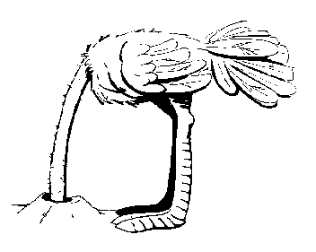
Our problems are not the real problem, the real problem is that we don’t do something about it
Every day we see a problem earlier, we have a day more to do something about it
Assumptions, assumptions … better assume that some of our assumptions are wrong
Notes:
Let’s take out head out of the sand and start doing something about it.
Again: That’s where QA people can do a good job!

Slide 22
Recognizing and understanding Human Behaviour helps QA to do a better job
Niels Malotaux
niels@malotaux.eu www.malotaux.eu/conferences
Notes:
In my work as a project/team/organizational coach, and sometimes as a ‘flying QA person’, I found that recognizing and understanding human behaviour is important to do a better job.
Better than trying to change the behaviour, I accept it, as we cannot change the genes, and try to see what we still can do to mitigate the risks that some human behaviour traits can pose for the successful result of our work.
In this session I want to share some of my findings with you, expecting that it can help you in your work as well.

Slide 23
People oppose change !
Right ?
People are not against change
People (sub-consciously) don’t like uncertainty
Any project changes something and thus introduces uncertainty
People can cope with uncertainty for a short time
Notes:
Some people say that people don't like change. I don't believe that. People love change, if they see the benefit.
What people (sub-consciously) don't like is uncertainty.
Pushing for change won’t work, because we'd work from the wrong end. Circumvent the uncertainty. Then change isn't that difficult.
Note I use the “Bullshit Stamp” when I hear unnecessary excuses. Real professionals know how to handle these issues and hence don’t need the excuses. If people don’t yet know how to handle issues that happen every time, we call them juniors.
Any new development changes something, therefore it will create uncertainty and hence more or less avoidance.
That’s something we should keep in mind, and think how to minimize the uncertainty time.
People can cope with uncertainty for a short time. If it takes too long, it won’t work.

Slide 24
We failed because of politics
Good politics:
People decide differently based on different beliefs
Bad politics: hidden agenda’s
Say this, mean that - often even unintentionally
Politics thrive by vagueness
Facts can make bad politics loose ground
If we accepted the responsibility, failure because of “politics” is just an excuse
What did we really do about it ?
Notes:
Bad politics strive by vagueness. If we don’t have facts, the boss may take a decision we don’t like.
If we have facts, we can talk business, and the boss suddenly turns out not to be as stupid as we thought.

