Slide 1

Software quality assurance days
26 International Conference on
Software Quality Assurance
sqadays.com
sqadays.com
Rakesh Kondreddy
Ellucian. Bengalore, India
Visual Test Automation for Coders and Non-coders
- Deploy quality Features with speed
Minsk, Belarus. November 15-16, 2019

Slide 2

Senior Software Test Engineer
@Ellucian, Ex- Oracle
Exploratory QA
Named 3rd in Test Automation Expert of year In world as per Tricentis Survey 2018
International Conference Speaker
Certified Scrum Master, Product Owner & Selenium professional
Testing Freak online Meetup Organizer
Blog contest Winner
Reach me @+91- 8142772717 /
rakeshkmr516@gmail.com
About Me

Slide 3

What is Visual Testing/ Test Automation
Visual Testing is a QA approach where manually /automatically verify that your web or mobile app GUI appears correctly to users across
All devices
All browsers
All screen sizes /resolutions
Visual Test Automation for Coders and Non-coders - Deploy quality Features with speed
Notes:
https://gradeup.co/processes-i-ccb8d352-b92c-11e5-92a4-c96fca7cdd55
https://medium.com/samsung-internet-dev/think-you-know-the-top-web-browsers-458a0a070175

Slide 4
Continued…
Test all the elements that appear on a screen with just one line of code

Slide 5
Continued…
Ensures GUI of applications –
Released code across environments
Make sure no visual breaking changes
Complements functional test automation

Slide 10
Benefits of Visual Test Automation
Cross Browser Testing
Cross Platform & Device Testing
Responsive Design Testing
Leverage Existing Test Automation codes
Automate Test maintenance with ease-of use
Meaningful Visual Reports

Slide 11

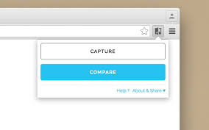





Visual Test Automation Tools / Techstack

Slide 12
Visual Testing/Automation Tool Expectations
Cognitive Ability
Baseline Management
Storage Footprint

Slide 13
Challenges
Humans and machines - perceive pixels differently
Drop shadows

Slide 14
False positive/Negatives
Baseline Management

Slide 15
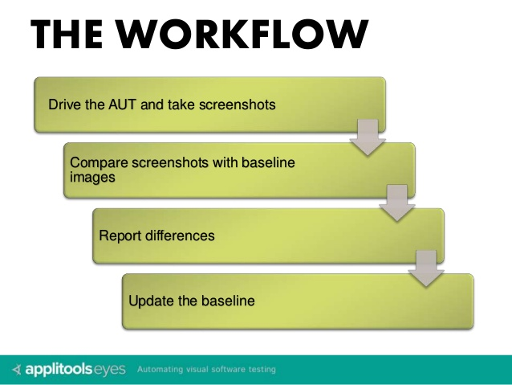
Visual Testing process / Workflow
Notes:
Image source: https://applitools.com/

Slide 16
Tools / Libraries
Demo Time

Slide 17
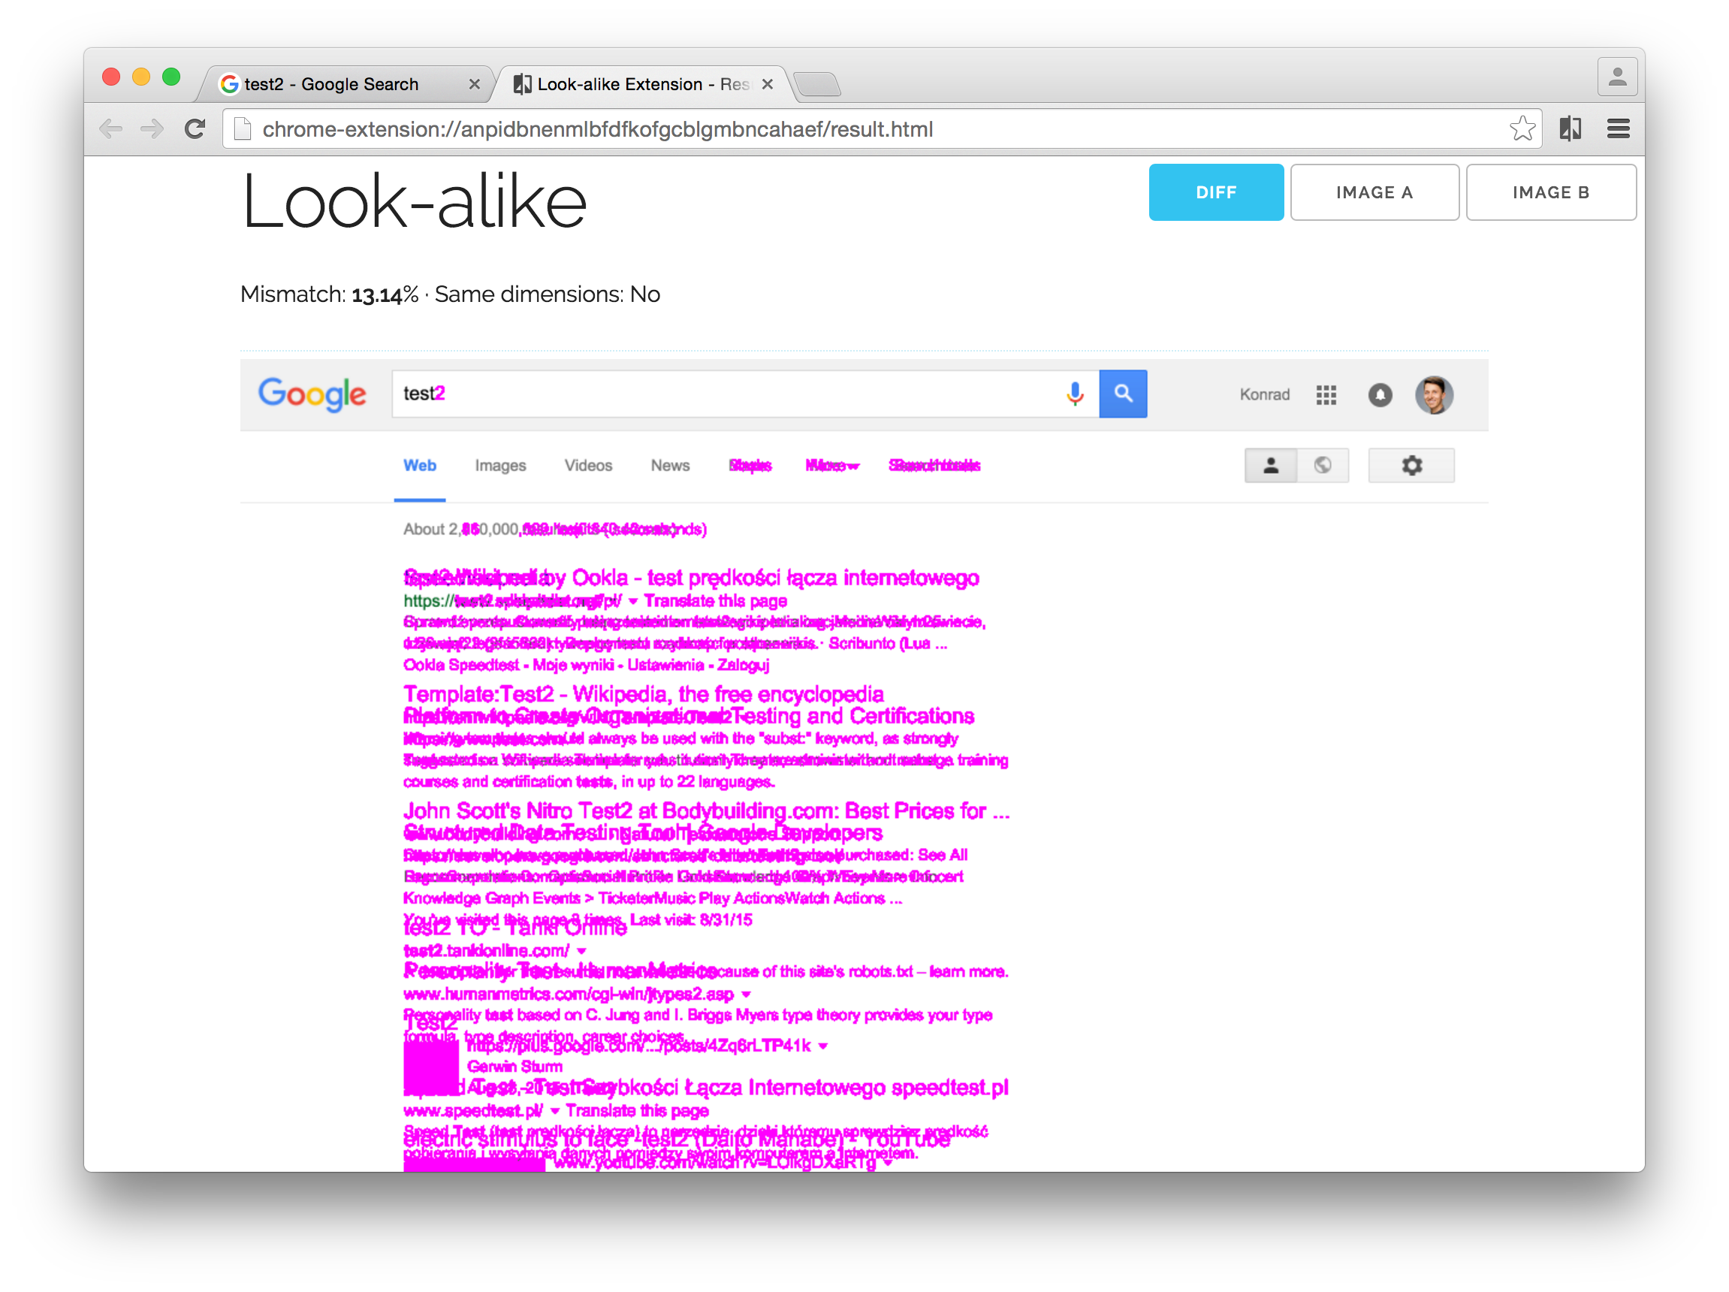
Look-alike plugin live Demonstration

Slide 18
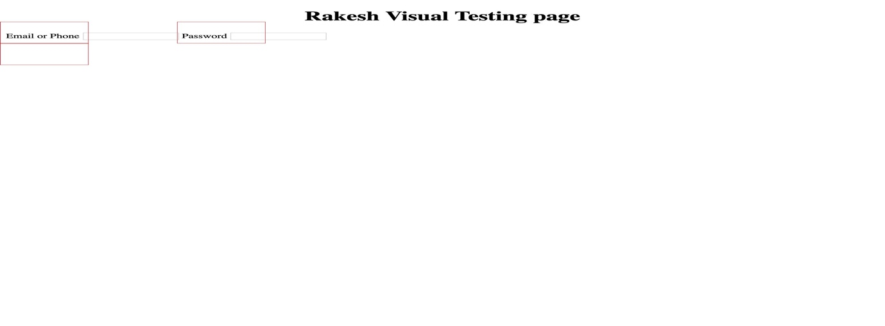
Visual Eye
Projects contains below techstack
Selenium
javax image IO
java AWT image

Slide 19
PDF Visual Validation
DEMO

Slide 20
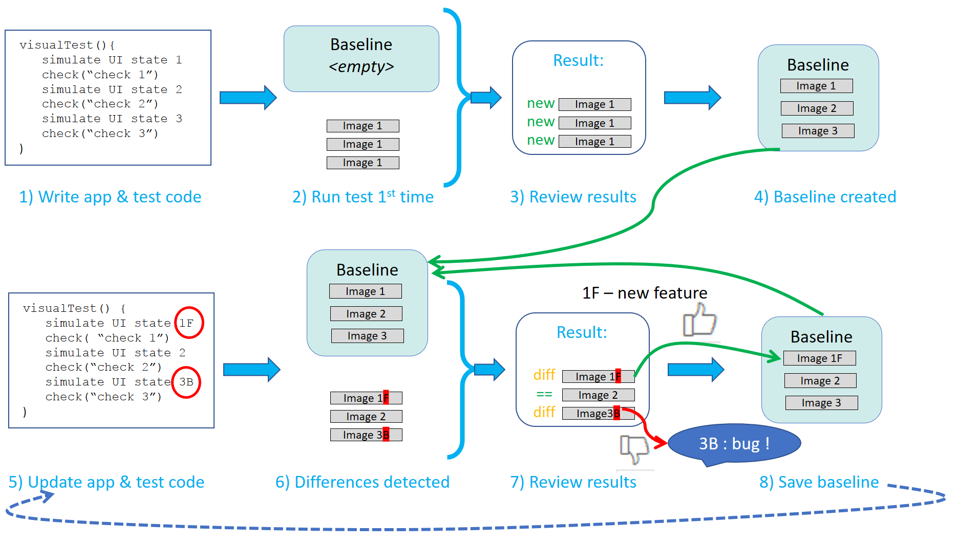
Visual Testing process / Workflow Continued…..
Notes:
Image source: https://applitools.com/

Slide 21
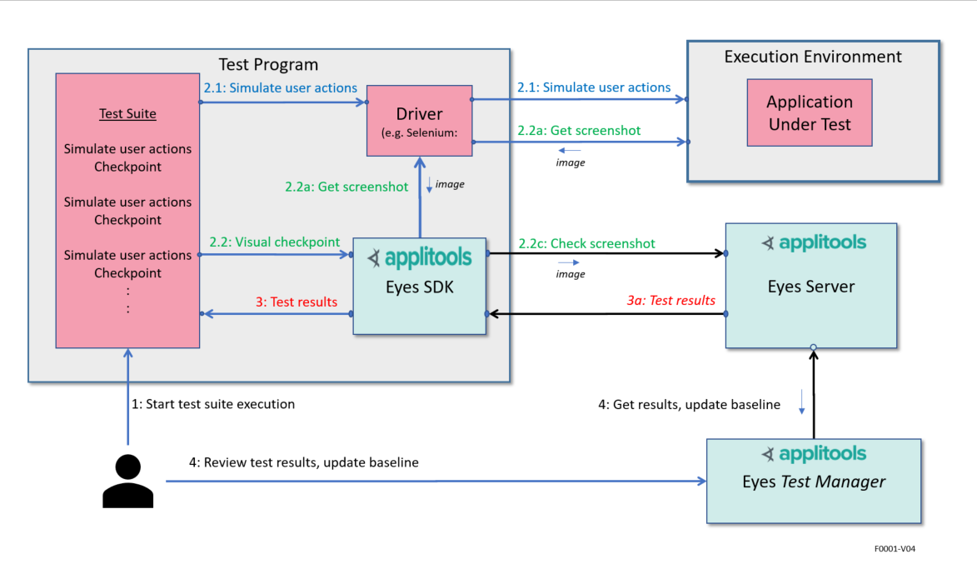
Applitools AI-powered solution
Notes:
Image source: https://applitools.com/

Slide 22
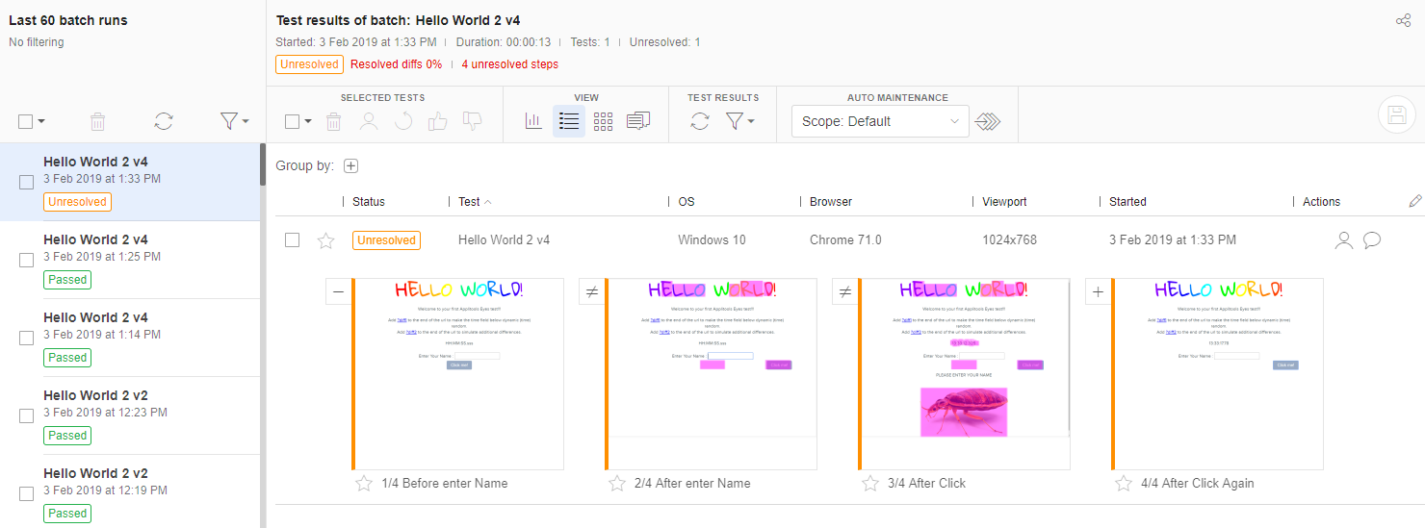
Visual Report

Slide 23
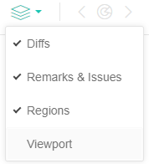
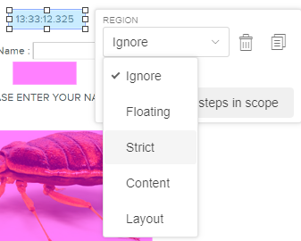

Slide 24
References
https://applitools.com/
https://github.com/kdzwinel/Look-alike
https://github.com/mojoaxel/awesome-regression-testing#tools-and-frameworks
https://applitools.com/docs/topics/overview/overview-visual-testing.html

Slide 26
https://www.linkedin.com/in/rakesh-kondreddy/

