Slide 1
The tune of API testing
@timlidos

Slide 2
1. C
2. D
3. E
4. F
5. G
6. A
7. B

Slide 3
1. C
2. D
3. E
4. F
5. G
6. A
7. B

Slide 4
1. C
2. D
3. E
4. F
5. G
6. A
7. B
6. A
7. B

Slide 5
1. C
2. D
3. E
4. F
5. G
6. A
7. B
6. A
7. B
1. C
2. D
3. E
4. F
5. G

Slide 6
1. C
2. D
3. E
4. F
5. G
6. A
7. B(H)
6. A
7. B(H)
1. C
2. D
3. E
4. F
5. G

Slide 7
1. C

Slide 8
1. C - Clearness

Slide 9
ACTION /object

Slide 10
ACTION /object
VERB /noun

Slide 11
GET /books

Slide 12
GET /books
GET /books/42

Slide 13
GET /books
GET /books/42
POST /book

Slide 14
GET /books
GET /books/42
POST /book
PUT /book/13

Slide 15
/getAllBooks
/getAllReadedBooks
/getAllUnreadBooks
/getBook
/newBook
/saveBook

Slide 16
/getBook
/newBook
/saveBook
/getJournals
/setJournal
/setNewJournal

Slide 17
POST
GET
PUT
DELETE

Slide 18
POST /book
GET /books
PUT /books
DELETE /books

Slide 19
POST /books/42
GET /books/42
PUT /books/42
DELETE /books/42

Slide 20
/books
/videos
/news
/users

Slide 21
/books
/videos
/news
/users
/items
/data

Slide 22
GET /books?genre=horror
&status=unsold
&location=UA

Slide 23
1. C - Clearness
2. D

Slide 24
1. C - Clearness
2. D - Documentation

Slide 25
http://petstore.swagger.io

Slide 26
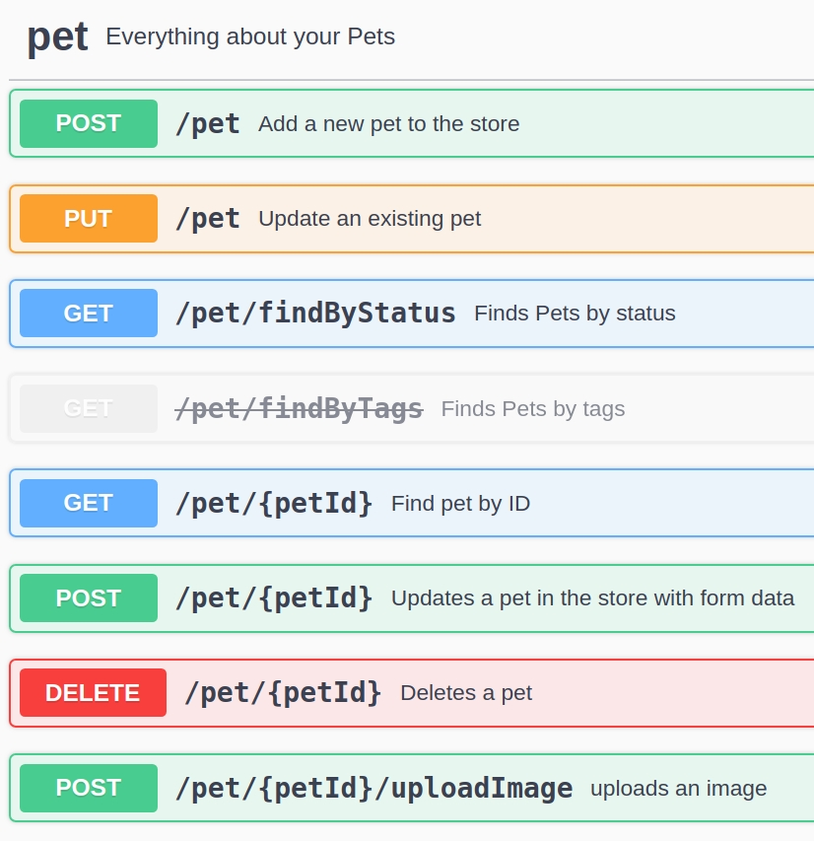
http://petstore.swagger.io

Slide 27
http://petstore.swagger.io
- methods

Slide 28
http://petstore.swagger.io
- methods

Slide 29
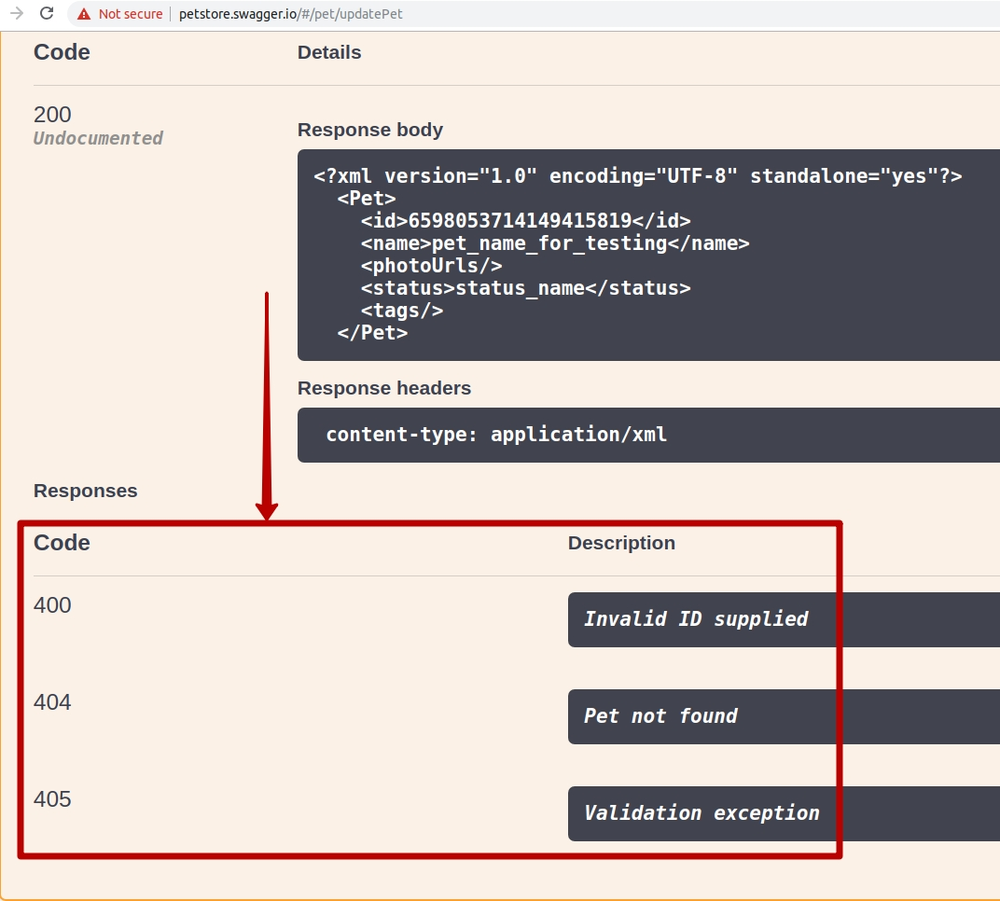
http://petstore.swagger.io
- methods
- status codes

Slide 30
http://petstore.swagger.io
- methods
- status codes

Slide 31
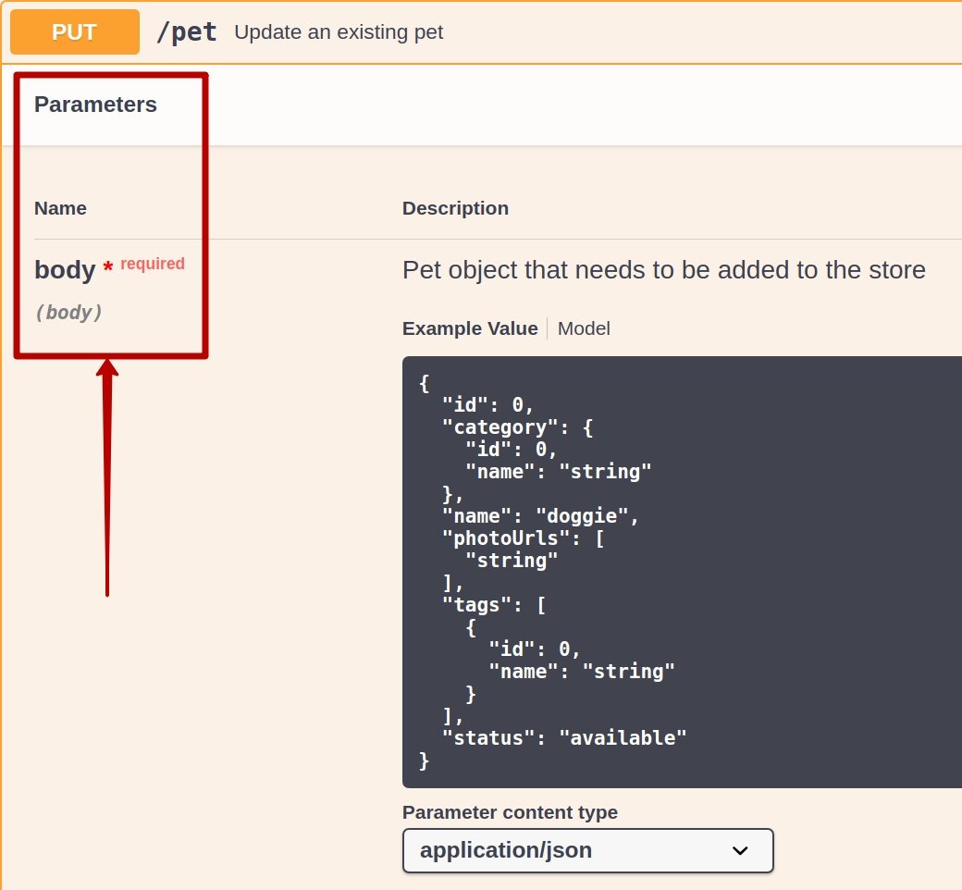
http://petstore.swagger.io
- methods
- status codes
- parameters / data

Slide 32
http://petstore.swagger.io
- methods
- status codes
- parameters / data

Slide 33
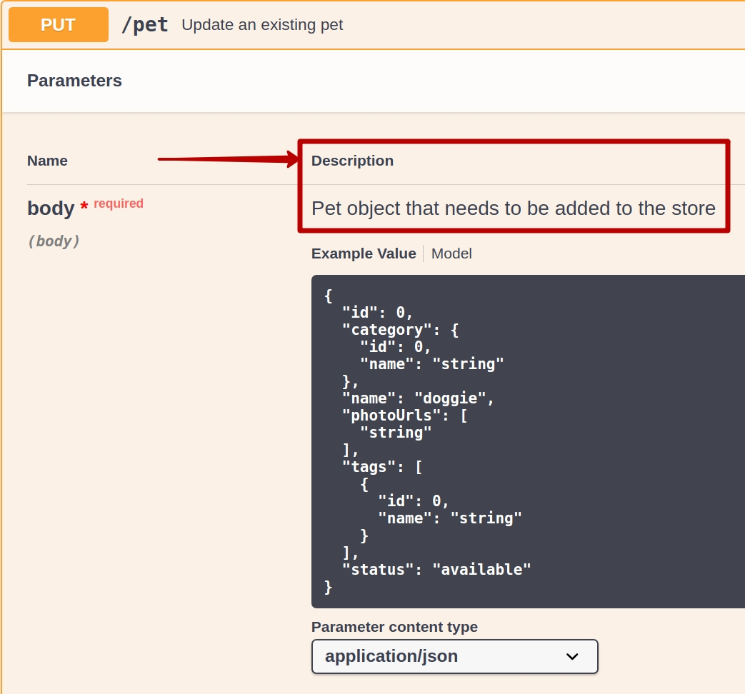
http://petstore.swagger.io
- methods
- status codes
- parameters / data
- descriptions

Slide 34
http://petstore.swagger.io
- methods
- status codes
- parameters / data
- descriptions

Slide 35
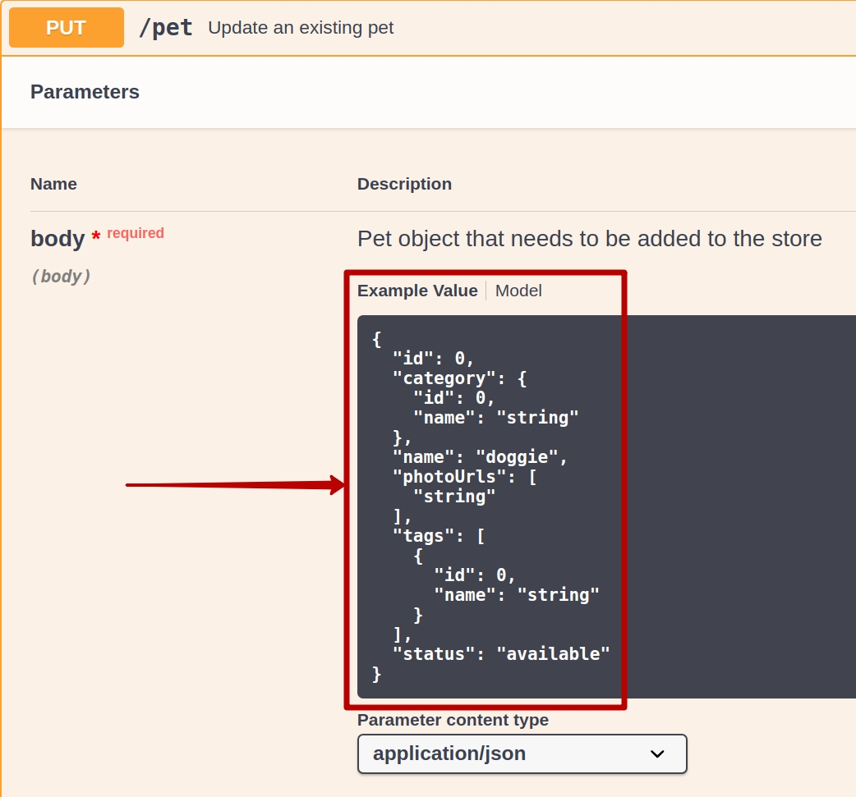
http://petstore.swagger.io
- methods
- status codes
- parameters / data
- descriptions

Slide 36
http://petstore.swagger.io
- methods
- status codes
- parameters / data
- descriptions
- examples of code
- links to more detailed or
educational materials

Slide 37
1. C - Clearness
2. D - Documentation
3. E

Slide 38
1. C - Clearness
2. D - Documentation
3. E - Exceptions

Slide 39
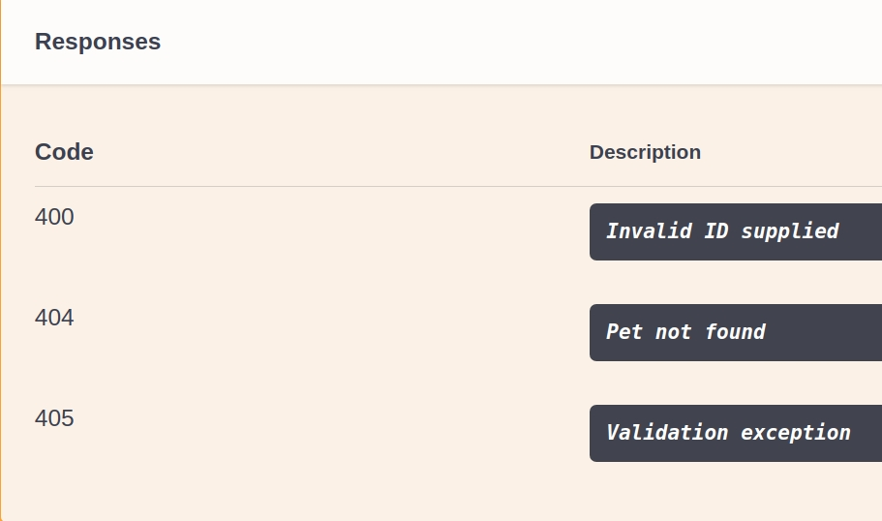

Slide 40
- success

Slide 41
- success
- client error

Slide 42
- success
- client error
- server error

Slide 43
- success – 200 (OK)
- client error
- server error

Slide 44
- success – 200 (OK)
- client error – 400 (Bad Request)
- server error

Slide 45
- success – 200 (OK)
- client error – 400 (Bad Request)
- server error – 500 (Internal Server Error)

Slide 46


Slide 47
<response>
<error>
You need to login before performing this action
</error>
</response>

Slide 48
<response>
<error>
You need to login before performing this action
</error>
</response>
<response>
<error>
Something bad happened
</error>
</response>

Slide 49
1. C - Clearness
2. D - Documentation
3. E - Exceptions
4. F

Slide 50
1. C - Clearness
2. D - Documentation
3. E - Exceptions
4. F - Format

Slide 51
- API general format

Slide 52
- API general format
- data format in response

Slide 53
API general format
- /api/v1/books.json
- /api/v1/books.xml
- /api/v1/books.yaml

Slide 54
API general format
- /books?format=JSON
- /books?format=XML
- /books?format=YAML

Slide 55
API general format
- /books?format=JSON
==
- /books?format=json

Slide 56
data format in response

Slide 57
{
"Hilton":{
"floor_2":{
"room_number":"2553",
"is_available":"0"
},
"floor_3":{
"room_number":"3569",
"is_available":1
}
}
}

Slide 58
{
"Hilton":{
"floor_2":{
"room_number":"2553",
"is_available":"0"
},
"floor_3":{
"room_number":"3569",
"is_available":1
}
}
}

Slide 59
1. C - Clearness
2. D - Documentation
3. E - Exceptions
4. F - Format
5. G

Slide 60
1. C - Clearness
2. D - Documentation
3. E - Exceptions
4. F - Format
5. G - General

Slide 61
1. C - Clearness
2. D - Documentation
3. E - Exceptions
4. F - Format
5. G - General
6. A

Slide 62
1. C - Clearness
2. D - Documentation
3. E - Exceptions
4. F - Format
5. G - General
6. A - Automation

Slide 63
- REST-Assured (Java)

Slide 64
@Test(description = "GET")
public void getRequestExampleTest() {
given()
.when()
.get("http://books.com/v1/authors/orwell")
.then()
.assertThat()
.body("popular", equalTo("1984"));
}

Slide 65
@Test(description = "POST")
public void postRequestExampleTest() {
given()
.urlEncodingEnabled(true)
.param("username", "username@example.com")
.param("password", "Pa$$w0rd")
.header("Accept", ContentType.JSON.getAcceptHeader())
.post("http://books.com/register")
.then()
.statusCode(200);
}

Slide 66
- REST-Assured (Java)
- Postman / SOAP UI (Test Suites)

Slide 67
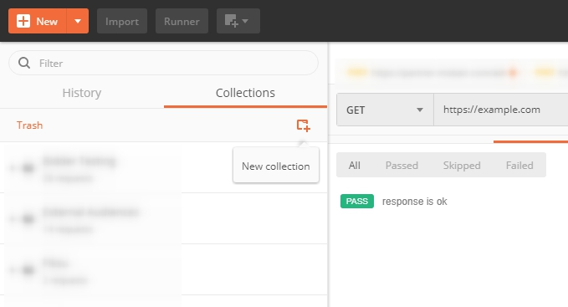

Slide 68
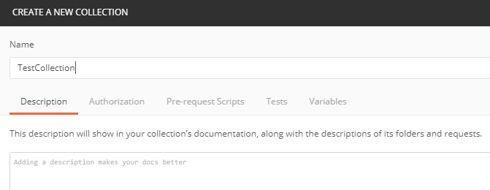

Slide 69
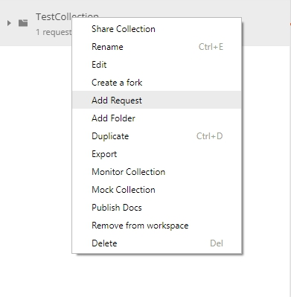

Slide 70
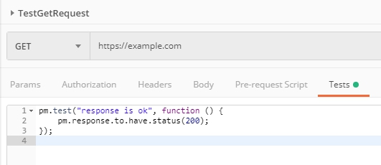

Slide 71
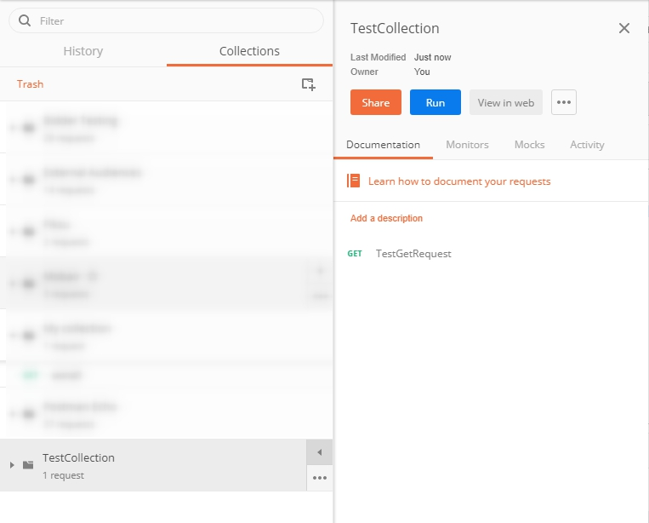

Slide 72
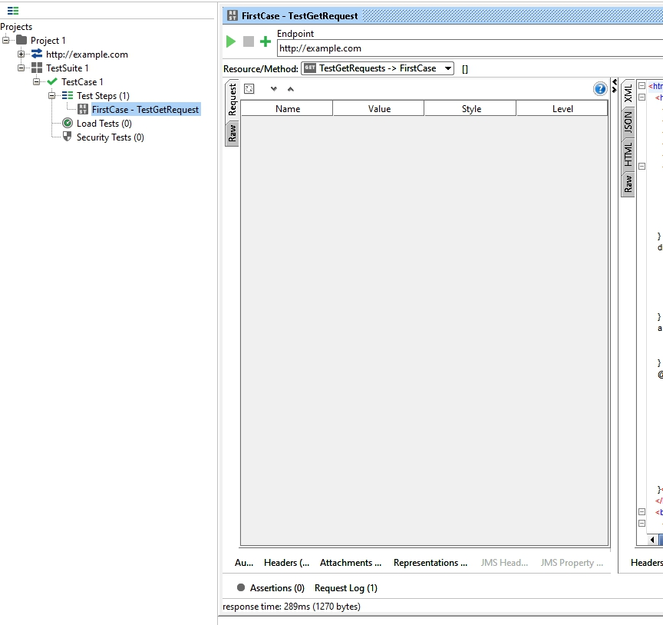

Slide 73
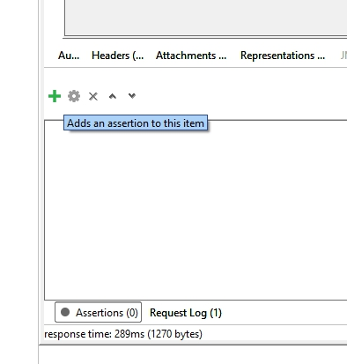

Slide 74
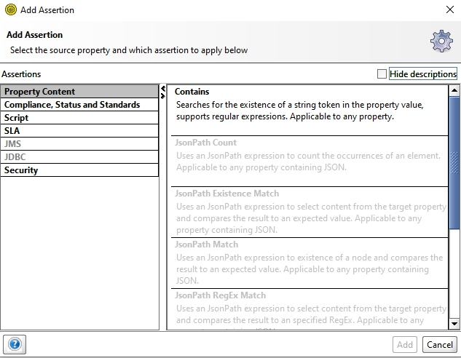

Slide 75
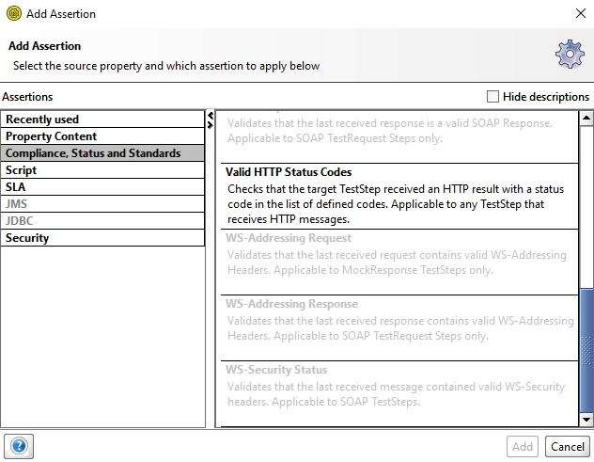

Slide 76
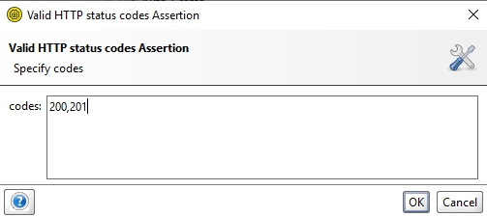

Slide 77
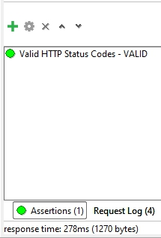

Slide 78
1. C - Clearness
2. D - Documentation
3. E - Exceptions
4. F - Format
5. G - General
6. A - Automation
7. B

Slide 79
1. C - Clearness
2. D - Documentation
3. E - Exceptions
4. F - Format
5. G - General
6. A - Automation
7. B - Business

Slide 80
1. C - Clearness
2. D - Documentation
3. E - Exceptions
4. F - Format
5. G - General
6. A - Automation
7. B - Business
(H

Slide 81
1. C - Clearness
2. D - Documentation
3. E - Exceptions
4. F - Format
5. G - General
6. A - Automation
7. B - Business
(H - Hacking)

Slide 82
OWASP / SmartBear

Slide 83
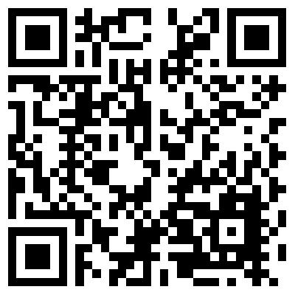
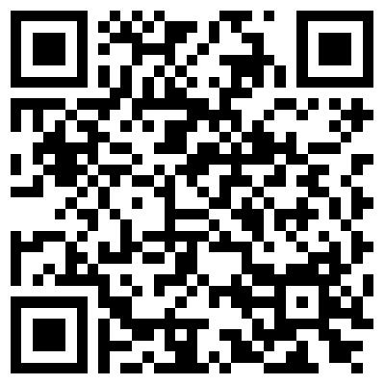
OWASP / SmartBear

Slide 84
- forget about restrictions

Slide 85
- forget about restrictions
- replace the parameters

Slide 86
- forget about restrictions
- replace the parameters
- know your project

Slide 87
1. C - Clearness
2. D - Documentation
3. E - Exceptions
4. F - Format
5. G - General
6. A - Automation
7. B - Business
(H - Hacking)

Slide 88
Thanks for attention!
Contacts:
Skype: john.klymenko
Telegram: @timlidos

