Slide 1

Verity Software
www.veritysoftware.in

Slide 2
AI in Testing

Slide 3
Coverage/Agenda...
Introduction
  Definition of AI
  AI History
  AI v/s ML v/s Deep Learning (DL)
AI-ML Fundamentals
  Machine Learning
  Learning
    Supervised/Directed
    Unsupervised/Undirected
    Reinforcement
AI in testing – various applications
Testing AI
  Challenges to test AI-based SW
  Testing AI-based application vs traditional SW
  Strategies to tackle testing of AI applications
  What to test in an AI app?
AI Driven Testing tools

Slide 4
What Is AI?
AI is a branch of Science which deals with helping machines find solutions to complex problems in a more human-like fashion*
The art of creating machines that perform functions that require intelligence when performed by people. - Kurzweil,1990
Thinking? Acting? Like humans? Which
How about rational thinking?

Slide 5
Types of AI
Narrow
General
Let us not talk about Super/Sentient conscious AI

Slide 6
AI History
1950s
  Goal was to create an artificial brain
  The term AI was proposed in Dartmouth Artificial Intelligence conference
1980s
  “Expert systems” - applying rules on specific topics to new data
  Fuzzy logic, Genetic algorithms, Evolutionary Programming, Neural Nets etc.
Present
  Machine learning, Deep learning, Big Data
  Still Narrow AI
You can take a look at the timeline here https://www.mckinsey.com/business-functions/mckinsey-analytics/our-insights/an-executives-guide-to-ai

Slide 7
AI/ML/DL
AI
ML
DL

Slide 8
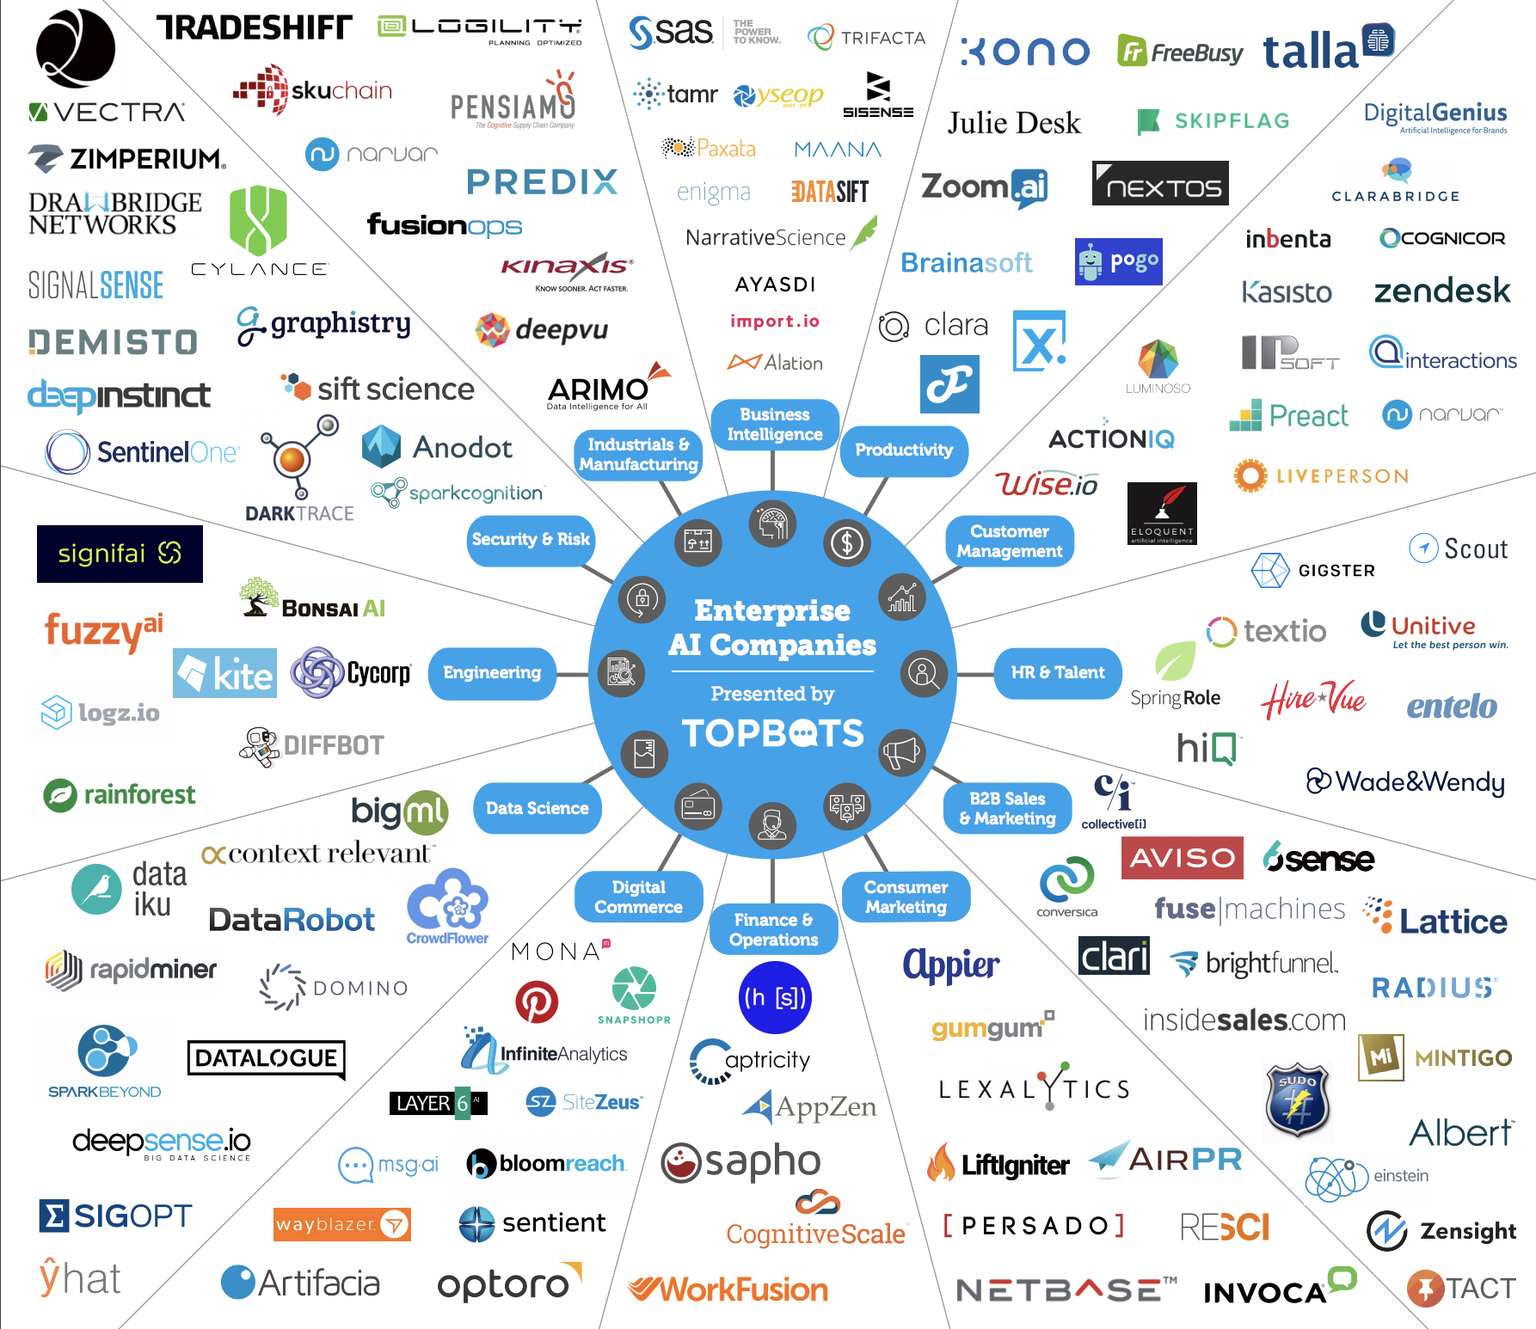
AI Enterprise Landscape
* https://topbots.com/downloads/infographics/TOPBOTS_Enterprise_AI_Landscape_2017.pdf

Slide 9
Some Known Applications of AI
Google Search, Assistant, Photos,
FB Photo search
Self-driving cars
Amazon product recommendation
Alexa
MS Cortana
IBM watson...

Slide 10
Skills for an AI Professional
Statistics and Mathematics knowledge
Technology and programing knowledge - Algorithms, model representation, programming, various existing technologies
Testing - ?

Slide 11
AI-ML Fundamentals

Slide 12
Learning in Machine Learning
Supervised/Directed
  Classification
  Regression
Unsupervised/Undirected
  Clustering
  Association
  Dimensionality reduction...
Semi-supervised
Reinforcement
Natural process based

Slide 13
Supervised Learning
Learning Process - The model learns through input sample data (Training Data) with its output defined and the system tries to learn a function that can define the input/output relationship.
The model/algorithm should to be able to generalize to predict results in the face of new data, with some level of accuracy
Two types of outputs
  Classification
  Regression
Used in predictive modeling

Slide 14
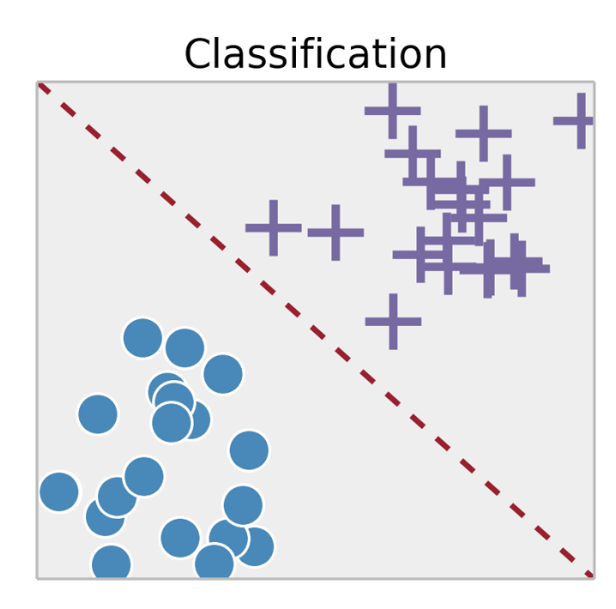
Supervised Learning - Classification
Classify the output for a given input of n features into one of the M possible classes
Apple or an Orange?
Spam or no-spam or appropriate labeling of an email
Patient diagnosis
Common Algorithms
Decision trees
Random forests
Support Vector Machines (SVM)
https://towardsdatascience.com/supervised-vs-unsupervised-learning-14f68e32ea8d

Slide 15
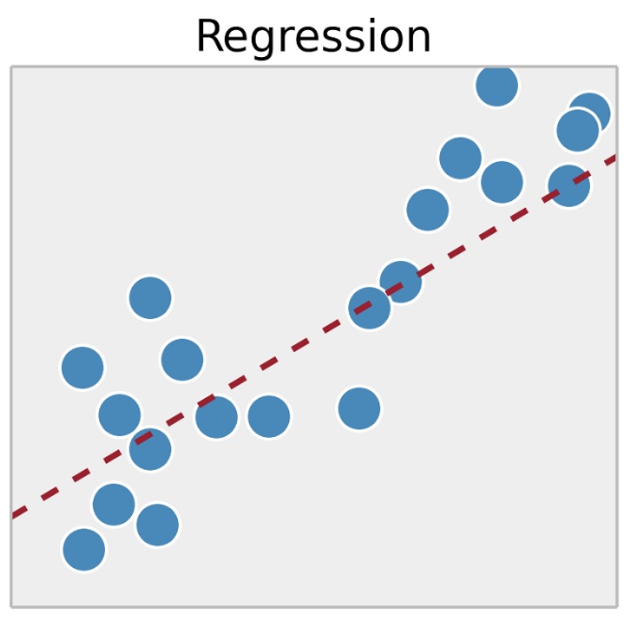
Supervised Learning - Regression
Inputs are a set of regressors and the output is a continuous quantity
Predicting sales, pricing etc.
Common algorithm
Linear regression
Multivariate regression
Regression trees etc.
https://towardsdatascience.com/supervised-vs-unsupervised-learning-14f68e32ea8d

Slide 16
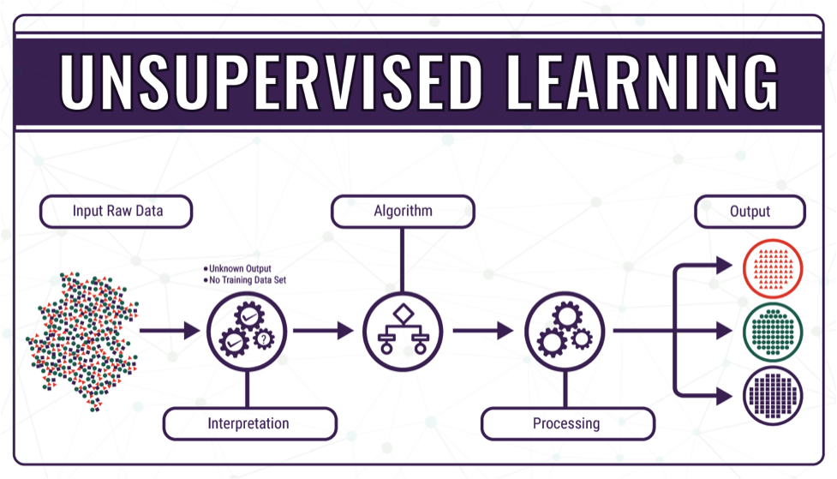
Unsupervised Learning
The model learns without labels in the training data
Purpose is to learn the patterns and structure of the data without associated labels
Used in
  Pattern detection
  Descriptive modeling
http://bigdata-madesimple.com/machine-learning-explained-understanding-supervised-unsupervised-and-reinforcement-learning/

Slide 17
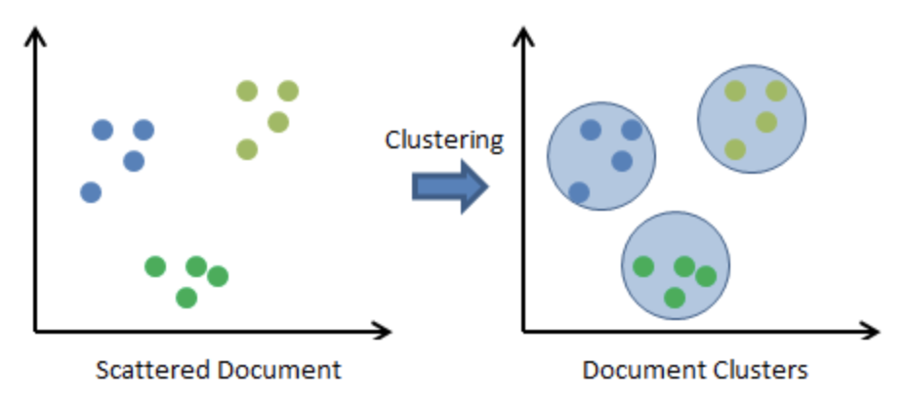
Unsupervised Learning - Clustering
The outputs are clusters of the input data
Clustering is done on the basis of statistical properties of input
Example Uses
  Social network analysis
  Image segmentation
  Customer segmentation
  Portfolio analysis etc.
Some algorithms
  Hierarchical clustering
  K-means clustering
  K-NN (k nearest neighbors)
  Neural networks / Deep Learning
https://en.proft.me/2015/12/24/types-machine-learning-algorithms/

Slide 18
Unsupervised Learning - Association
Used to discover patterns/interesting relationships in the data
Example uses include
  Market Basket Analysis (MBA)
  Recommendation engine
  Medical diagnosis
  Web mining
Some algorithms
  Apriori
  Association rules

Slide 19
Semi-Supervised Learning
Some data labels are present in otherwise unlabeled data
Labeling of data is costly, human-intervention exercise hence this type of learning is very useful

Slide 20
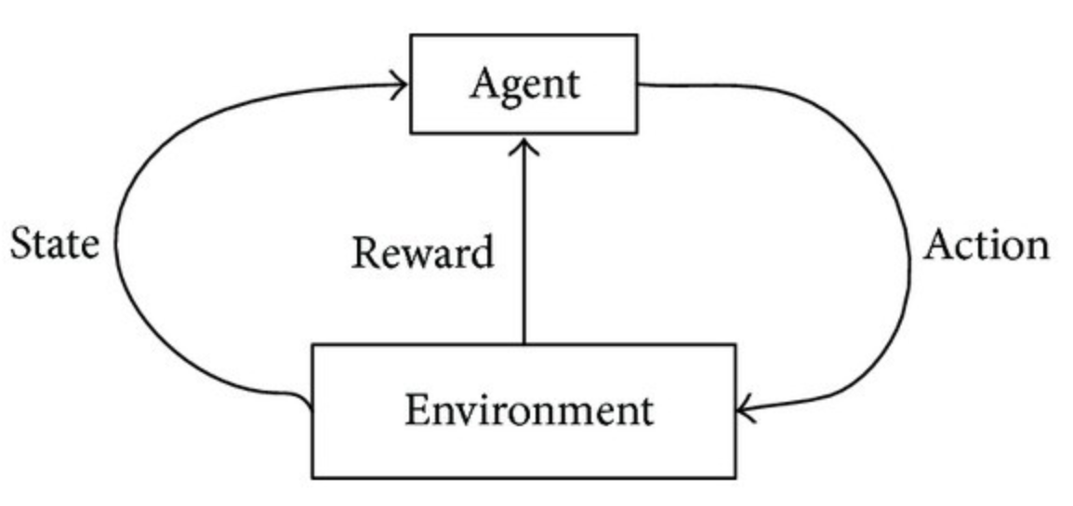
Reinforcement Learning (RL)
This type of learning uses reward/risk minimization for the observations of the system’s interaction with the environment
The algorithm (Agent) learns from the environment in an iterative manner
Used for decision making
  Robotic vision
  Playing games
  Driverless cars etc.
Some algorithms
  Q-Learning
  Temporal Difference (TD)
  Deep Adversarial Networks
https://towardsdatascience.com/types-of-machine-learning-algorithms-you-should-know-953a08248861

Slide 21
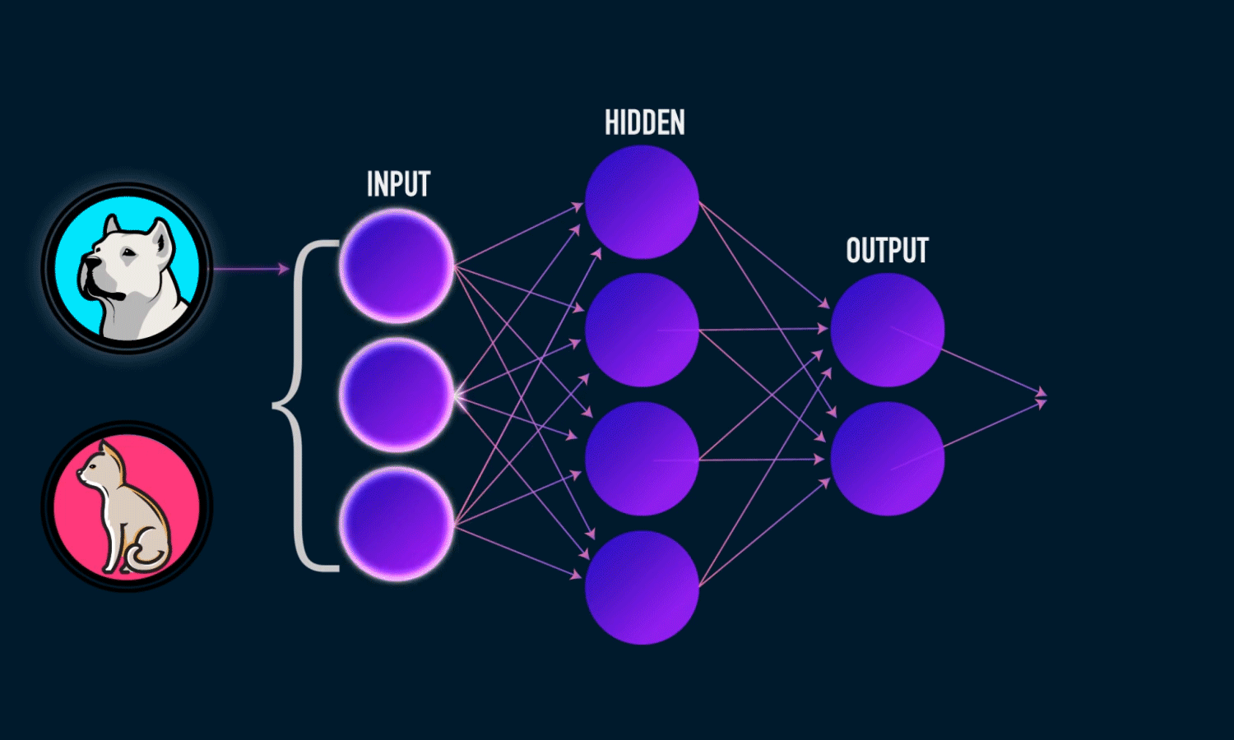
Artificial Neural Network
https://towardsdatascience.com/visualizing-artificial-neural-networks-anns-with-just-one-line-of-code-b4233607209e

Slide 22
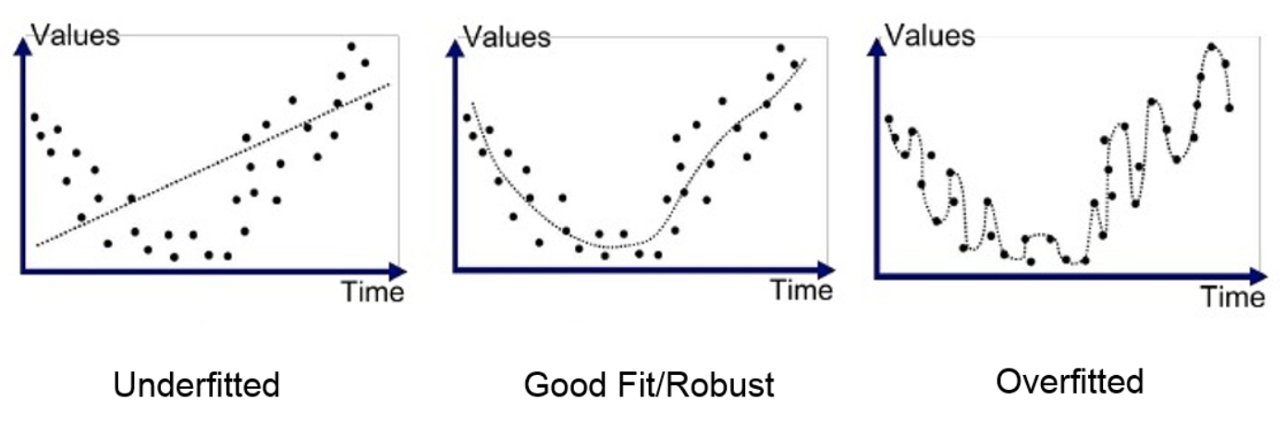
Some Terms
Structured Data - Unambiguous, pre-defined format (eg. mm/dd/yy)
Unstructured Data - Data without any predefined structure (most of the data)
Underfitting - When a model cannot fit the training data well
Overfitting - When a model captures the noise of the data and fits the training data too well
https://medium.com/greyatom/what-is-underfitting-and-overfitting-in-machine-learning-and-how-to-deal-with-it-6803a989c76

Slide 23
AI-Testing-AI

Slide 24
AI Application in Testing
Functional testing
User-interface testing
AI in traditional Automation
AI in defect analysis and prediction
AI to Test AI

Slide 25
Types of Tools...
Visual, automated UI testing
  Using image processing technology instead of pixel comparison
  Can check various UI attributes such as color, positioning, size etc.
  It can find differences that are likely to be missed by testers
GUI testing
  Using ML walk the GUI and record the app
  Over iterations it is able to learn, compare and identify bugs
  May include GUI, DOM, performance etc.
API testing
  Tools learn the APIs, the parameter variation and also sequences etc.
  Esp. when there is no GUI to be tested

Slide 26
Types of Tools
Coverage analysis
  Using ML tools can learn which tests yield best coverage and hence the optimum number of tests to be run
  Identify least covered areas
  Identify duplicate tests and failures
Automation
  Combine elements from visual GUI tests
  Use ML to figure out changes and possible correlation between locators and elements and whether change is a bug or an expected change
  Drive existing automation tools

Slide 27
Challenges
With large number of tests how does one verify correctness of tests?
How does one know there are no false positives and false negatives? After all test results are generally a probability
How to ensure there are no missing tests?
For complex applications the resource need might be huge (meaning expensive testing). How does one calculate the cost of testing?

Slide 28
Testing The AI

Slide 29
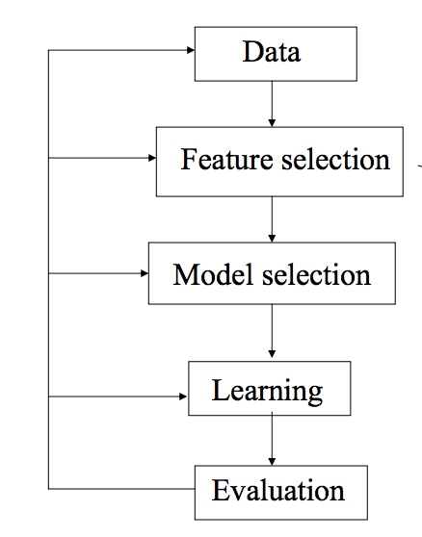
The Need for Testing the AI
Use of AI in various walks of life is increasing
The theory around how to test AI is in nascent stage
Testing could be performed at the stage of training the algorithm, as in the design cycle OR as part of system testing
We will treat the Algorithm as black-box and look at testing as part of system testing
Let us take a stab at it
*https://people.cs.pitt.edu/~milos/courses/cs2750-Spring03/lectures/class2.pdf

Slide 30
Evaluating Learning
Some of the parameters on which learning systems can be evaluated are
Accuracy
Robustness
Speed and complexity
Continuous Learning
Scalability
Testability

Slide 31
Accuracy
It is the most important parameter for the acceptance of a solution
It is the ability of the system to generalize, to deal with unknown data, based on training data
Mathematical precision may not be required and a “good enough” solution is often desired
Some sort of “error estimation” is required to quantitatively measure the generalization capability of the system

Slide 32
Robustness
Ability of the system to handle “noise” in the data
  Corrupt data
  Incomplete data
  Irrelevant data
Typically tested using synthetic data with increasing degree of inconsistency in the data

Slide 33
Speed and complexity
Performance of the system is an important parameter
Some of the aspects of performance are
  Speed
  Processor utilization
  Memory utilization

Slide 34
Continuous Learning
Ability of the system to incorporate learning from new data, esp. From a real time environment

Slide 35
Scalability
Ability of the system to handle large volume of data
Can be tested using a series of datasets of increasing volume/size

Slide 36
Testability
What features does the implementation provide for
  Observability
  Controllability

Slide 37
Question
How do we know what is the ML algorithm doing? Do we understand it?
Can we use our understanding as an Oracle for the ML algorithm?
How can we find out “corner” cases?
By doing all of the above can we improve the ML algorithm?
How do we test the improved algorithm?
Does our approach work with ML or DL as well? (Hint: Complexity of data/structure and (non)visibility of patterns)
“Despite the fact that many machine learning models are black boxes, understanding the rationale behind the model's predictions would certainly help users decide when to trust or not to trust their predictions” - From “Introduction to Local Interpretable Model-Agnostic Explanations (LIME) A technique to explain the predictions of any machine learning classifier. By Marco Tulio Ribeiro, Sameer Singh, Carlos Guestrin August”

Slide 38
Let’s Learn By Examples
Isn’t that Supervised Learning? ;-)

Slide 39

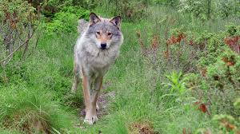
ML Mistakes - Learning Through Examples
Classification of Wolf and Husky worked with first image
Failed when provided second wolf image
Why?
http://innovation.uci.edu/2017/08/husky-or-wolf-using-a-black-box-learning-model-to-avoid-adoption-errors/
https://www.videoblocks.com/video/wolf-in-forest-watching-walking-away-rjq5xnejisirb1f6

Slide 40
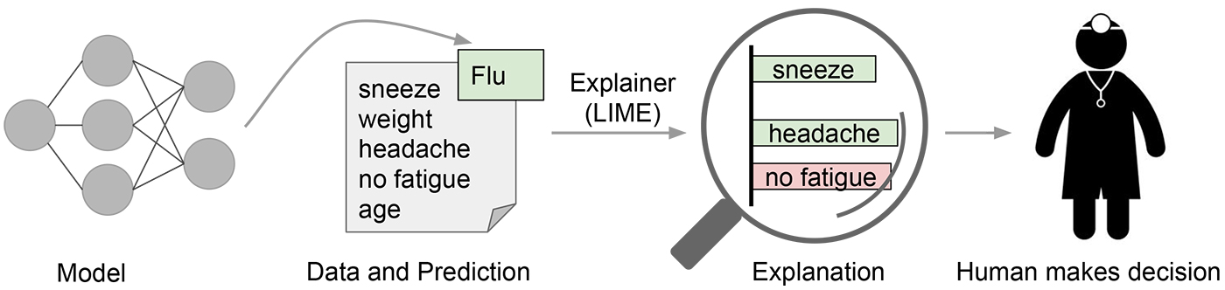
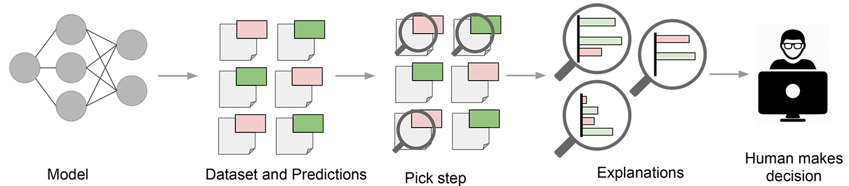
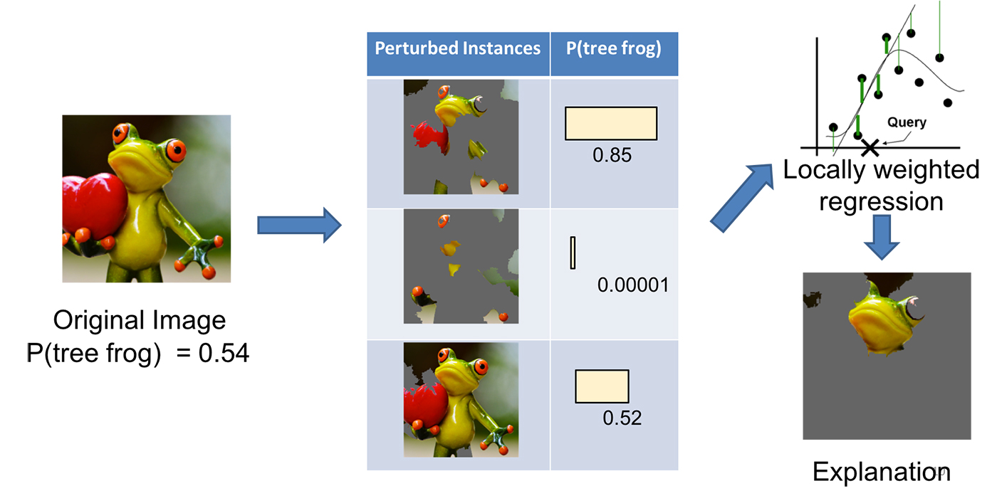
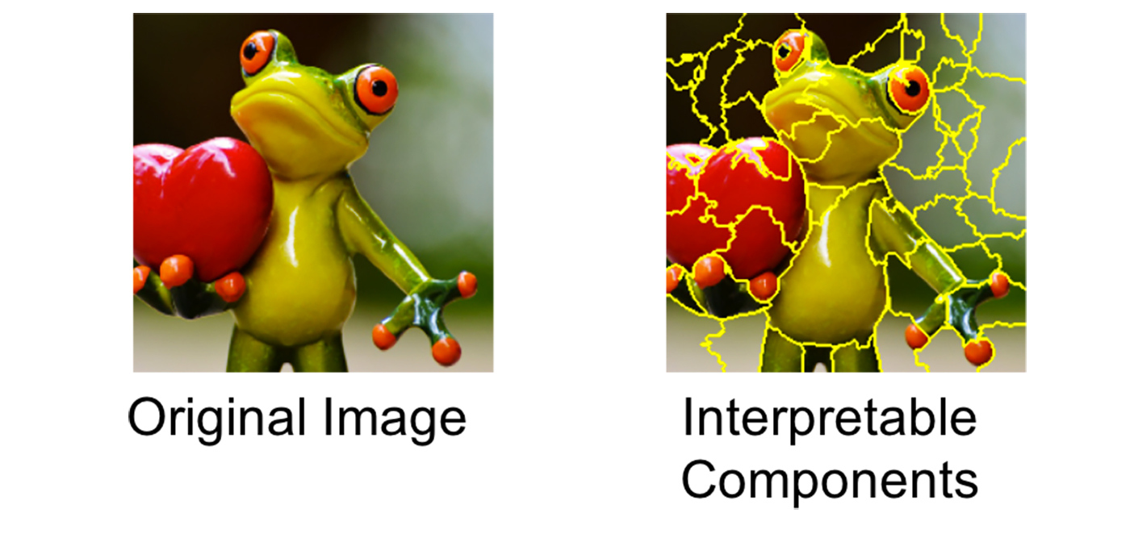
LIME
Local Interpretable Model-Agnostic Explanations (LIME) algorithms can help
*https://www.oreilly.com/learning/introduction-to-local-interpretable-model-agnostic-explanations-lime

Slide 41
More Model Agnostic Methods
Surrogate Models – Train a simple model on the output of your system under test and use that information to interpret what is happening
Feature importance – Measure a feature’s importance. Change the feature value and if it increases error then the feature is considered important else is not important because the model uses/doesn’t use the feature
For details and more such methods a good resource is - https://christophm.github.io/interpretable-ml-book/global.html

Slide 42
Using Black-Box
In my opinion the questions raised by the authors of lime* are very important -
Can we understand what the machine learning algorithms are doing?
Can we compare different machine learning algorithms?
Can we improve the existing machine learning algorithms?
And can we predict how machine learning will behave on new data?
The best way today to test AI apps is to test them in black-box/grey-box manner
* http://innovation.uci.edu/2017/08/husky-or-wolf-using-a-black-box-learning-model-to-avoid-adoption-errors/

Slide 43
Uber Accident
A woman in Arizona, USA died when a self-driving car hit her. Let us look at the series of events
The Uber vehicle had been in autonomous mode for 19 minutes and was driving at about 40 mph
Elaine Herzberg was walking her bike across the street
The car’s radar and lidar sensors detected Herzberg about six seconds before the crash
  first identifying her as an unknown object
  Then as a vehicle
  Then as a bicycle, each time adjusting its expectations for her path of travel
About a second before impact the self-driving system determined that an emergency braking maneuver was needed to mitigate a collision
WHAT WENT WRONG?
* https://www.wired.com/story/uber-self-driving-crash-arizona-ntsb-report/

Slide 44
Some Tests First
The victim suddenly emerging from darkness on the side of the road
Being perpendicular to the lidar creates visibility issues
The woman with the bicycle image wasn’t used enough to train the s/w
Vehicle speed was high
The woman was moving/not-moving/moving erratically
The woman had sudden movements
There were items on the bicycle that looked like plastic/hay
Fog/exhaust fumes caused distortion
Dress of the woman matched the road or plants or plastic bag...

Slide 45
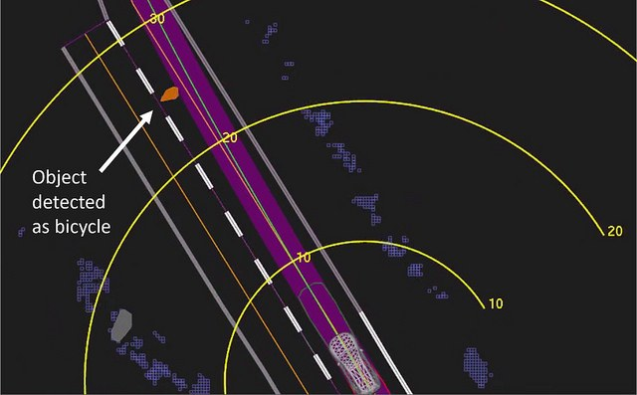
How It Happened...
Uber, however, does not allow its system to make emergency braking maneuvers on its own - rather than risk “erratic vehicle behavior”—like slamming on the brakes or swerving to avoid a plastic bag—Uber relies on its human operator to watch the road and take control when trouble arises.
Furthermore, Uber had turned off the Volvo’s built-in automatic emergency braking system to avoid clashes with its own tech. This is standard practice, experts say. “The vehicle needs one master”
However the human operator was looking somewhere else..
https://www.wired.com/story/uber-self-driving-crash-arizona-ntsb-report/

Slide 46
Lets Test
https://tone-analyzer-demo.ng.bluemix.net/ analyzes tones. This is an IBM product.
How will you test it?

Slide 47
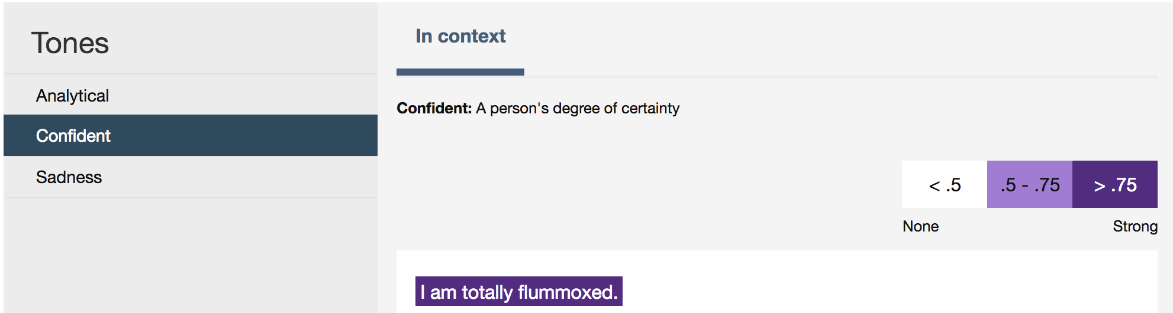
?

Slide 48
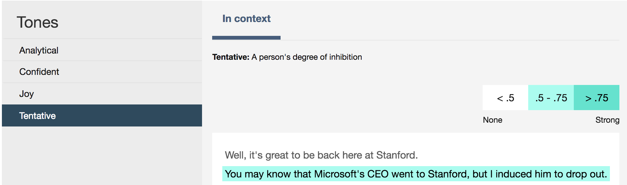
A Test Case
https://genius.com/Bill-gates-bill-gates-speech-at-stanford-university-annotated
Well, it's great to be back here at Stanford. You may know that Microsoft's CEO went to Stanford, but I induced him to drop out. So, he never got a degree from Stanford. He did get an undergraduate degree, but I still think of him as a fellow dropout. (Laughter.)

Slide 49
Testing Candy Crush
Test goal - To understand whether a level is solvable, and how difficult it it.
Brute force technique which tried all paths, and checked how many of them lead to success worked but took hours
Genetic Algorithms - Start with a few algorithms with fixed premises and choose the ones that produced best results and mix them and continue till you have the best results
https://www.infoq.com/presentations/candy-crush-ai-test
https://www.infoq.com/news/2018/06/testing-artificial-intelligence

Slide 50
Example Problems you can try out
Facebook friend recommendation
Gmail Spam filtering

Slide 51
Do Lookup These Cases
And ask yourself how would you have tested these?
Dollhouse debacle - https://www.kaspersky.com/blog/ai-fails/18318/
Computer program steals money - http://www.sciencemag.org/news/2016/04/artificial-intelligence-steals-money-banking-customers
Racist image labeling algorithm - https://www.theverge.com/2018/1/12/16882408/google-racist-gorillas-photo-recognition-algorithm-ai
Burger king - https://www.npr.org/sections/thetwo-way/2017/04/13/523740193/ok-google-burger-king-hijacked-your-speakers-and-failed-pretty-quickly

Slide 52
How to Think of Corner Cases
Let us take a look at my technique - “Ext. to Noun-and-verb”

Slide 53
Thanks

