Slide 1

Quality of
Quality Assurance
By Svetlana Korneva
Kyriba, 2019
Move your duties to the next level

Slide 2
About me
QA fan
>12 years in IT
https://www.linkedin.com/in/svetlanakorneva/
sviatlana.korneva

Slide 3
♯1 Cloud Platform for Treasure & Finance
2000 clients, 100+ countries
$110 Million in revenue

Slide 4

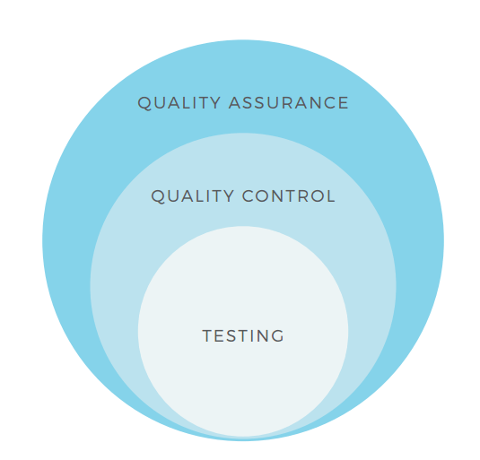
QA is more than just testing

Slide 5
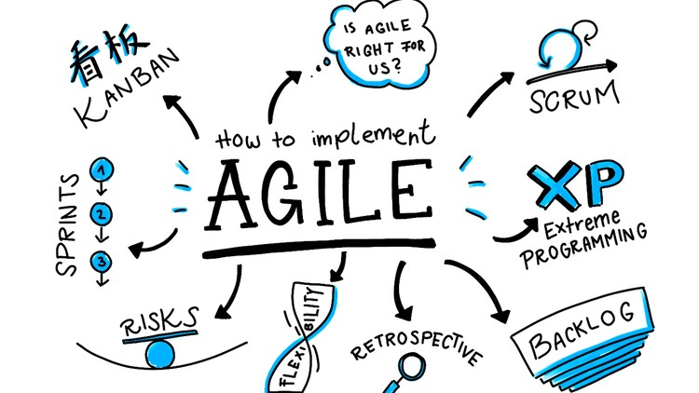
Agile changed the QA engineers’ life

Slide 6

Market-driven development

Slide 7
What is Quality?
The loss a product imposes on society after it is shipped
Value to some person
The result of care
the standard of something as measured against other things of a similar kind; the degree of excellence of something.
A combination of quantitative and qualitative perspectives for which each person has his or her own definition; examples of which include...
Conformance to requirements.
Quality in a product or service is not what the supplier puts in. It is what the customer gets out and is willing to pay for
Number of defects per million opportunities

Slide 8

Aesthetic view
Quality is elegance.

Slide 9
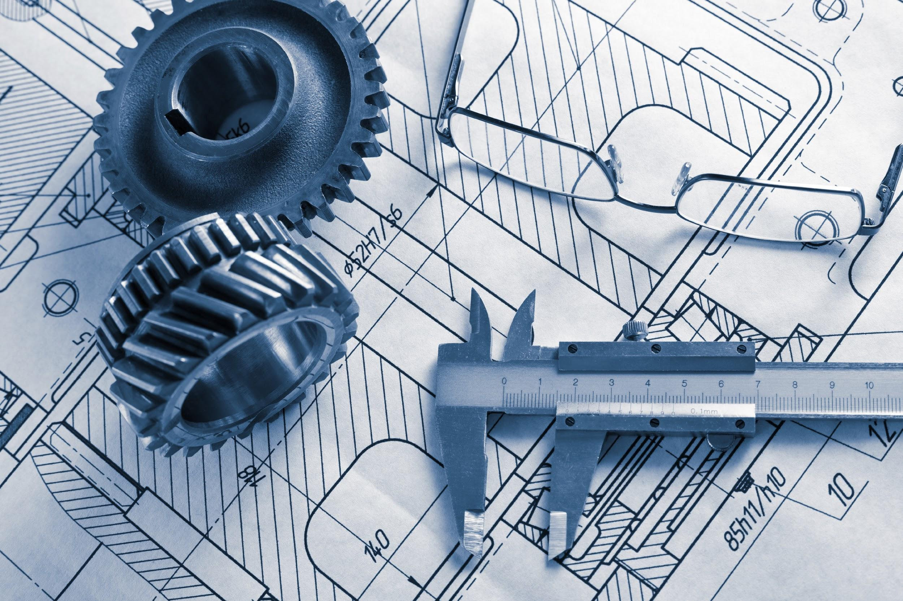
Manufacturing view
Quality is correctness, conformance to specifications.

Slide 10

Customer view
Quality is fitness to use.

Slide 11
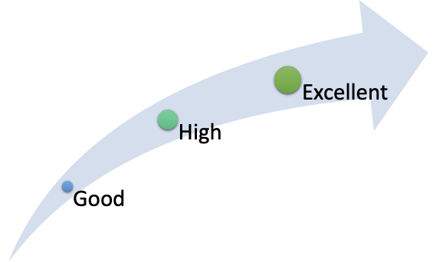
Quality level

Slide 12
Costs of “super”quality
Blurred focus
Overpriced “next found bug”
Longer time to market
Missed opportunities

Slide 13
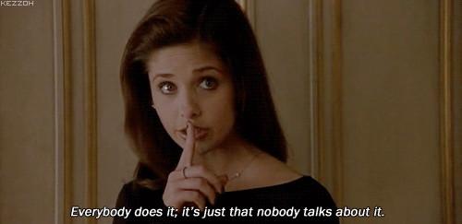
Ok, we’re all doing it

Slide 14
“Our behaviour should be driven by reason, not by compulsion.”

Slide 15
Good-enough quality
It has sufficient benefits
It has no critical problems
The benefits sufficiently overweight the problems
Further improvements would be more harmful than helpful

Slide 16
Good enough for you is not good enough for me
Assess the benefits of the project
Assess the problems of the project
Assess product quality
Assess the logistics of improving the project

Slide 17





Whom to ask?

Slide 18


Slide 19
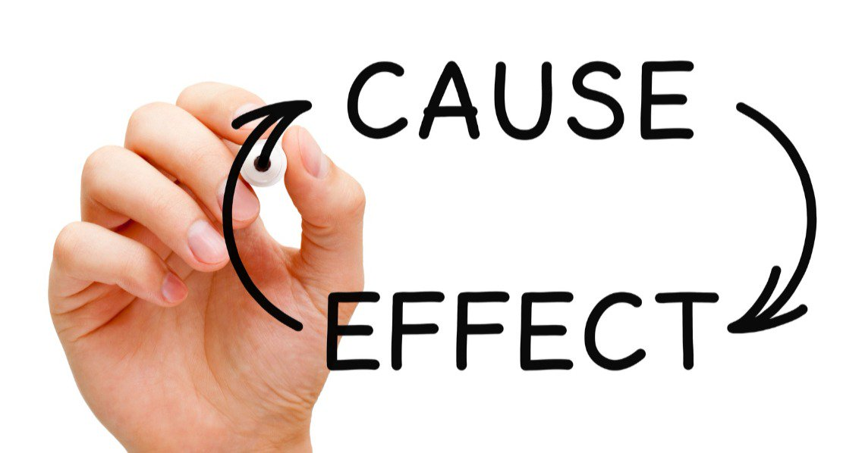
Problems first
Notes:
Improving out-of-dated UI. Benefits: customers will like it, they will spend less time to do their job. Probems: time to become similar with new workflows, some “features” of old UI have to be deprecated, possible problems with performance.

Slide 20
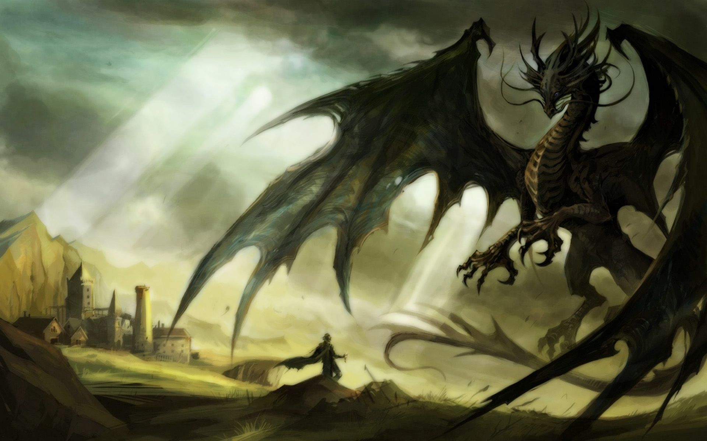
Face your fears
Accept it…
Identify it…
Feel it…
Face it…
Practice it...

Slide 21
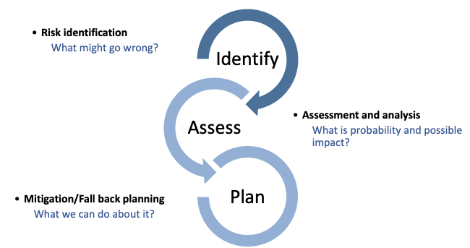
Risk-based thinking
Notes:
Example with new UI implementation: big risk that new UI won’t be accepted by customers.

Slide 22

Houston,
We have
a problem…
Hurray!

Slide 23
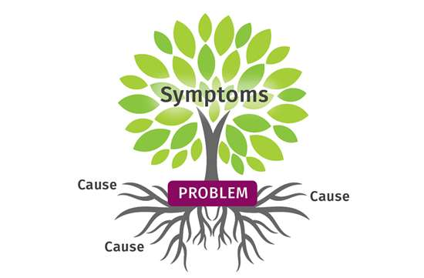
Root of the cause
Notes:
Production defects, issues in processes, cross-team “conflicts”.

Slide 24
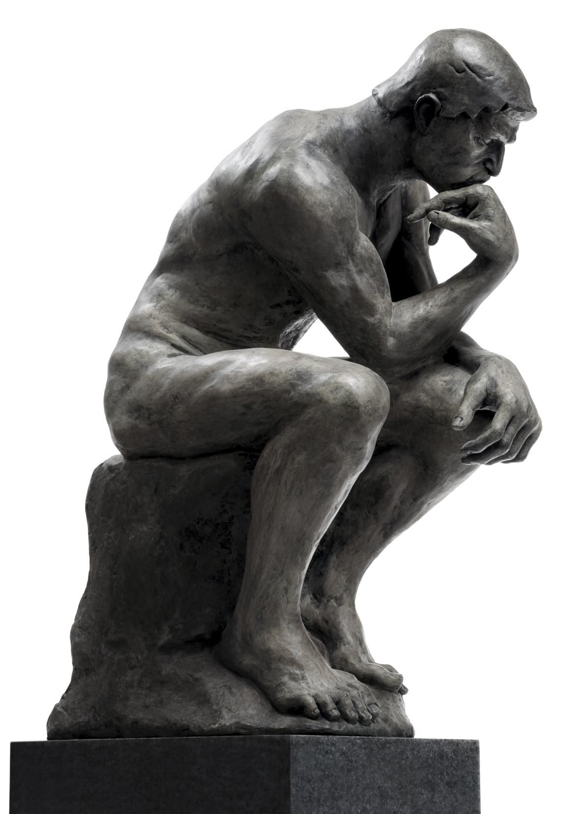
Why-man
Notes:
Example: you was asked to do task A, knowing that there is planned task B that logically should be implemented before task A. Why? What is the reason? Mistake? Just “Demo” task? Checking of hypothesis? Internal usage only? No technical possibility to do so?

Slide 25
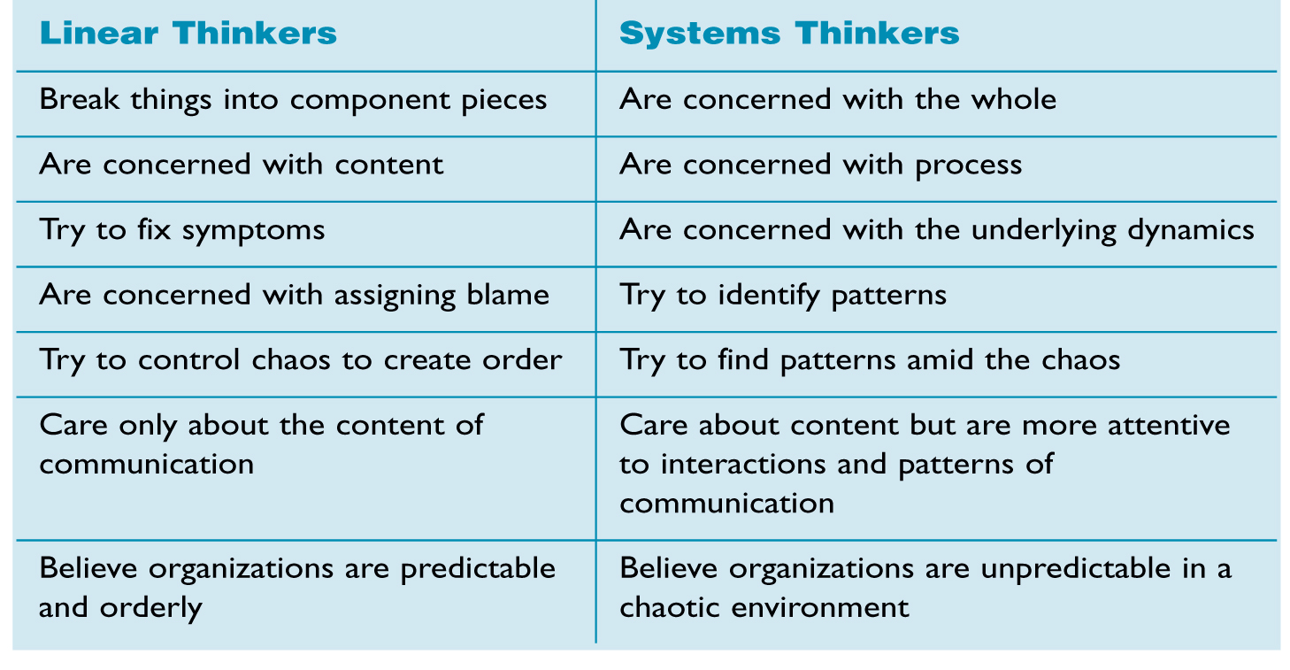
System thinking
Notes:
Example: team has lags in performance, and it was decided to extend team by hiring new people.

Slide 26
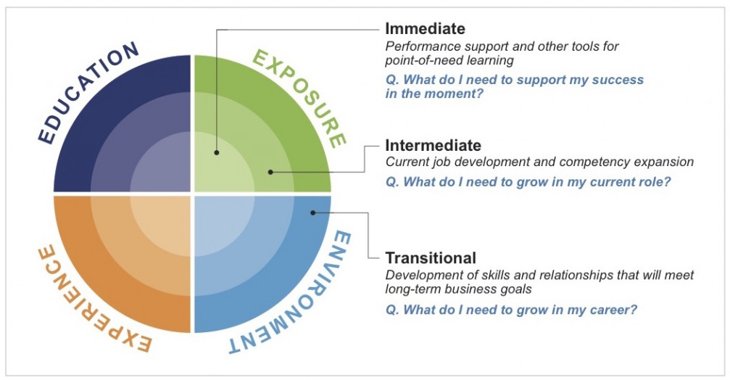
Learn continuously
Notes:
Metrics explanation and statistics basics.

Slide 27

Be here and now
Notes:
“It was always done in such way” behavior. Future changes in approach/technology (Hub example).

Slide 28
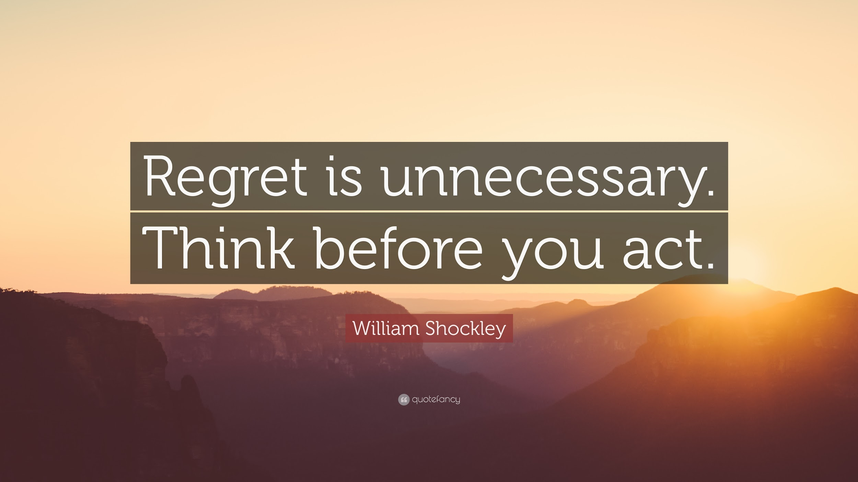
Notes:
Quality of thinking

Slide 29
Questions?

