Slide 1

Tests written by themselves
(almost)
Arnika Hryszko

Slide 2
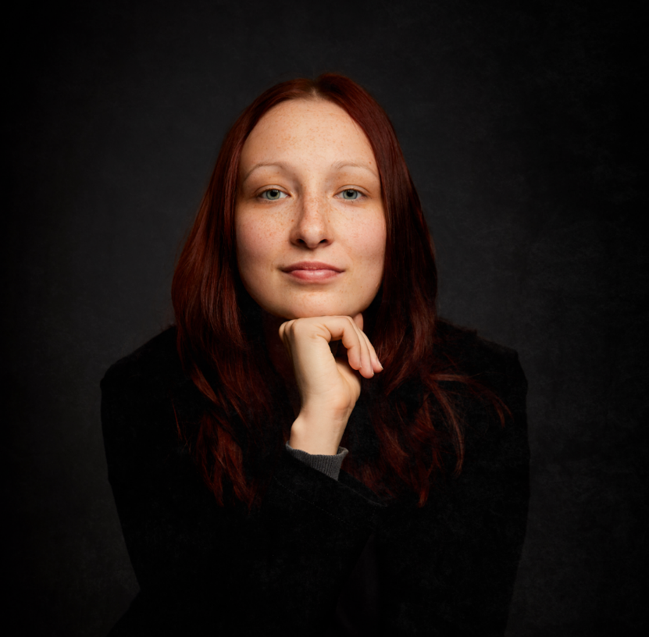

Arnika Hryszko
PTB’s Audit Comitee
Ms Eng in Computer Science
Tester since 2008
Exploratory Tester of the Year
Finalist of the sport rifle cup competition.

Slide 3

Agenda
The begining
The idea behind Model Based Testing
Tools
The process of creation
Other possibilities
Summary

Slide 4

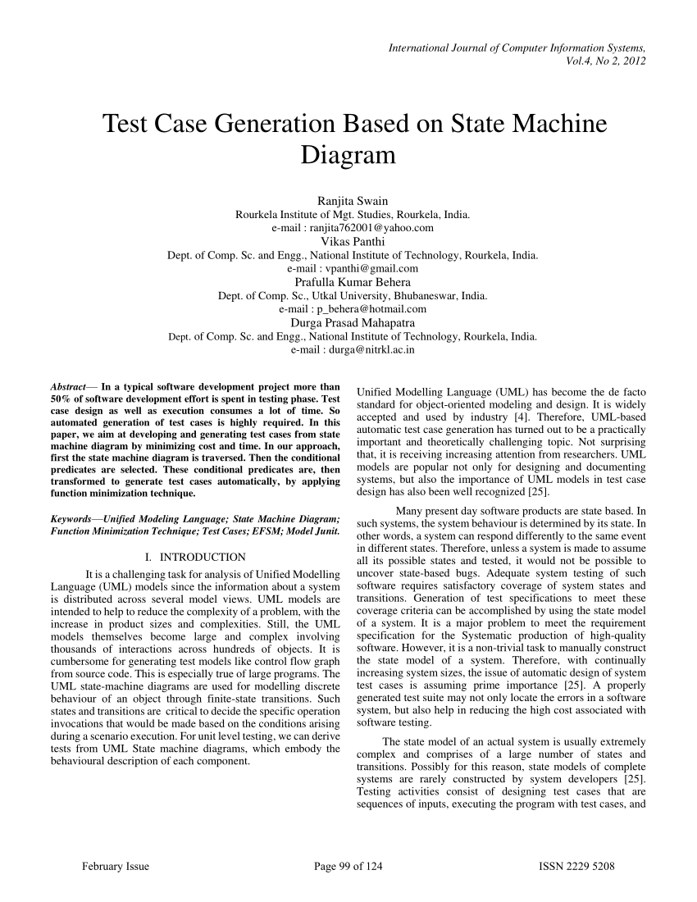
The begining
Using UML Collaboration Diagrams
for Static Checking and Test Generation
Aynur Abdurazik, Jeff Offutt

Slide 5
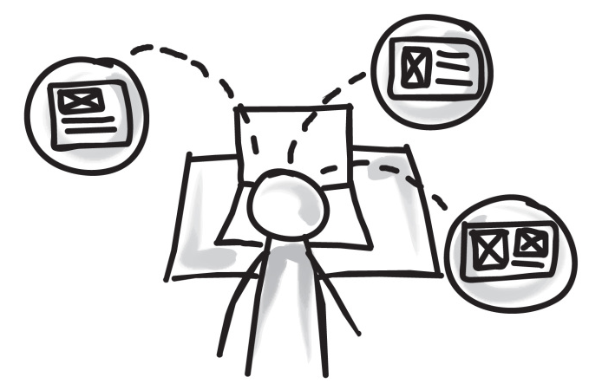
Test Case Design
Time consuming
Uneven
Unmeasurable (in connection to requirements)

Slide 6


Solution
Time
Consistency
Requirements coverage
Automted Test Case generation
Generated by one mechanism
Model = specification

Slide 7
The idea behind MBT
Requirements
TC’s spec.
Model
Test Cases
Scripts*
SUT

Slide 8
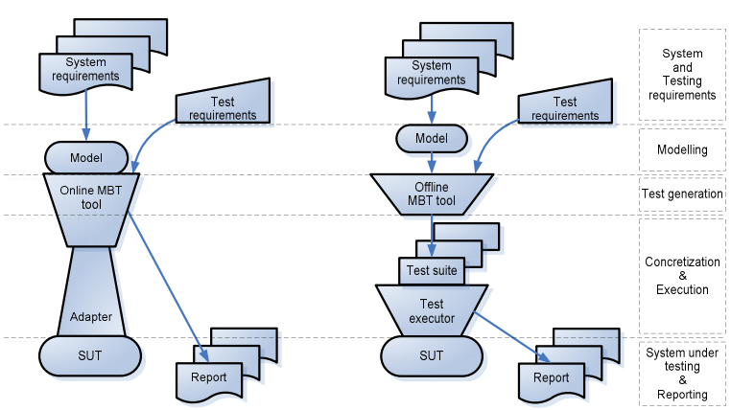
Online vs Offline

Slide 9

MBT vs Test Automation
Automated test case generation
Focus on model (actual use of application)
Easy to maintain

Slide 10











Tools

Slide 11

Tools

Slide 12
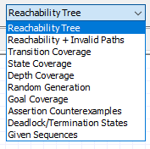
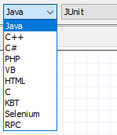

Process – configuration

Slide 13
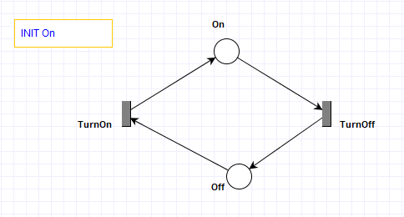
Process – build the model

Slide 14
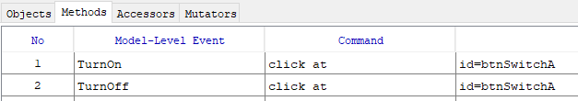
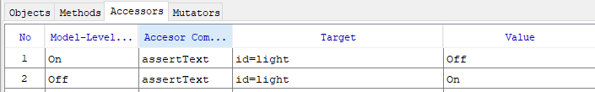
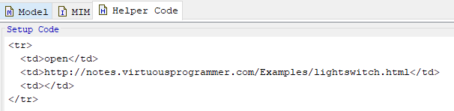
Process – connect to SUT

Slide 15
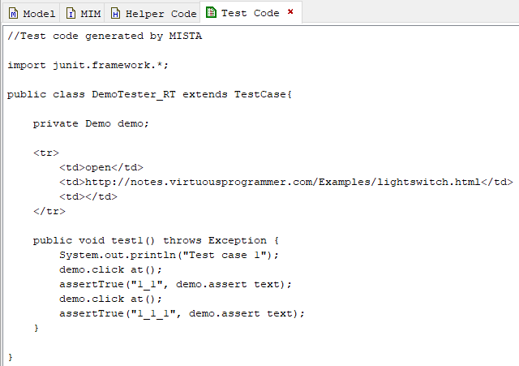
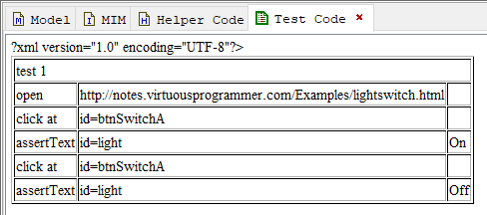
Process – generate test case

Slide 16
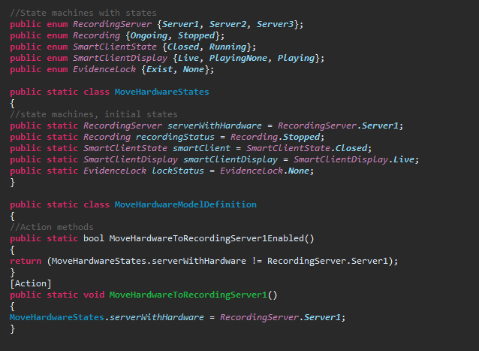
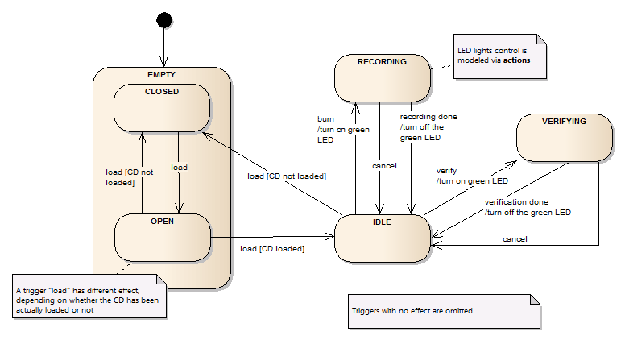
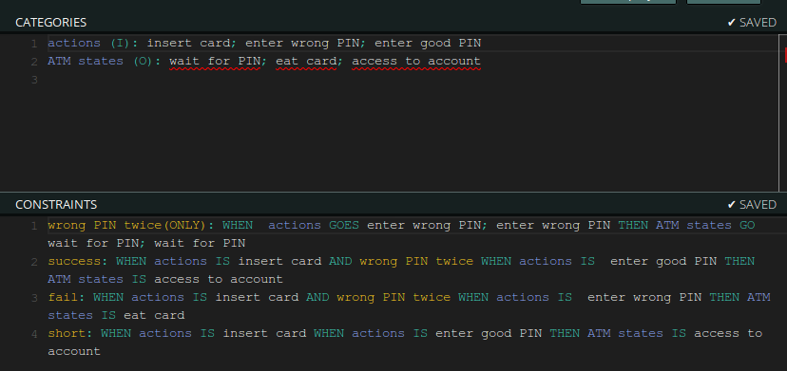
Other options – model creation

Slide 17
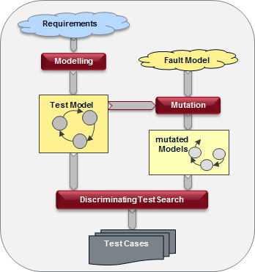
Other options – mutations

Slide 18

Advantages
Forces detailed understanding of the system behavior
Early bug detection
Test suite grows with the product
Manage the model instead of the cases
Can generate endless tests
Can provide better coverage
And many more...

Slide 19

Disadvantages
Excessive amount of skills is required from the testers
Expertise in tools and scripts is required
Large initial effort in terms of man-hours is required
Requires a formal specification or model to carry out testing
Changes to the model might result in a different set of tests altogether
Test Cases are tightly coupled to the model

Slide 20
Summary
Model Based Testing requires new skill - modelling
Additional time and effort required
Can be a suplementary to existing test suits
Allows to focus on how the system works
It is necessary to choose the right tools to suit your needs

Slide 21


Большое спасибо! ☺

