Slide 1



Slide 2
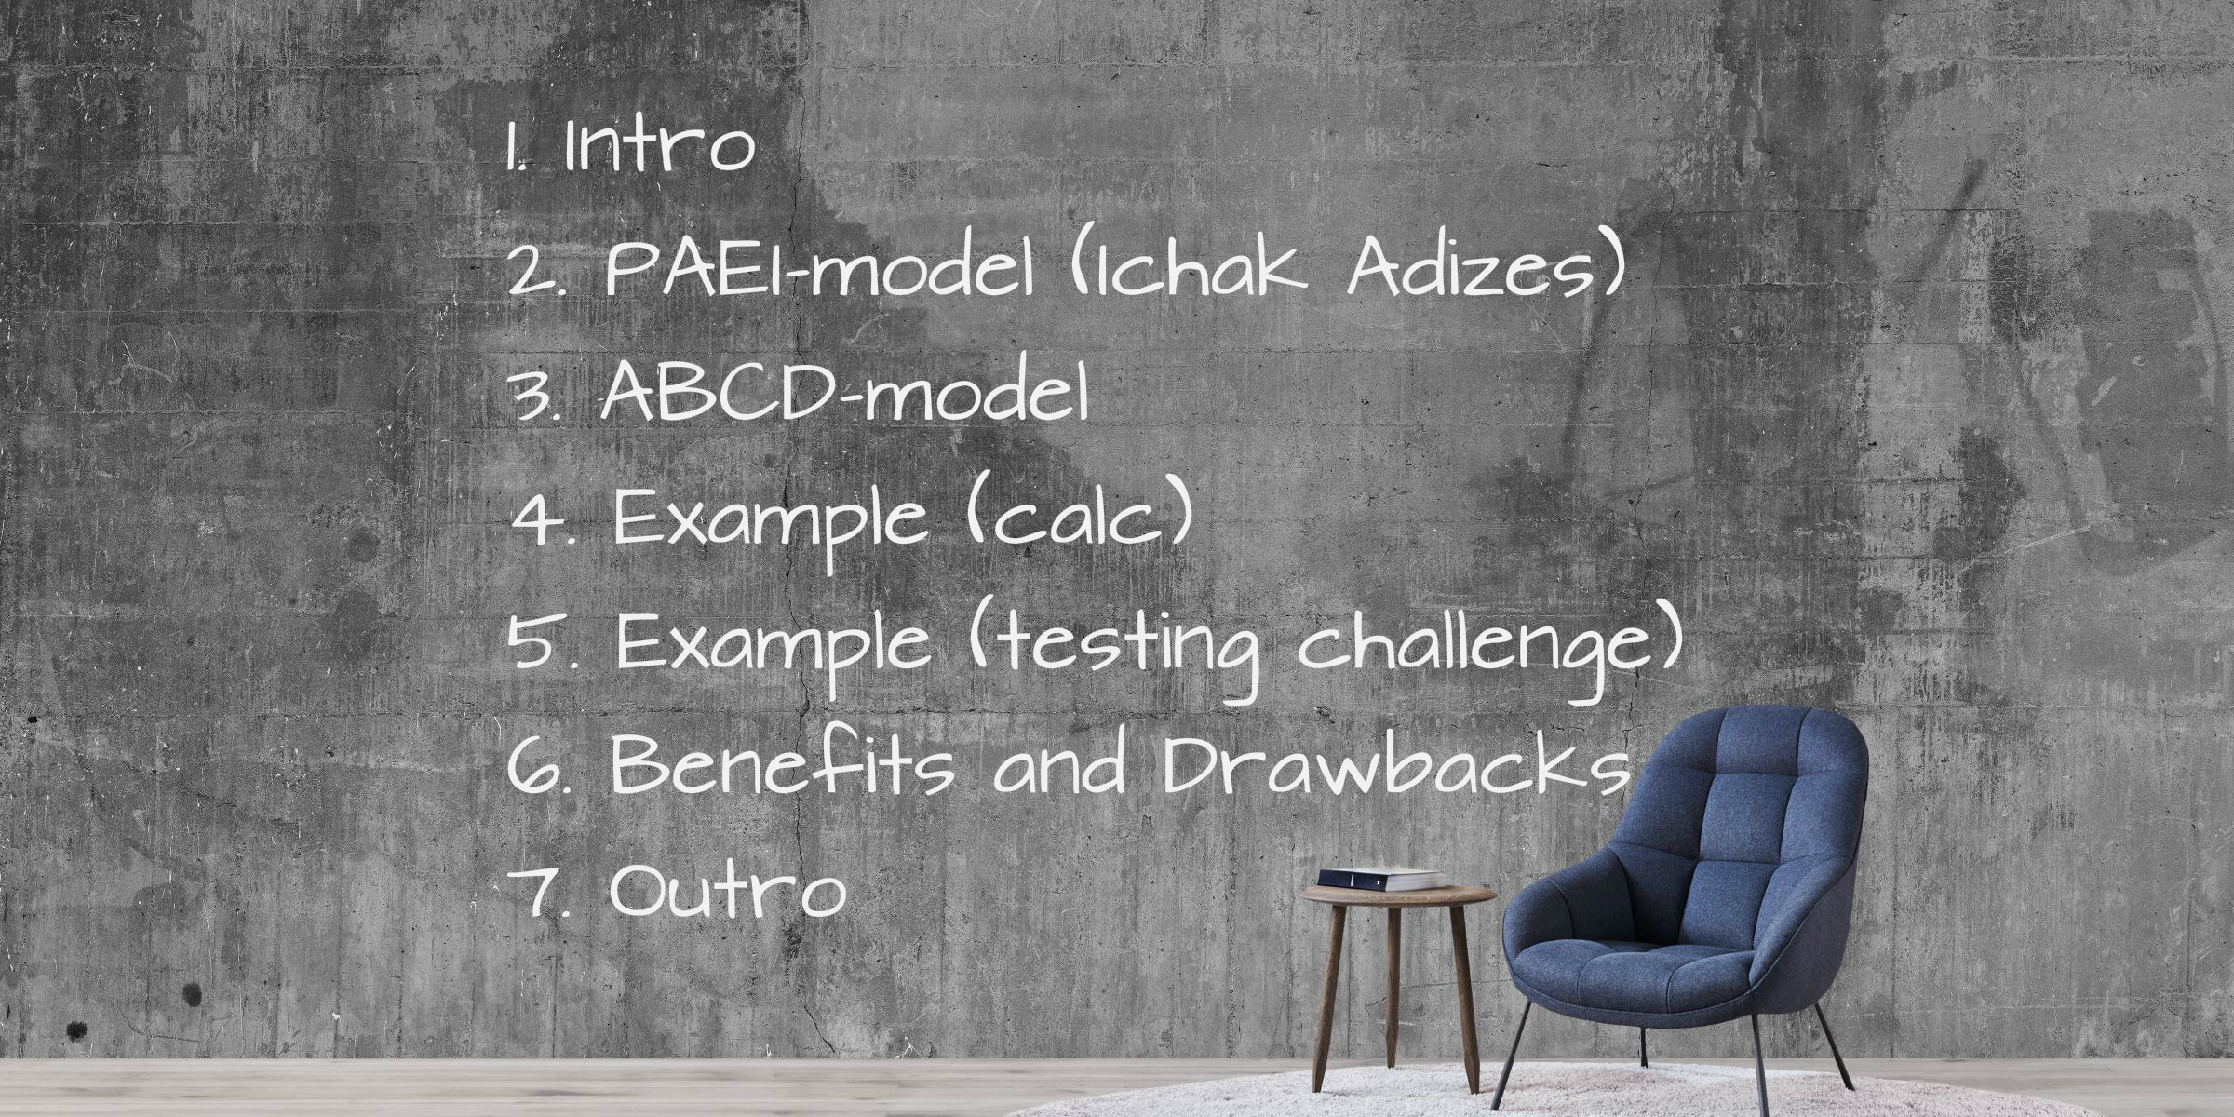

Slide 3


Slide 4


Slide 5


Slide 6


Slide 7


Slide 8
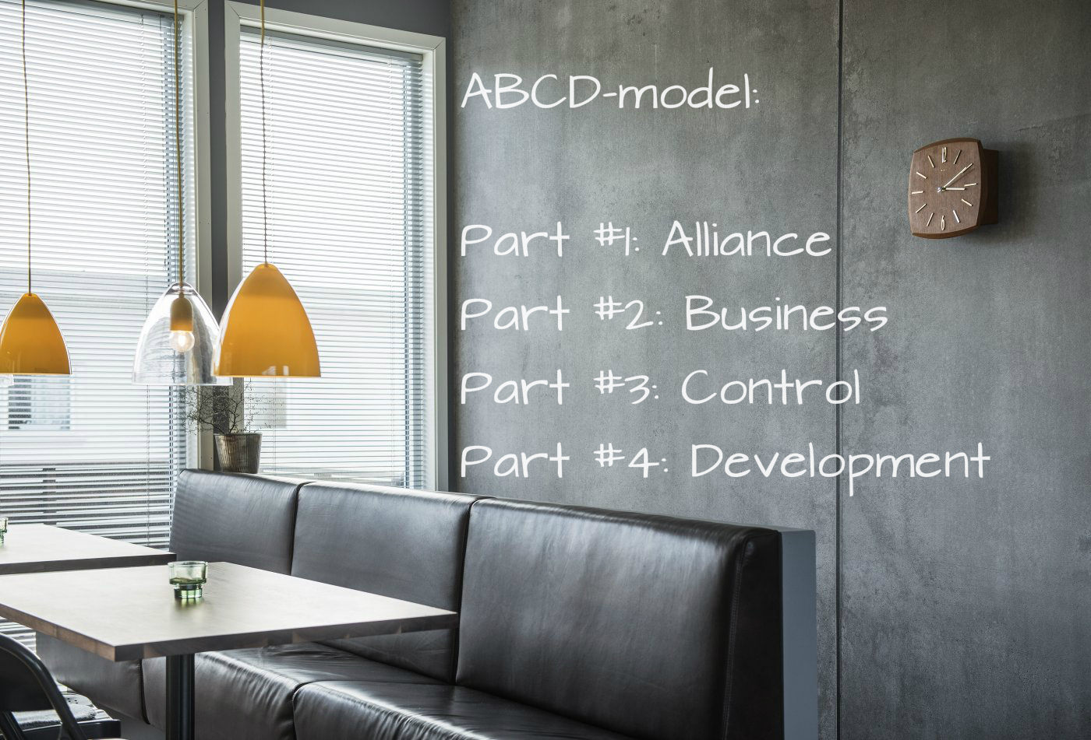

Slide 9


Slide 10


Slide 11


Slide 12


Slide 13


Slide 14
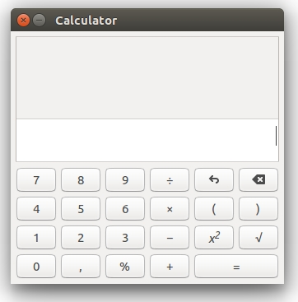

Slide 15
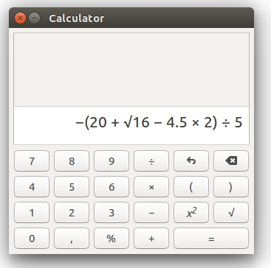

Slide 16
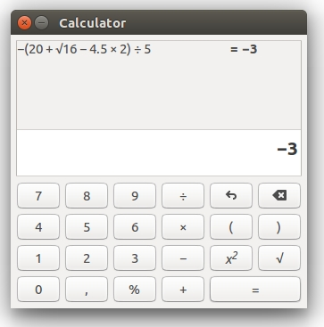

Slide 18
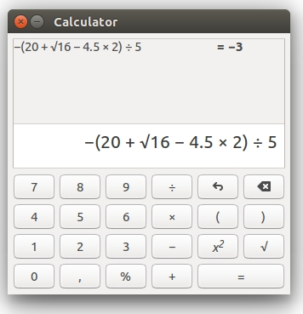

Slide 20
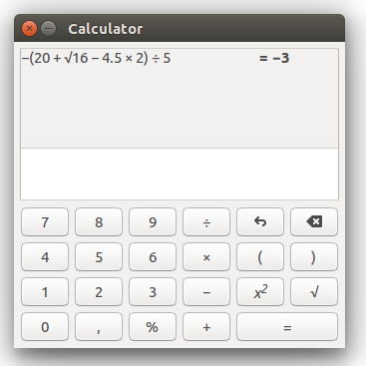

Slide 21

Initial
State

Slide 22
Initial
State
Argument #1
Argument #2
Result

Slide 23
Initial
State
Argument #1
+ -
Argument #2
=
Result

Slide 24
Initial
State
Argument #1
+ -
Argument #2
=
Result

Slide 25
Initial
State
Argument #1
+ -
Argument #2
=
Result

Slide 26
Initial
State
Argument #1
+ -
Argument #2
=
Result

Slide 27
Initial
State
Argument #1
+ -
* /
Argument #2
=
Result

Slide 28
Initial
State
Argument #1
Action
Argument #2
=
Result

Slide 29
Initial
State
Argument #1
Action
Argument #2
=
Result

Slide 30
Initial
State
Argument #1
Action
Argument #2
=
Result

Slide 31
Initial
State
Argument #1
Action
Argument #2
=
Result

Slide 32
Initial
State
Argument #1
+ -
Argument #2
=
Result

Slide 33
Initial
State
Argument #1
Action
Argument #2
=
Result

Slide 34


Slide 35


Slide 36
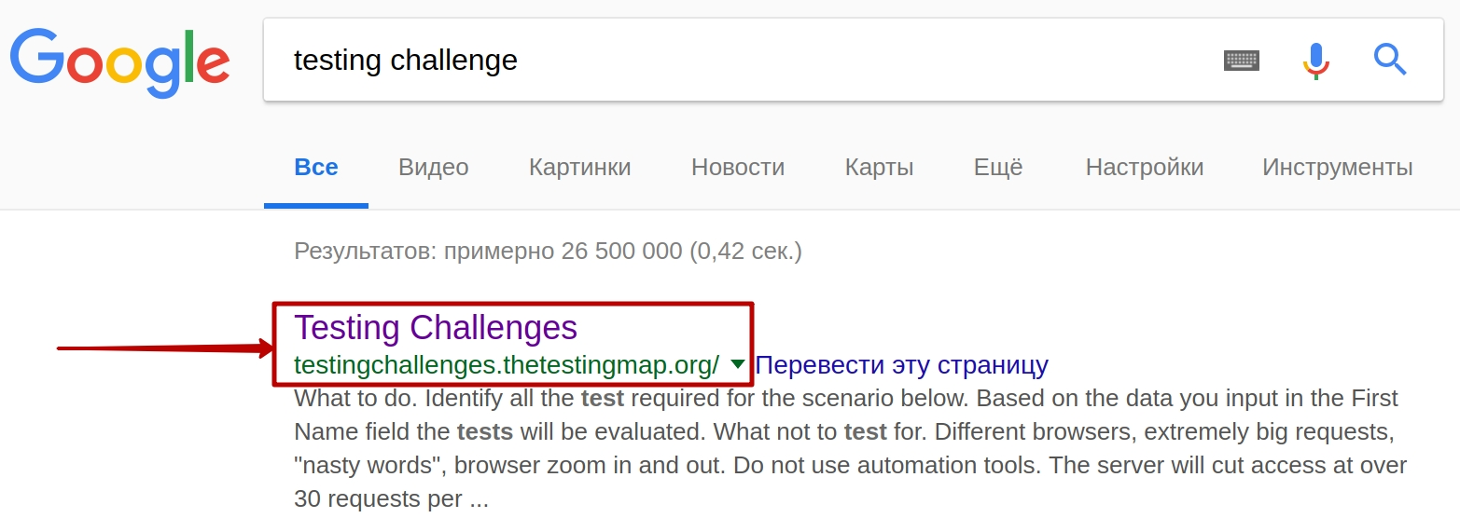

Slide 37
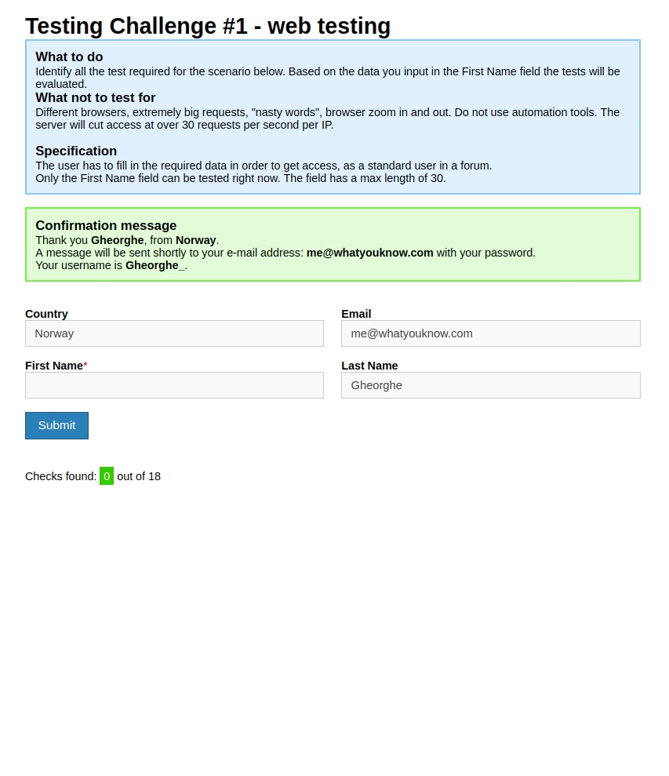

Slide 38
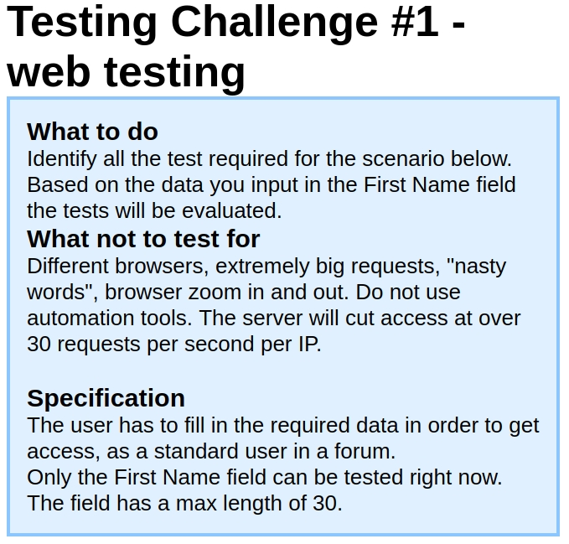

Slide 39
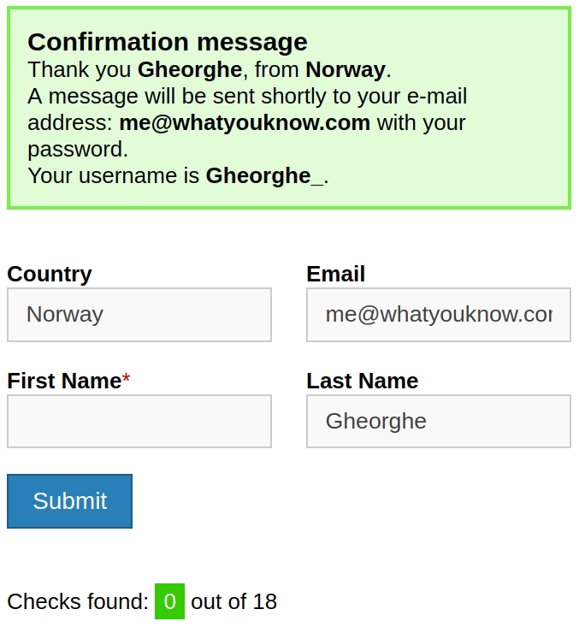

Slide 41

John

Slide 42
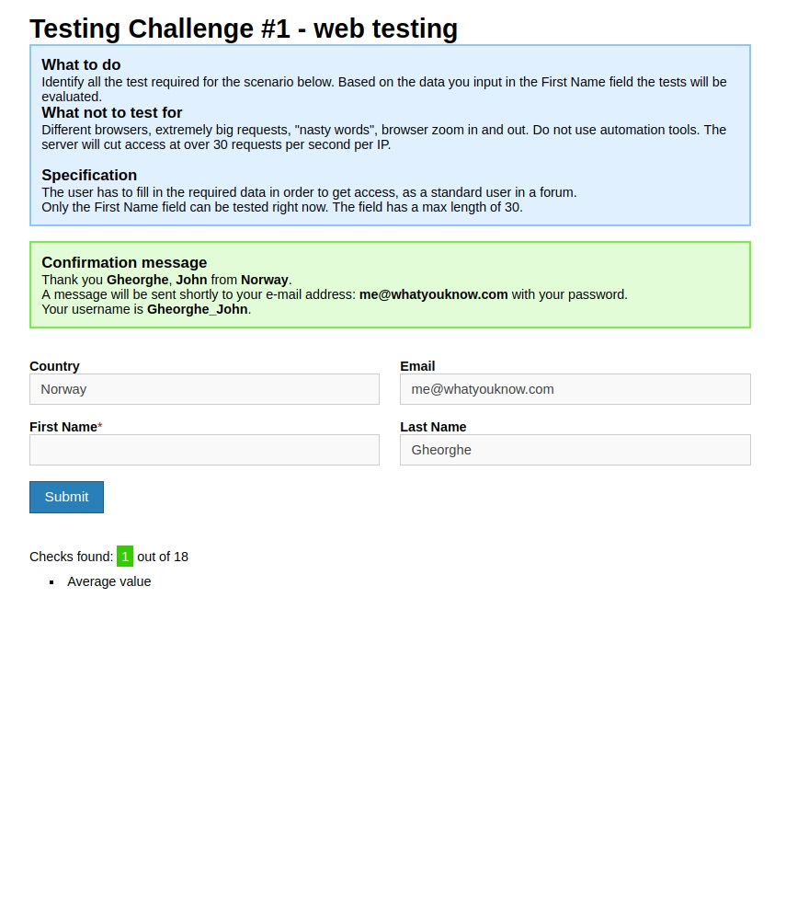

Slide 43
A
B
C
D

Slide 44
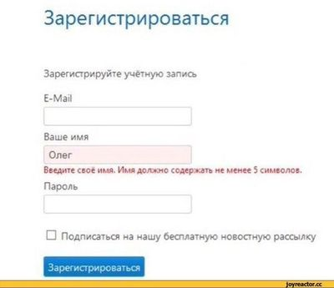

Slide 45
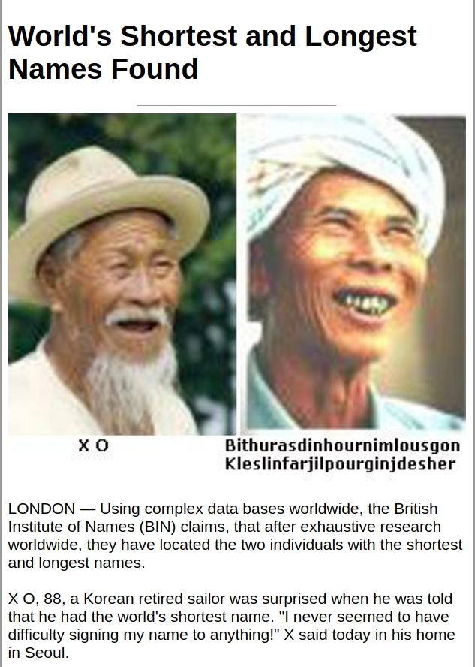

Slide 46
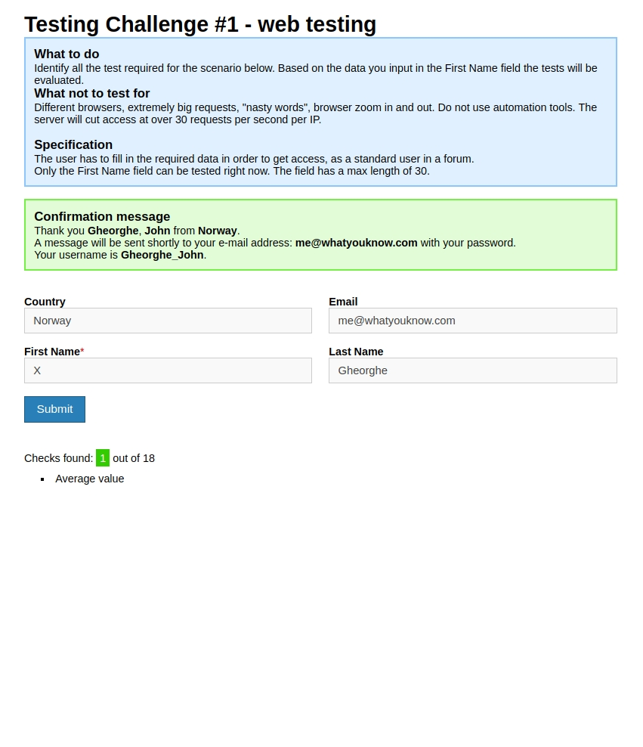
A
B
C
X
D

Slide 47
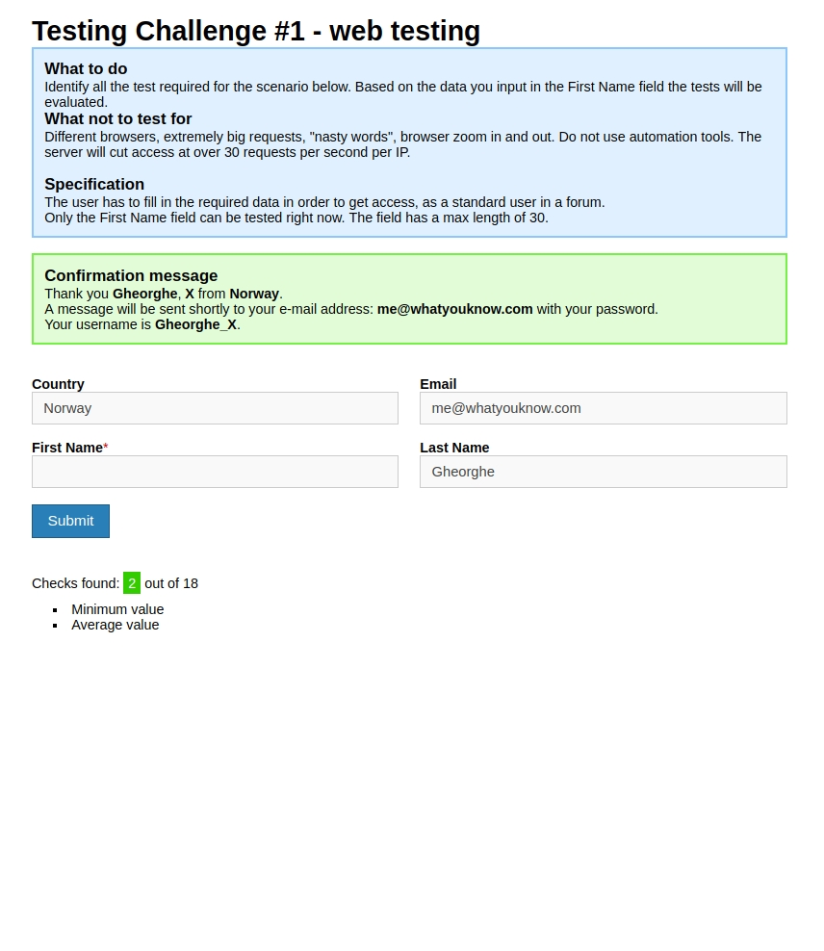
A
B
C
D

Slide 48

A
B
C
Rhoshandiatellyneshiaunneveshe
D

Slide 49
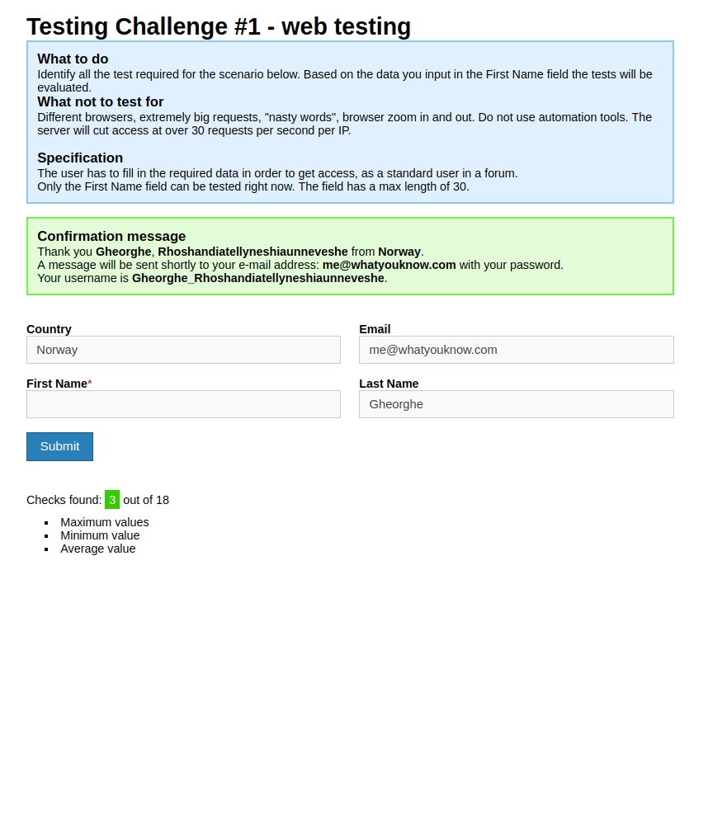
A
B
C
D

Slide 50
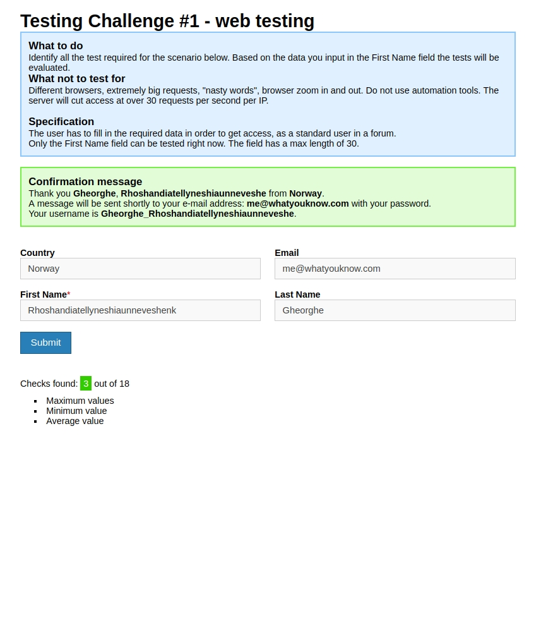
A
B
C
Rhoshandiatellyneshiaunneveshenk
D

Slide 51
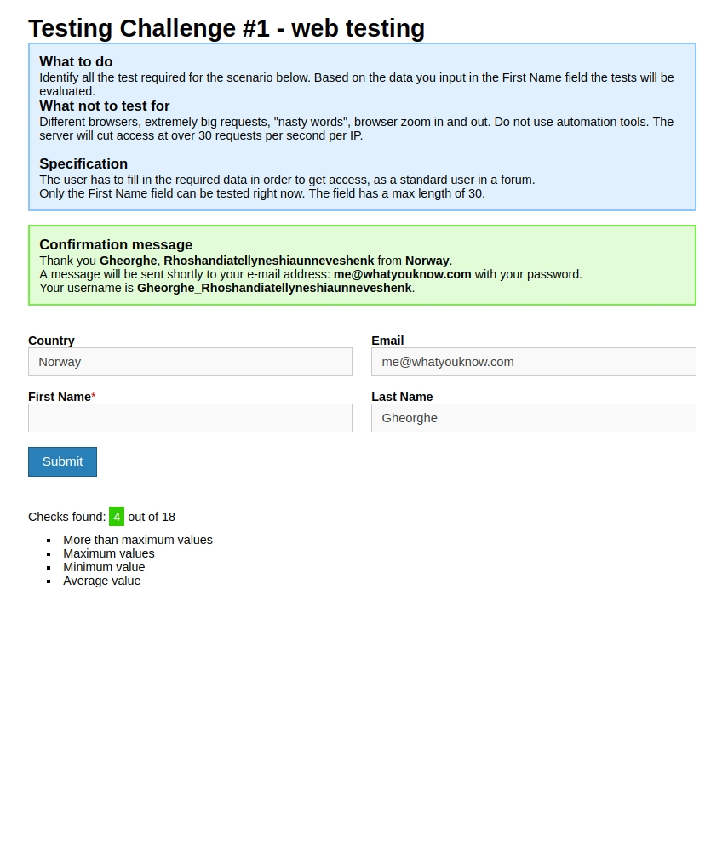
A
B
C
Empty value
D

Slide 52
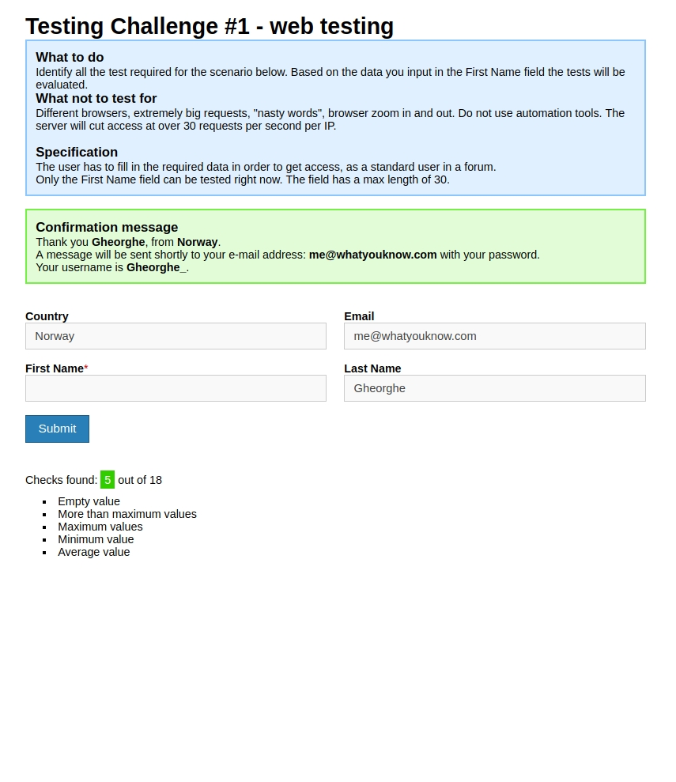
A
B
C
D

Slide 53
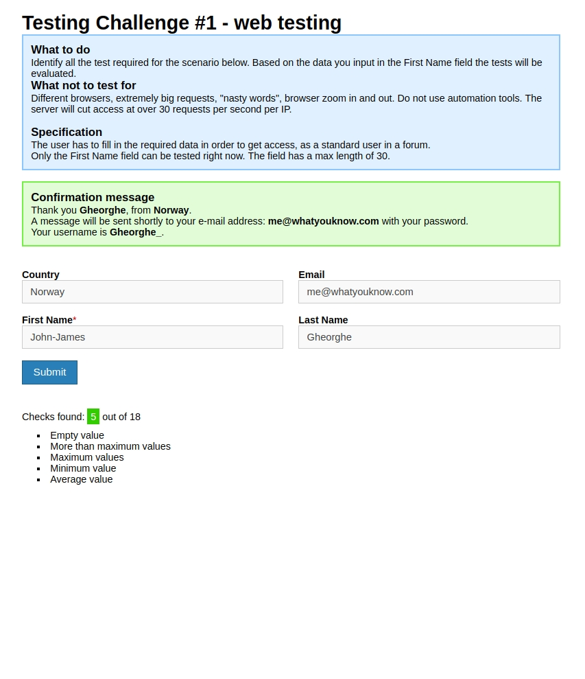
A
B
C
John-James
D

Slide 54
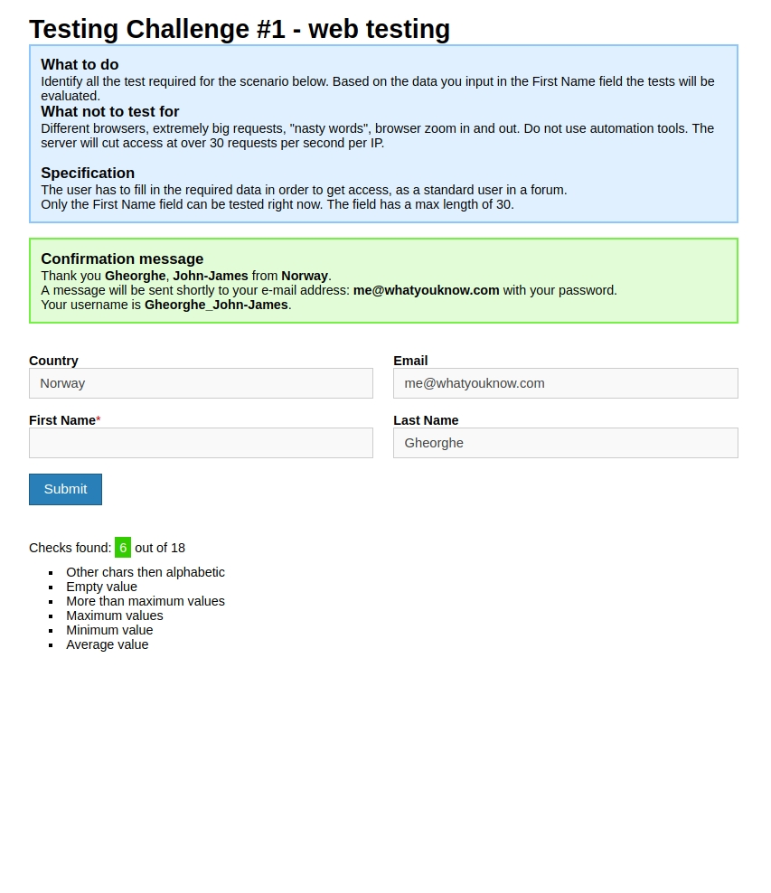
A
B
C
D

Slide 55
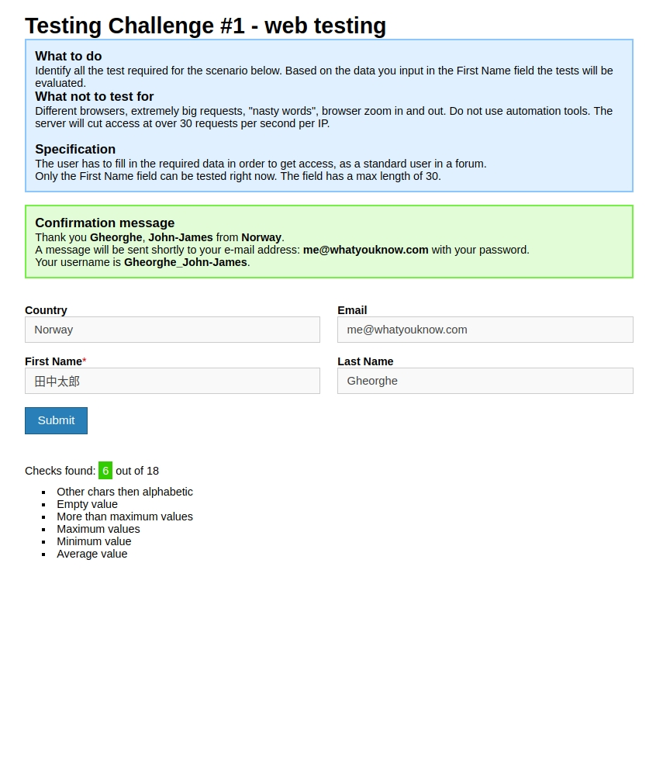
A
B
C
北海公园等
D

Slide 56
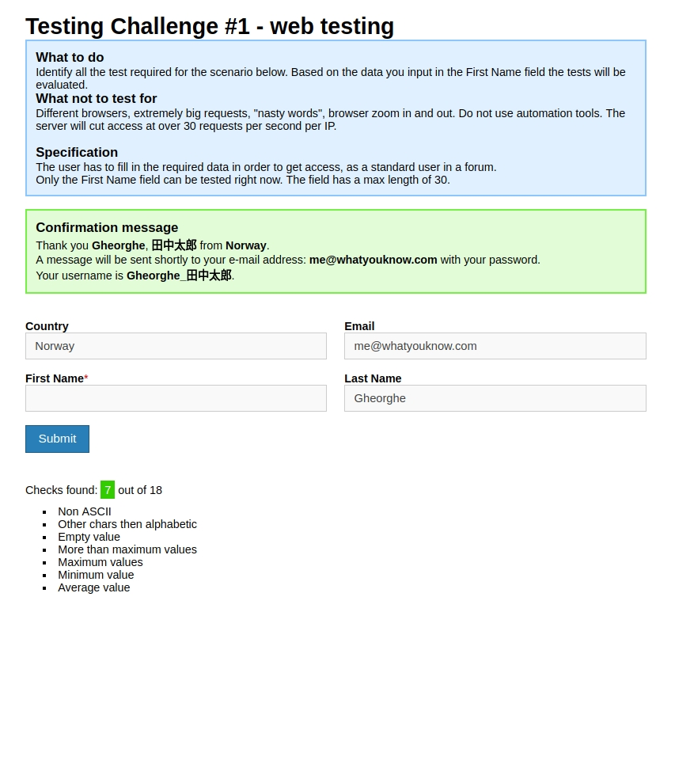
A
B
C
D

Slide 57
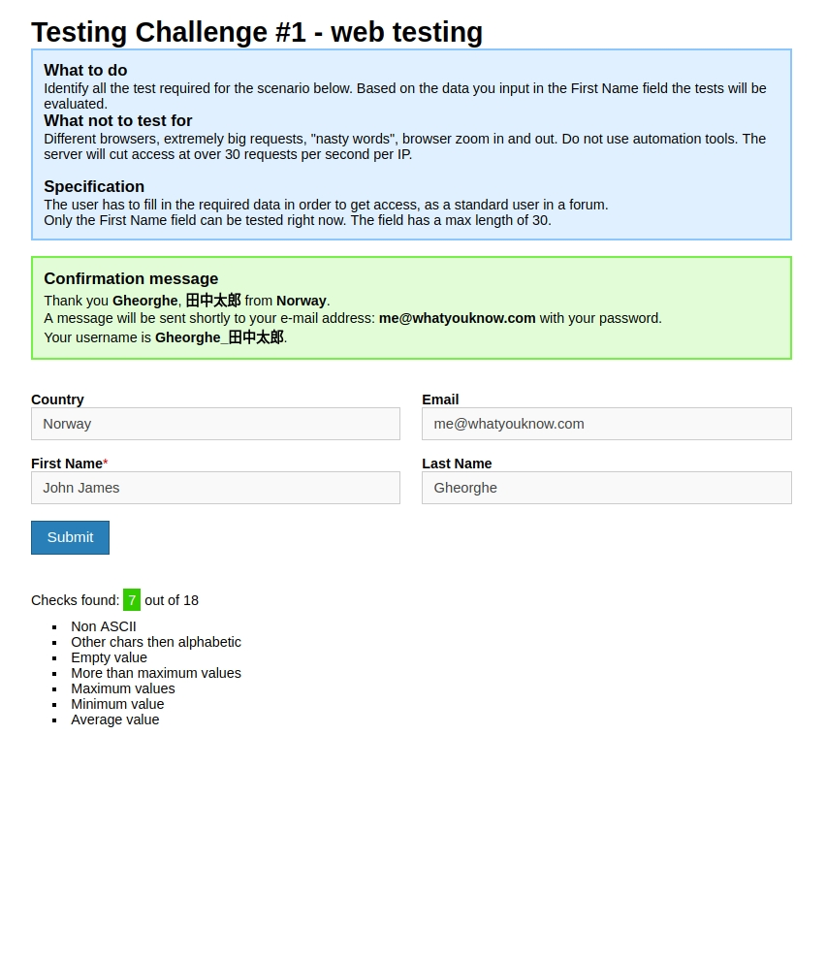
A
B
C
John James
D

Slide 58

A
B
C
D

Slide 59
A
B
C
D

Slide 60
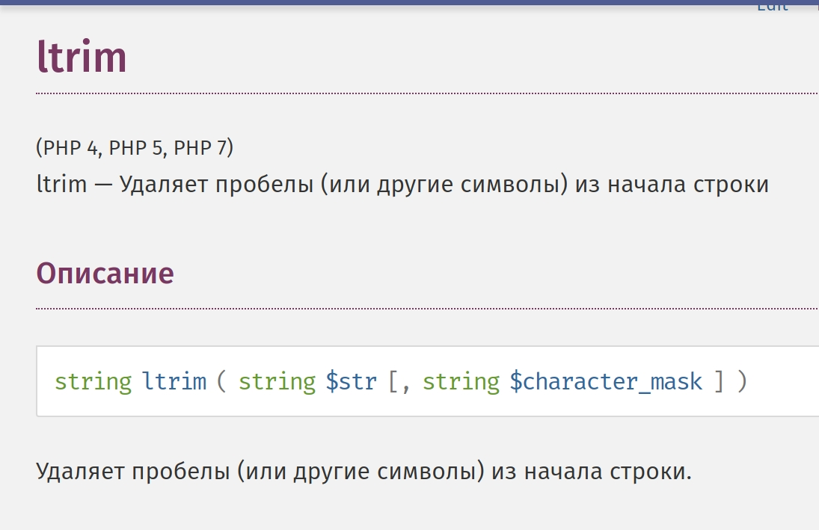

Slide 61
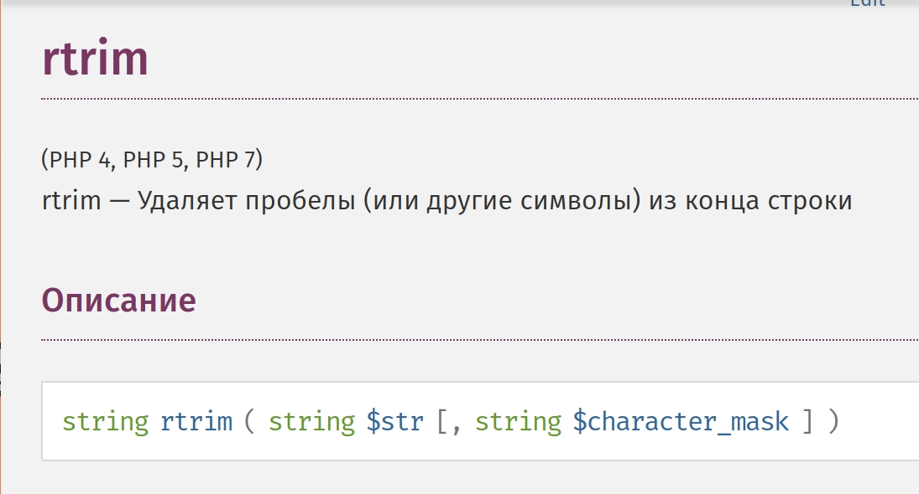

Slide 62
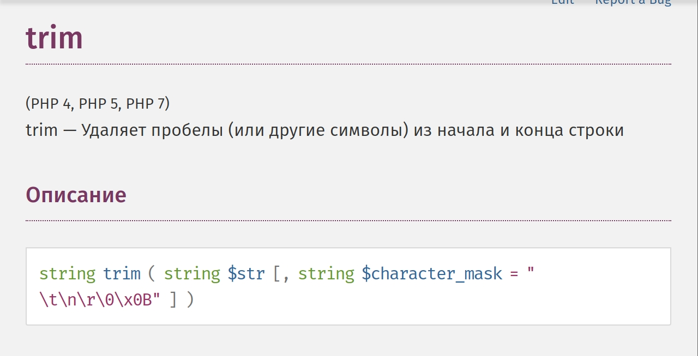

Slide 63
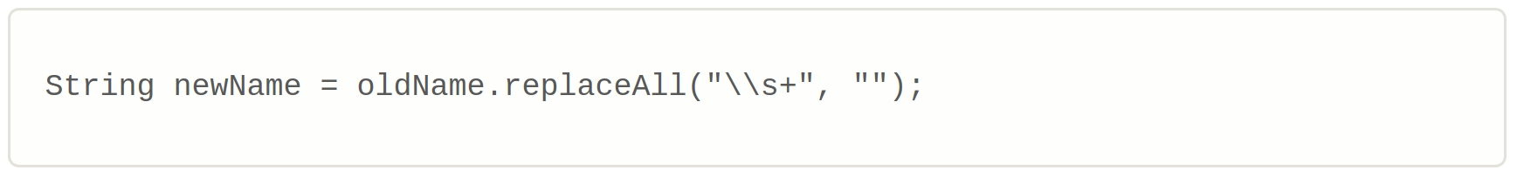

Slide 64
A
B
C
D

Slide 65

A
B
C
John James
D
There are spaces in the beginning, in the middle
and in the end of the string

Slide 66
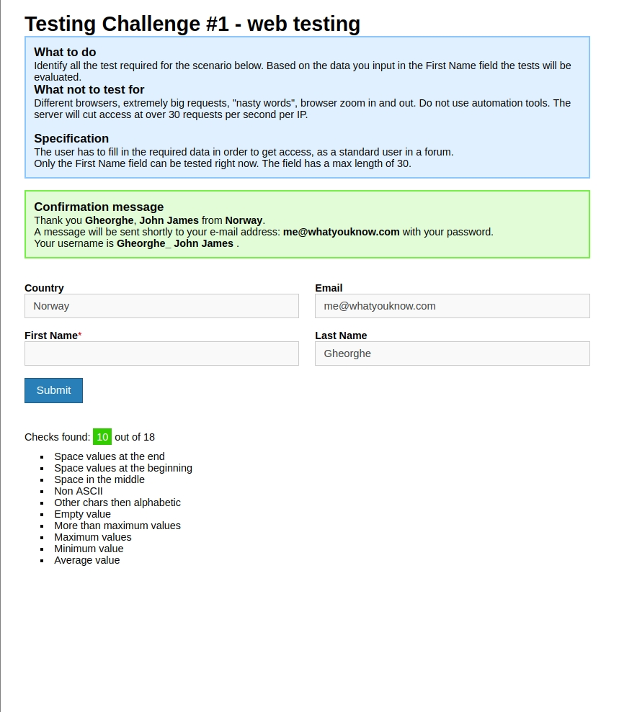
A
B
C
D

Slide 67
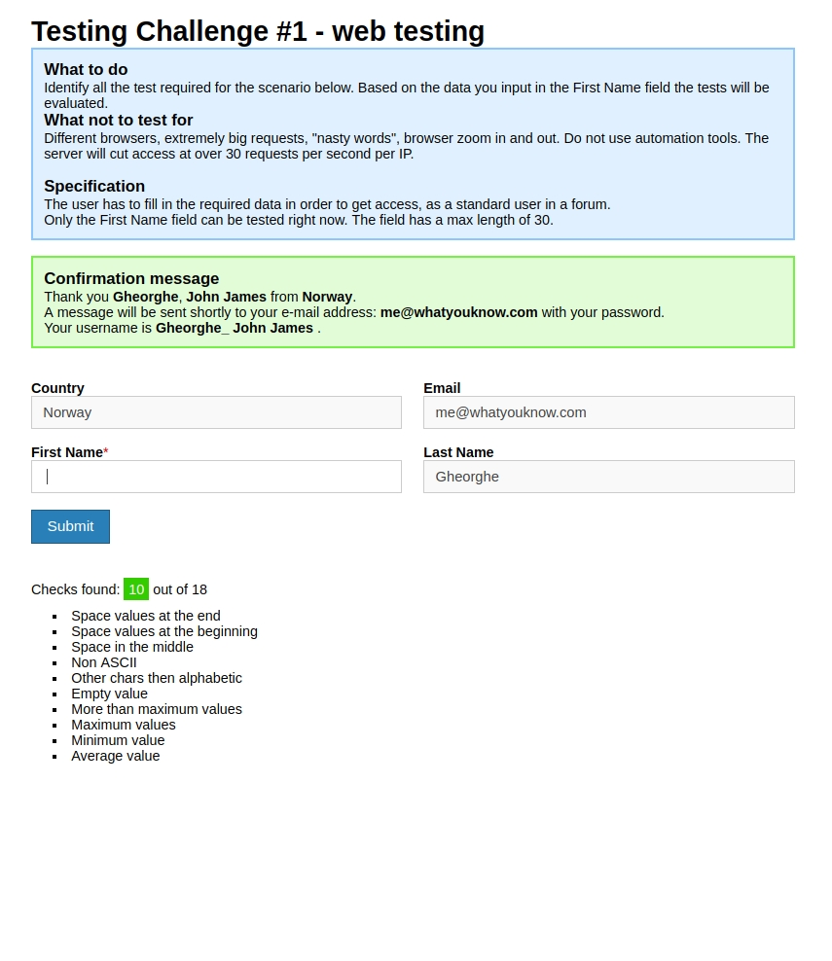
A
B
C
D
There are space here, NOT EMPTY string

Slide 68
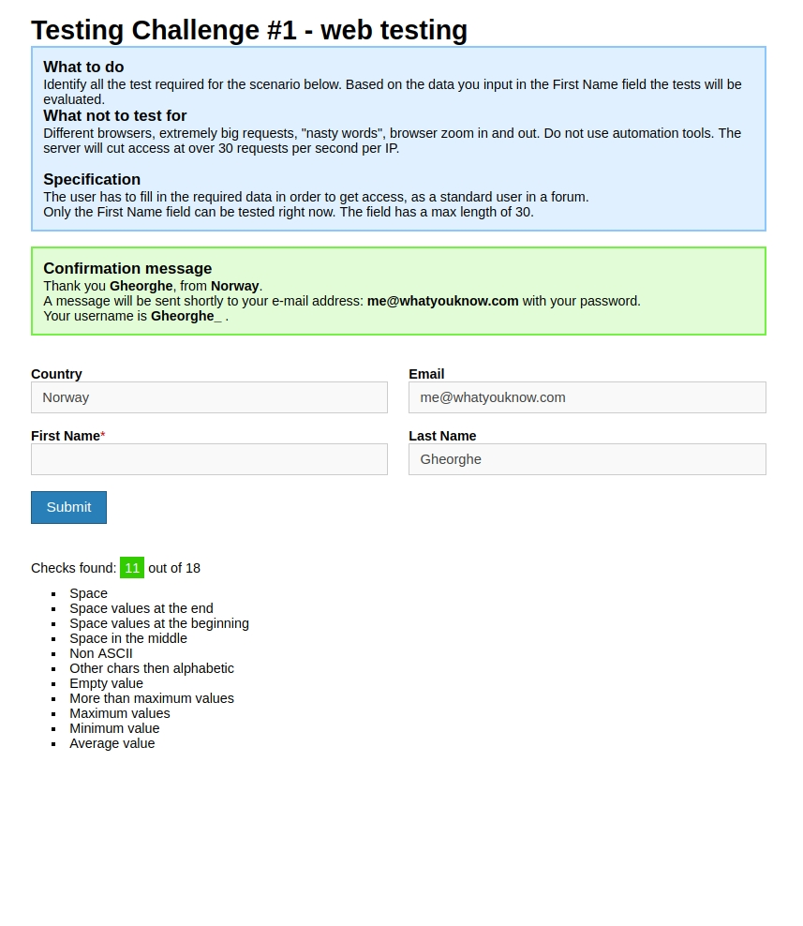
A
B
C
D

Slide 69
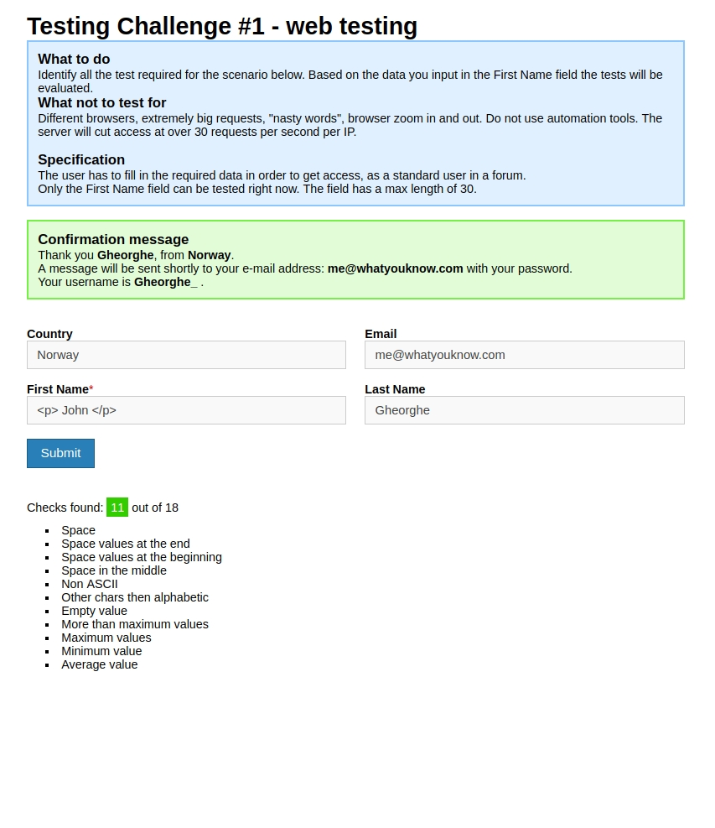
A
B
C
D

Slide 70
A
B
C
<p> John </p>
D

Slide 71
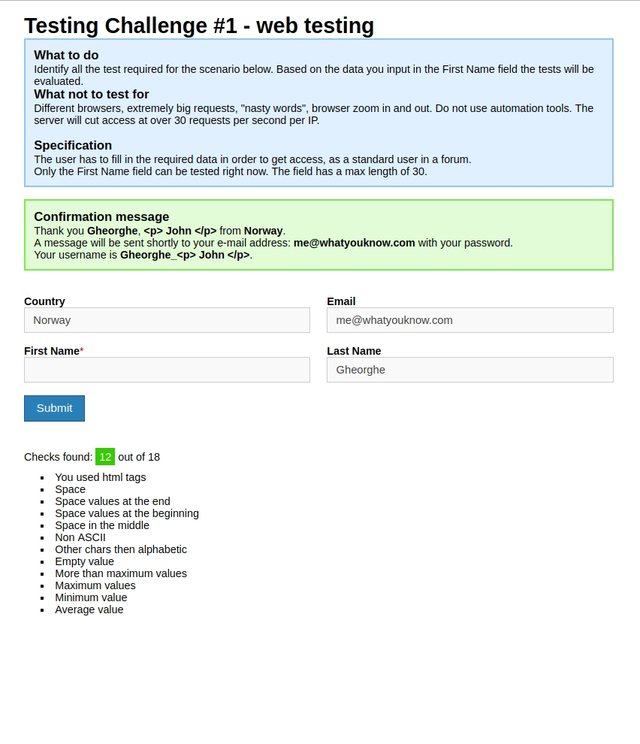
A
B
C
D

Slide 72
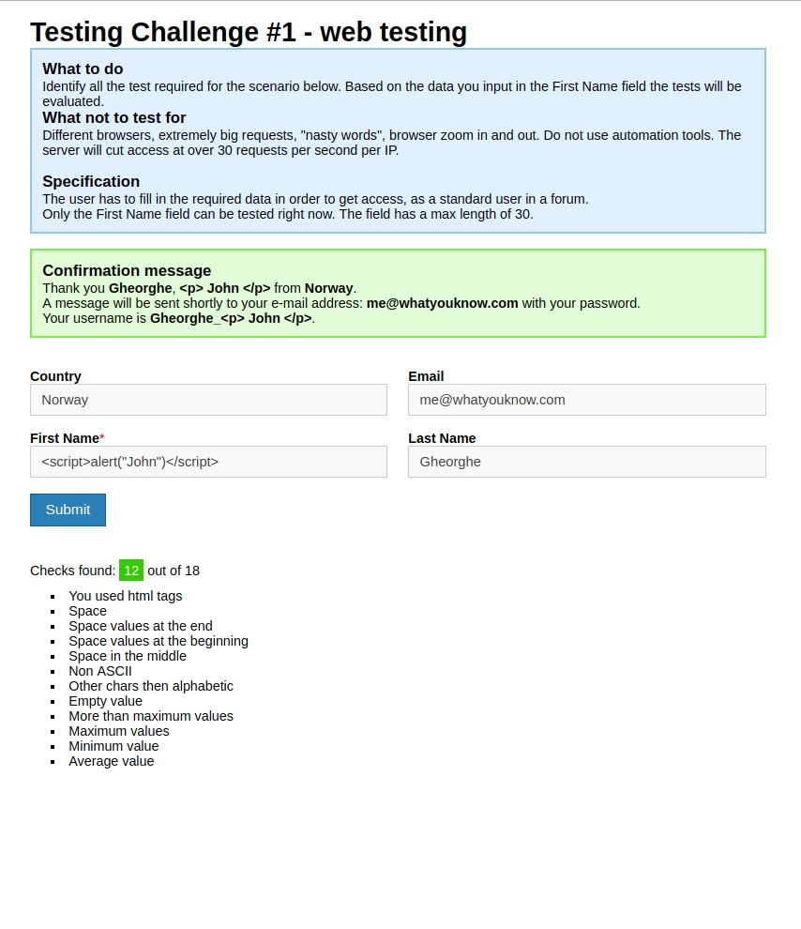
A
B
C
<script>
alert(“John”)
</script>
D

Slide 73
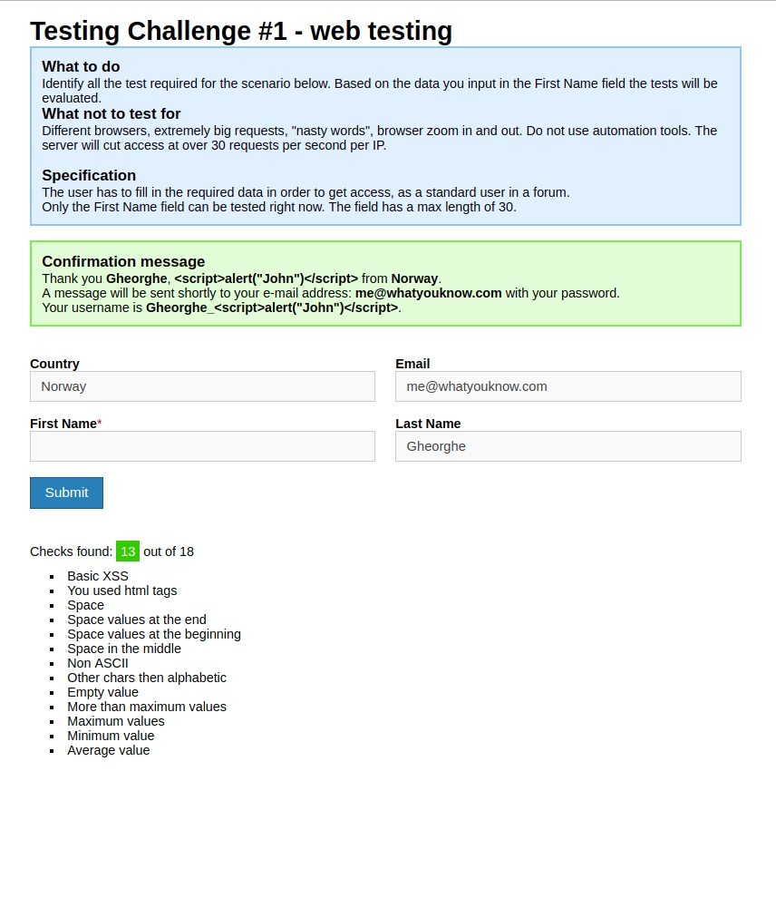
A
B
C
D

Slide 74
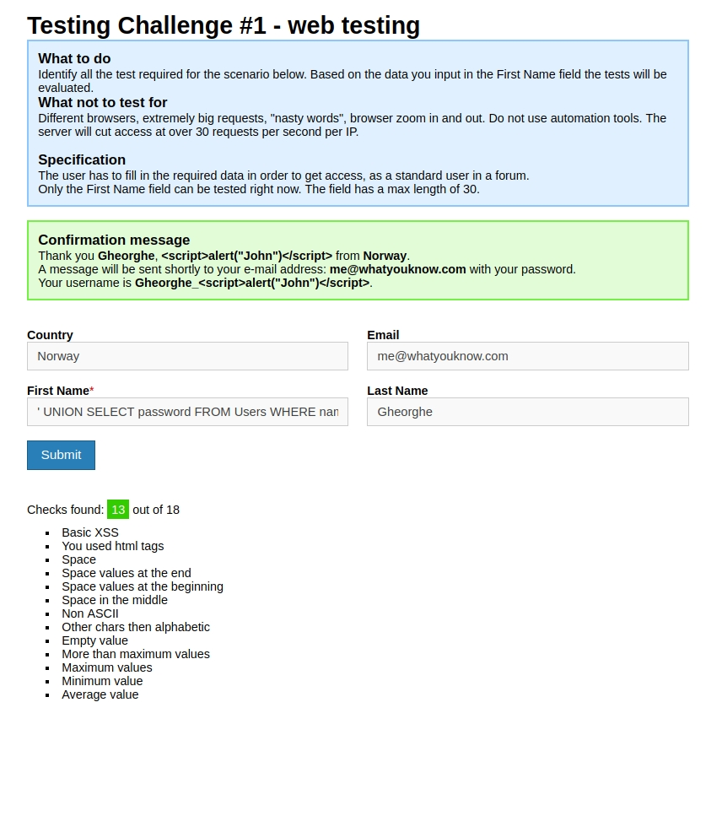
A
B
C
‘ UNION
SELECT password
FROM users
WHERE name = ‘admin’--
D

Slide 75
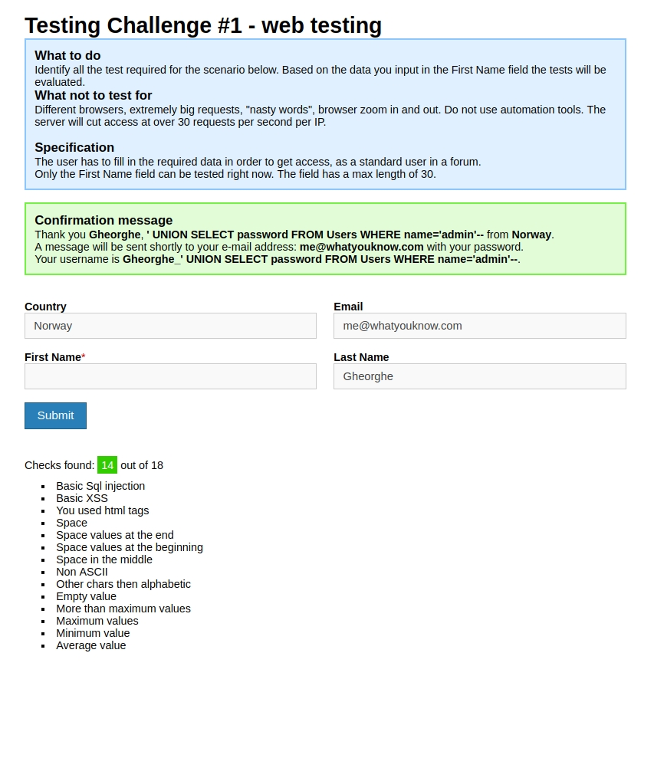
A
B
C
D

Slide 76
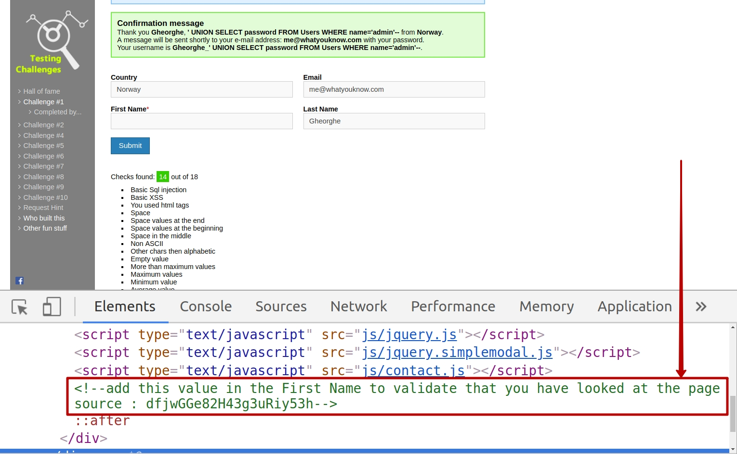

Slide 77
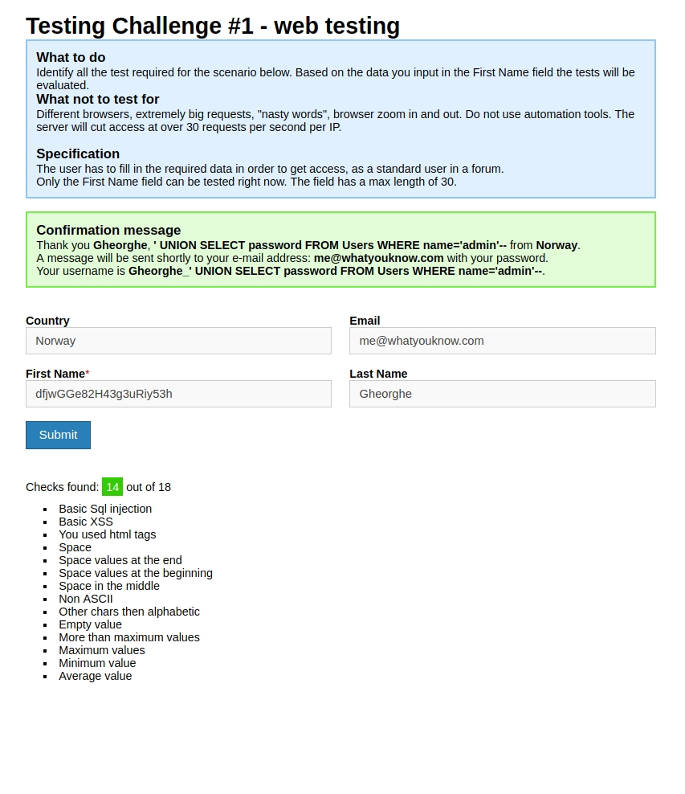
A
B
C
dfjwGGe82H43g3uRiy53h
D

Slide 78
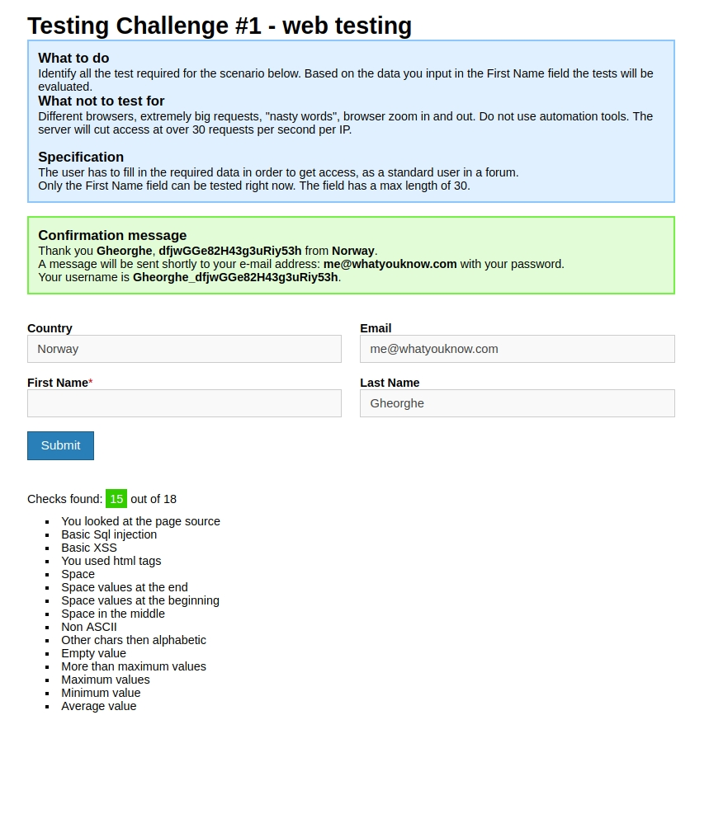
A
B
C
D

Slide 79
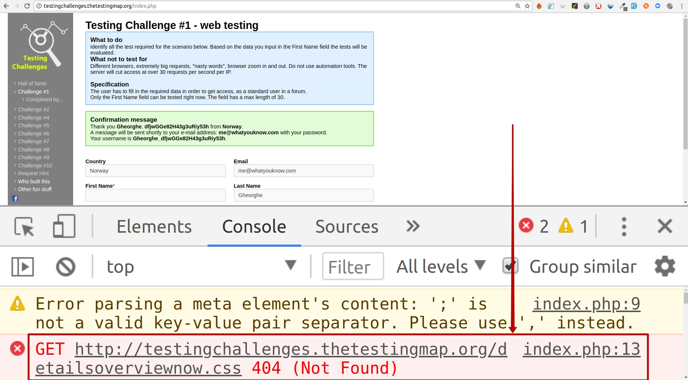

Slide 80
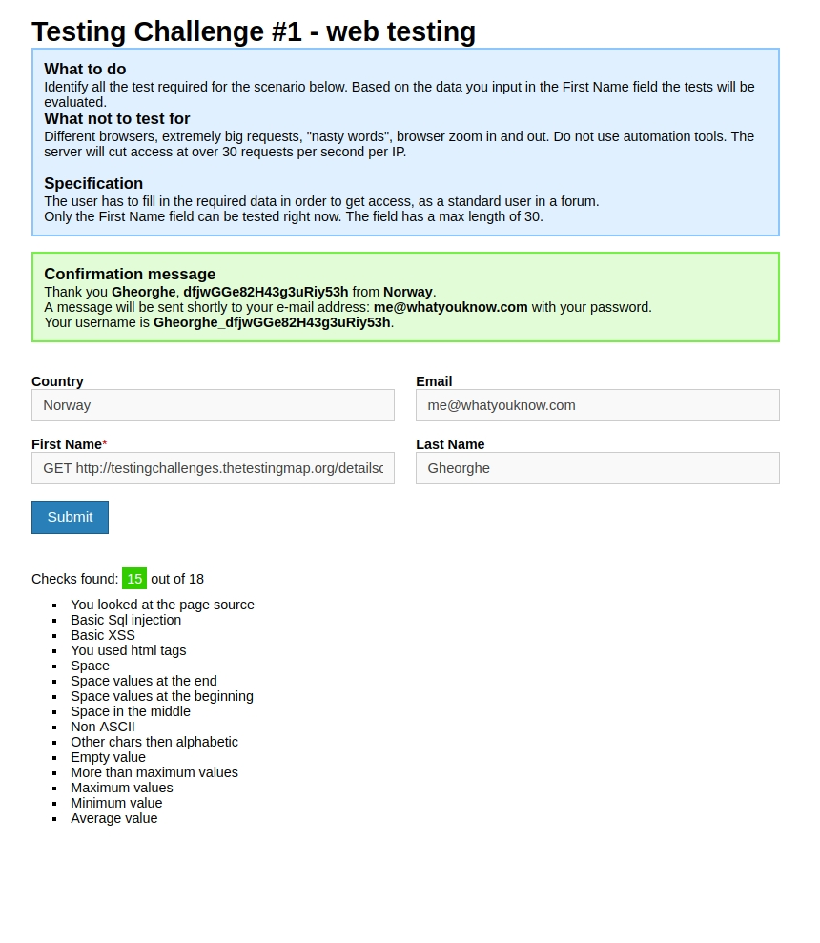
A
B
C
GET
http://testingchallenges
.thetestingmap.org
/detailsoverviewnow.css
404 (Not Found)
D

Slide 81
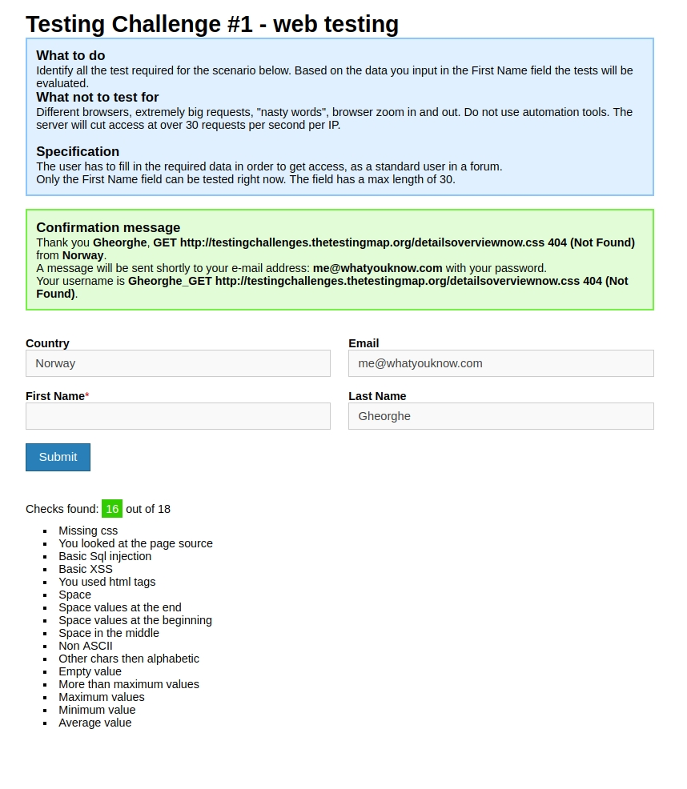
A
B
C
D

Slide 82
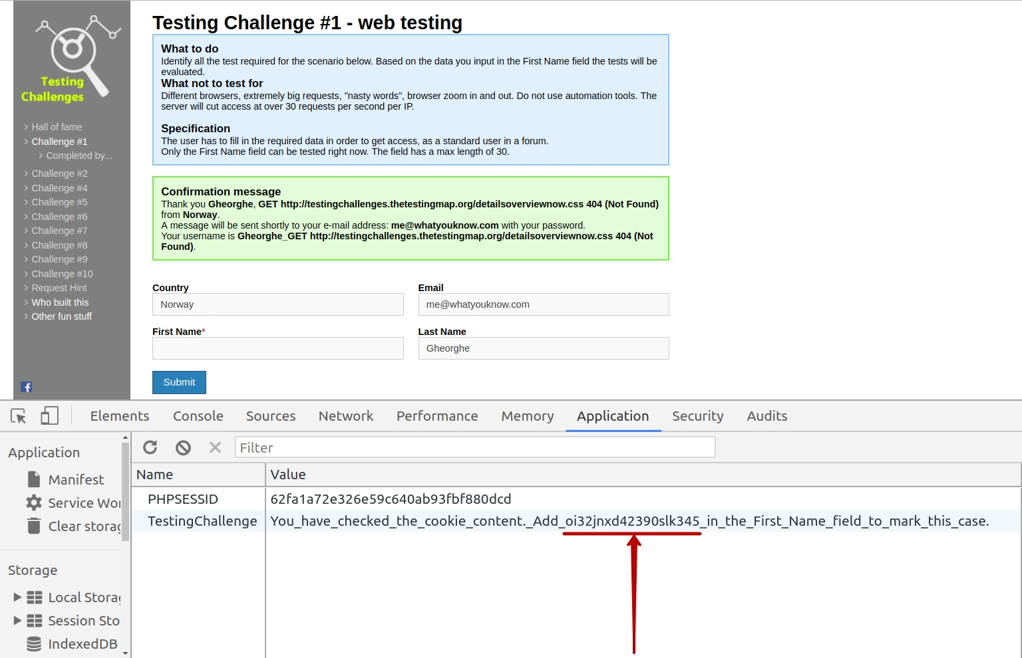

Slide 83
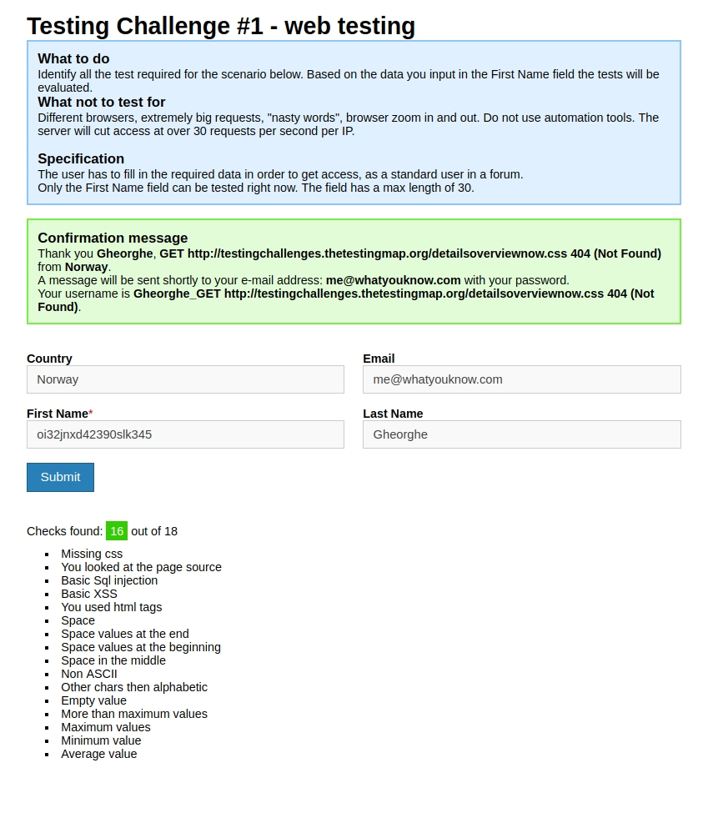
A
B
C
D
oi32jnxd42390slk345

Slide 84
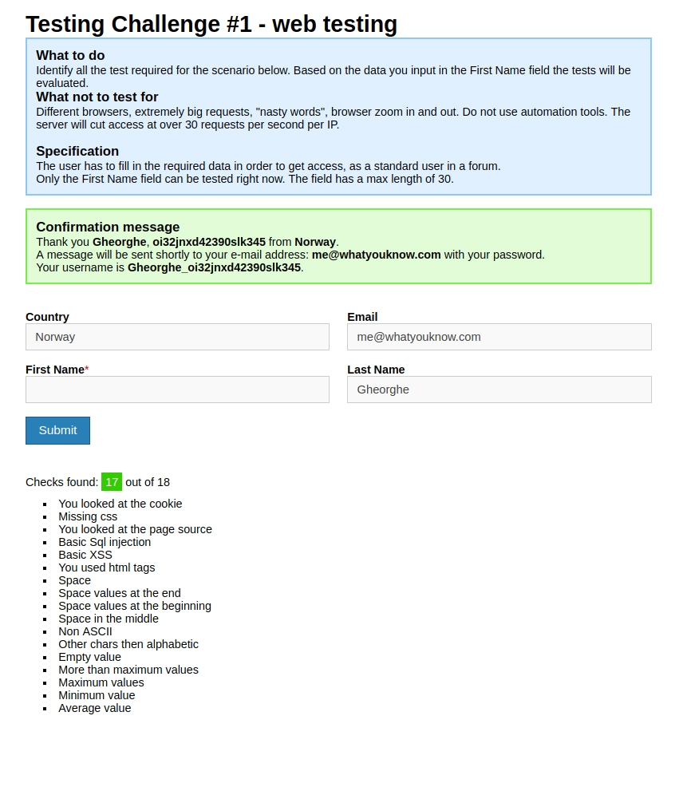
A
B
C
D

Slide 85
A
B
C
D

Slide 86
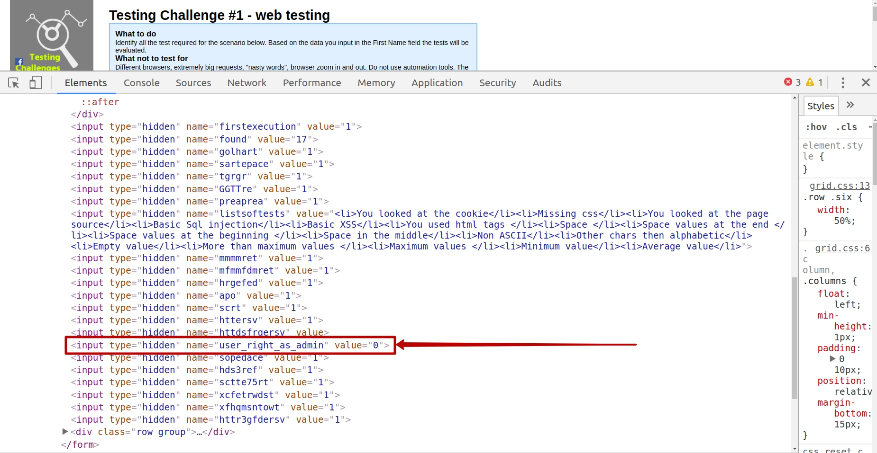

Slide 87
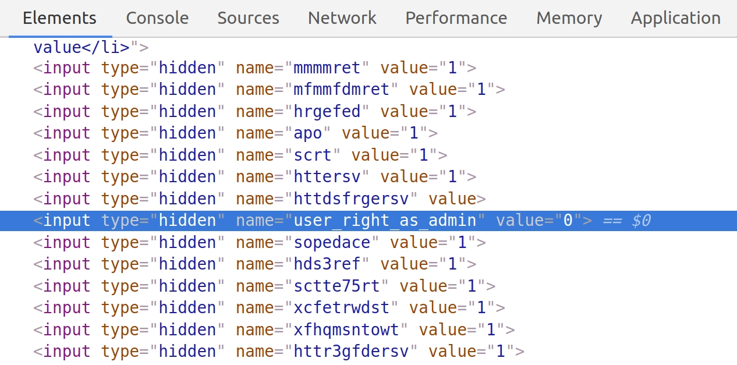

Slide 88
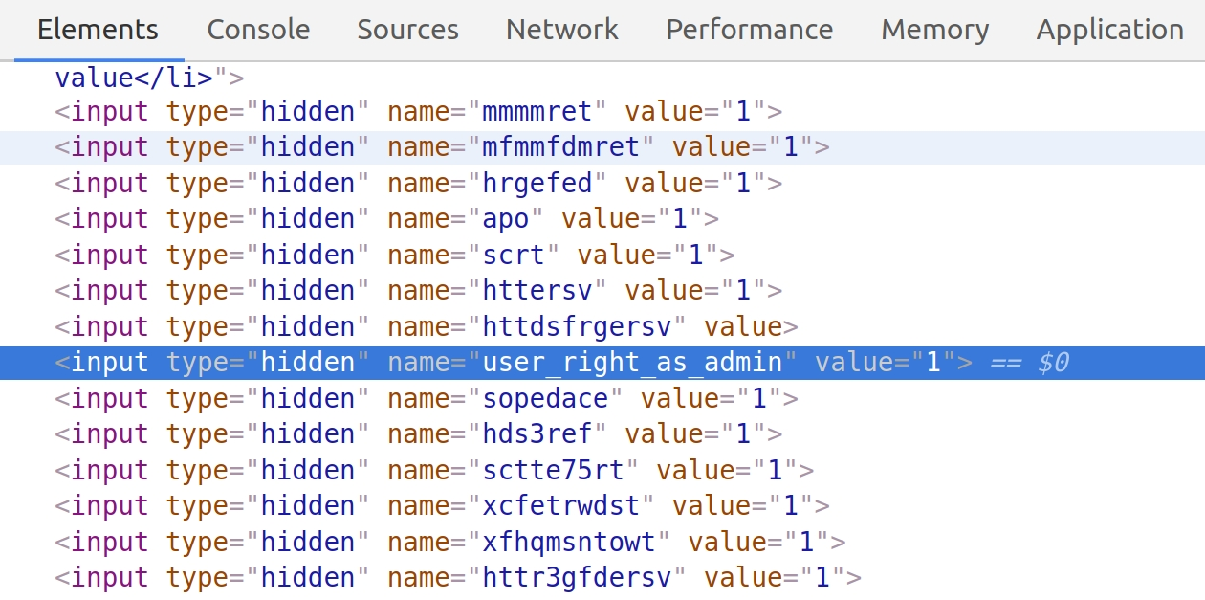

Slide 89

A
B
C
D

Slide 90


Slide 91


Slide 92


Slide 93


