Slide 1

sqadays.com
Tatiana Sintina
Epam Systems. Saint-Petersburg, Russia
How to test your team leader and how it involves your career?
Notes:
1
1

Slide 2



Your career
How to test your team leader and how it involves your career
Notes:
2
2
Существует несколько способов для связи мобильного приложения и веб версии
Самыми распространенными являются баннеры и Url-схемы. Поговорим также о тестировании перехода в приложение минуя браузер и о том, как можно тестировать индексацию ссылок.
On start of career we’re like shrubs.
We are open to all new stuffs and want to try everything with fire in eyes. So a shrub has a lot of branches in all directions.
And our manager is more like the gardener who needs to smooth our desires and put our strength of growth in the right direction. So that each of us can become a pieces of art.

Slide 3



Agenda
people
knowledge
tools
How to test your manager and how its involves your career
How to test your team leader and how it involves your career
Notes:
3
3
Согласно статистике Flurry,владельцы смартфонов проводят до 90% времени в приложениях и только 10% в браузуре. Соответственно,если пользоватль попал на ваш сайт, то основной задачей является перенаправить его в приложение и предложить совершить в нем покупку. Так как пользователи мобильных приложений чаще совершают покупки, чем аудитория веб сайтов.
Most common way how to test manager’s way of leading: people, person knowledge, used tools

Slide 4


People
Manager’s team
Managers social circle
How to test your team leader and how it involves your career

Slide 5
Manager’s team
How to test your team leader and how it involves your career
Notes:
5
5
Согласно статистике Flurry,владельцы смартфонов проводят до 90% времени в приложениях и только 10% в браузуре. Соответственно,если пользоватль попал на ваш сайт, то основной задачей является перенаправить его в приложение и предложить совершить в нем покупку. Так как пользователи мобильных приложений чаще совершают покупки, чем аудитория веб сайтов.
You and your colleagues can be united under one manager so you’re in some kind of “team of your manager”:
There is always risk to be in the pool of unskilled manager. The lower your position like junior the higher risk is.
What kind of people are in the pool?
Are they interested in work? Do they have passion for testing?
Do they discuss new technology?
What are their motivators?
What values do they have?
Do I want to work with this people in 5 years or so?

Slide 6
Managers social circle
How to test your team leader and how it involves your career
Notes:
6
6
Согласно статистике Flurry,владельцы смартфонов проводят до 90% времени в приложениях и только 10% в браузуре. Соответственно,если пользоватль попал на ваш сайт, то основной задачей является перенаправить его в приложение и предложить совершить в нем покупку. Так как пользователи мобильных приложений чаще совершают покупки, чем аудитория веб сайтов.
Managers circle
What authority your manager has inside the managers cycle (among other managers).

Slide 7

Man in the middle
Managers
Manager’s
unit
How to test your team leader and how it involves your career
Notes:
Need to find person who has connections with managers circle to obtain info about manager. It’ll make the opinion about manager more objectively.

Slide 8
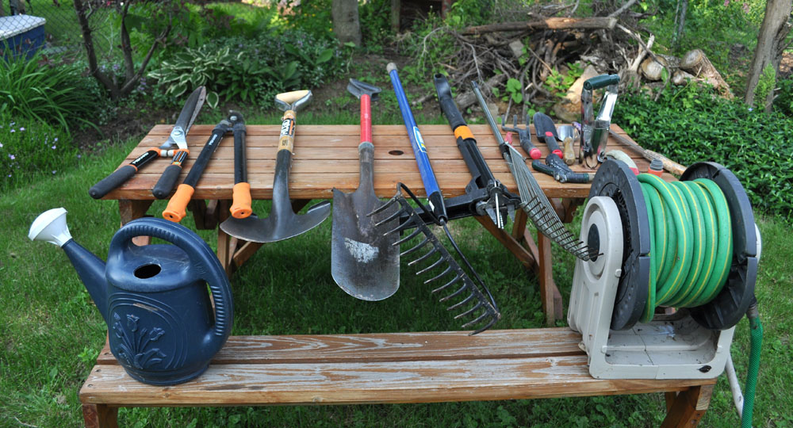
Tools
How to test your team leader and how it involves your career
Notes:
Tools can be divided in 2 parts like tools that your manager is using for growing their pool and specially for you.
Team tools:
Team trainings -> how skilled pool is
How often new knowledge is shared inside the pool
Personal tools:
Do you have 1-to-1 and personal development plan with SMART goals? Have you discussed something interesting and valuable on such meetings?
Have you been proposed to participate in some trainings?
Have you asked how to grow as tester and what response was?
How often you’re involved in non-project activities?
Are you comfortable to work with this manager?

Slide 9

Knowledge
How to test your team leader and how it involves your career
Notes:
How adequate manager’s answers on your questions?
What happened after you’ve followed advices of your manager?
What have you learned from him?
Have they participated in some conferences? If no then why?
Do they have wide vision on technologies?
Do they know/use much tools in work?
How many test types and approaches are they using? (additional)

Slide 10
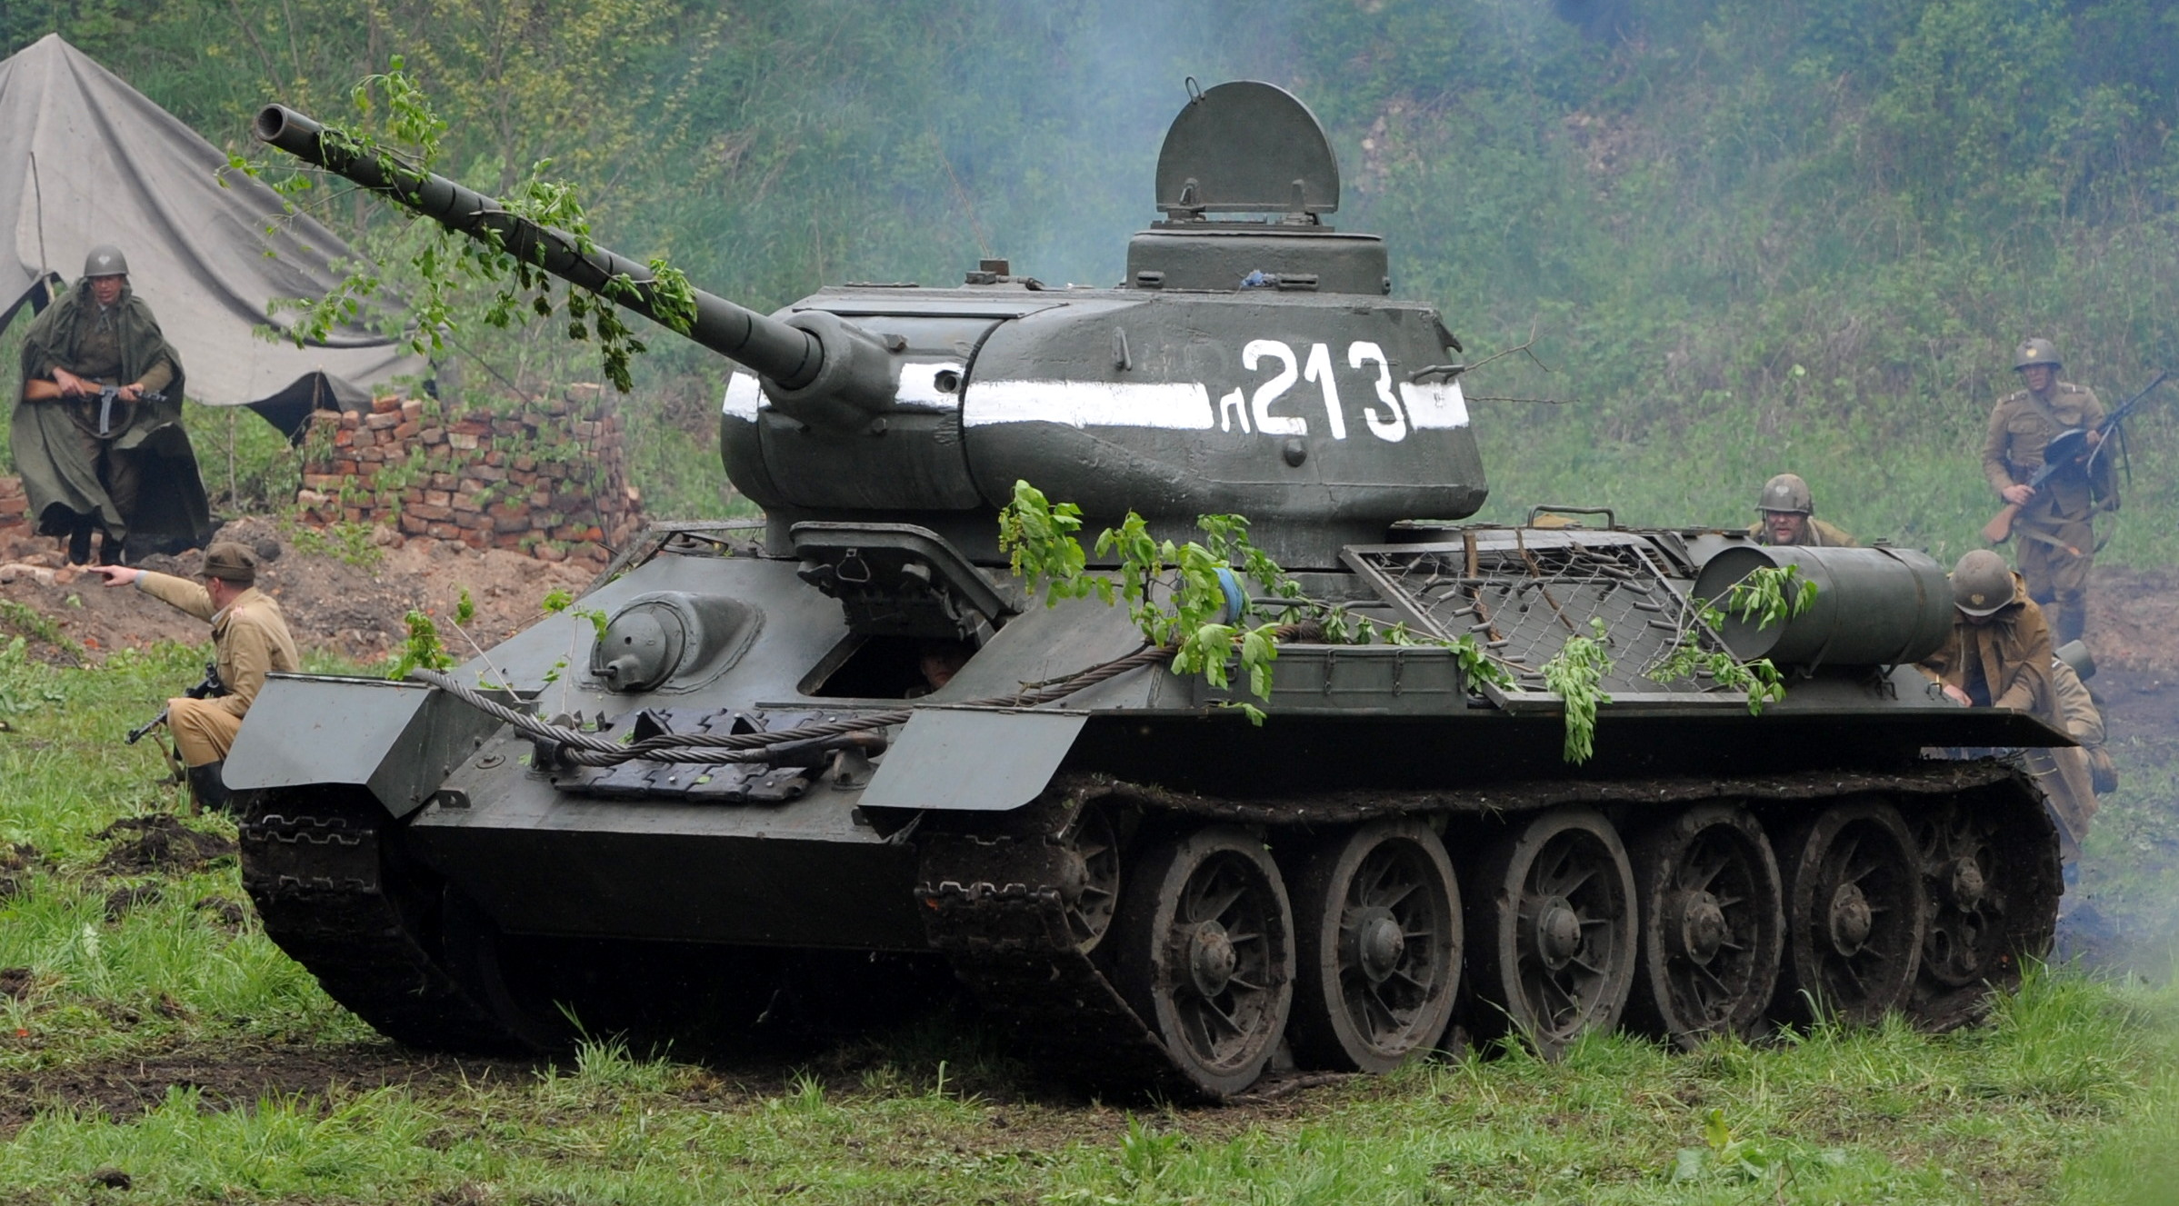
Life on the project
How to test your team leader and how it involves your career
Notes:
If you’re working with your manager on the same project you can test him “in prod”
Are they capable to overseen the problem and prevent risks
How they delegate tasks? Do you able to understand all of them? Is goals are clear and have deadline?
Do you often asked to overtime? Do all of your teammates have work to do or some of them are often free?
How precise tasks are distributed among the team? So that tasks are effectively and fast are closed
Are the capable to save the team if some of subordinates are unable to cope with tasks?

Slide 11
Thank you for your attention
Q&A
How to test your manager and how its involves your career
How to test your team leader and how it involves your career
Notes:
11
11

