Slide 1

CTG eXperience Day: Oct. 17th 2013
Reducing your testing efforts… magically!
Michaël Pilaeten
#CTGXP
@mpilaeten

Slide 2

Magic?

Slide 3
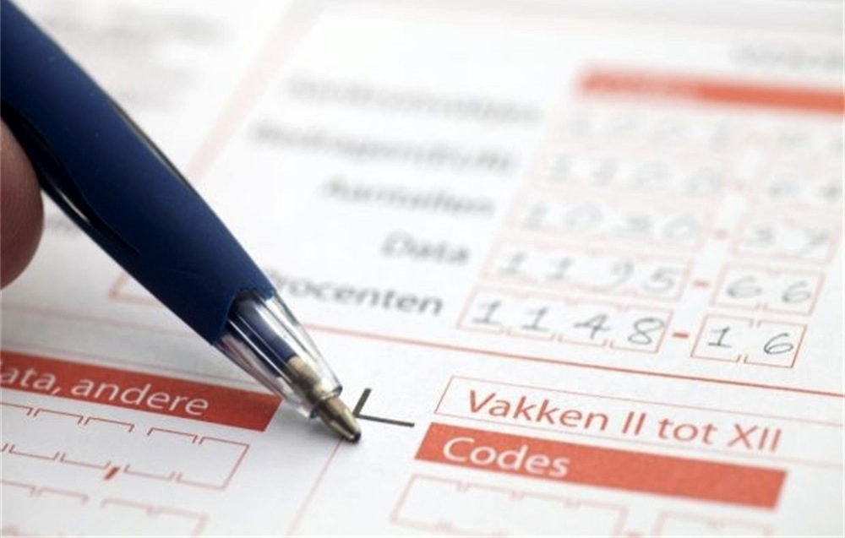

Slide 4

Huh?

Slide 5

simplification

Slide 6
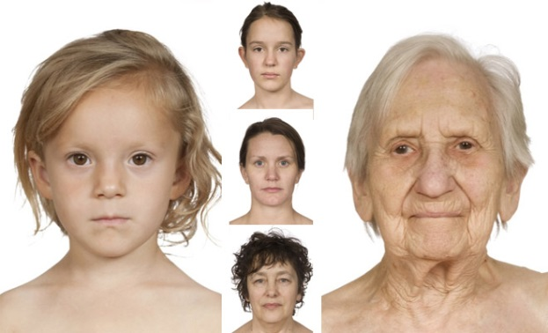



civil status
residence
age

Slide 7

How many test cases do you need?

Slide 8
Again….

Slide 9





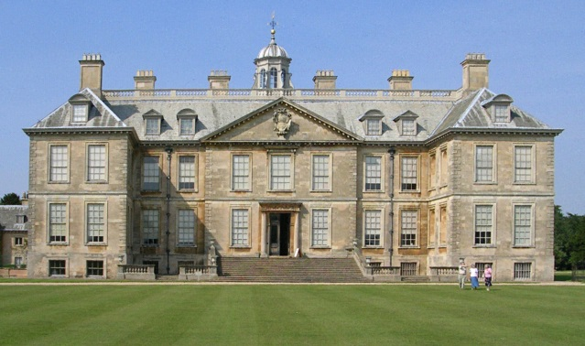

civil status
residence
age
wage
work
savings
ecological
children
properties
charity

Slide 10
How many test cases do you need?
All combinations
One test per combination
No negative tests

Slide 11

5 x 3 x 3 x 5 x 6 x 7 x 6 x 8 x 8 x 10
= 36.288.000 test cases
Writing a test case: 4 minutes
Executing a test case: 1 minute
36.288.000 test cases x 5 minutes
= 181.440.000 minutes of testing
= 378.000 man days of testing
= 2016 man years of testing

Slide 12
One more thing….

Slide 13
















Slide 14

Alternatives?
Notes:
Outsourcing / offshoring
Test automation
Or…
Not testing everything (cherry picking)
RRBT

Slide 15


Slide 16

Automation?

Slide 17

CHERRY
PICKING

Slide 18

Notes:
Risk and requirement based testing: writing and executing the test cases which poses the highest risk of malfunctioning.
Pro:
- functionalities with highest risk will most likely work
Con:
- how to make the risk assessment (based on)?
- what with low risk areas which are used a lot? (customer satisfaction)

Slide 19
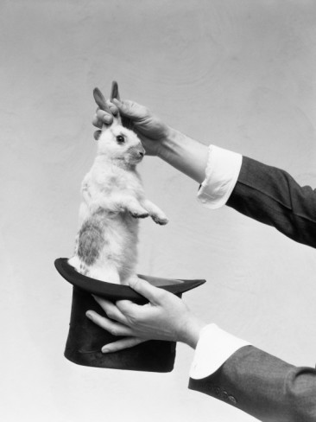

Slide 20

Bug research

Slide 21


Single mode
Double mode
Notes:
Research shows that over 99,8% of all defects and incidents reported are either single-mode defects or double-mode defects.
Single mode: one mistake in the code results in a defect that shows up during executiuon
Double mode: two combined mistakes in the code result in a defect that shows up during execution
The change for a Three (or higher) mode defect in the code, after all single mode and double mode defects are found, is below 0,02%.

Slide 22
The solution …

Slide 23
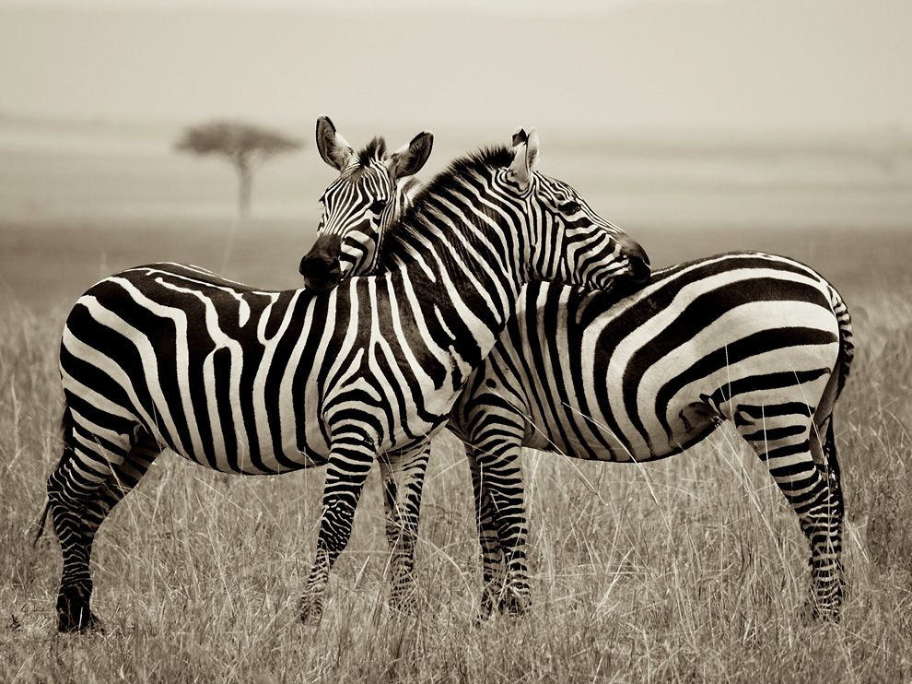
Pairwise Testing

Slide 24
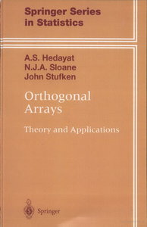

Slide 25
Binary orthogonal arrays are easy !
Only yes/no options
Conditions | TC 1 | TC 2 | TC 3 | TC 4 | TC 5 | TC 6
Condition 1
Condition 2
Condition 3
Condition 4
Condition 5
1
1
0
0
0
0
1
0
1
0
0
0
1
0
0
1
0
0
1
0
0
0
1
0
1
0
0
0
0
1
Step 1: # TC = (# conditions + 1)
Step 2: TC 1 all true
Step 3: Left diagonal true
Step 4: Remaining untrue

Slide 26
Binary orthogonal arrays are easy !
Only yes/no options
Conditions | TC 1 | TC 2 | TC 3 | TC 4 | TC 5 | TC 6
Condition 1
Condition 2
Condition 3
Condition 4
Condition 5
1
1
0
0
0
0
1
0
1
0
0
0
1
0
0
1
0
0
1
0
0
0
1
0
1
0
0
0
0
1
single mode defects
Each single condition value is tested
Each couple of condition values is tested
double mode defects

Slide 27
Binary orthogonal arrays are easy !
Only yes/no options
Conditions | TC 1 | TC 2 | TC 3 | TC 4 | TC 5 | TC 6
Condition 1
Condition 2
Condition 3
Condition 4
Condition 5
1
1
0
0
0
0
1
0
1
0
0
0
1
0
0
1
0
0
1
0
0
0
1
0
1
0
0
0
0
1
100% certainty of finding all combinatorial defects
2⁵ or 2 x 2 x 2 x 2 x 2 = 32 -> 32 Test Cases

Slide 28
Binary orthogonal arrays are easy !
Only yes/no options
Conditions | TC 1 | TC 2 | TC 3 | TC 4 | TC 5 | TC 6
Condition 1
Condition 2
Condition 3
Condition 4
Condition 5
1
1
0
0
0
0
1
0
1
0
0
0
1
0
0
1
0
0
1
0
0
0
1
0
1
0
0
0
0
1
100% certainty of finding all combinatorial defects
99,8% certainty of finding all combinatorial defects
32 Test Cases
6 Test Cases

Slide 29
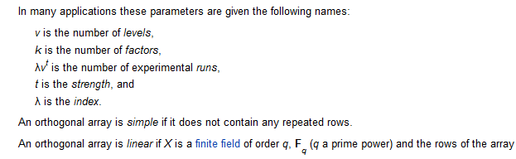

Non-Binary orthogonal arrays…

Slide 30
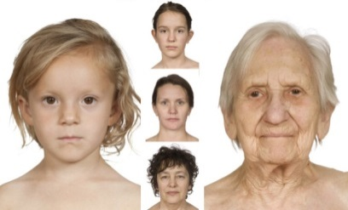







Age:
3 possibilities
Savings:
8 possibilities
Civil status:
5 possibilities
Residence:
3 possibilities
Children:
6 possibilities
Ecological:
10 possibilities
Properties:
6 possibilities
Wage:
7 possibilities
Work:
5 possibilities
Charity:
8 possibilities

Slide 31
Age:
3 possibilities
Savings:
8 possibilities
Civil status:
5 possibilities
Residence:
3 possibilities
Children:
6 possibilities
Ecological:
10 possibilities
Properties:
6 possibilities
Wage:
7 possibilities
Work:
5 possibilities
Charity:
8 possibilities
We need this* orthogonal array:
L 10¹
* or larger

Slide 32
Age:
3 possibilities
Savings:
8 possibilities
Civil status:
5 possibilities
Residence:
3 possibilities
Children:
6 possibilities
Ecological:
10 possibilities
Properties:
6 possibilities
Wage:
7 possibilities
Work:
5 possibilities
Charity:
8 possibilities
We need this* orthogonal array:
L 10¹
8²
* or larger

Slide 33
Age:
3 possibilities
Savings:
8 possibilities
Civil status:
5 possibilities
Residence:
3 possibilities
Children:
6 possibilities
Ecological:
10 possibilities
Properties:
6 possibilities
Wage:
7 possibilities
Work:
5 possibilities
Charity:
8 possibilities
We need this* orthogonal array:
L 10¹
8²
7¹
* or larger

Slide 34
Age:
3 possibilities
Savings:
8 possibilities
Civil status:
5 possibilities
Residence:
3 possibilities
Children:
6 possibilities
Ecological:
10 possibilities
Properties:
6 possibilities
Wage:
7 possibilities
Work:
5 possibilities
Charity:
8 possibilities
We need this* orthogonal array:
L 10¹
8²
7¹
6²
* or larger

Slide 35
Age:
3 possibilities
Savings:
8 possibilities
Civil status:
5 possibilities
Residence:
3 possibilities
Children:
6 possibilities
Ecological:
10 possibilities
Properties:
6 possibilities
Wage:
7 possibilities
Work:
5 possibilities
Charity:
8 possibilities
We need this* orthogonal array:
L 10¹
8²
7¹
6²
5²
* or larger

Slide 36
Age:
3 possibilities
Savings:
8 possibilities
Civil status:
5 possibilities
Residence:
3 possibilities
Children:
6 possibilities
Ecological:
10 possibilities
Properties:
6 possibilities
Wage:
7 possibilities
Work:
5 possibilities
Charity:
8 possibilities
We need this* orthogonal array:
L 10¹
8²
7¹
6²
5²
3²
* or larger

Slide 37

Catalogs of Non-Binary orthogonal arrays:
http://neilsloane.com/oadir/index.html
http://www.york.ac.uk/depts/maths/tables/orthogonal.htm
The Taguchi Orthogonal Array Selector:
http://www.freequality.org/documents/tools/Tagarray_files/tamatrix.htm

Slide 38


Slide 39



James Bach
@jamesmarcusbach
www.satisfice.org

Slide 40
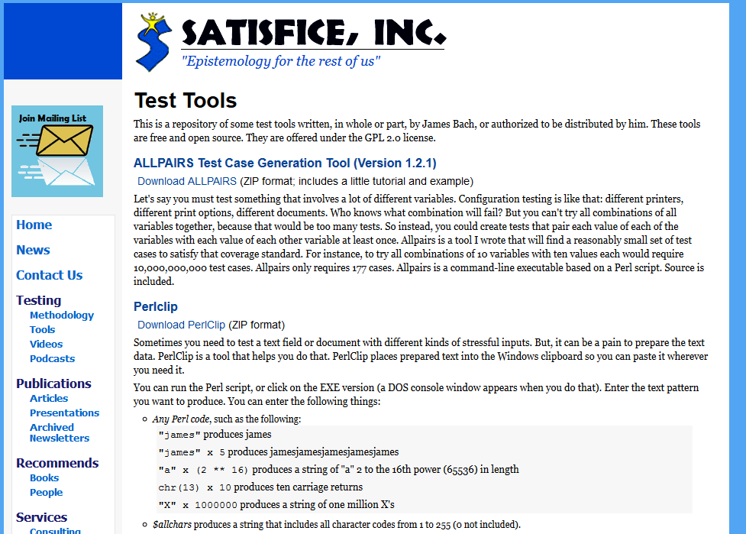

Slide 41
5 x 3 x 3 x 5 x 6 x 7 x 6 x 8 x 8 x 10
= 36.288.000 test cases
Writing a test case: 4 minutes
Executing a test case: 1 minute
36.288.000 test cases x 5 minutes
= 181.440.000 minutes of testing
= 2016 man years of testing
Allpairs algorithm:
= 97 test cases
97 test cases x 5 minutes
= 485 minutes of testing
= 1 man day of testing
1 man day versus 2016 man years ?
Notes:
378.000 x less effort

Slide 42

99,8% is not 100%
Different types of tests
Defect taxonomy

Slide 43

REDUCE
FOCUS

