Slide 1
When SF become the tester’s reality
Deep Learning and IoT testing Light talk by Jaroslaw Hryszko

Slide 2
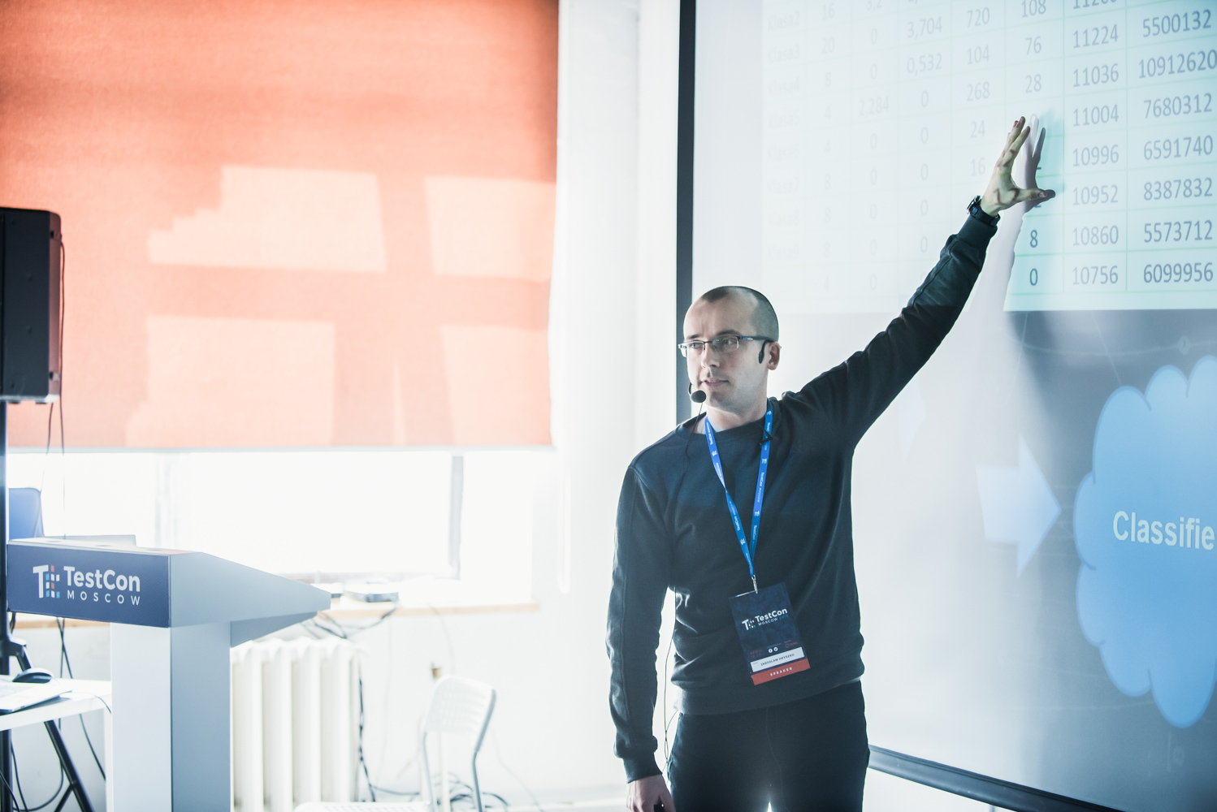
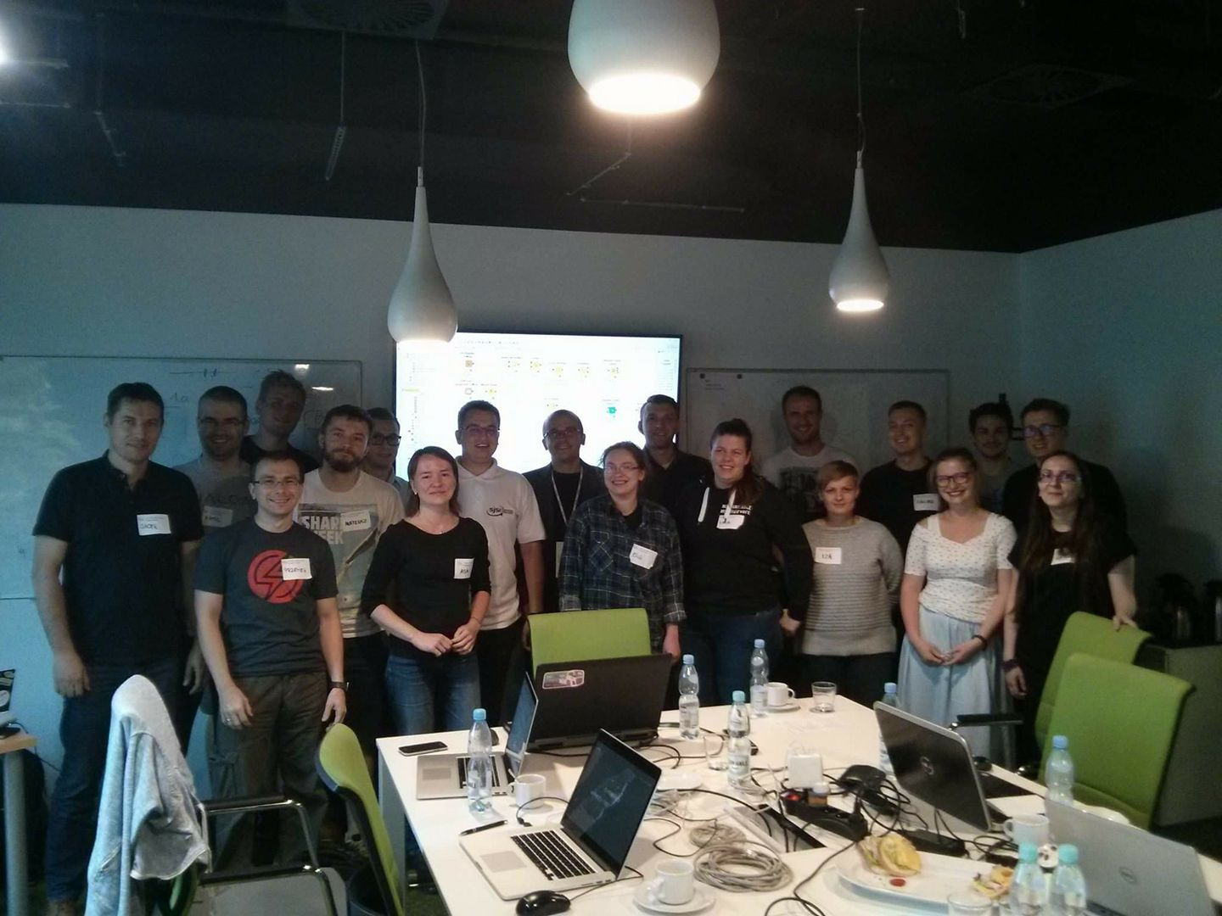
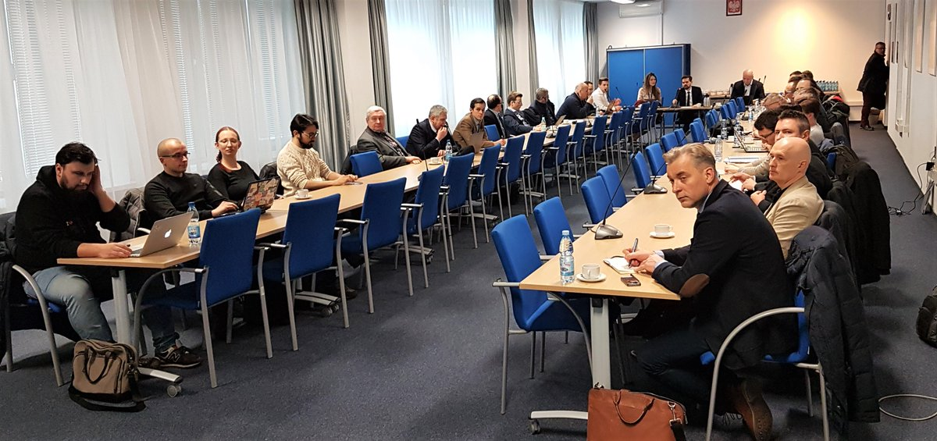
Jarosław Hryszko, SJSI – Polish Testing Board

Slide 3

INTERNET OF THINGS!!!

Slide 4
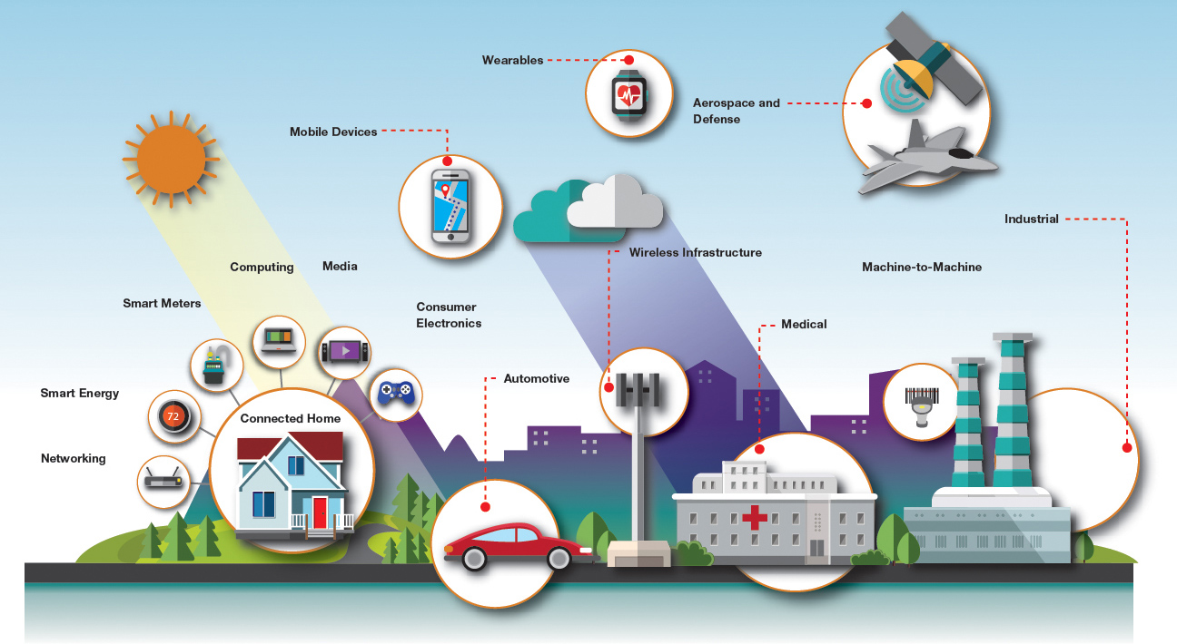

Slide 5
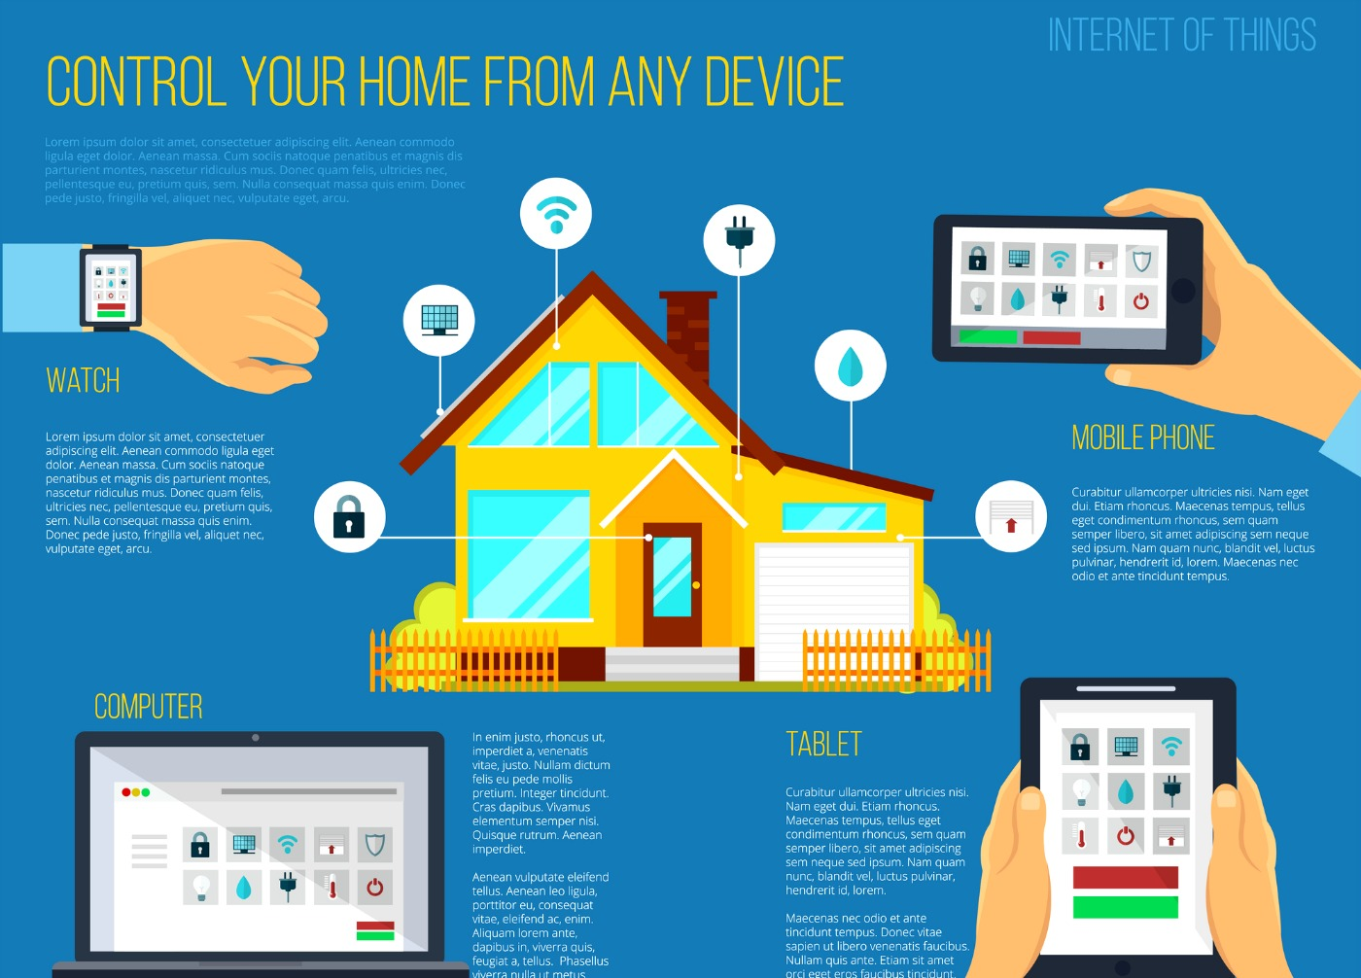

Slide 6
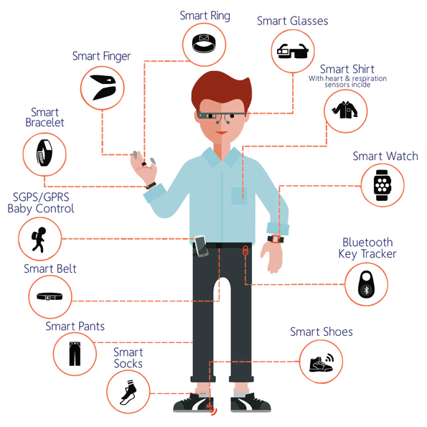

Slide 7
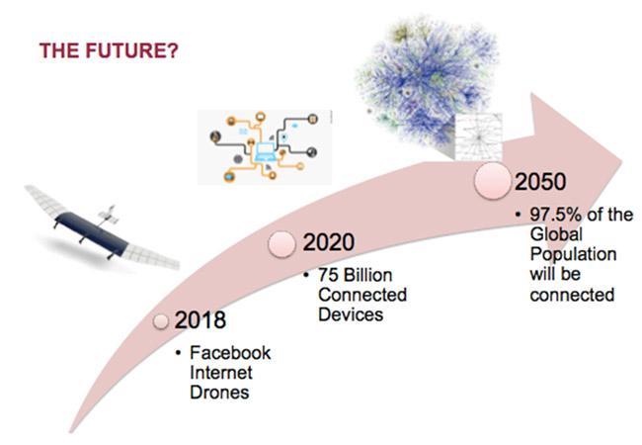

Slide 8


Slide 9
7.5 Billion humans on Earth

Slide 10

Is there any way to test all of these?

Slide 11

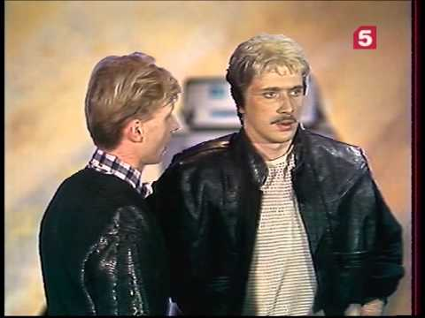

Slide 12
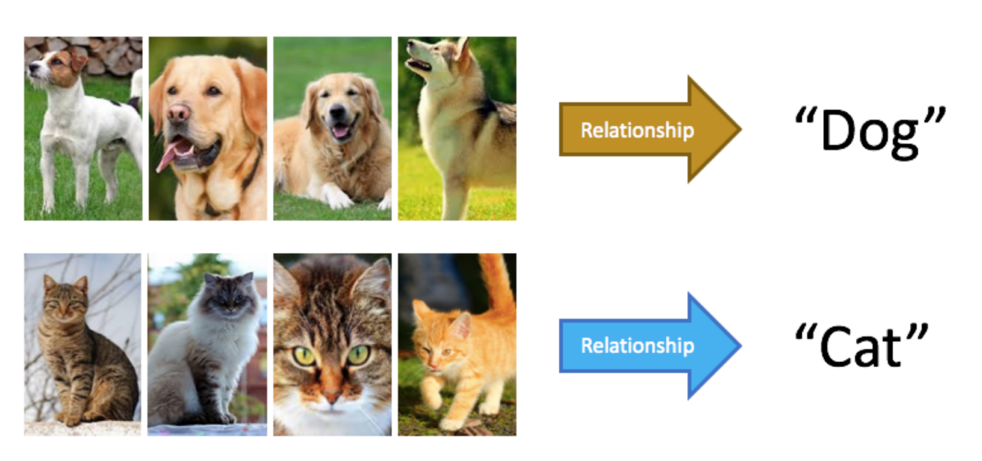
Deep Learning

Slide 13
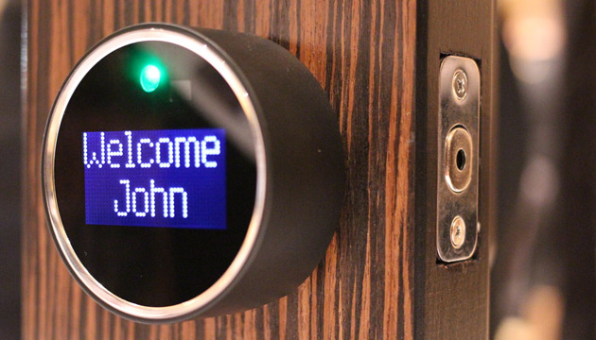
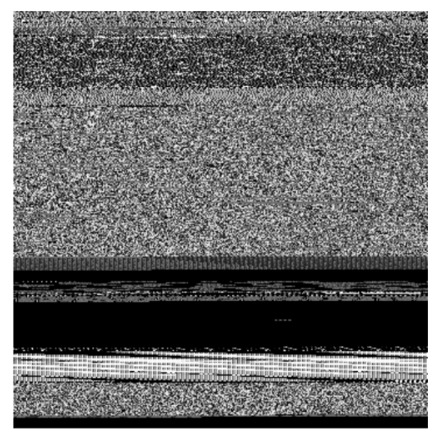
IoT devices generate a lot of data

Slide 14
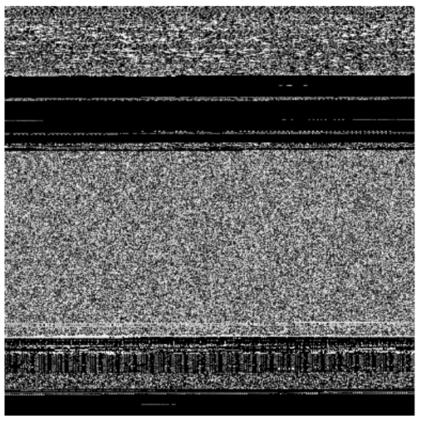

...DL can be trained using examples...

Slide 15

...to proactively react to any defects!

Slide 16
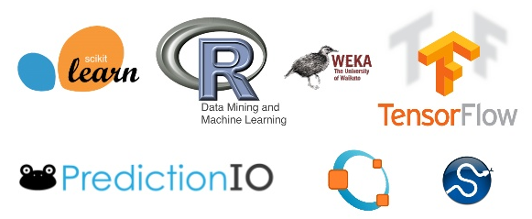

Slide 17
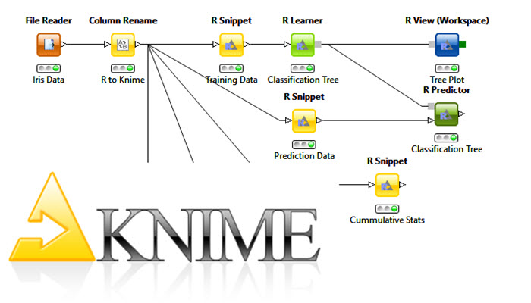
www.knime.com
Based on Eclipse
Distributed under GPL v3 licence

Slide 18
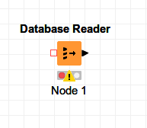

Slide 19
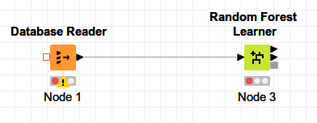

Slide 20
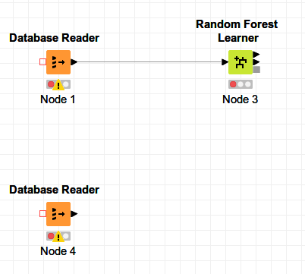

Slide 21
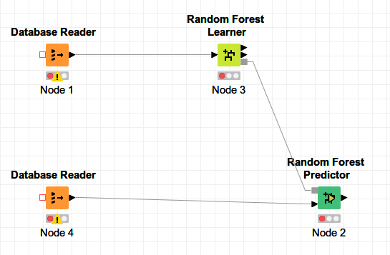

Slide 22
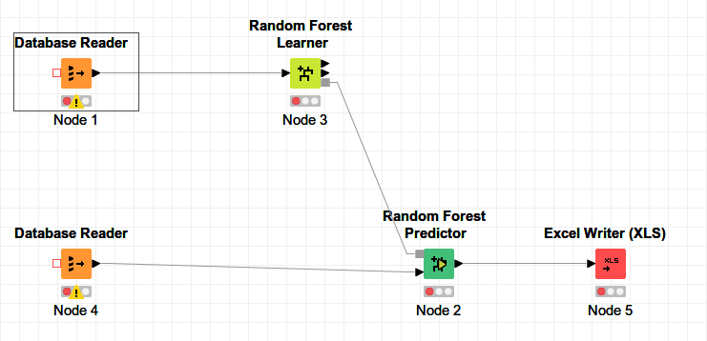


Slide 23


Slide 25
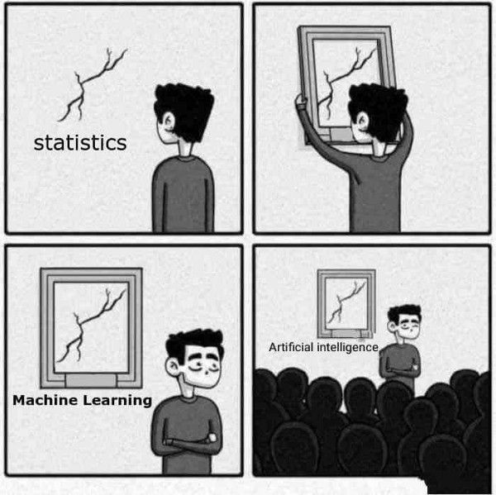
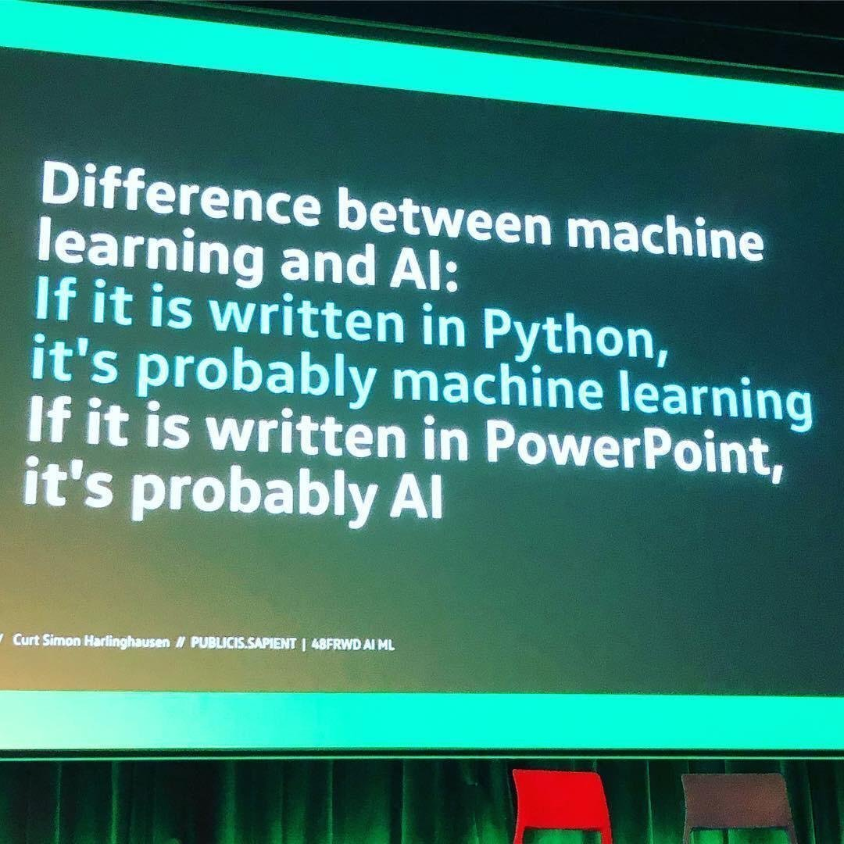

Slide 26

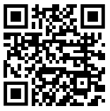

Want more?
j.hryszko@sjsi.org

