Slide 1



Essential
Business Skills
for
Software Testers

Slide 2

A view from
the other side

Slide 3


Slide 4


Slide 5
Frameworks
Tools
TDD
Jenkins
Continuous Integration
Automation

Slide 6
Speed to market
Risk
Cost reduction
Compliance
Customer experience
IP
retention

Slide 7
What will you get out of this talk?

Slide 8

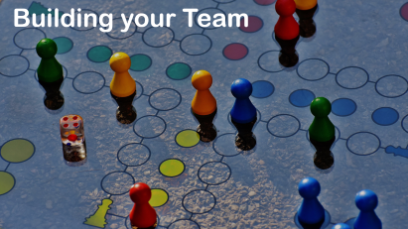
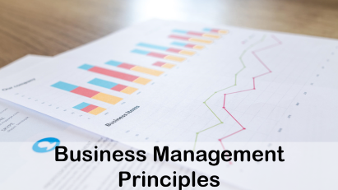
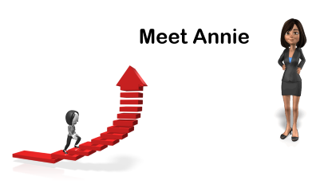
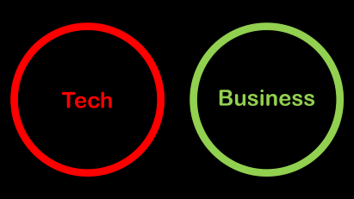
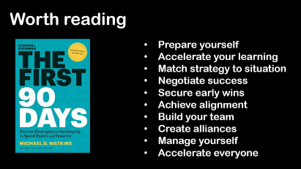

Slide 9
Tech
Business

Slide 10
Tech
Business

Slide 11
Business
Tech

Slide 12


QA as % of total IT spend
26%

Slide 13


Technical skills
Business skills

Slide 14
Where are you in your career?
Management
Technical
Career progression

Slide 15


Meet Annie

Slide 16



The new Head of QA

Slide 17

Where to start?

Slide 18

Business Management
Principles

Slide 19

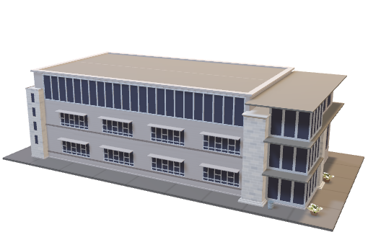

Why create a business?
Supply
Demand
Business process

Slide 20
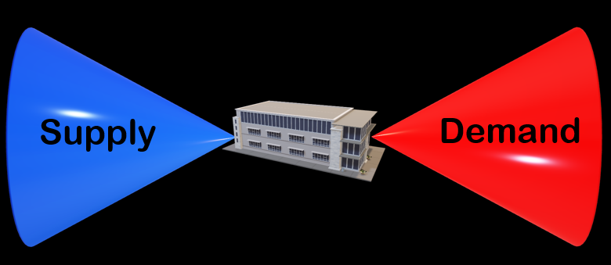
Demand
Source of demand (business, PMO, Dev)
Demand approval process
Logging & tracking – visibility
Funding model
Future view (capacity / skills)

Slide 21
Supply
Current team / capacity
Workforce planning
Recruitment
Vendors / contractors
Assets (laptops / tools / tech)
On-boarding process
Future skills / training

Slide 22
Engine room
TCoE / CoX
Centralised? Mandate?
Enterprise coverage / relationships?
Maturity / skills?
Business process – Lean / Engineering

Slide 23

Building your Team

Slide 24

Current team
Map skill levels – current
Permanent staff – HR policies
Vendor contractors – MSA terms
How did you enter leadership?

Slide 25
Future team
Future skills plan / roles (HR)
Upskilling / training plan – measure
Redeployment / off-boarding
Change management
Culture
Transformation

Slide 26

Leading your team

Slide 27

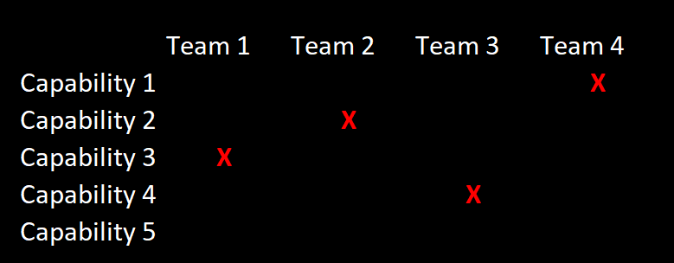
Capacity / deployment

Slide 28
Enterprise relationships
Business, Dev, PMO, Architecture
HR, Legal, Finance, Vendor management
Executive leaders
Influencers, enemies

Slide 29
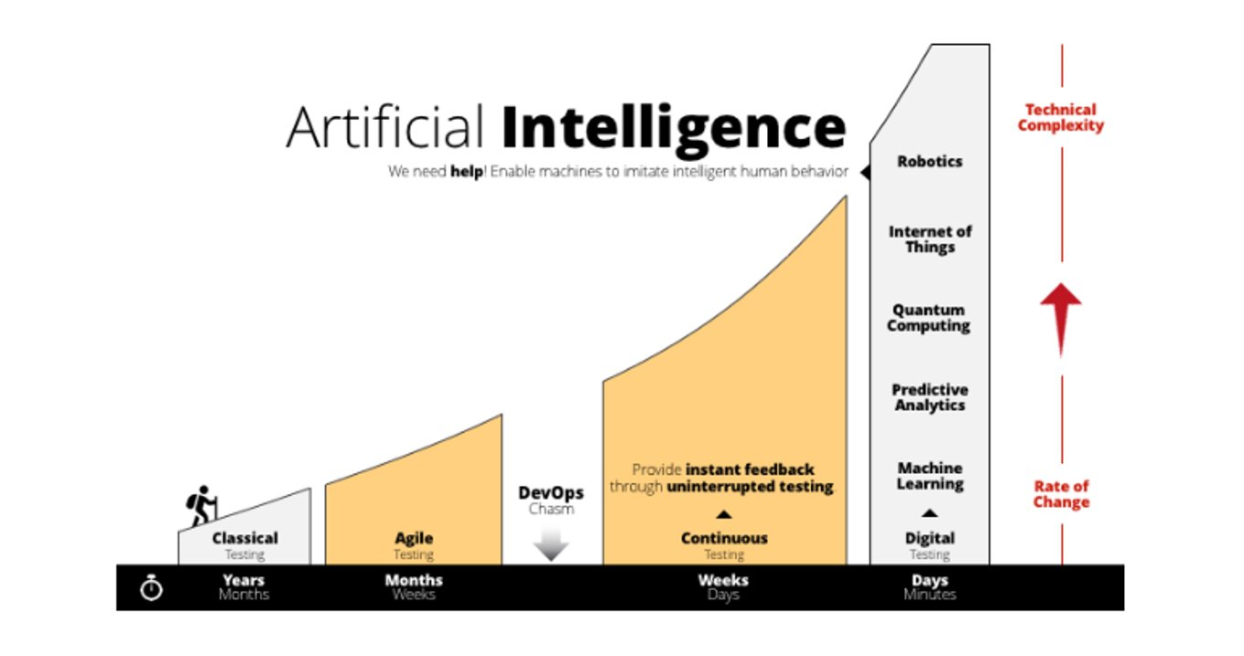
Maturity / skills
Source: https://www.tricentis.com/artificial-intelligence-software-testing/

Slide 30
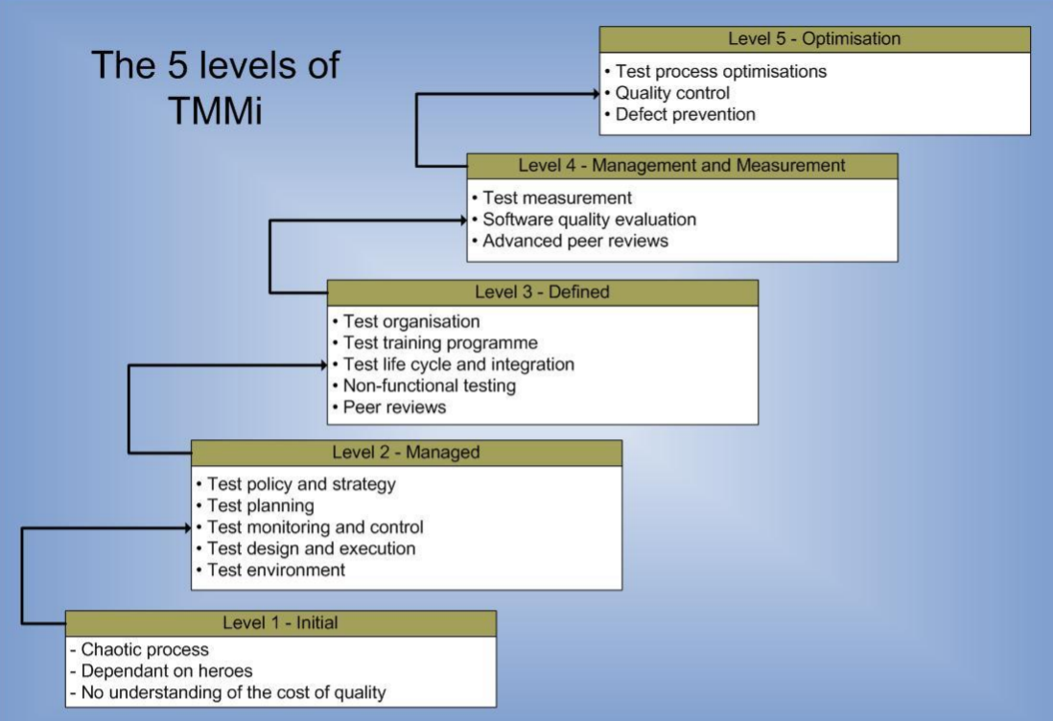

Slide 31

Worth reading
Prepare yourself
Accelerate your learning
Match strategy to situation
Negotiate success
Secure early wins
Achieve alignment
Build your team
Create alliances
Manage yourself
Accelerate everyone

Slide 32

Conclusion

Slide 33





