Slide 1


Software quality assurance days
International Conference of
Software Quality Assurance
sqadays.com
Lucjan Stapp
L.Stapp@sjsi.org
Testing tools for Blockchains
Preliminary report
Saint Petersburg, Russia. May 31-June 1, 2019

Slide 2

About me
Author of over 50 publications, including
15 about various problems related
to testing and quality assurance;
Manager and member of Quality Assurance
teams in several projects;
Co-organizer and speaker at many testing conferences;
Multiannual researcher at Warsaw University of Technology;
Vice-president of the Stowarzyszenie Jakości Systemów Informatycznych - Polish Testing Board;
CTAL - TM, CTAL - TA

Slide 3



Why Blockchain
I’m NOT interested in bitcoin problems
Security problems in IoT applications.
https://www.wired.com/story/xiaomi-scooter-hack/

Slide 4
Why Blockchain?
“…using […] blockchain only makes sense when multiple mutually mistrusting entities want to interact and change the state of a system, and are not willing to agree on an online trusted third party […]”
K. Wüst & A. Gervais “Do you need a blockchain?”
https://eprint.iacr.org/2017/375.pdf

Slide 5
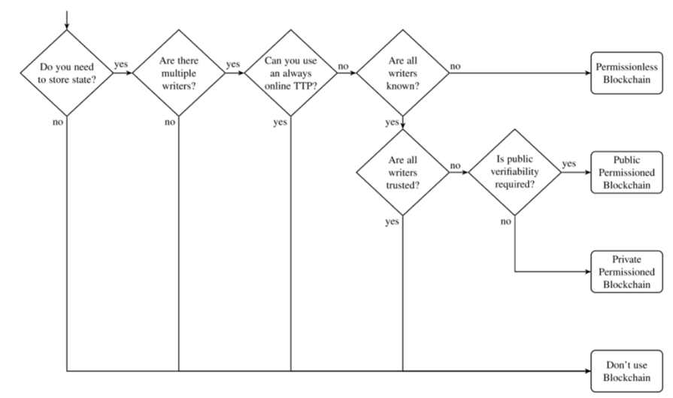
Why Blockchain?
K. Wüst & A. Gervais “Do you need a blockchain?”
https://eprint.iacr.org/2017/375.pdf

Slide 6
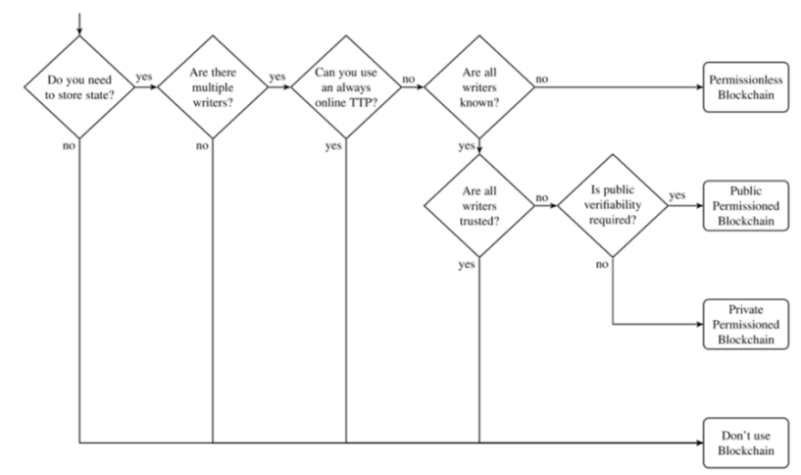
Why Blockchain?
Do you need to store the state?
Are there multiple writers?
YES
YES
1

Slide 7
Why Blockchain?
Can you use an always online TTP?
Are all writers known?
YES
NO
1
2

Slide 8
Why Blockchain?
Permissionless
blockchain
2

Slide 9
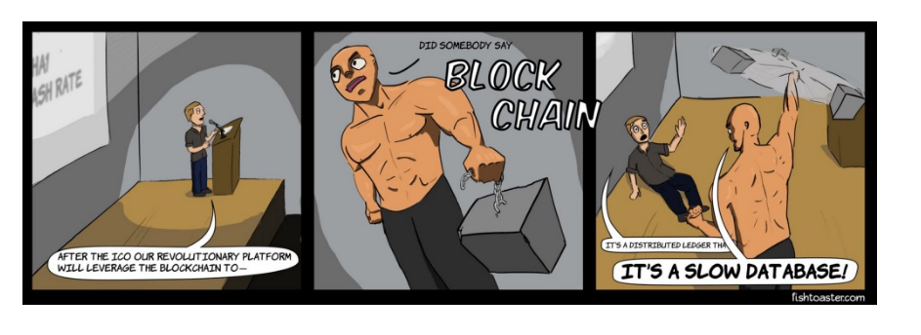
Common knowledge about blockchains
“The blockchain is an incorruptible digital ledger of economic transactions that can be programmed to record not just financial transactions but virtually everything of value.” – Don & Alex Tapscott, authors Blockchain Revolution (2016).
https://blockgeeks.com/guides/what-is-blockchain-technology

Slide 10
Common knowledge about blockchains
A kind of self-auditing ecosystem of a digital value, the network reconciles every transaction that happens in ten-minute intervals.
Each group of these transactions is referred to as a “block”.
Two important properties result from this:
Transparency data is embedded within the network as a whole, by definition it is public.
It cannot be corrupted altering any unit of information on the blockchain would mean using a huge amount of computing power to override the entire network.

Slide 11
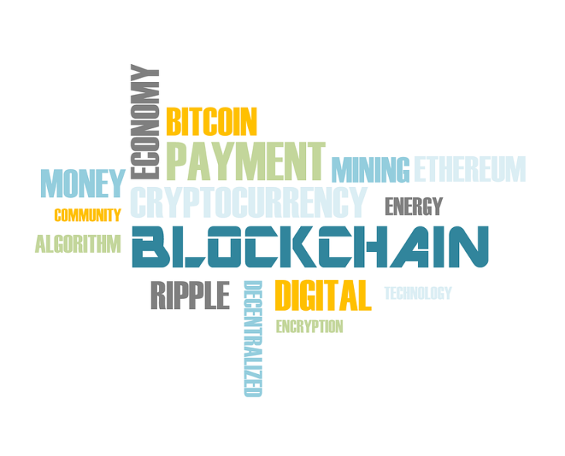
Blockchain technology
Decentralization is already a reality;
The blockchain eliminates the risks that come with data being held centrally;
Blockchain security methods use encryption technology.
https://blockgeeks.com/guides/what-is-blockchain-technology/

Slide 12
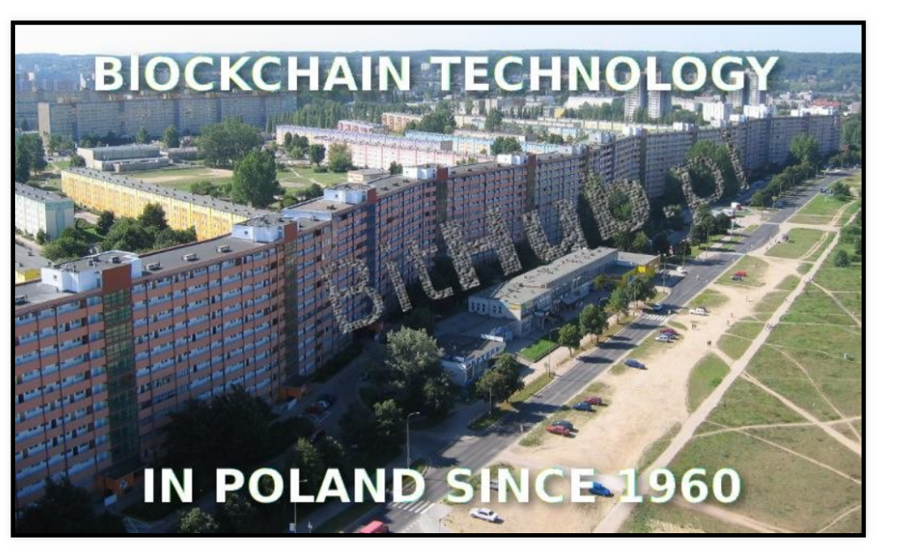
Blockchain technology

Slide 13
First problem
Only 1 percent of CIOs indicated any kind of blockchain adoption within their organizations.
Only 8 percent of CIOs were in short-term planning or active experimentation with blockchain.
77 percent of CIOs surveyed said their organization has no interest in the technology and/or no action planned to investigate or develop it.
Gartner report:
Scarcity of Current Blockchain Deployments
https://www.gartner.com/en/newsroom

Slide 14
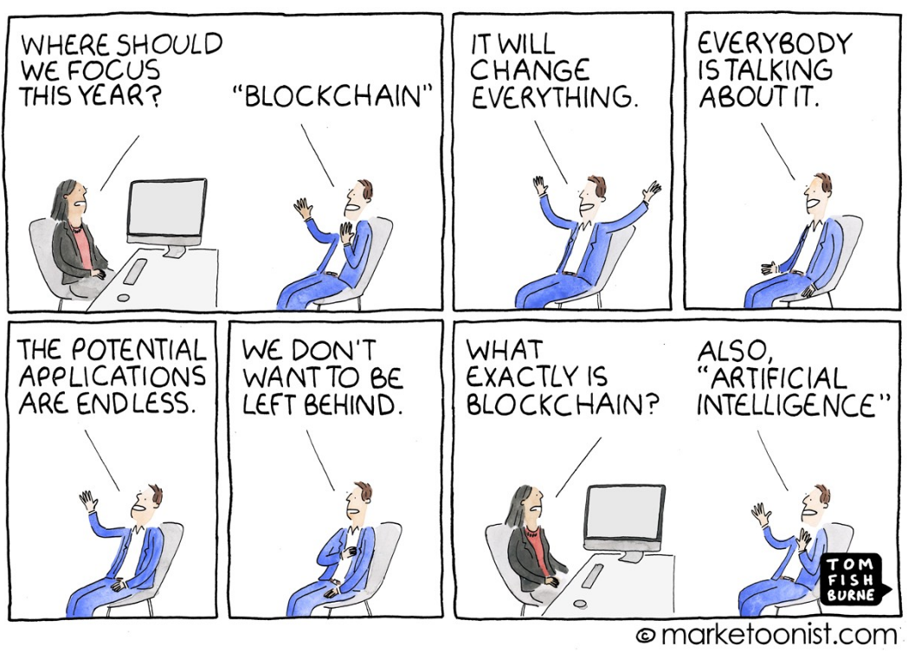
First problem

Slide 15
Second problem
Blockchain vs Ecology
One Bitcoin transaction is worth
~948 KWh
~32.03 U.S. households powered for 1 day
464 kg C02 (Carbon footprint)
https://digiconomist.net/bitcoin-energy-consumption

Slide 16
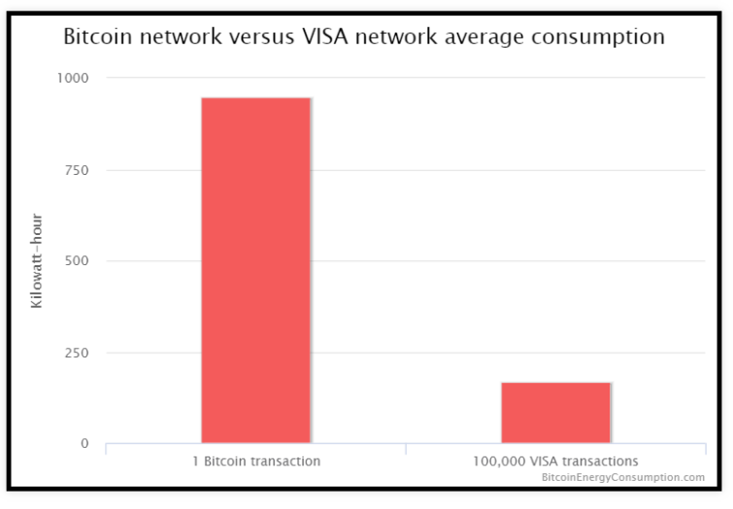
Second problem
Blockchain vs Ecology
https://digiconomist.net/bitcoin-energy-consumption

Slide 17
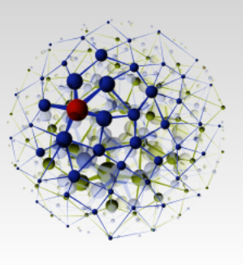

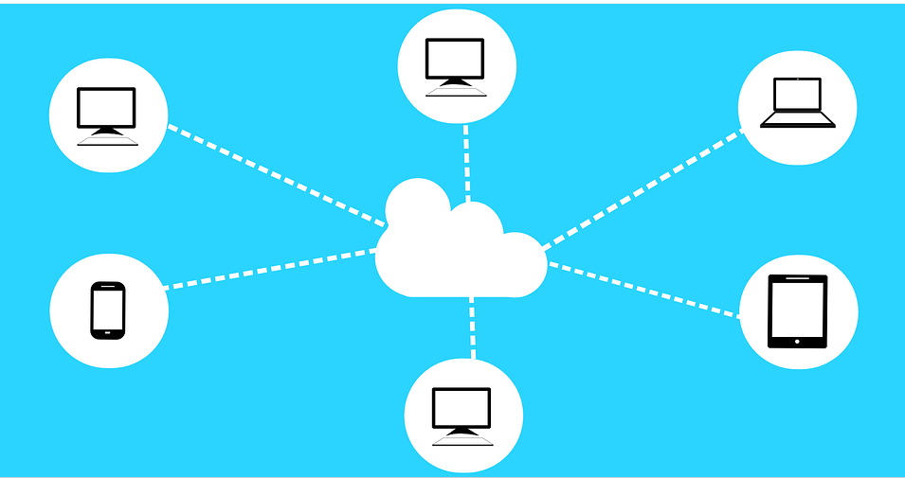

Clouds

Slide 18
Azure & AWS (Amazon)
If you do not have possibility of your own, you can use Azure
https://docs.microsoft.com/en-us/azure/blockchain/workbench/
Very helpful information are here
https://blogs.msdn.microsoft.com/uk_faculty_connection/2016/08/01/getting-started-with-blockchain-as-a-service-using-microsoft-azure-dev-test-labs/
or Amazon’s AWS: https://aws.amazon.com/blockchain/

Slide 19
Blockchain framework
There are few frameworks for blockchains:
Most popular is Ethereum.
Ethereum | Open source | General platform, Ethereum foundation
Hyperleger Fabric | Linux Foundation | Modular platform
Multichain | Open platform
Exonum
R3 Corda | R3 | Especially for BFSI (Banking, financial services and insurance)

Slide 20

Ethereum
Ethereum in the narrow
sense refers to a suite of
protocols that define a
platform for decentralized
applications.
It used Ethereum Virtual Machine (“EVM”), which can execute code of arbitrary algorithmic complexity.
Developers can create applications that run on the EVM using friendly programming languages modelled on existing languages like JavaScript and Python.

Slide 21

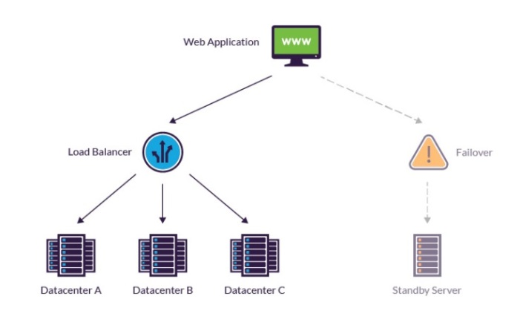
Ethereum - pluses
Every Ethereum node runs
the EVM in order to maintain
consensus across the
blockchain.
Decentralized consensus gives
Ethereum extreme levels of
fault tolerance, ensures zero
downtime, and makes data
stored on the blockchain forever unchangeable
and censorship-resistant.

Slide 22

Ethereum - problems
This massive parallelization of computing across the entire Ethereum network is not done to make computation more efficient.
This process makes computation on Ethereum far slower and more expensive than on a traditional “computer”.

Slide 23
Testnet
There is possibility to test our application before install them in real nets.
Needs Ethereum.
We used private cloud and Kovan.
Testnet
Ropsten | Very popular, but not working now
Kovan | Most popular in the moment
Rinkeby | The newest, introduced in 2018

Slide 24
TOOLS
There are many tools for blockchain testing.
The following list does not cover all of them
Ethereum | Others
Truffle suite Truffle Ganache Drizzle | BitCoinJ
Populus | Exonum (Corda)
Embark | HeperlegerComposer

Slide 25

Truffle
Unit tests in:
Mocha
Test framework in JavaScript using the Chrome's V8 JavaScript engine.
Solidity
Designed specifically for Ethereum (+-)
contract-oriented programming language;

Slide 26
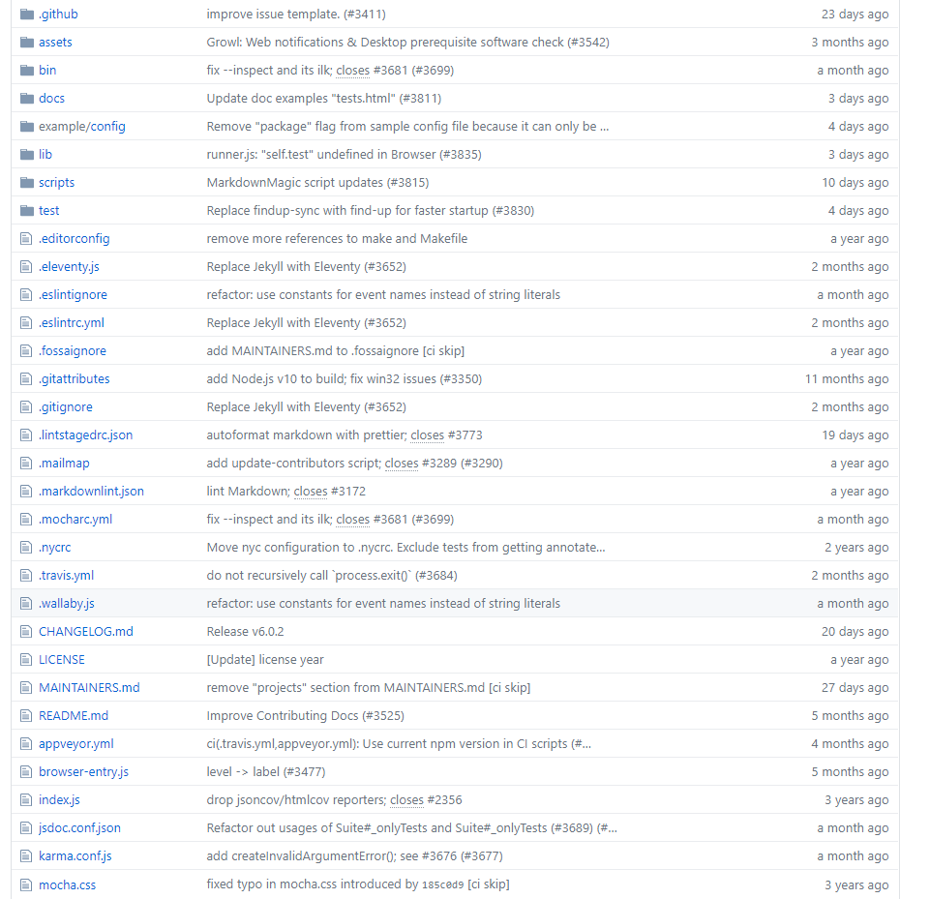
Truffle Mocha (1/3)
List of available modules on GitHub

Slide 27
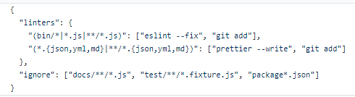
Truffle Mocha (2/3)
Sample module in Mocha

Slide 28
Truffle Mocha (3/3)
Unit tests in Mocha:
More assertion than tests (-)
Good form of reports (+)
Syntax (-)
Hosted on GitHub (+) https://github.com/mochajs/mocha

Slide 29
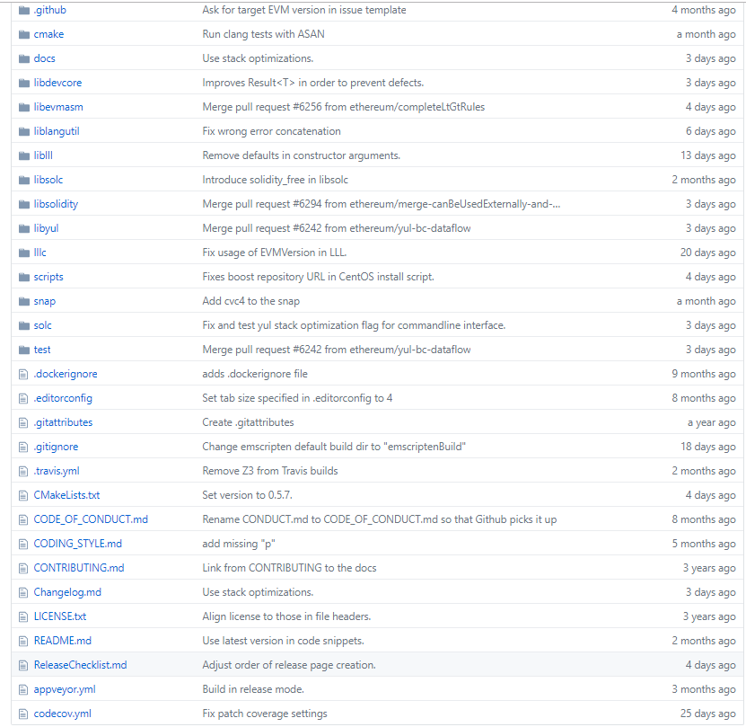
Truffle Solidity (1/3)
List of available modules on GitHub

Slide 30
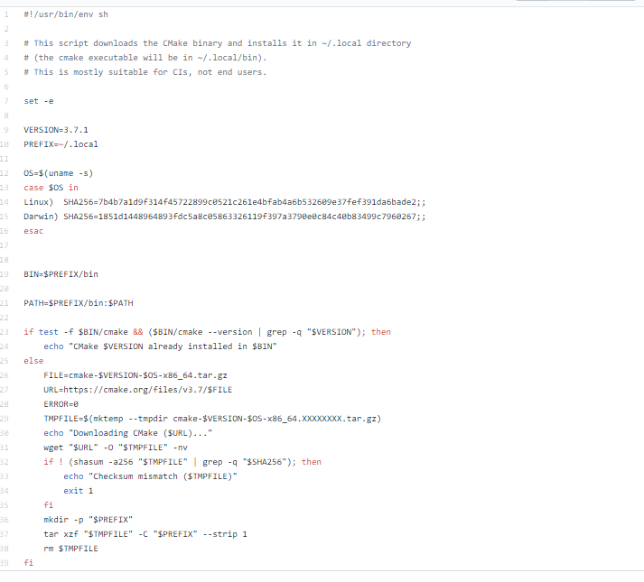
Truffle Solidity (2/3)
Sample module in Solidity

Slide 31

Truffle Solidity (3/3)
Unit tests in Solidity:
Designed specifically for Ethereum (+-)
contract-oriented programming language;
"Similar" to Java Script (+-)
Hostedon GitHub (+)
https://github.com/ethereum/solidity

Slide 32

Truffle - summary
Definitely for developers (-)
The ability to create tests in Java Script (+)
Modular functional tests
easy to create (+)
The possibility of asynchronous tests (+)
A lot of available examples (+)
Very poor support for non-functional tests (-)
More:
https://www.truffleframework.com/docs/truffle/testing/testing-your-contracts

Slide 33


Ganache & Drizzle
These are “premaids" for developers:
Ganache - Ethereum blockchain design
tool
can be used for
running tests,
executing commands
checking the status
Drizzle - front-end libraries

Slide 34
Populus
Definitely for developers (-)
The ability to create tests in Python(+)
PY.TEST
Modular functional tests
easy to create(+)
You can run from a laptop(+)
Failed to run performance tests (-)
Running Tests With Pytest
To run the full test suite of your project:
$ py.test tests/
or to run a specific test
$ py.test tests/test_greeter.py

Slide 35
Embark
https://mlgblockchain.com/learn/tutorials/blockchain-embark-framework/
Loss of documentation (-)
https://media.readthedocs.org/pdf/embark/latest/embark.pdf
Empty pages

Slide 36
BitcoinJ
bitcoinj is a library for working with the Bitcoin protocol. It can maintain a wallet, send/receive transactions without needing a local copy of Bitcoin Core and has many other advanced features.
It's implemented in Java but can be used from any JVM compatible language: examples in Python and JavaScript are included.
It comes with full documentation and many large, well known Bitcoin apps and services are built on it.
https://bitcoinj.github.io/

Slide 37
Corda
Still working on it ☺
Checked:
Private testnet (+)
Works well with Azure (+)
Easy commissioning of stress tests (+)

Slide 38

TOOLS
Some decent tools for developers
unit tests level
And what for"real" testers?
We do not have good tools
We need such tools
minimal possibilities of manual tests (very difficult)

Slide 39

TOOLS
WHY?
Testing distributed systems remains challenging.
The main difficulties are:
the high-level degree of
interleaving,
large number of scenarios.

Slide 40

Questions, comments, remarks

