Slide 1

Path of a Rebel Tester and how it helps Your team
MICHAL BUCZKO
SyproSoft Solutions, Poland
Minsk, Belarus. November 15-16, 2019

Slide 2
Software quality assurance days
26 International Conference on
Software Quality Assurance
sqadays.com
sqadays.com
Michał Buczko
SpyroSoft Solutions. Wrocław, Poland
Path of a Rebel Tester
and how it helps Your team
Minsk, Belarus. November 15-16, 2019

Slide 3
Introduction – WHY?
Core message – HOW?
Summarize – USE IT
Q & A
Path of a Rebel Tester and how it helps Your team

Slide 4
8 steps to be a Rebel Tester and help Your project
Path of a Rebel Tester and how it helps Your team

Slide 5
Why him?
SpyroSoft
Automotive
Test Manager
15 years experience
Public Speaker
Test Consultant
Agile Testing Consultant
DevTest Pairing enthusiast
Supporting Career Development for Testers
Path of a Rebel Tester and how it helps Your team

Slide 6
Why this topic? Problem with testers:
Bad news messengers
Problem indicators not solvers
Biases victims
Bad communication with developers
Bad image in eyes of Project Management
Bad image in eyes of Customers
Toronto University research
Harvard Business School research
Path of a Rebel Tester and how it helps Your team

Slide 7
Have the courage to be the Rebel in Your team !!
Path of a Rebel Tester and how it helps Your team

Slide 8

1. Seek out the new
Break away from routine
Search for inspiration in technology and business
Experiment and get out form the pesticides problem
Search for new ways, not obviously related suggestions
Path of a Rebel Tester and how it helps Your team

Slide 9

2. Encourage the constructive dissent
Seek opinions not matching Yours
Encourage conflict in discussions
Be the brave to disagree and ask for clarifications
Control the emotions level
Do all above at controlled level
Photo by Austin Distel on Unsplash
Path of a Rebel Tester and how it helps Your team

Slide 10

3. Open conversations
Expand the discussions
Do not close the conversations
Be honest and make all people involved comfortable with Your point of view
Keep open mind for arguments from the team
Photo by Austin Distel on Unsplash
Path of a Rebel Tester and how it helps Your team

Slide 11

4. Reveal Yourself
Reflect of the data and opinions You gather
Focus on Your strengths
Be honest about Your weaknesses
Be mindful on both during the discussion
Fight the biases You face
Photo by Riccardo Annandale on Unsplash
Path of a Rebel Tester and how it helps Your team

Slide 12

5. Learn fast and forget easily
Master the fundamentals of the domain
Understand the business
Learn the project constrains and restrictions
Do not become slave to the rules
Have the courage to challenge the reality
Path of a Rebel Tester and how it helps Your team

Slide 13

6. Seek freedom in constrains
Find the inspiration in the rules
Is there a better way to do that?
Job spec is not Your limit
Build a place for Yourself
Path of a Rebel Tester and how it helps Your team

Slide 14
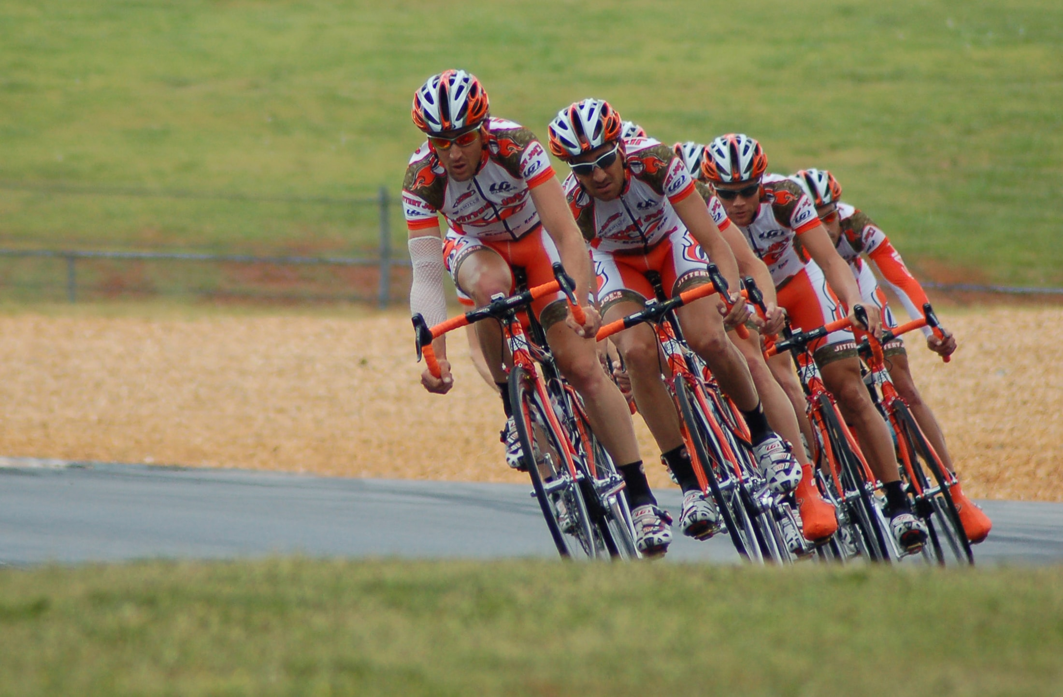
7. Lead form the trenches
Be ready to get Your hand dirty
Lead Your team
Lead the Problem Solving
Build Your position
Grain respect
Photo by James Thomas on Unsplash
Path of a Rebel Tester and how it helps Your team

Slide 15

8. Foster happy accidents
“WOW” effect in discussion
Know and appreciate the value of happy accidents
Encourage workspaces and teams that crosspollinate
Any mistake can unlock a break-through
Keep open mind
Photo by sydney Rae on Unsplash
Path of a Rebel Tester and how it helps Your team

Slide 16
BONUS RULE: Be the positive rebel in Your project. Get better in time management. They will want You at many meetings.
Path of a Rebel Tester and how it helps Your team

Slide 17

Summary:
Seek out the new
Encourage the constructive dissent
Keep the conversations open
Reveal Yourself
Learn and forget
Seek freedom
Lead
Embrace sudden incidents
Photo by Joshua Hibbert on Unsplash
Path of a Rebel Tester and how it helps Your team

Slide 18
Michal Buczko
Facebook: https://www.facebook.com/buczkomichal
Linkedin: https://www.linkedin.com/in/buczkomichal
Twitter: https://twitter.com/Docatisto
Mail: buczko.michal@gmail.com
Path of a Rebel Tester and how it helps Your team

Slide 19
Q&A
Path of a Rebel Tester and how it helps Your team

Slide 20
END

