Slide 1


Big Data testing
Andrey Guitelson
Andrey Guitelson
QA Engineering Manager
QA Engineering Manager
Big Data testing
Big Data testing
Andrey Guitelson
QA Engineering Manager

Slide 2
What is Big Data?

Slide 3
3 V’s criteria
Velocity
Volume
Batch, real-time stream processing
Terabytes of data, billions of records
3 V’s of BigData
Structured, unstructured, semistructured data
Variety

Slide 4

Batch vs Streaming. How to eat an elephant?

Slide 5













MapReduce concept
Map
Reduce

Slide 6

Apache Hadoop
Application
MapReduce
Spark
Tez
...
Compute
YARN
Storage
HDFS and HBase

Slide 7

Apache Spark
Worker Node
Executor
Cache
Task
Task
Driver Program
Cluster Manager
SparkContext
Worker Node
Executor
Cache
Task
Task

Slide 8
Business problem

Slide 9

Advertisement

Slide 10



Advertisement(ad) task. Raw data.
User opened advertisement…
User used google chrome with OS …
The ad is on the screen more than 1 sec…
The ad is on the screen more than 5 sec…
The ad is on the screen more than 15 sec…
User scrolled down the ad

Slide 11



Advertisement ETL task. Reports
The user viewed the add 15 seconds
3 users viewed the add today
2 users viewed the add less than 5 secs
The user is 70% chance is a bot

Slide 12
Solution overview

Slide 13

ETL(Extract, Transform, Load) Batch processing
Ten data centers across the globe
200k+ events/second in major data centers
20 TB of data per day
Traffic
Application servers
Reports

Slide 14

ETL(Extract, Transform, Load) Stream processing
Traffic
Application servers
DB

Slide 15
Data description

Slide 16
Reports. Logs.
Date | Session Id | Action Type | Duration (seconds) | Percentage in view | AdvId
2019-05-07 23:20:47 | 0001 | InView | 1 | 100 | adv1
2019-05-07 23:21:47 | 0001 | InView | 5 | 100 | adv1
2019-05-07 23:23:47 | 0001 | InView | 15 | 50 | adv1
2019-05-07 23:23:47 | 0002 | InView | 1 | 0 | adv2

Slide 17

Reports
Ad Id | Everage in view
adv01 | 15s
adv02 | 1s
Ad Id | Amount of sessions
adv01 | 1
adv02 | 1
Session ID | In view
0001 | 15s
0002 | 1s

Slide 18

Data types
Valid rich data
Orphan data
Corrupted data
Outdated data

Slide 19
Testing

Slide 20


Problems in testing
No suitable test frameworks
No best practices
Unpredictable results
Verification of huge amount of data
Expected?
Actual?
300 GB Data
1 GB Data

Slide 21

What do we actually test?
Wrappers
python/bash scripts
schedulers’ scripts
Business logic
MapReduce
Spark Jobs

Slide 22

Data to use for testing
Functional tests on synthetic data
Smoke tests on a real data
Functional tests on a real data
Functional tests using synthetic data inside the real data

Slide 23

Tests on small data
Hadoop Local (Standalone) Mode

Slide 24
Log Generator
<CURRENT_TIME> | <RANDOM_UUID_1> | InView | 1 | 100 | <RANDOM_IP_1>
<CURRENT_TIME> | <RANDOM_UUID_1> | InView | 5 | 100 | <RANDOM_IP_1>
100
LOG.txt

Slide 25

Embedded tests
Embedded mode Spark
Embedded mode Kafka
Apache MRUnit
Embedding Pig

Slide 26
Testing on large datasets

Slide 27


Apache Hive
Apache Hive is a data warehouse software project built on top of Apache Hadoop for providing data query and analysis. Hive gives a SQL-like interface to query data stored in various databases and file systems that integrate with Hadoop.

Slide 28
Apache Hive
0001 15
0002 1
CREATE TABLE Logs
(
SESSION_DATE TIMESTAMP,
SESSION_ID STRING,
ACTION_TYPE STRING,
SECONDS_IN_VIEW INT,
PERCENTAGE INT,
ADV_ID STRING
) row format delimited fields TERMINATED BY '\t'
LOCATION 'hdfs:///user/ubuntu/logs/2017/03/03/';
SELECT SESSION_ID,
max(SECONDS_IN_VIEW)
FROM Logs
WHERE SESSION_DATE >= date_sub(CURRENT_TIMESTAMP, 365)
GROUP BY SESSION_ID;

Slide 29
Tests with Spark DataFrames
data_schema = StructType([StructField('session_date', TimestampType()),
StructField('session_id', StringType()),
StructField('action_type', StringType()),
StructField('second_in_view', IntegerType()),
StructField('percentage', IntegerType()),
StructField('weight', IntegerType())])
raw_logs = sqlContext.read.schema(data_schema).csv('...logs/2017/03/03/LOG.2017030301.log')
events = raw_logs.select('session_id', 'second_in_view', 'session_date')
filtered = events.filter(datediff(current_date(), events.session_date) < 365)
result = filtered.groupBy('session_id').max('second_in_view').collect()
assert_that(result, has_length(2))

Slide 30
Infrastructure testing

Slide 31

Environment verification
Hadoop installed in a proper mode
Hadoop shows root folder
RAM is enough to run tests
Check running processes
Check enough space on a disc

Slide 32
Plans

Slide 33
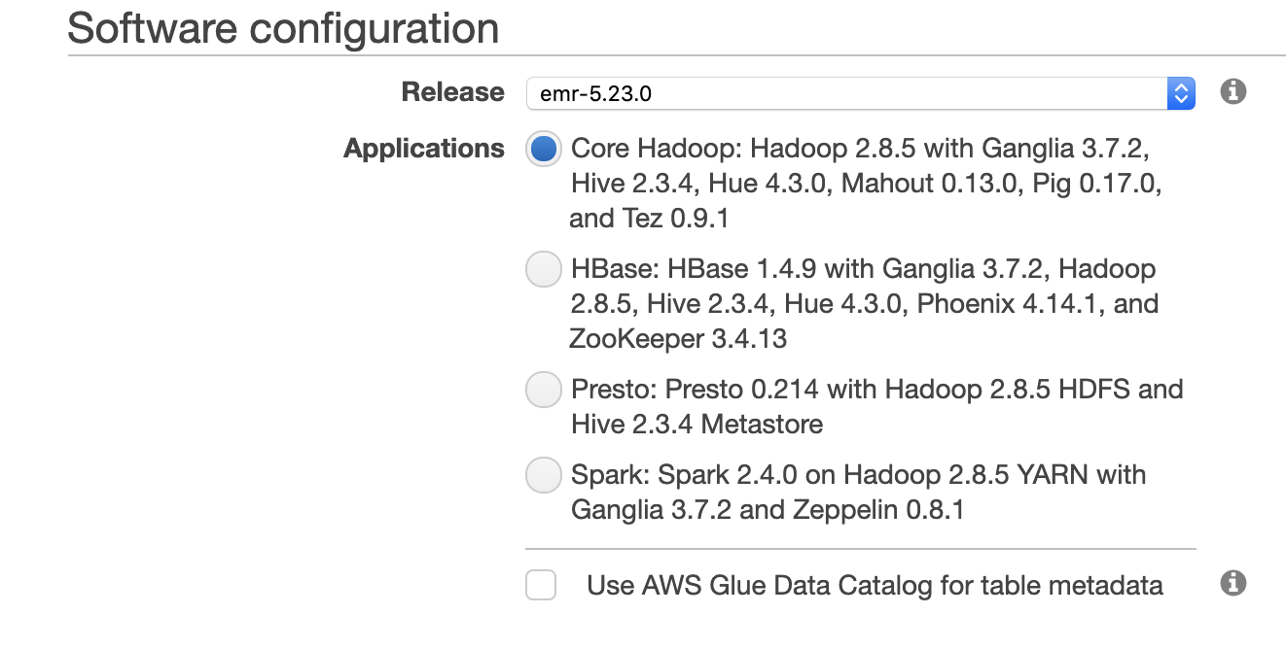
Future: Amazon Elastic MapReduce(EMR)

Slide 34


Thank you!
Q&A
apetrarko

