Slide 1

BDD triangle of Risk Management, QA Management and Tech side
Anton Semenchenko

Slide 2

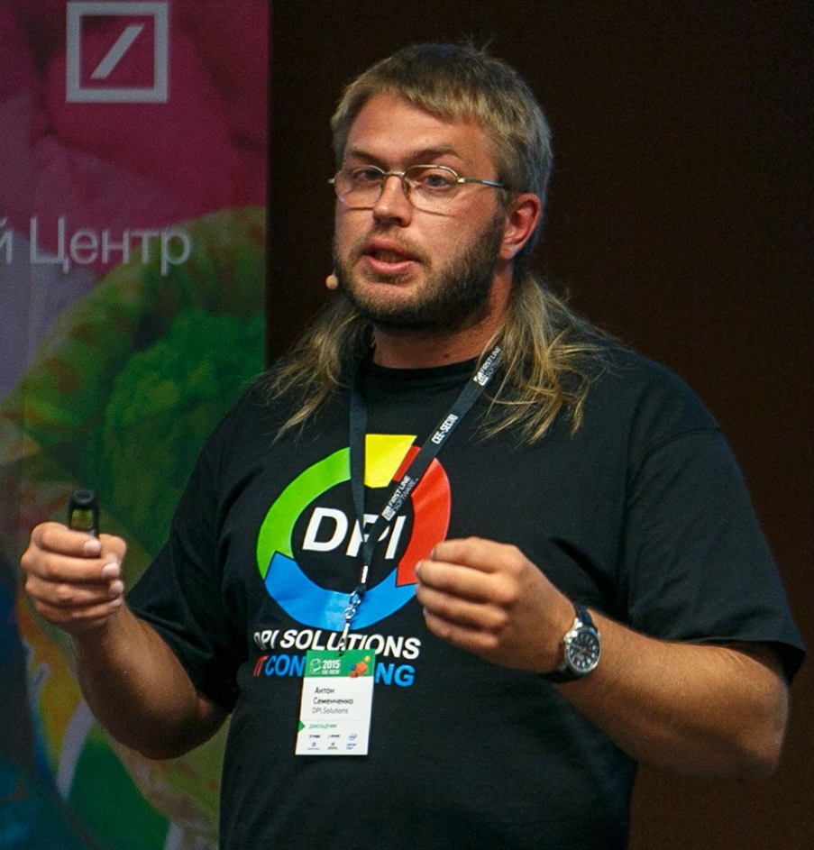


About
QA community COMAQA co-founder
C++ community CoreHard co-founder
“International IT” community InterIT co-founder
50+ international conferences organizer
IT evangelist (300+ speeches on meetups and conferences)
Field of scientific interest: using math for differential diagnostic in cardiology, psychiatry, virology and immunology
C++ books editor
QA Automation, QA Management, Low level development, Agile trainer
ICAgile Certified Professional
DPI.Solutions co-founder
Anton Semenchenko

Slide 3
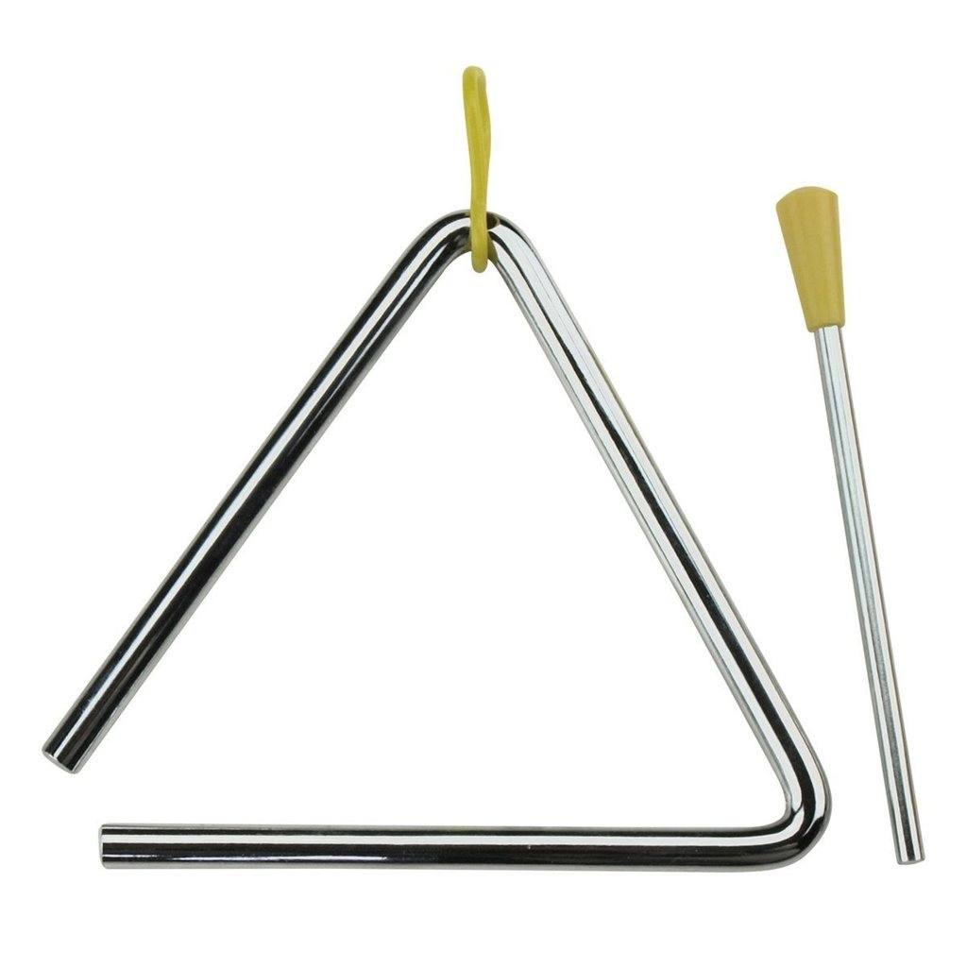
BDD triangle of Risk Management, QA Management and Tech side ☺

Slide 4
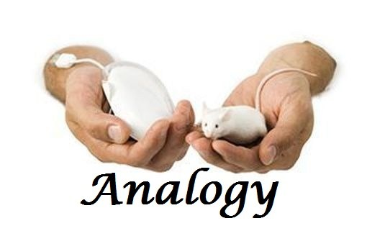
Agile – as analogy
Kanban: late 1940s
Iterative and incremental software development methods: 1957
Evolutionary project management and adaptive software development: early 1970s
Scrum: 1986
Agile: 2001
«Mmm Danone» … Frederic Beigbeder “99F”
We sell BDD to the customer and IT management and tech specialists, who implement it

Slide 5
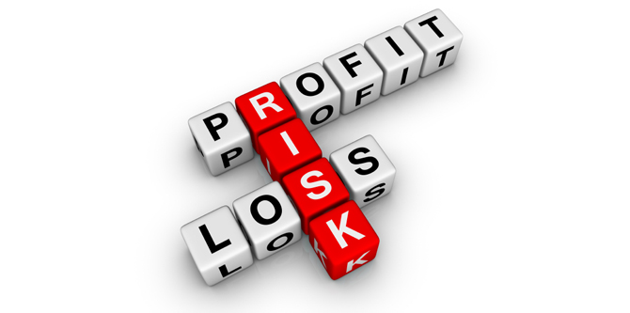
Business risks
Quality assurance risks: process related
Technical risks: auto tests implementation related
People management risks: hire, rotation, transferring code to another vendor (contractor)

Slide 6

Reasons of mutual “mistrust”
“Incompetent” customer
Without IT background
Without IT-consultant at the state
With negative experience of working with IT Contractor
Incompetent contractor
Skilled manual testers, with base knowledge of Automation
Automation engineers with good engineering background without serious understanding of QA processes

Slide 7
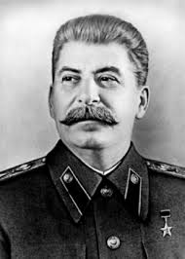
Citation ☺
"A Healthy Mistrust - a good basics for cooperative work" - rephrase of report XVII of party meeting about work of Org Bureau of the Communist Party of the Soviet Union from January 26, 1934 Joseph Stalin

Slide 8

Guarantees are ALWAYS more preferable of emotional TRUST and "other lyrical stuff"

Slide 9
Risks
Quality assurance risks: process related
Test Cases
Traceability Matrix
Business oriented reports
Technical risks: auto tests implementation related
Initial infrastructure
2 layers (min)
Code re-usage step based (at least)
People management risks: hire, rotation, transferring code to another vendor (contractor)

Slide 10
Risks
People management risks: hire, rotation, transferring code to another vendor (contractor)
Predictable (not always optimal) complexity \ simplicity of solution
Predictable (not always optimal) skillset of Automation specialist
As a result: predictable complexity, hire, rotation, code transferring process from one vendor (contractor) to another

Slide 11
Quality assurance risks
Test Cases:
Formulated
Under VCS
Available to any team member
Verified by Product Owners (Product owners as Façade for Business Team)
Formulated in business terms
Are part of integral process of Software Development (such as, as example, Part of Backlog Items and Definition of Done)

Slide 12
Quality assurance risks
Traceability Matrix:
Exists
Used as at least 1-1 mapping Backlog Item - BDD based automated acceptance test

Slide 13
Quality assurance risks
Business oriented reports:
Exist
Generated automatically
Business needs oriented

Slide 14
Technical risks
Initial infrastructure:
Tests are, at least, implemented not in main
Minimal architecture \ infrastructure of Automated testing is guaranteed to be implemented

Slide 15
Technical risks
2 layers (min):
Implemented architecture
At least - 2 level architecture
Test layer (possibly incorrectly formulated) and business actions layer on the level where code is reused (possibly implemented incorrectly)

Slide 16
Technical risks
Code re-usage step based (at least)

Slide 17
People management risks
Hire, rotation, transferring code to another vendor (contractor)
Predictable (not always optimal) complexity \ simplicity of solution
Predictable (not always optimal) skillset of Automation specialist
As a result: predictable complexity, hire, rotation, code transferring process from one vendor (contractor) to another

Slide 18
“How to Draw QA Architecture Automation in Few Slight Movements” Appendix
Test
Under the hood of a Test
Business Actions
Arrange
Act
Keyword based Test Case for Automation
Low Level Actions
Assert
Implemented keyword (verb on noun)
Gherkin scenario
Implemented Gherkin Step
Page Object
The same Test case for Automation in a Flow way
Implemented API in a Flow way
The same Test case for Automation using DSL
Internal, external or hybrid DLS construction

Slide 19
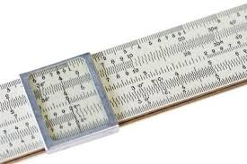
Faculty of "Non-traditional usage of logarithmic ruler"
~BDD low level actions focused approach
~BDD Page Objects focused approach
~BDD Business Reports focused approach

Slide 20
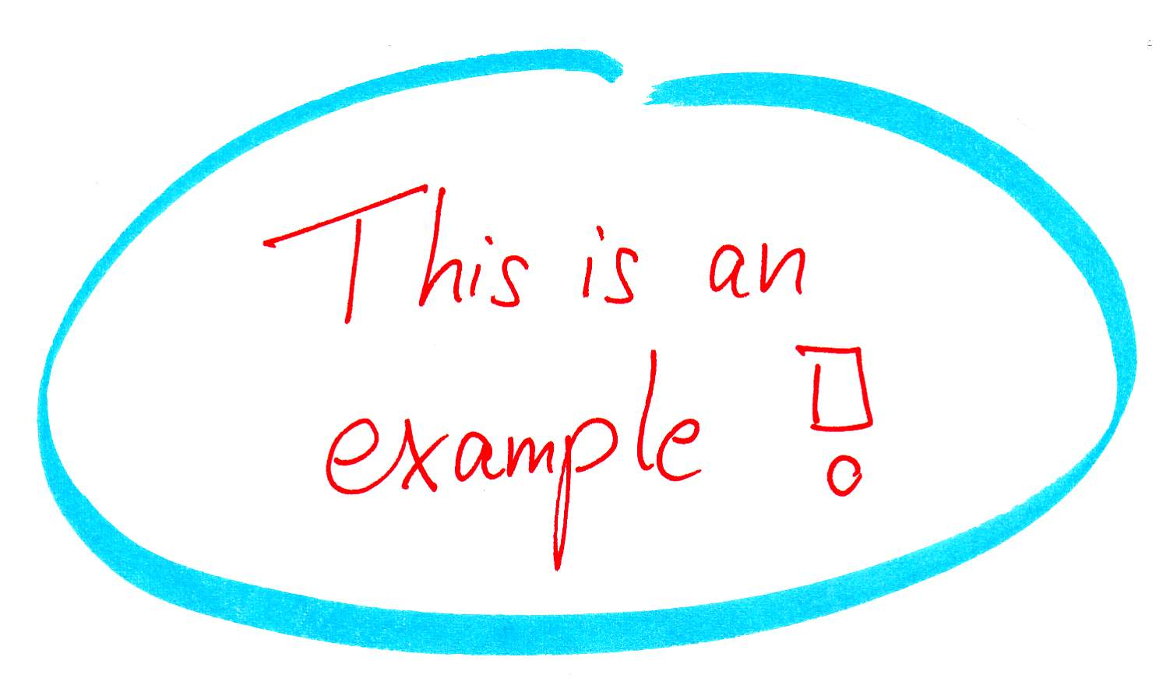
3 funny examples
~BDD low level actions focused approach
~BDD Page Objects focused approach
~BDD Business Reports focused approach

Slide 21
What you should not expect from BDD
Time saving \ money while formulating Test Cases
Time saving \ money while developing and supporting Automated Tests
Risk Management:
project with Risk Management is ALWAYS a bit more expensive, than a project without Risk Management (at the time when no risks appeared on the second option)
project with Risk Management is sufficiently cheaper, than a project without Risk Management (in case, that at least one risk appeared)

Slide 22
Basics of Risk Management
“Waltzing with Bears: Managing Risk on Software Projects” Tom DeMarco and Timothy Lister

Slide 23
What you should not expect from BDD: detailed information
Time saving \ money while formulating Test Cases
Time saving \ money while developing and supporting Automated Tests
Risk Management:
project with Risk Management is ALWAYS a bit more expensive, than a project without Risk Management (at the time when no risks appeared on the second option)
project with Risk Management is sufficiently cheaper, than a project without Risk Management (in case, that at least one risk appeared)

Slide 24
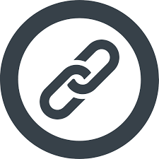
Serenity and the Screenplay Pattern
https://janmolak.com/serenity-bdd-and-the-screenplay-pattern-27819d0db780
https://www.baeldung.com/serenity-screenplay
http://serenity-bdd.info/docs/articles/screenplay-tutorial.html
https://www.infoq.com/articles/Beyond-Page-Objects-Test-Automation-Serenity-Screenplay

Slide 25
“How to Draw QA Architecture Automation in Few Slight Movements” Appendix
Test
Under the hood of a Test
Business Actions
Arrange
Act
Keyword based Test Case for Automation
Low Level Actions
Assert
Implemented keyword (verb on noun)
Gherkin scenario
Implemented Gherkin Step
Page Object
The same Test case for Automation in a Flow way
Implemented API in a Flow way
The same Test case for Automation using DSL
Internal, external or hybrid DLS construction

Slide 26
Conclusions
The presentation

Slide 27
Contact Information
Anton Semenchenko
Email: semenchenko_anton_v@tut.by
Skype: semenchenko_anton_v
Telegram: +375 33 33 46 120
Phones: +375 33 33 46 120 & +375 44 74 00 385 74 00 https://www.facebook.com/semenchenko.anton.v
https://www.linkedin.com/in/anton-semenchenko-612a926b/
https://twitter.com/comaqa

Slide 28
Thank you for you attention!
Bid you farewell!
http://conference.comaqa.by/
https://comaqa.by/
https://www.youtube.com/channel/UCzAhXR53eIvHht9qmFPBVxg

Slide 29
How to Draw QA Architecture Automation in Few Slight Movements: goals
Show that visual representation of framework makes it easier to support the project, provide knowledge transfer and implement new features;
Provide a ready-to-go example of how to draw architecture in few minutes (for UI project, as example);
Demonstrate that “Architecture” is not frightening as it may sound like;
Show you hints of drawing schemes at interviews, knowledge-transfers, etc…

Slide 30
QA Automation Architecture as a technical challenge
Main challenge – find evolutionary changing balance point;
Solution should not be too complicated, or too simple;
Finding that balance point which is changing from time to time - is the most complicated part of architecture;
When balancing is low in quality - business will financially suffer;
Tech discussion about project hypothetical growth are always futile;
And tech understanding may be different from business needs – results in monstrously complex project;
Solving “balancing Architecture challenge” - by using visualization and focusing.

Slide 31
Legend
Entity
Note
Color == level \ frequency of interactions inside one layer
Topic that require additional investigation, and can be covered via conversation at community stand
?
Direction == use
Bi-direction == equal
Weight == frequency or probability of interactions
Dashes == potential relations

Slide 32
3 main layers & external data source with locators
Under the hood of a Test
Business Actions
Low Level Actions
External data source with locators, for example:
ini file
xml
json
Java property file
Page Object

Slide 33
3 main layers & any UI Engine
“Smart” Singleton
UI Engine
Selenium Helper
Selenium Wrapper
?
? Do we need a wrapper
? Can we use Selenium directly via Wrapper
Selenium WebDriver
Change UI Automation Engine case

Slide 34
3 main layers & any UI Engine Option 1: simpler => preferable
Test
?
Under the hood of a Test
Business Actions
“Smart” Singleton
UI Engine
Selenium Helper
Low Level Actions
Selenium Wrapper
?
?
??
?
??
?
External data source with locators, for example:
ini file
xml
json
Java property file
Page Object
Selenium WebDriver

Slide 35
3 main layers & any UI Engine; Sption 2: more complicated - Yandex WebElements based
Test
?
Under the hood of a Test
Business Actions
“Smart”” Singleton
UI Engine
Selenium Helper
Low Level Actions
Selenium Wrapper
?
??
?
Seldom
External data source with locators, for example:
ini file
xml
json
Java property file
Page Object
?
Selenium WebDriver
Change UI Automation Engine case

Slide 36

3A Rule Arrange, Act, Assert test structure rule
Basically tests consist of 3 steps:
Arrange - establishing the test environment;
Act - executing the logic;
Assert - verifying the expectation.

Slide 37
Test & 3A Rule Arrange, Act, Assert test structure rule
Test
Under the hood of a Test
Business Actions
Arrange
Act
Assert
Low Level Actions
Page Object

Slide 38
Test & 3A Rule - Arrange
DB Engine
Test
API Engine
“Smart”” Singleton
?
Arrange
Rest Engine
Act
Assert
Under the hood of a Test
Data source (DDT)
SOAP Engine
Business Actions

Slide 39
Test & 3A Rule - Act
Test
Arrange
Act
Under the hood of a Test
Assert
Business Actions

Slide 40
Test & 3A Rule - Assert
Test Runner
Assert Engine
Test
UI Engine
Arrange
Selenium Helper
Act
Assert
Selenium Wrapper

Slide 41
Test & 3A Rule: Arrange, Act, Assert
Test
DB Engine
Under the hood of a Test
Business Actions
?
Arrange
API Engine
“Smart”” Singleton
Act
?
Assert
?
Test Runner
Rest Engine
Assert Engine
Selenium Helper
Data source (DDT)
SOAP Engine
Selenium Wrapper

Slide 42
Test & “Global” Entities \ “Smart Singleton”
Logger
Test
“Smart”” Singleton
Tracer
Arrange
Act
Test Runner
Assert
Reporting Engine

Slide 43
Test & “Global” Entities \ “Smart Singleton”
Logger
Test
“Smart”” Singleton
Tracer
Arrange
Act
Test Runner
Assert
Reporting Engine
Reporting Engine

Slide 44
Test & “Global” Entities - run test in parallel
Logger
Test
“Smart”” Singleton
Tracer
Arrange
Act
Test Runner
Parallelization Engine
Assert
Reporting Engine
Reporting Engine

Slide 45
Test level mapping: 4 examples of entities mapping in one
Test
Keyword based Test Case for Automation
Arrange
Gherkin scenario
Act
Assert
The same Test case for Automation in a Flow way
The same Test case for Automation using DSL

Slide 46
QA Automation approaches Keyword, BDD, Fluent interface, DSL
Ubiquitous language
Key word driven QA Automation
Behavior Driven Development (BDD) approach – as a special case of DSL based QA Automation solutions
Domain specific language (DSL) based QA Automation
Flow – as a way of implementation DSL\BDD
Flow- fluent interface is an implementation of an object oriented API that aims to provide more readable code.

Slide 47
Test level mapping: 4 examples of entities mapping in one
Test
Keyword based Test Case for Automation
Arrange
Gherkin scenario
Act
Assert
The same Test case for Automation in a Flow way
The same Test case for Automation using DSL

Slide 48
Business Action level mapping: 4 examples of entities mapping in one
Implemented keyword (verb on noun)
Under the hood of a Test
Business Actions
Implemented Gherkin Step
Low Level Actions
Implemented API in a Flow way
Page Object
Internal, external or hybrid DLS construction

Slide 49
Test & 3A Rule: 4 examples of entities mapping in one
Test
Under the hood of a Test
Business Actions
Arrange
Act
Keyword based Test Case for Automation
Low Level Actions
Assert
Implemented keyword (verb on noun)
Gherkin scenario
Implemented Gherkin Step
Page Object
The same Test case for Automation in a Flow way
Implemented API in a Flow way
The same Test case for Automation using DSL
Internal, external or hybrid DLS construction

Slide 50
Conclusion: 4 results of the presentation for technical specialists
visual representation makes it easier to understand the project when you new to it;
show you that architecture is not as frightening as it may sound like;
helpful tip for any interview – draw simple project’s diagram;
provided you with the presentation, which can be used as a cheat sheet.

Slide 51
Conclusion: 3 results of the presentation for Business
solve “balancing Architecture challenge” – by creating diagrams;
avoid potential issues of over complexing or over simplification of the system;
completing those saves money for our partners and increase quality of the final product.

Slide 52
Contact Information
Anton Semenchenko
Email: semenchenko_anton_v@tut.by
Skype: semenchenko_anton_v
Telegram: +375 33 33 46 120
Phones: +375 33 33 46 120 & +375 44 74 00 385 74 00 https://www.facebook.com/semenchenko.anton.v
https://www.linkedin.com/in/anton-semenchenko-612a926b/
https://twitter.com/comaqa

Slide 53
Thank you for you attention!
Bid you farewell!
http://conference.comaqa.by/
https://comaqa.by/
https://www.youtube.com/channel/UCzAhXR53eIvHht9qmFPBVxg

Slide 54
QA Automation approaches Keyword, BDD, Fluent interface, DSL
Domain specific language (DSL) based QA Automation
Flow – as a way of implementation DSL\BDD
Flow- fluent interface is an implementation of an object oriented API that aims to provide more readable code.
A fluent interface is normally implemented by using method cascading (concretely method chaining) to relay the instruction context of a subsequent call (but a fluent interface entails more than just method chaining).
Generally, the context is defined through the return value of a called method self-referential, where the new context is “equivalent” to the last context terminated through the return of a void context.

Slide 55
QA Automation approaches Fluent interface by Martin Fowler
“Building a fluent API like this leads to some unusual API habits.”
“One of the most obvious ones are setters that return a value.”
“The common convention in the curly brace world is that modifier methods are void, which I like because it follows the principle of CommandQuerySeparation. This convention does get in the way of a fluent interface, so I'm inclined to suspend the convention for this case.”
“You should choose your return type based on what you need to continue fluent action.”
“The key test of fluency, for us, is the Domain Specific Language quality. The more the use of the API has that language like flow, the more fluent it is”

Slide 56
QA Automation approaches DSL – Domain Specific Language
DSL = Domain (ether technical or business … or both – Gherkin for specific domain) + Language
Language = Dictionary + Structure
Dictionary = Ubiquitous language
Structure = some rules how to combine words (business terms) from dictionary in a proper ways (based on business logic)
Way of implementation (one of the ways) – Flow Design Pattern

Slide 57
QA Automation approaches DSL by Martin Fowler
The basic idea of a domain specific language (DSL) is a computer language that's targeted to a particular kind of problem (QA Automation or even QA Automation in exact domain), rather than a general purpose language that's aimed at any kind of software problem. Domain specific languages have been talked about, and used for almost as long as computing has been done.
DSLs are very common in computing: examples include CSS, regular expressions, make, rake, ant, SQL, HQL, many bits of Rails, expectations in JMock …
It's common to write tests using some form of DomainSpecificLanguage, such as Cucumber or an internal DSL. If you do this it's best to layer the testing DSL over the page objects so that you have a parser that translates DSL statements into calls on the page object.

Slide 58
QA Automation approaches DSL types by Martin Fowler
Internal DSLs are particular ways of using a host language to give the host language the feel of a particular language. This approach has recently been popularized by the Ruby community although it's had a long heritage in other languages - in particular Lisp. Although it's usually easier in low-ceremony languages like that, you can do effective internal DSLs in more mainstream languages like Java and C#. Internal DSLs are also referred to as embedded DSLs or FluentInterfaces

Slide 59
QA Automation approaches DSL types by Martin Fowler
External DSLs have their own custom syntax and you write a full parser to process them. There is a very strong tradition of doing this in the Unix community. Many XML configurations have ended up as external DSLs, although XML's syntax is badly suited to this purpose.
Mixed (internal with external)
Graphical DSLs requires a tool along the lines of a Language Workbench.

