Slide 1

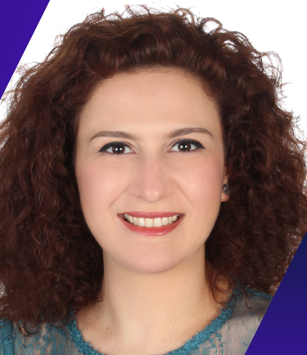
MARINA BECHAALANI
Murex. Beirut, Lebanon
Measuring Release Quality
& Delivering Release Value

Slide 2


Capital Markets Technology
32 Years of Innovation & Partnership

Slide 3

A worldwide presence
Strategically located to be close to our customers
4 regional hubs
18 offices covering all time zones
Dublin
London
Moscow
Toronto
Paris
Luxembourg
Beijing
57,000 users
New York
Cyprus
Seoul
Tokyo
Beirut
Dubai
Hong Kong
300+ clients
Singapore
60 countries
Santiago
Sao Paulo
Sydney

Slide 4












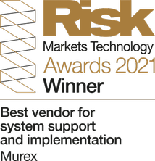





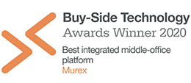




Murex is a recognized industry leader
Overall #1 top technology vendor
2013, 2014, 2015, 2016, 2017, 2018, 2019, 2020, 2021
2020
2021

Slide 5
BIG CHALLENGE AS A RELEASE TEST LEAD
HOW WILL I MEASURE RELEASE QUALITY?

Slide 6

GETTING INSPIRED FROM ALREADY USED KPIS?
Passed Test Cases Coverage = (Number of passed tests / Total number of tests executed) x 100
Defect Leakage = (Total Number of Defects Found in UAT (User Acceptance Tests)/ Total Number of Defects Found Before UAT) x 100
Defect Removal Efficiency= Number of defects resolved by the development team/ (Total number of defects at the moment of measurement)
Defect Category = Defects belonging to a particular category/ Total number of defects.
Defect Severity Index (DSI) = Sum of (Defect * Severity Level) / Total number of defects
Defect Density = Defect Count/Size of the Release/Module
Test Cases Blocked = (Number of blocked tests / Total number of tests executed) x 100
Number of Test Run Per Time Period = (Number of test run / Total time)
Test Effectiveness (TEF) = (Total number of defects injected + Total number of defects found / Total number of defect escaped) x 100
…

Slide 7
NOT ALWAYS ADAPTED TO OUR CONTEXT

Slide 8
GETTING INSPIRED FROM SOFTWARE QUALITY DEFINITIONS?
Software quality is the degree of conformance to explicit or implicit requirements and expectations.
The degree to which a system, component, or process meets specified requirements.
The degree to which a system, component, or process meets customer or user needs or expectations.
The totality of functionality and features of a software product that bear on its ability to satisfy stated or implied needs.
Quality is a customer determination, not an engineer's determination, not a marketing determination, nor a general management determination. It is based on the customer's actual experience with the product or service, measured against his or her requirements -- stated or unstated, conscious or merely sensed, technically operational or entirely subjective -- and always representing a moving target in a competitive market.
…

Slide 9
FAR FROM CONCRETE MEASUREMENTS
UNTIL I FOUND…

Slide 10
“QUALITY IS VALUE TO SOME PERSON, AT SOME TIME, WHO MATTERS”
ADAPTABLE TO EACH ONES CONTEXT
ASSOCIABLE TO MEASUREMENTS
Thank you, Gerald Weinberg, Mickael Bolton and James Bach!

Slide 11
BY THE END OF THE SESSION
STEP1
DEFINING THE VALUES
STEP2
DEFINING THE KPIS ASSESSING THE STATUS OF VALUES
STEP3
GATHERING FEEDBACK FROM RELEASES USED BY CLIENTS
STEP4
USING THE METRICS

Slide 12
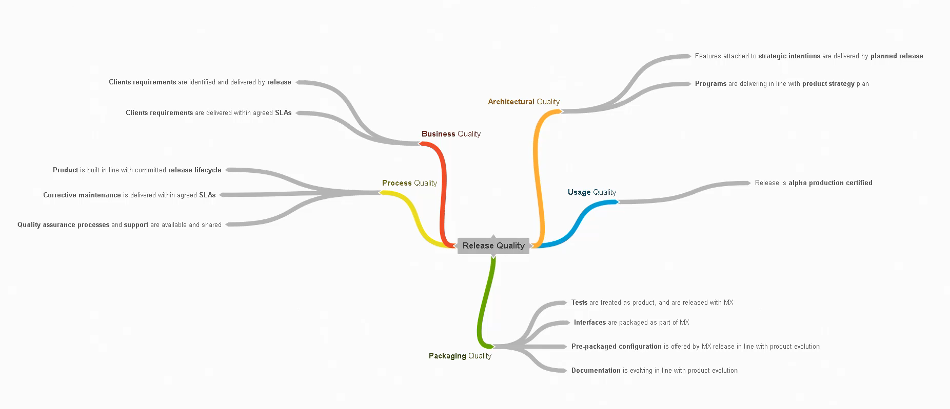
STEP
1
QUALITY ASSURANCE CLIENT SERVICES
PRODUCT MANAGEMENT
DEVELOPMENT
DEFINING VALUES OF RELEASEt USERS/CONSUMERSt
BRAINSTORMING WITH STAKEHOLDERS

Slide 13


STEP
2
EVALUATING STATUS OF VALUES THROUGH
AVAILABLE AND MEASURABLE KPIS
Client requirements are identified and delivered by release
Value for a person
100% of client requested features JIRA tickets have Status=Closed at release branch creation
KPI customized to available data
300 features are targeting a release
We still have 4 months to release
45 features (15%) are done
?

Slide 14
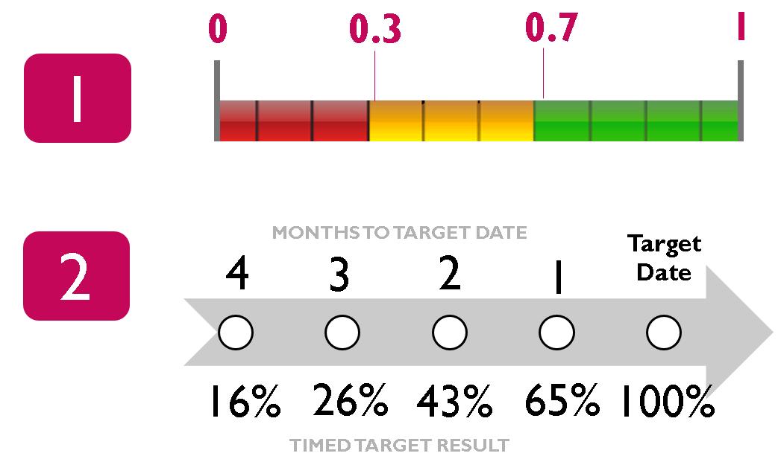

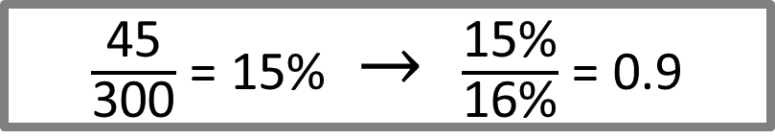
STEP
2
EVALUATING STATUS OF VALUES THROUGH
AVAILABLE AND MEASURABLE KPIS
Client requirements are identified and delivered by release
Value for a person
100% of client requested features JIRA tickets have Status=Closed at release branch creation
KPI customized to available data
$\frac{\text{45}}{\text{300}}$ = 15% $\text{→}$ $\frac{\text{15\%}}{\text{16\%}}$ = 0.9

Slide 15
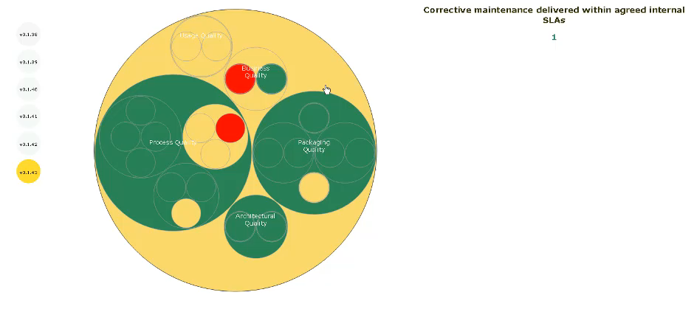

STEP
2
EVALUATING STATUS OF VALUES THROUGH
AVAILABLE AND MEASURABLE KPIS
Release Quality Progress Indicator
Visual representations of data
effective mean of conveying meaningful information
Open-source JavaScript library to create custom interactive data visualizations​
Dynamic, intuitive and needs minimum amount of effort​
Uses SVG, HTML and CSS​

Slide 16
STEP
3
EVALUATING STATUS OF VALUES AFTER RELEASING
Client requirements are identified and delivered by release
Value for a person
100% of client requested features JIRA tickets have Status=Closed at release branch creation
KPI customized to available data
Number of defects do not exceed the equivalent of 2 severity 1 regressions per release
KPI after releasing
100 defects with following severity and type have been seen by clients on release R1 and release R2
 | S1 | S2 | S3 | S4
Bug | 1 | 8 |  | 89
Regression |  | 2
 | S1 | S2 | S3 | S4
Bug |  | 3
Regression |  |  | 50 | 47
RELEASE R1
RELEASE R2
?

Slide 17
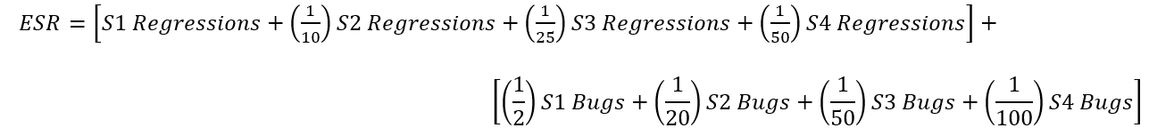
STEP
3
EVALUATING STATUS OF VALUES AFTER RELEASING
Client requirements are identified and delivered by release
Value for a person
100% of client requested features JIRA tickets have Status=Closed at release branch creation
KPI customized to available data
Number of defects do not exceed the equivalent of 2 severity 1 regressions per release
KPI after releasing
WEIGHT REGRESSIONS > WEIGHT BUGS
WEIGHT S1 > WEIGHT S2 > WEIGHT S3 > WEIGHT S4
WEIGHTS BASED ON HISTORICAL DATA
Equivalent S1 Regressions
$$ESR R1=1.99 ESR R2=3.09$$

Slide 18

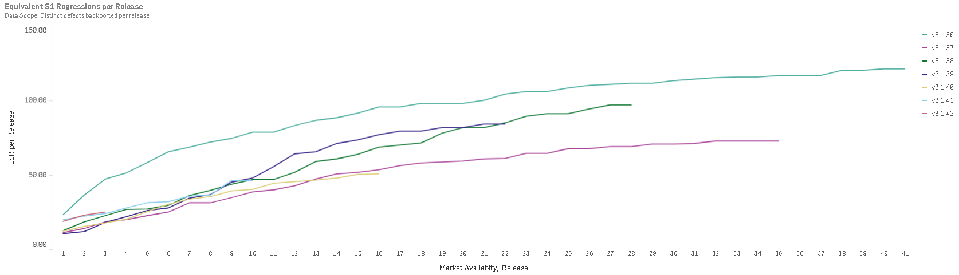

STEP
3
EVALUATING STATUS OF VALUES AFTER RELEASING
Client requirements are identified and delivered by release
Value for a person
100% of client requested features JIRA tickets have Status=Closed at release branch creation
KPI customized to available data
Number of defects do not exceed the equivalent of 2 severity 1 regressions per release
KPI after releasing
ESR per release
R1
R2
R3
R4
R5
R6
R7
Months after market availability of release
Drill down per client built

Slide 19

STEP
4
USING THE METRICS
SOFTWARE ENGINEERING MANAGEMENT
QUALITY ASSURANCE MANAGEMENT
PORTFOLIO MANAGEMENT
SOFTWARE DEVELOPMENT MANAGEMENT
RELEASE MANAGEMENT
PRODUCTION AND ARCHITECTURE MANAGEMENT
CLIENT SERVICES MANAGEMENT
FOR GLOBAL DECISIONS
RELEASE BOARD INCLUDING AROUND 10 PERSONS
MEETING ONCE PER MONTH
DELAYING MARKET AVAILABILITY OF A RELEASE
to reach adequate level of quality for current release
PERFORMING GLOBAL CLIENT RETROSPECTIVES
to reach adequate level of quality for future releases
Decisions
such as

Slide 20
STEP
4
USING THE METRICS
FOR SPECIFIC DECISIONS
A management cliché says
WHAT GETS MEASURED GETS DONE
Metrics shared to ~800 concerned stakeholders
Basic tools shared to analyzed data
Detailed analysis and customized tooling done by stakeholders
THE “WHY” WAS SHARED,
THE “HOW” TO BE FINE-TUNED BY STAKEHOLDERS

Slide 21
THIS IS HOW MUREX DID IT
STEP1
DEFINING THE VALUES
STEP2
DEFINING THE KPIS ASSESSING THE STATUS OF VALUES
STEP3
GATHERING FEEDBACK FROM RELEASES USED BY CLIENTS
STEP4
USING THE METRICS

Slide 22
Questions?
Questions?
Twitter. @marinabechalani
Email. mbechaalani@murex.com
Twitter. @marinabechalani
Email. mbechaalani@murex.com

Slide 23
REFERENCES
https://www.thinksys.com/qa-testing/software-testing-metrics-kpis/
http://tryqa.com/what-is-software-quality/
Contemporary Complex Systems and Their Dependability
http://softwaretestingfundamentals.com/software-quality/
https://flowoftesting.wordpress.com/2014/05/26/what-is-quality/
https://www.a1qa.com/blog/interview-with-michael-bolton-part-1/
https://secretsofconsulting.blogspot.com/search?q=quality
https://d3js.org/
https://www.qlik.com/us/products/qlik-sense

