Slide 1


Slide 2
За что банит Google (и Apple)
Павел Щедухин Head of Mobile QA

Slide 3
Про что?
1
2
3
Кейс
Причина
Что делать?

Slide 4


Гайдлайны
App Store Review Guidelines
Developer Policy
Monetization and Ads
Restricted Content
UIKit
WatchKit
Store Listing and Promotion
Malware
AppKit
Human Interface Guidelines
Intellectual Property
Impersonation
Apple File System
Privacy, Deception and Device Abuse
App Extensions
Apple Pay Marketing Guidelines
Spam and Minimum Functionality
iOS Data Storage Guidelines
Families
Enforcement
Other Programs
Marketing Resources and Identity Guidelines

Slide 5

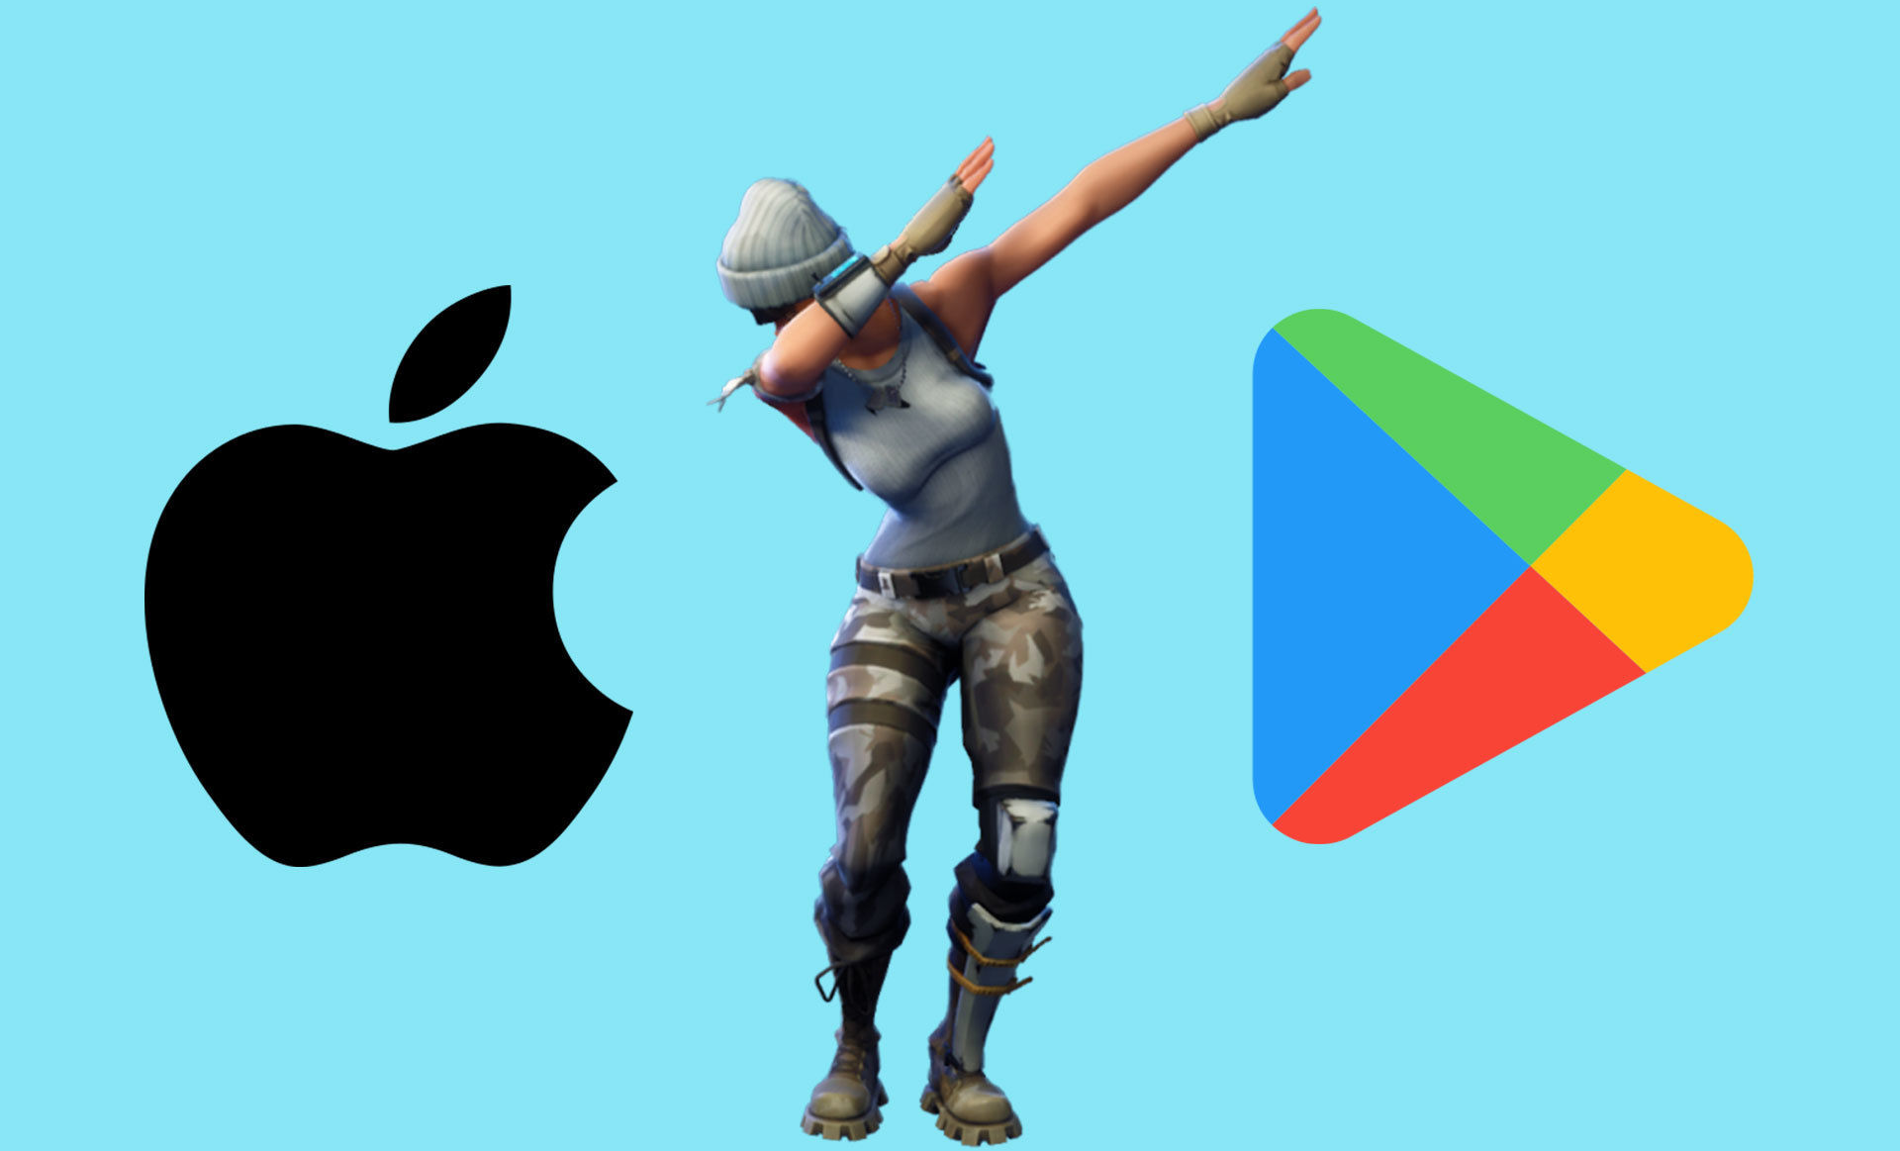
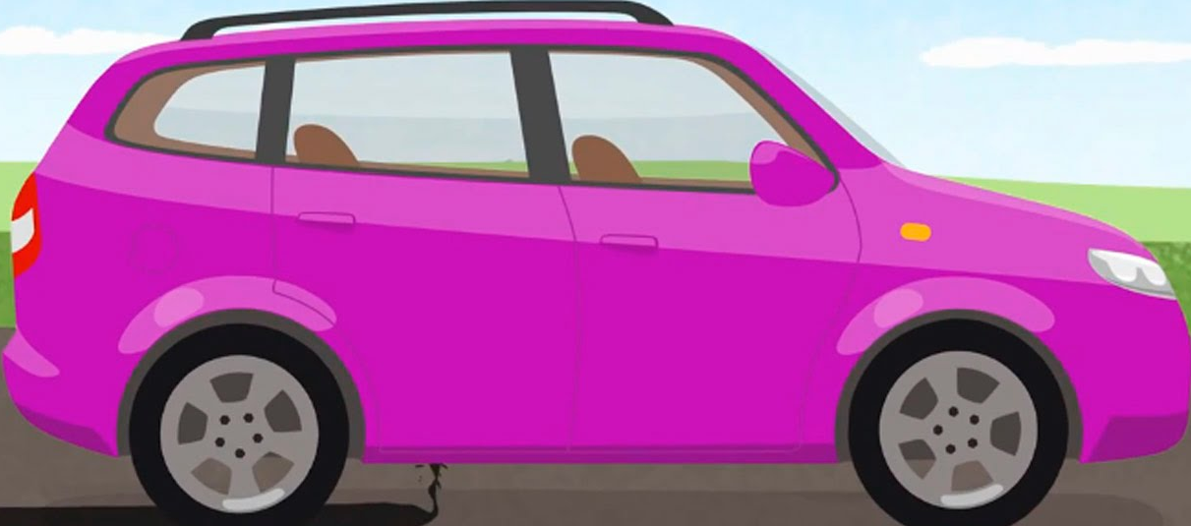
Покупки не через сервисы G&A
Developers offering products within a game downloaded on Google Play or providing access to game content must use Google Play In-app Billing as the method of payment.
ОК
Не ОК
3.1.1 In-App Purchase: Apps and their metadata may not include buttons, external links, or other calls to action that direct customers to purchasing mechanisms other than in-app purchase.

Slide 6
COVID-19
5.2.1 “apps should be submitted by the person or legal entity that owns or has licensed the intellectual property and other relevant rights.”
8.3 Google Play Developer Distribution Agreement

Slide 7
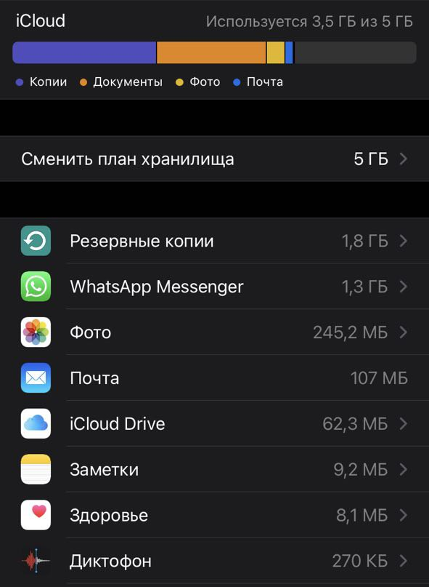
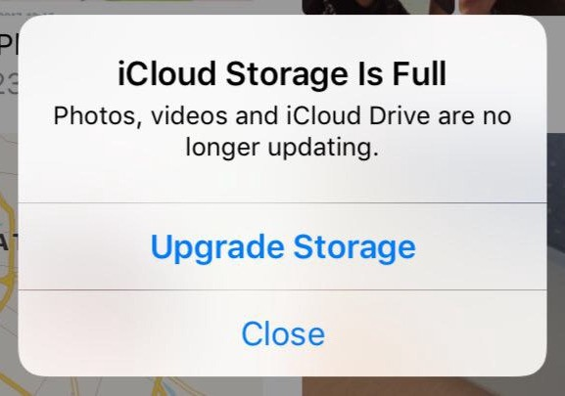
Хранение данных
Only documents and other data that is user-generated, or that cannot otherwise be recreated by your application, should be stored in the <Application_Home>/Documents directory and will be automatically backed up by iCloud

Slide 8
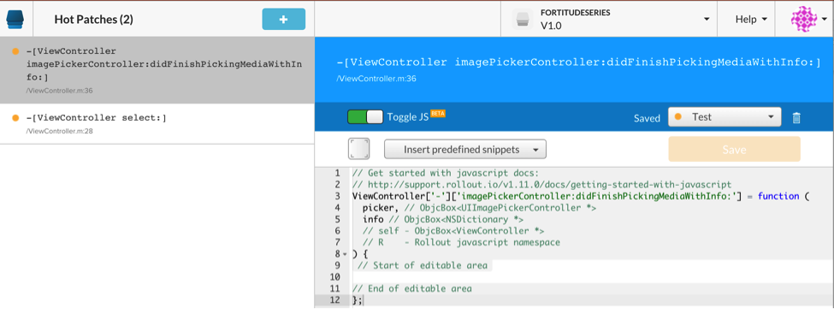
Изменение кода без обновления
Фичефлаги
2.5.2 Apps should be self-contained in their bundles, and may not read or write data outside the designated container area, nor may they download, install, or execute code
An app distributed via Google Play may not modify,
replace, or update itself using any method other than
Google Play's update mechanism

Slide 9
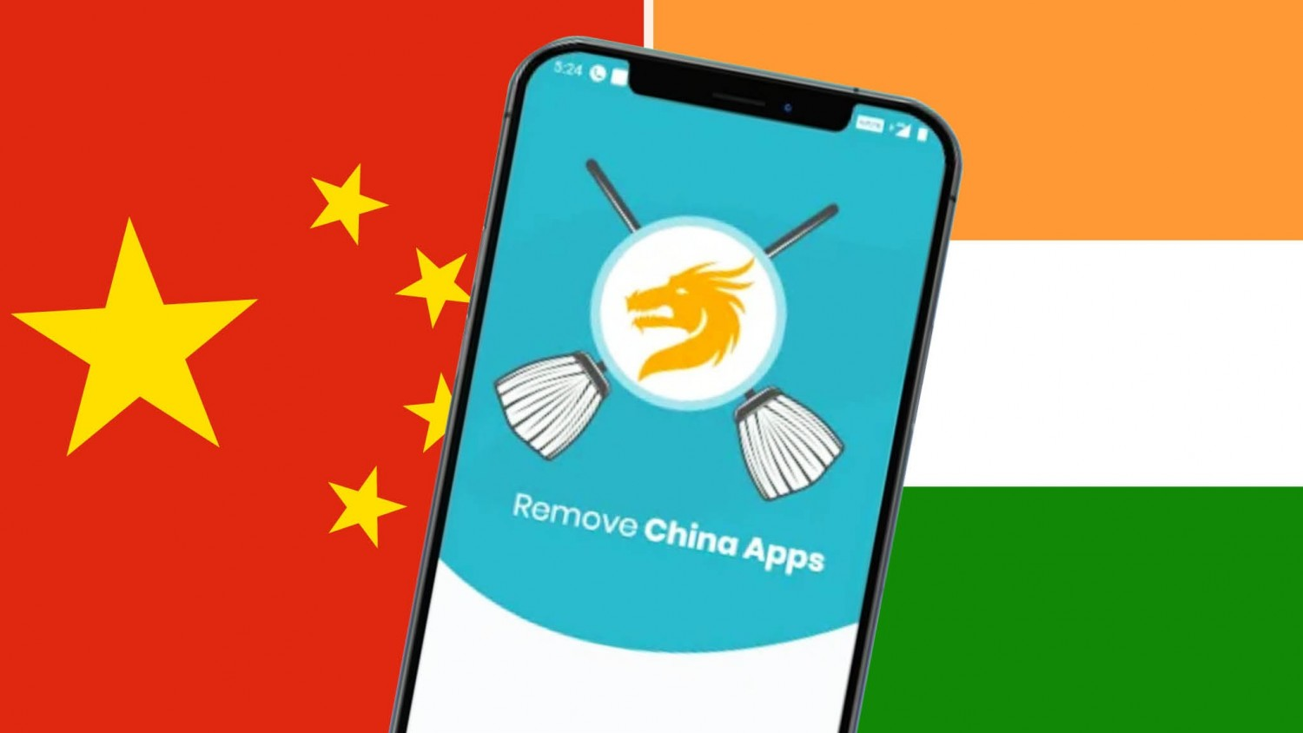
Удаление других приложений
Apps that mislead users into removing or disabling third-party apps or modifying device settings or features.

Slide 10
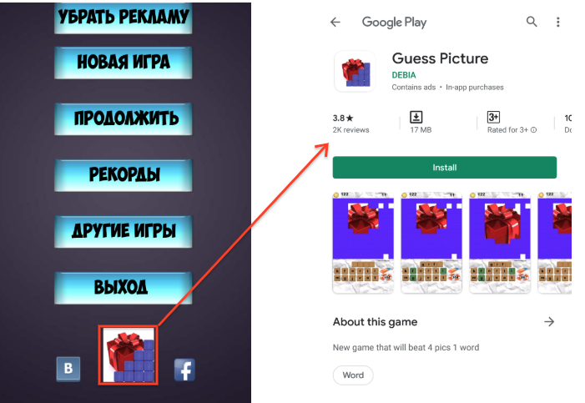
Ссылки на другие приложения
AD:
Ads must not simulate or impersonate the user interface of any app, notification, or warning elements of an operating system
Interstitial ads or ads that interrupt or block the user experience must clearly indicate that they are an ad

Slide 11



18+
Clothing that provides excessively tight, or minimal coverage of breasts, buttocks, or genitalia
"explicit descriptions or displays of sexual organs or activities intended to stimulate erotic rather than aesthetic or emotional feelings."

Slide 12
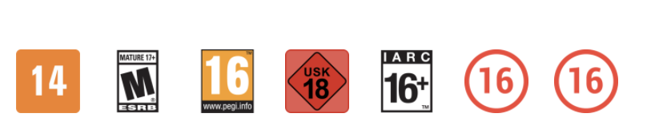
Слишком взрослый рейтинг
we determined that some elements of your store listing may appeal to children under 13:
Animated characters in the app icon.
Young characters.

Slide 13
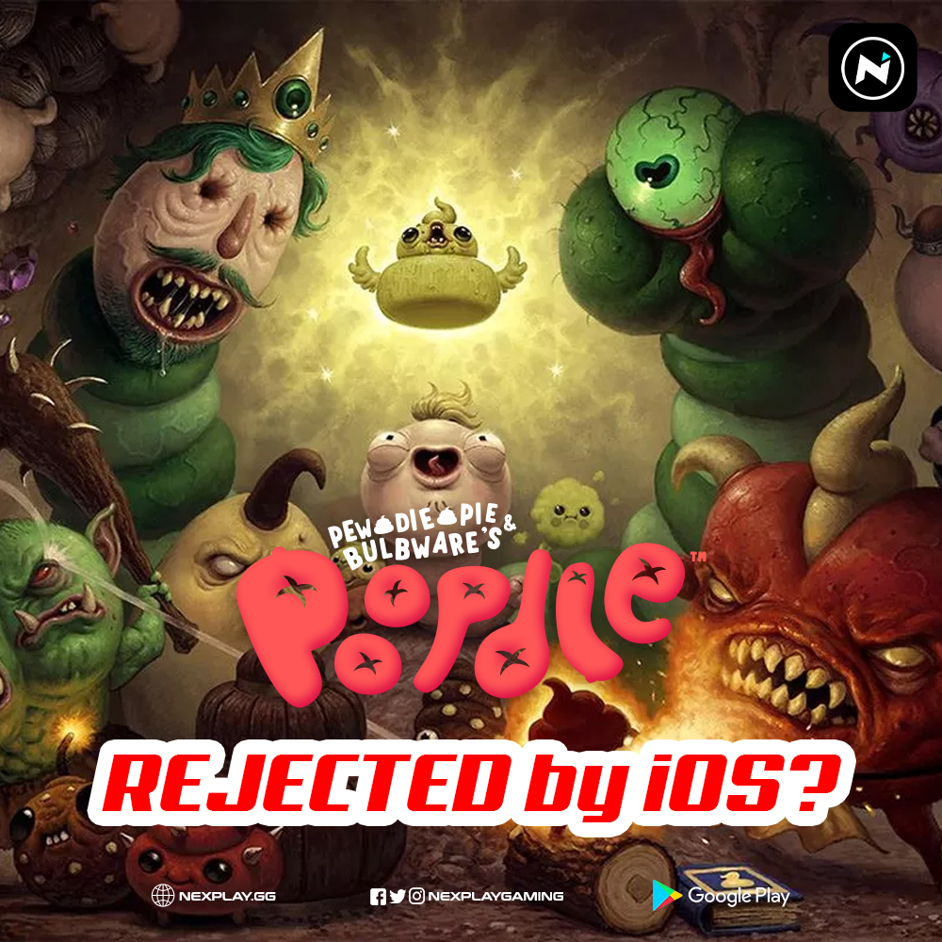
Изображения или звуки, которые…
Hate Speech
Violence
Sensitive Events
Bullying and Harassment
1.1 Apps should not include content that is offensive, insensitive, upsetting, intended to disgust, in exceptionally poor taste, or just plain creepy
Долгое исправление текущих багов
Отключение старого функционала очень сложное
Мелкие фичи ждут большую

Slide 14
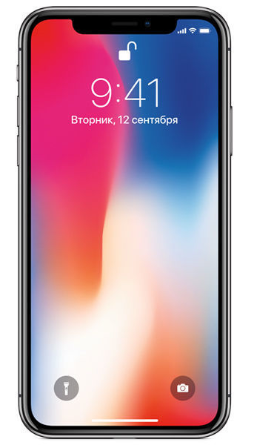
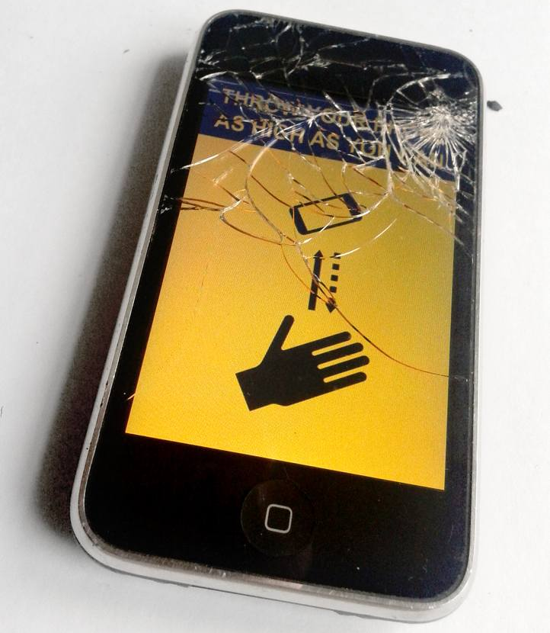
Повредить телефон
2.4.2 Design your app to use power efficiently and be used in a way that does not risk damage to the device.
If Your Product contains elements that could cause serious harm to user devices or data, Google reserves the right to disable the Product or remove it from Devices
Долгий регресс
Долгое исправление багов
Много хотфиксов

Slide 15
Апелляции
https://support.google.com/googleplay/android-developer/answer/2477981?hl=en
https://developer.apple.com/contact/app-store/?topic=appeal

Slide 16
Выводы
Читайте гайдлайны. И не только гайды ревью.
Опирайтесь на чужой опыт.

Slide 17
Спасибо за внимание!
Павел Щедухин
pshchedukhin@ozon.ru
https://telegram.me/unlying

