Slide 1
6 ways how to manage the risk taking in enhancing Your talents as a Tester
Michał Buczko

Slide 2

Software quality assurance days
26 International Conference on
Software Quality Assurance
sqadays.com
sqadays.com
Michał Buczko
SpyroSoft Solutions. Wroclaw, Poland
6 ways how to manage the risk taking
in enhancing Your talents as a Tester
Minsk, Belarus. November 15-16, 2019

Slide 3
Introduction – WHY?
Core message – HOW?
Summarize – NEXT STEPS?
Q&A – Lunch ☺
6 ways how to manage the risk taking
in enhancing Your talents as a Tester

Slide 4
Introduction
Why we are here?
6 ways how to manage the risk taking
in enhancing Your talents as a Tester

Slide 5
Why him?
6 ways how to manage the risk taking
in enhancing Your talents as a Tester
Spyrosoft
Test Manager
15 years of expirience
Public Speaker
Consultant
Part of recruitment team of testers at all levels for different specialities

Slide 6
Why this topic?
6 ways how to manage the risk taking
in enhancing Your talents as a Tester
Personal Developement Plan
Carrer paths
Talents
Testing specializations
Risk-taking
Personal Growth
MIT research
Junior Testers?

Slide 7
How to grow Your Talents? Why risk-taking?
6 ways how to manage the risk taking
in enhancing Your talents as a Tester

Slide 8

1. Know what You know and what You do not know
6 ways how to manage the risk taking
in enhancing Your talents as a Tester
Understand Your limits
Recognize your preferences
Resist predicting outcomes on limited evidence
Gather information before actions
Aknowledge bises that affect judgement
Photo by Sharon McCutcheon on Unsplash

Slide 9

2. Take risks incrementally
6 ways how to manage the risk taking
in enhancing Your talents as a Tester
Small initial investment
Build protorypes
Evluate the idea
Work as it is experiment
Decide if invest further
Test and collect information
new projects,
new technologies
new tools
Photo by Sammie Vasquez on Unsplash

Slide 10
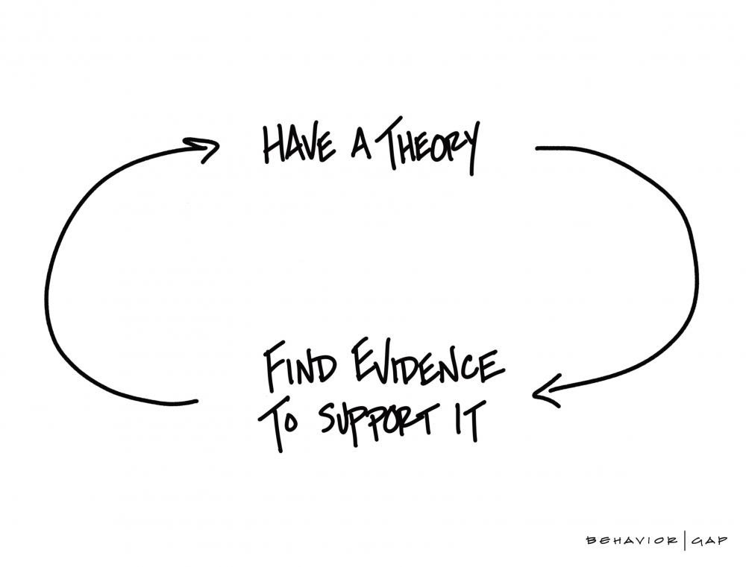
3. Beware of confirmation bias while learning
6 ways how to manage the risk taking
in enhancing Your talents as a Tester
It affects Your learning
It affects Your projects
Stay positive to all counters to Your idea or concept
It affects Your decisions
Consult with people with opposite view
Sketch by Carl Richards on behaviorgap.com

Slide 11

4. Construct scenarios for growth decision making
6 ways how to manage the risk taking
in enhancing Your talents as a Tester
Envision the future
Analyze different directions
Estimate outcomes in all directions
Bring the potential risks into the light
Balance the chosen path against existing risks
Photo by Ian Schneider on Unsplash

Slide 12

5. Don’t gamble
6 ways how to manage the risk taking
in enhancing Your talents as a Tester
Use careful calculated risks
Remember the priorities and project responsibilities before jumping to a new fancy idea
Always have a plan to mitigate the risks
Collect feedback and adapt if required
Photo by Heather Gill on Unsplash

Slide 13

6. Kill unimportant projects
6 ways how to manage the risk taking
in enhancing Your talents as a Tester
Don’t over estimate number of projects You can handle
Build a shorlins of pprojects You are involved
Evaluate the projects of short loop
Keep focus on the ones connected with Your plan nd purpose
Ditch the rest
Photo by Aron Visuals on Unsplash

Slide 14
Bonus rule:
Build Your own plan and use it.
Do not wait for the company to fit You to their plan.
6 ways how to manage the risk taking
in enhancing Your talents as a Tester

Slide 15







To summarize:
6 ways how to manage the risk taking
in enhancing Your talents as a Tester
Understand You knowledge and its limits
Take risks incrememntaly
Beware of confirmation bias while learning
Construct scenarios for growth decision making
Don’t gamble
Kill unimportant projects
Photo by Kimberly Farmer on Unsplash

Slide 16
Contact
6 ways how to manage the risk taking
in enhancing Your talents as a Tester
buczko.michal@gmail.com
@docatisto
https://www.facebook.com/buczkomichal
https://www.linkedin.com/in/buczkomichal/
https://www.spyro-soft.com/
6 ways how to manage the risk taking
in enhancing Your talents as a Tester

Slide 17
Michał Buczko
6 ways how to manage the risk taking
in enhancing Your talents as a Tester

