Slide 1
JDI Nova
Roman Iovlev
30.10.2021

Slide 2




ROMAN IOVLEV
QA Architect
JDI Evangelist
More than 16 years in Testing
More than 14 years in Test Automation
http://roman-iovlev.site/
roman.Iovlev
roman.Iovlev.jdi@gmail.com

Slide 3
AGENDA
1
Simple demo
2
Collections of the elements (JDI Light)
3
JDI Nova – fast and stable JS Driver
4
Layout and Visual Validation (JDI Nova)
5
What else?

Slide 4
JDI Nova
Fast and Stable Test Automation Framework

Slide 5
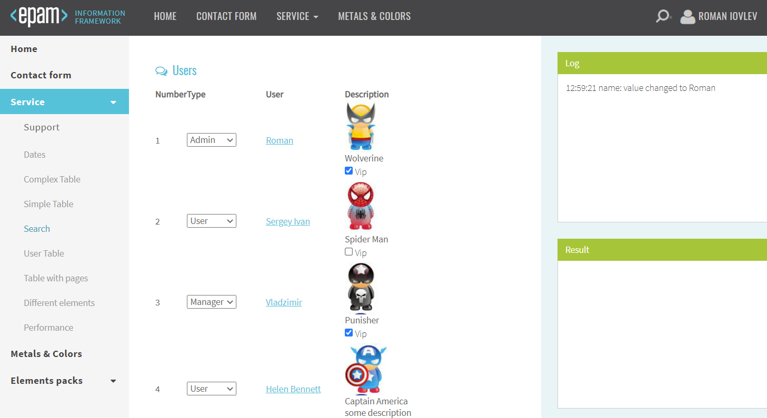
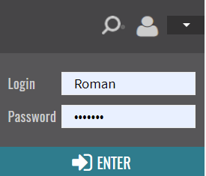
2
3
5
Open page "https://jdi-testing.github.io/jdi-light"
Click User Icon
Login as Default User
Select in the Side Menu "Service“ > "User Table“
Check that data in 2nd row in User Table is equals to “SpiderMan” data
4

Slide 6
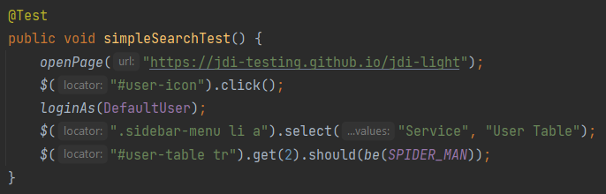
JDI Nova scenario

Slide 7
JDI Nova – Multiple data in one request
Json data = element.getJson("{
'id': element.id,
'value': element.value,
'valueA': element.getAttribute(‘value’),
'tag': element.tagName,
'font': styles.fontSize,
'bg-color': styles.backgroundColor }");
…
data.get(“font”);
data.get(“tag”);

Slide 8
JDI Nova – Multiple data in one request
Product product = element.getEntity();
assertEquals(product.name, “Jdi”);
Strint expectedTitle = product.title;
assertThat(product.price, moreThan(100));
public class Product { String name;
String title;
int price;
…
}
List<Product> products = element.getEntityList();
loginAs(AdminUser);
fillForm(ContactDetails)

Slide 9
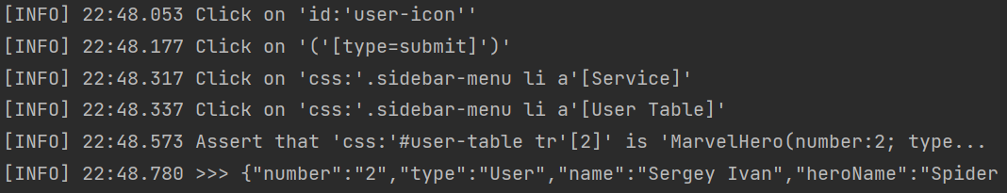
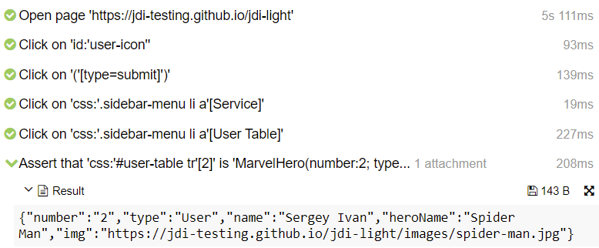
Logs and Reports

Slide 10
Compare to Selenium and Selenide

Slide 11
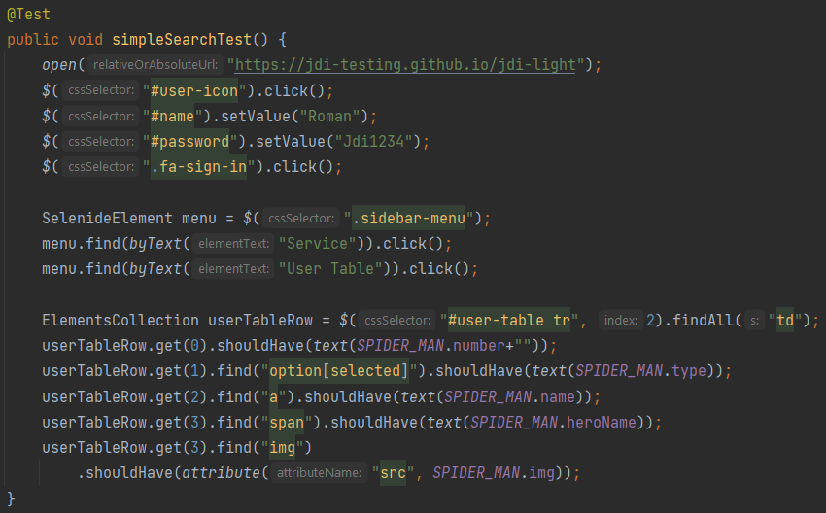
Selenide scenario

Slide 12
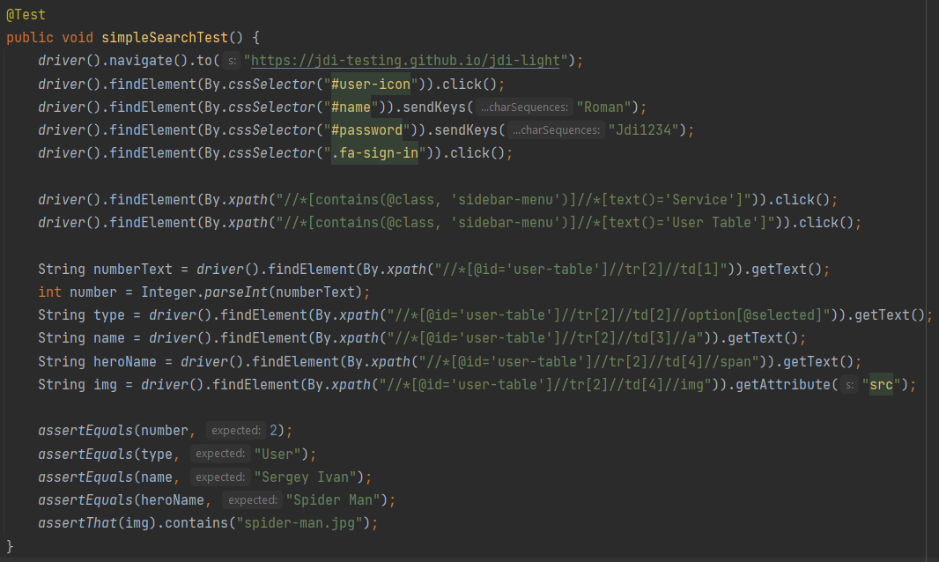
Selenium scenario

Slide 13
JDI Nova scenario

Slide 14
JDI Nova – Boost
ACTION | SELENIUM | SELENIDE | JDI NOVA | Boost
Check one Super Hero | 808 ms | 1000 ms | 392 ms | x2 / x2.5
 | 1226 symb | 703 symb | 195 symb | -84%(x6.3)
Check all (6) Heroes | 1383 ms | 2124 ms | 410 ms | x3.4 / x5.1
 | 1360 symb | 864 symb | 246 symb | -82%(x5.5)
https://github.com/jdi-testing/jdi-nova/blob/master/tests-jdi-nova/src/test/java/com/jdiai/tests/benchmarks/BenchmarkTests.java

Slide 15




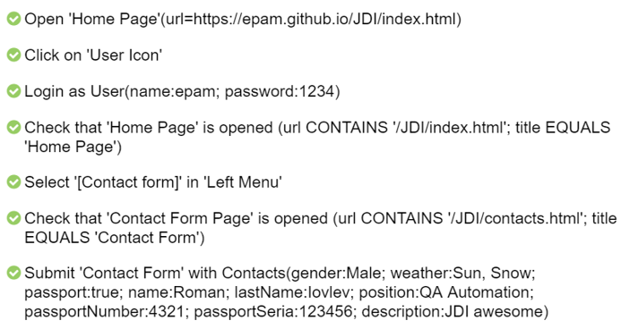
JDI Nova – Develop with pleasure
SPEED
CLEARNESS
HAPPYNESS
STABILITY
DETAILED LOGS AND REPORTS

Slide 16
JDI Nova – Actions Boost
ACTION | SELENIUM | JDI NOVA | JDI NOVA Boost (times)
 |  |  | average | min | max
Get text | 11.5 ms | 4.3 ms | 2.7 | 2.2 | 4
Chain locators | 26.7 ms | 5.4 ms | 5 | 3.4 | 8.3
Multiple attributes | 28.9 ms | 4 ms | 7 | 5.6 | 10
Multiple elements | 59.1 ms | 5.8 ms | 10.2 | 7.7 | 16.5
Find first in table (398/400) | 6480 ms | 9.5 ms | 684.5 | 219.6 | 920.1
Get list values (400) | 2825 ms | 8.2 ms | 343.1 | 263.2 | 450.3
https://github.com/jdi-testing/jdi-nova/blob/master/tests-jdi-nova/src/test/java/com/jdiai/tests/benchmarks/BenchmarkTests.java

Slide 17
Page Objects

Slide 18
JDI Nova – Cascade PageObjects
$(“.submit-form”, “/..”, “li.item”).getText();
element.find(“.some”).ancestor().children();
PAGE OBJECTS
public class ContactPage {
@UI("#contact-form") public ContactForm contacts;
…
public class ContactForm extends Section {
@UI(“//*[.=‘Personal Data’]") public PersonalData contacts;
…
public class PersonalData extends Section {
@UI("[type=submit]") public JS submitButton;
…
submitButton.click();

Slide 19
UI Objects

Slide 20
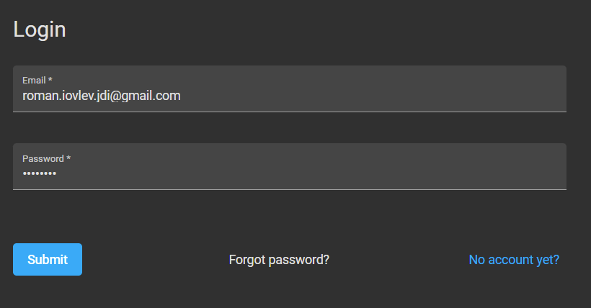
Page Objects (recap)
Design Pattern developed by Selenium team
Each page (or valuable section) of the application represented by Page Object class

Slide 21
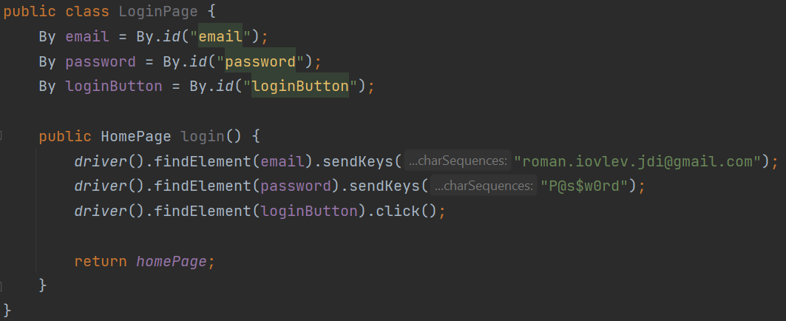
Page Objects (recap)
Concept described by Selenium developers
Each page (or valuable section) of the application represented by Page Object class
Page Object class consists of actions on the page (methods) and elements (optionally)

Slide 22
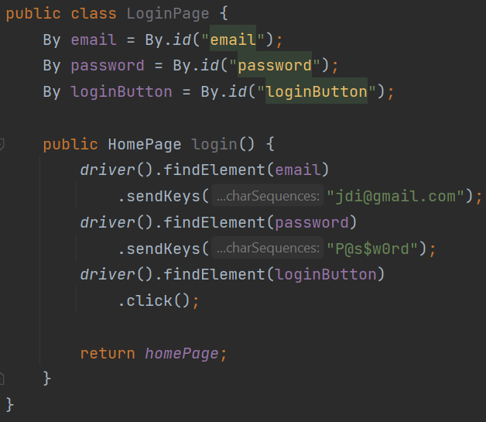
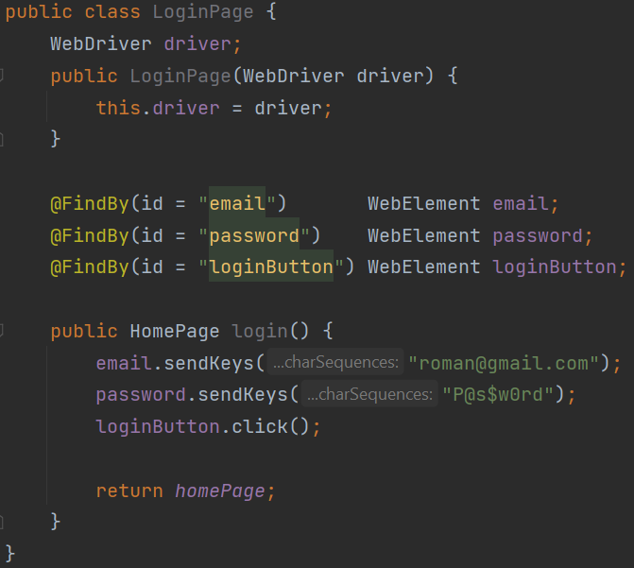
Page Factory (recap)

Slide 23
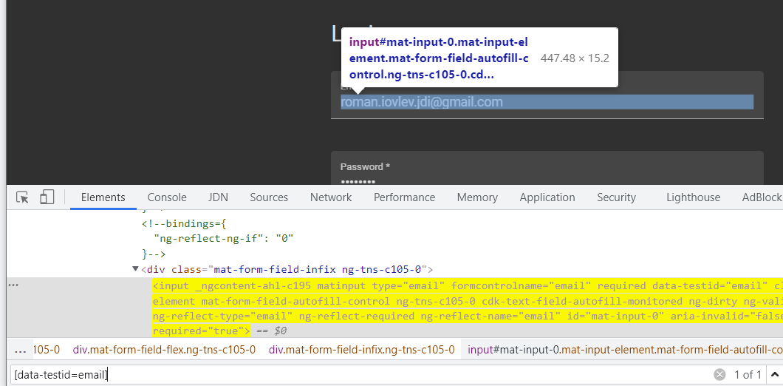
Page Objects (recap)
Concept described by Selenium developers
Each page (or valuable section) of the application represented by Page Object class
Page Object class consists of actions on the page (methods) and elements (optionally)
Note: WebElement - represents tag in html structure. Not always UI Element

Slide 24
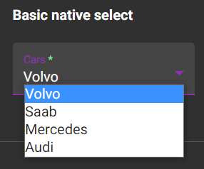
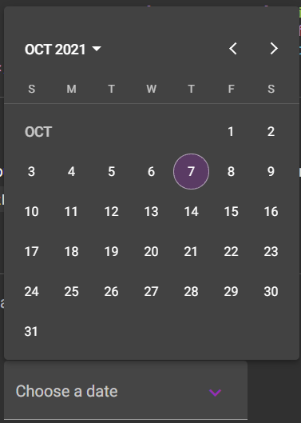
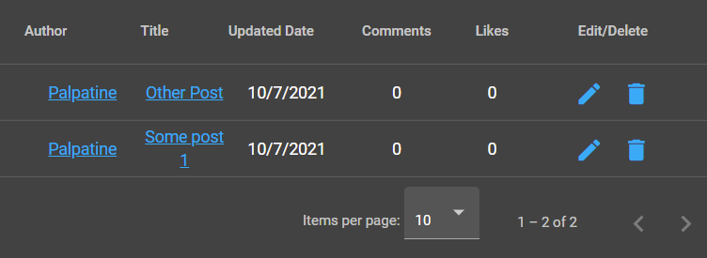
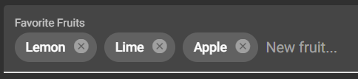
Page Objects not equals User Interface Element
Dropdown
DatePicker
Table
Chips

Slide 25
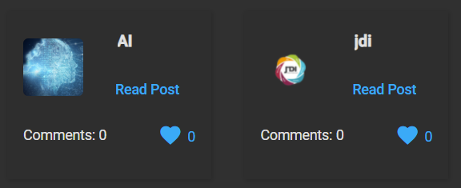
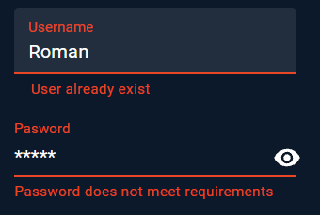
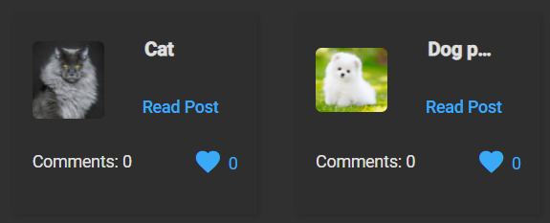
Page Objects not equals User Interface Element
Card tiles
Textfield or Password

Slide 26
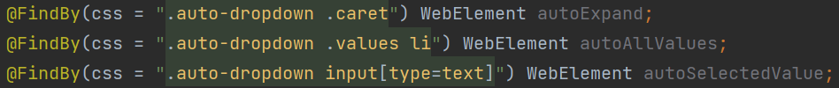
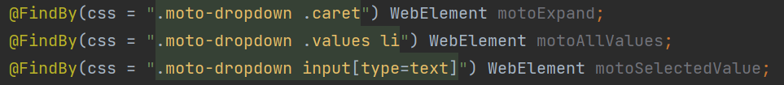
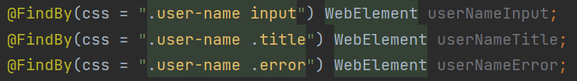
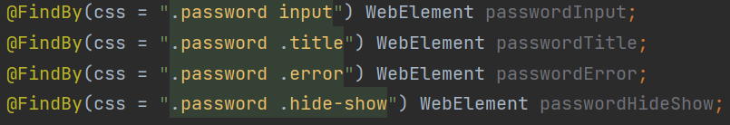
Complex elements in Selenium / Selenide
Dropdown
Textfield / Password

Slide 27
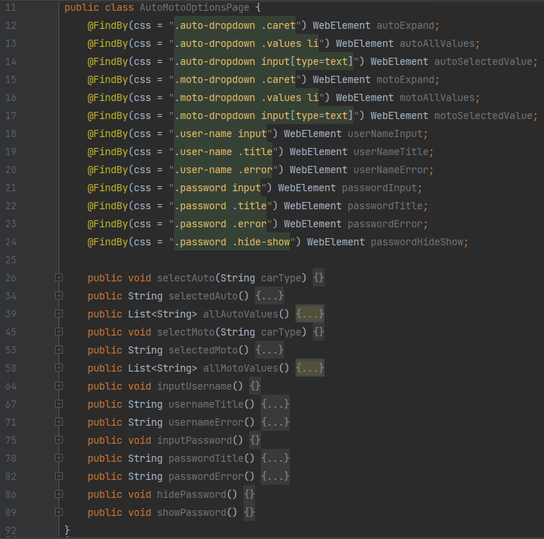
Complex elements in Selenium / Selenide
About 100 lines of code for 4 standard elements
Problems:
Code mess
Amount of code / time
Code duplication for each element of the same type

Slide 28
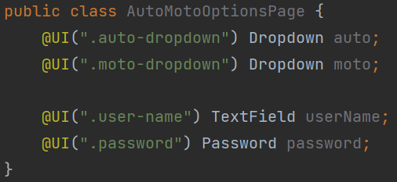
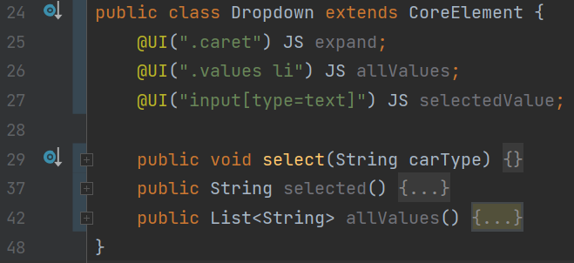
UI Objects – JDI Light / JDI Nova
Only 4 lines of code for user
Simple to understand
Easy to Develop
Easy to Maintain
Scalability

Slide 29
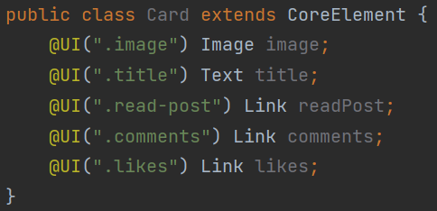
JDI Nova – List of elements
Card tiles

Slide 30
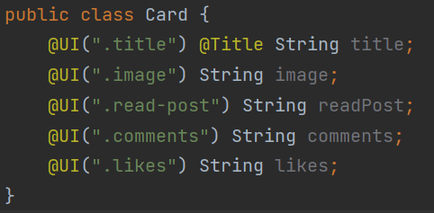
JDI Nova – List of data entities
Card tiles

Slide 31





JDI Light
Collections of standard frameworks elements
Html 5 (https://developer.mozilla.org/en-US/docs/Web/HTML/Element )
Angular Material UI (https://material.angular.io/components/ )
Bootstrap (https://getbootstrap.com/docs/5.1/components/ )
React Material UI (https://mui.com/components/ ) – In Progress
Vue Vutify (https://vuetifyjs.com/en/components/inputs/ ) – In Progress

Slide 32
Conclusion - profit
UI Objects approach allow:
QA Engineer:
Develop your own specific Components
Write obvious and Simple Page Objects (or even generate them)
Save your time on both development and maintenance (write more stable tests)
Generate Live documentation from your tests
Business:
Tests that you can trust (stable and with all evidences)
Shift left (fast tests development and fixes) – Reduce regression cycle
Live documentation after tests execution – Evaluate results (GXP)

Slide 33
Layout and Visual validations
JDI Nova

Slide 34
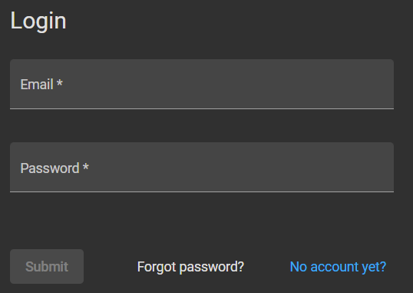
Login Form
95% QA Engineers will write tests like:
Correct login
Incorrect login
Forgot password
etc. – functional tests

Slide 35
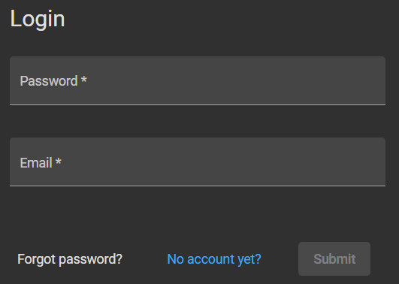
Find 5 differences

Slide 36
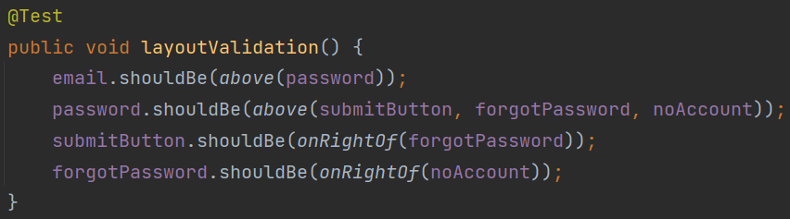
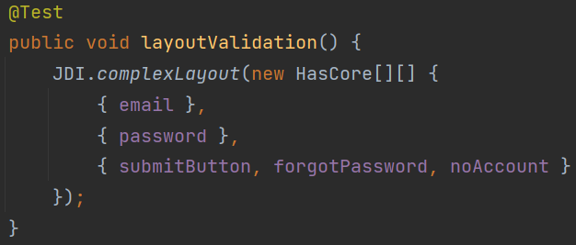
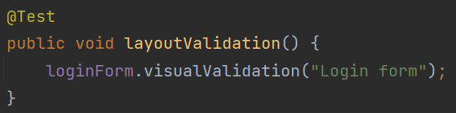
Layout and visual validation
Layout validation
Visual validation

Slide 37
JDI Nova Highlights
Test Framework based on JS Builder
Fastest Java Test Framework (5 - 1000 times faster than Selenium and Selenide)
Simple to use framework (like Selenide)
Stable execution of all elements (like in Selenide)
Extremely simple, clear and readable UI Objects
Provide detailed user actions logs (console / file / Allure report)
Provide Live Documentation (executed test scenarios steps and evidences)

Slide 38
JDI Nova Highlights
Huge number of basic actions (all Selenium-Selenide actions and more)
Layout Validation
Image validation / Record Canvas video
Right/Double click/DragNDrop/Bg-color/Covered/Visible elements etc.
Work with Styles, Attributes and Properties
Work with list entitles as Data
Cons (Warning)
New framework – small community
In Beta test - poor documentation (will be fixed soon)

Slide 39
What next in JDI Nova?
Contribute:
JDI Nova is in the beta test, we will be appreciated for help in:
Feedback
Ideas
Tests or documentation
Write code
Join YouTube channel: "JDI IT - Interesting Testing"

Slide 40

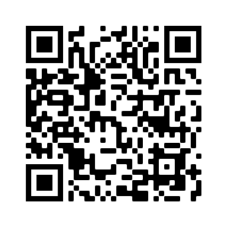


YouTube channel
https://www.youtube.com/channel/UCck0VgwbPVgXht5ah6PGCdgg

Slide 41
SUMMARY
JDI Nova

Slide 42
JDI Nova Summary

Slide 43
JDI Nova – Develop with pleasure
SPEED
CLEARNESS
HAPPYNESS
STABILITY
DETAILED LOGS AND REPORTS

Slide 44

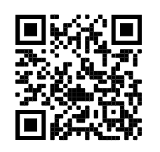
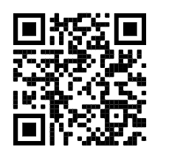


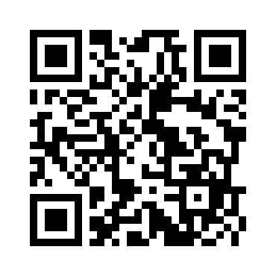

Thank you!
https://jdiai.com/
roman.Iovlev
roman.Iovlev.jdi@gmail.com

