Slide 1
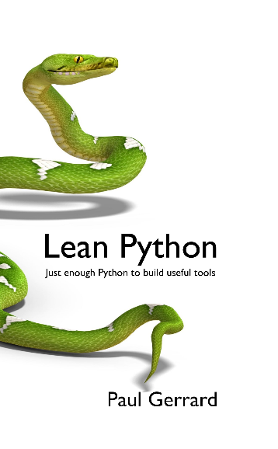


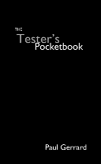
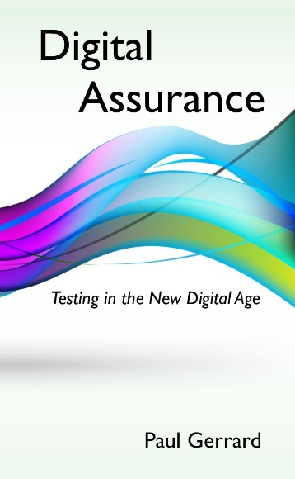
Building a Software Community-Driven Tester Skills Programme
Paul Gerrard
paul@gerrardconsulting.com
Web: gerrardconsulting.com
@paul_gerrard
LinkedIn: linkedin.com/in/paulgerrard

Slide 2














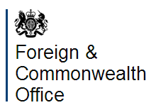







Helping clients transform their testing through
INNOVATION, COACHING and LEADERSHIP
Our CLIENTS
Want to be agile rather than follow Agile dogma
Have a pragmatic approach and are focused on delivery
Want a solution that fits, not a badly fitting suit.

Slide 3
Agenda
Why we need to think differently about testing
The Old Ways Won’t Work in the Future
New Model for Testing
A Different Skillset
The Tester Skills Program
Background
Teaching testers to think for themselves
Structure of the Foundation Scheme
Want to know More?
22 years ago(!) I was the first Chair of the BCS ISEB Tester Certification Board in 1997

Slide 4


Digital
Are you …
The whole world is on a Digital journey
See Chapter 1 in the “Digital Assurance” pocket book

Slide 5
Testers need to think for themselves
Pressure on testers – greater than ever
Digital – a business initiative that needs/mandates new approaches
Shift-left, DevOps, continuous, pervasive automation, experimentation, analytics, machine learning, artificial intelligence…
These approaches are not standardised, they are changing and new tools appear every week
There is no testing ‘formula’ – what I offer are some ideas and thinking tools

Slide 6
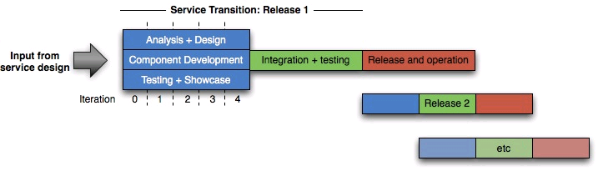
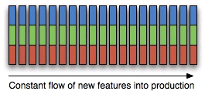
From traditional delivery…
… to Continuous Delivery

Slide 7

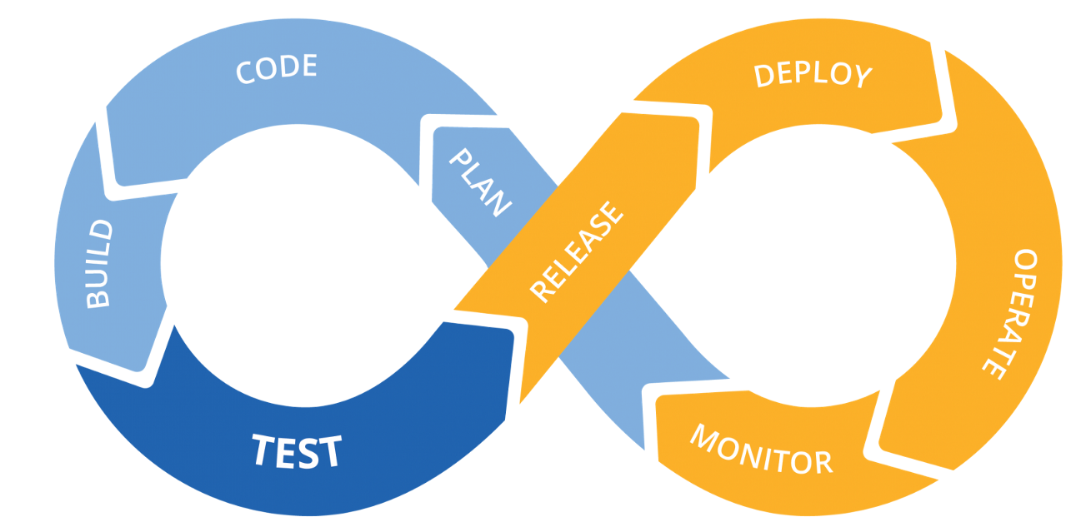
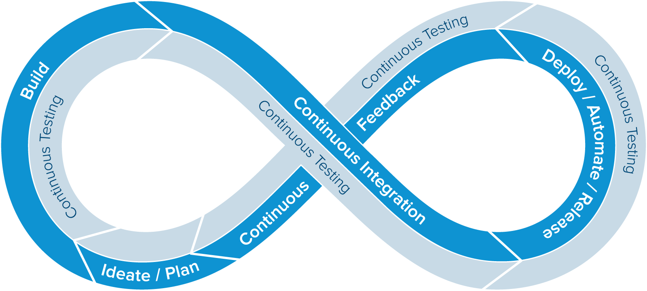
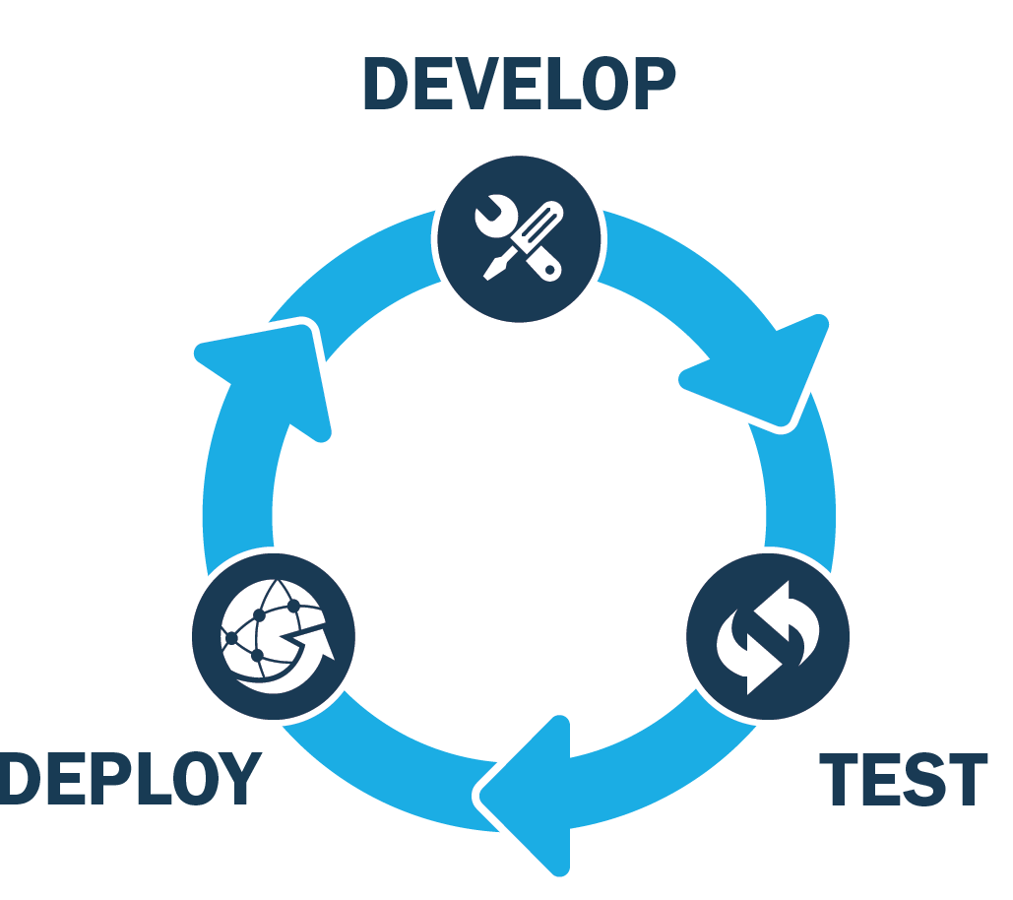
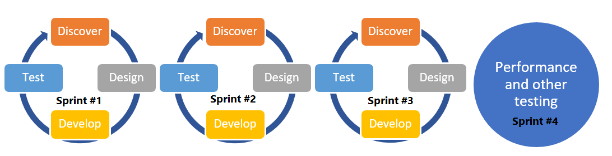
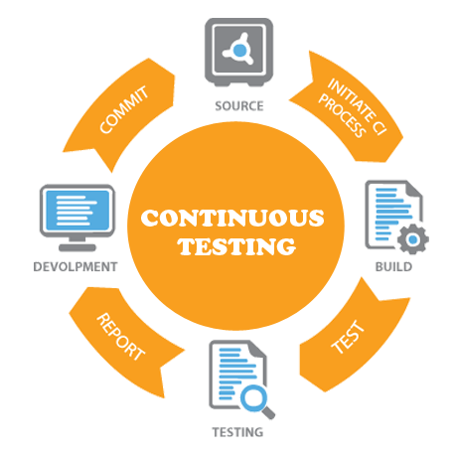
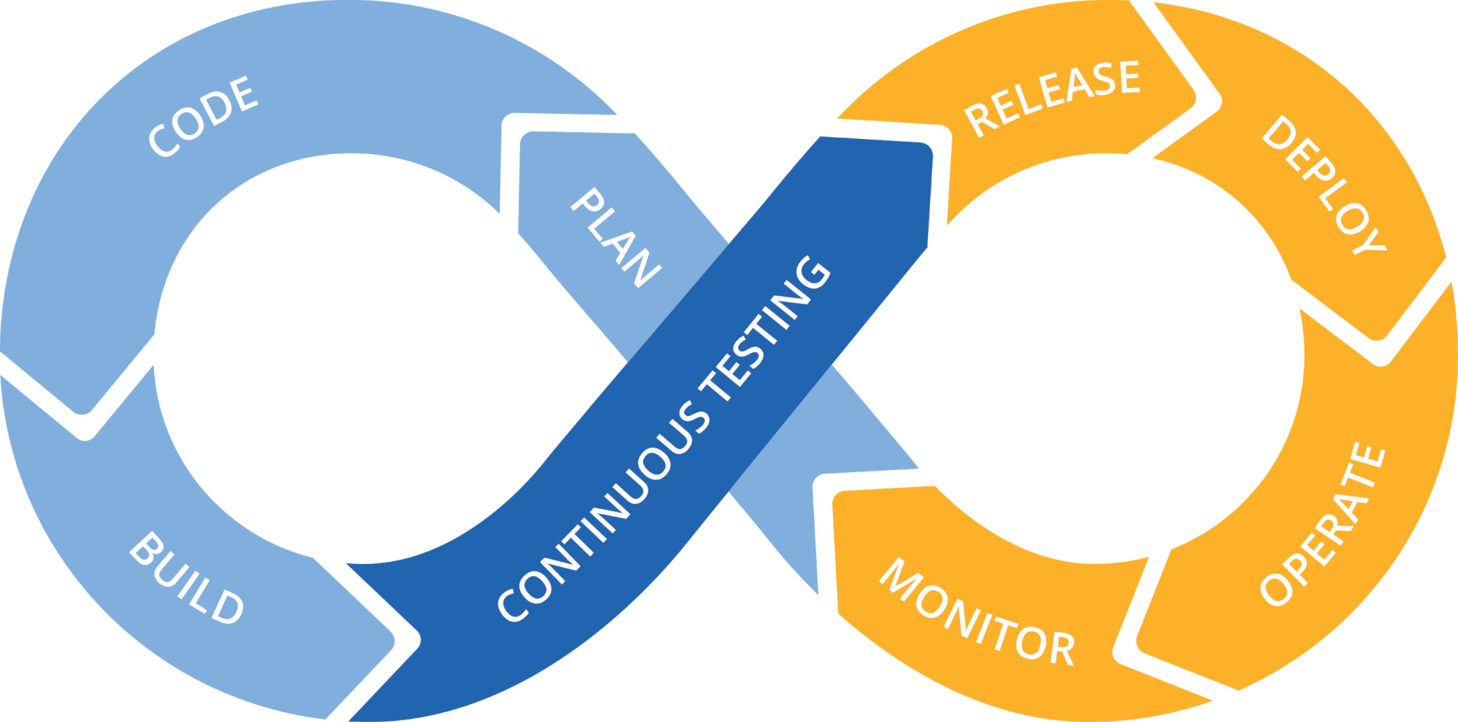

Slide 8

Plan
Code
Build
Test
Release
Deploy
Operate
Monitor
All these models extend Waterfall, Structured thinking into continuous delivery

Slide 9
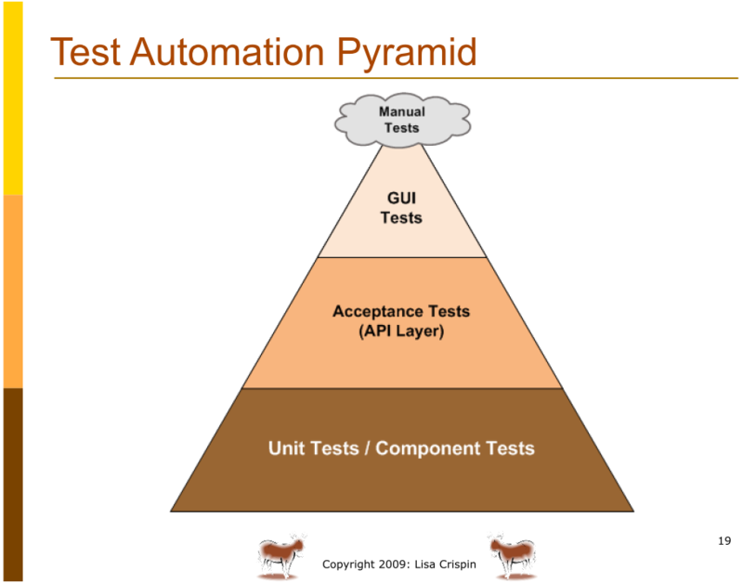
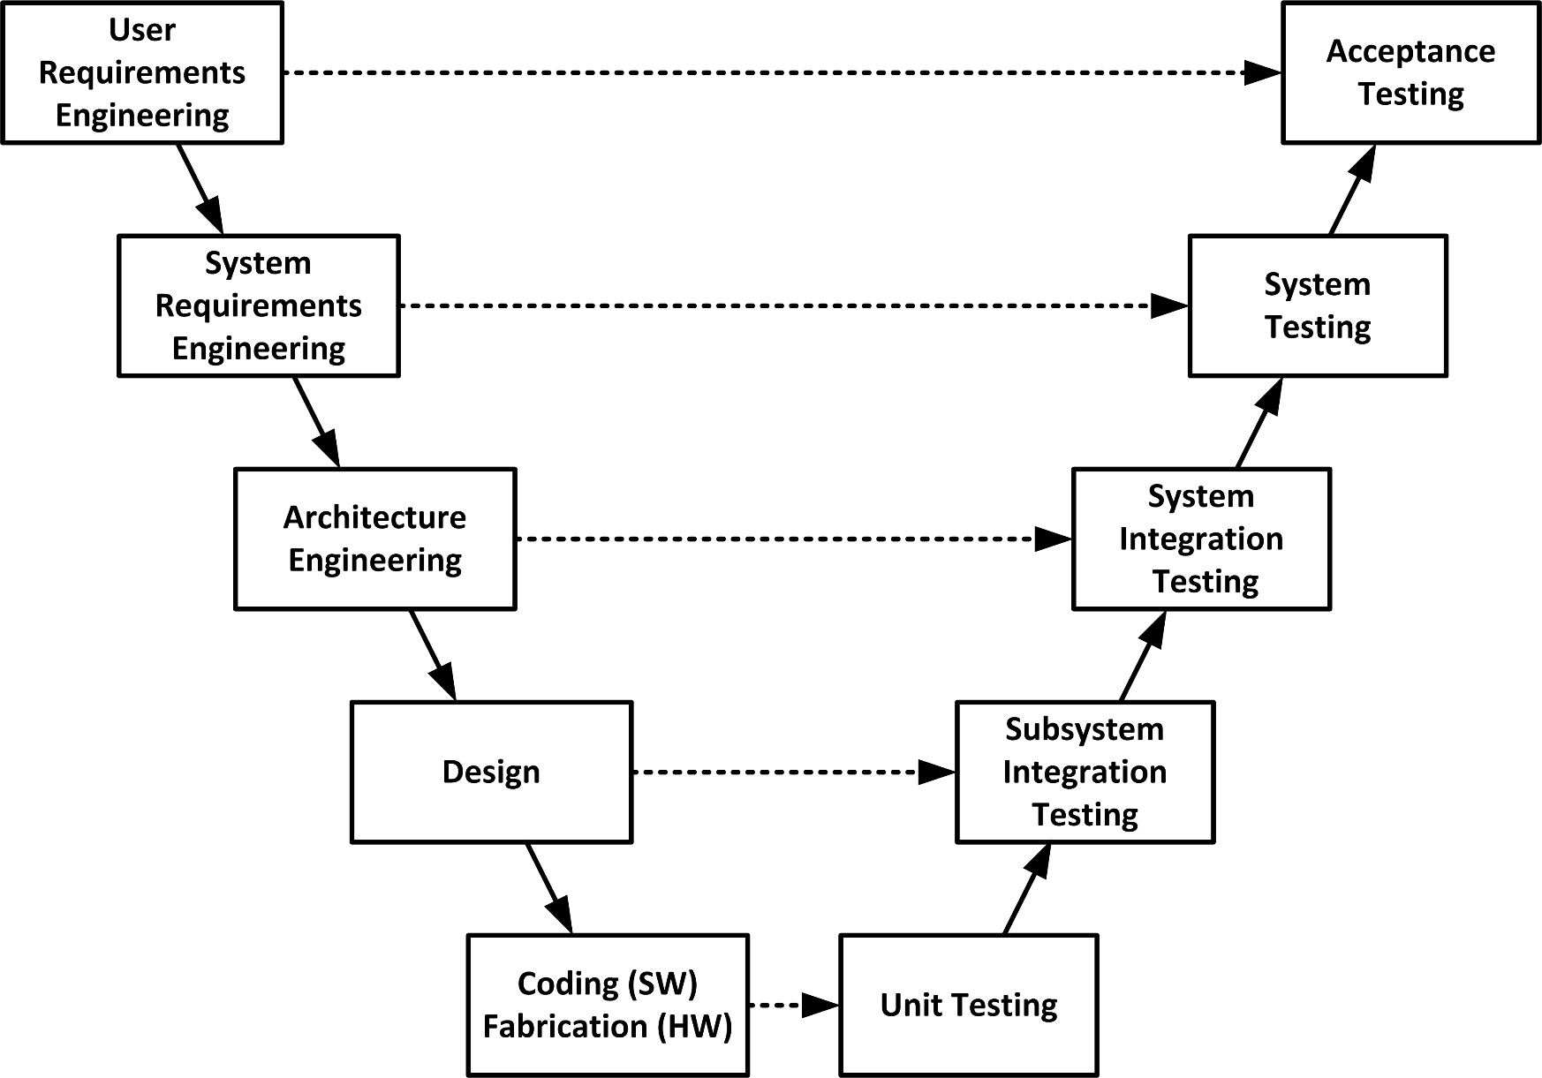
It’s just the 1980s V-Model all over again!

Slide 10
Staged thinking won’t work in a continuous process
It’s SEQUENTIAL – one stage follows another – no variation
DEPENDENCIES RULE – can’t start one stage before previous stage is done
It’s NOT RE-ENTRANT – no flexibility to react to external events
TESTING HAS STAGES ITSELF – we KNOW that testing has itself stages of thinking and activities spread through the process
Only ONE PHASE of testing – we know there are developer and tester manual and automated test execution activities
TESTING IS SQUEEZED – timeboxed activities – the thinking, preparation and execution time is all limited
NO FEEDBACK LOOP(S) – we know that testing finds bugs – but the continuous process has no feedback loop
Agile is based on these ideas

Slide 11
We need to think clearly; Let’s remove LOGISTICS (for now)
Document or not?
Automated or manual?
Agile v waterfall?
This business or that business?
This technology v that technology?

Slide 12
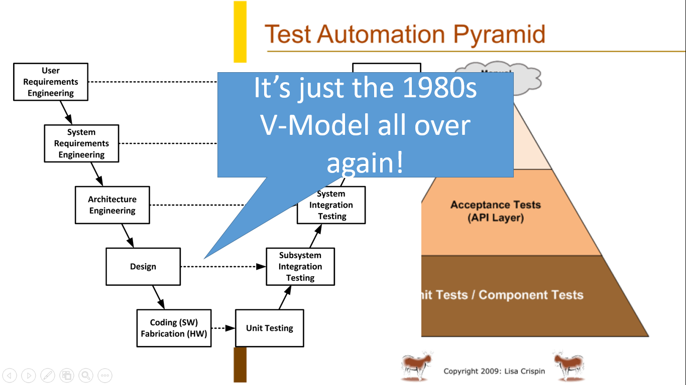
From sequential, staged processes to …

Slide 13
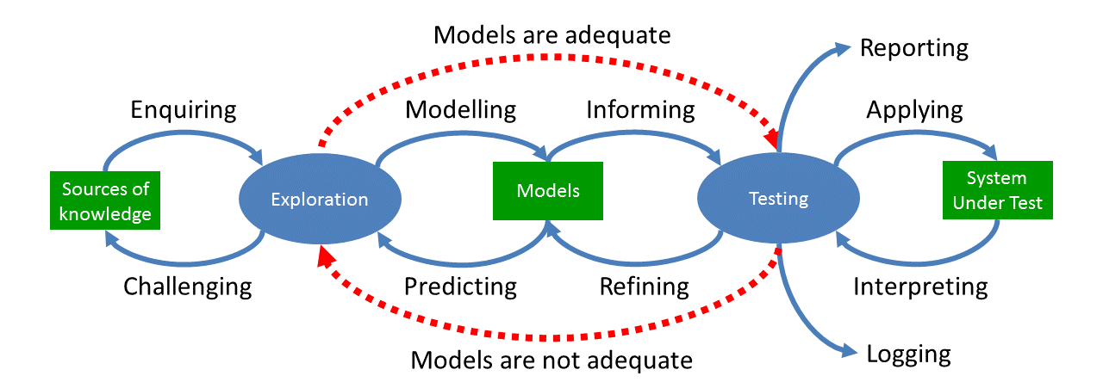
Continuous event-driven THOUGHT processes
Agile Testing Days Webinar: https://www.youtube.com/watch?v=1Ra1192OpqY
See Chapter 4 in the “Digital Assurance” pocket book

Slide 14
Thinking in a Dynamic, Event-Driven Process
Ten thinkING activities have associated real activities
Our brains can run these processes in parallel
Not stages, but MODES of thinking
For each feature/requirement in an iteration, we might be thinking differently – think STATUS
In a short time, we might be doing all ten thinking activities; DYNAMIC, EVENT-DRIVEN not STAGED

Slide 15

Status is what we are thinking and doing, not where a feature is on a board
Plan
Feature
Enquiring
Modelling
Predicting
Challenging
Informing
Refining
Status?

Slide 16

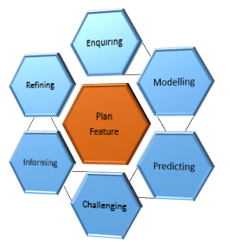
Continuous Collaboration
Each of the thinking activities exists, regardless who does it
Three Amigos: analysts/users/stakeholders, developers and testers
It doesn’t matter who does what
Collaboration is a series of responses to events and interactions, driving requirements along the pipeline
Of course, the tester will probably lead on challenging requirements, managing risks, thinking about coverage, deriving tests…

Slide 17
A very different skillset is required

Slide 18
Testing Career Development
(2014)
Strategic
Test Strategy
Project Intelligence
Test Assurance
Supplier Management
ISTQB, TMMi etc...
Management
Stakeholder management
Analytics & visualisation
Managing uncertainty
Test Process Management
Technical
Scripting/
Programming
Test Automation
Technical (Excel, SQL, OS utils etc)
Methodology
Foundations
Systems Thinking
Testing Fundamentals
Exploration
Critical Thinking

Slide 19
Certification schemes …
Certification Schemes do not assess your ability as a tester
(this is a big problem)
Certification scheme teach mostly what I’ll call LOGISTICS
Much of the content is about remembering definitions
They teach test design as procedures, not as a modelling discipline
They don’t teach thinking skills
Exams focus on remembering the syllabus content
They offer (usually) one way of implementing testing

Slide 20
The Tester Skills Program
Introduction to a deeper learning and development scheme for people who test

Slide 21
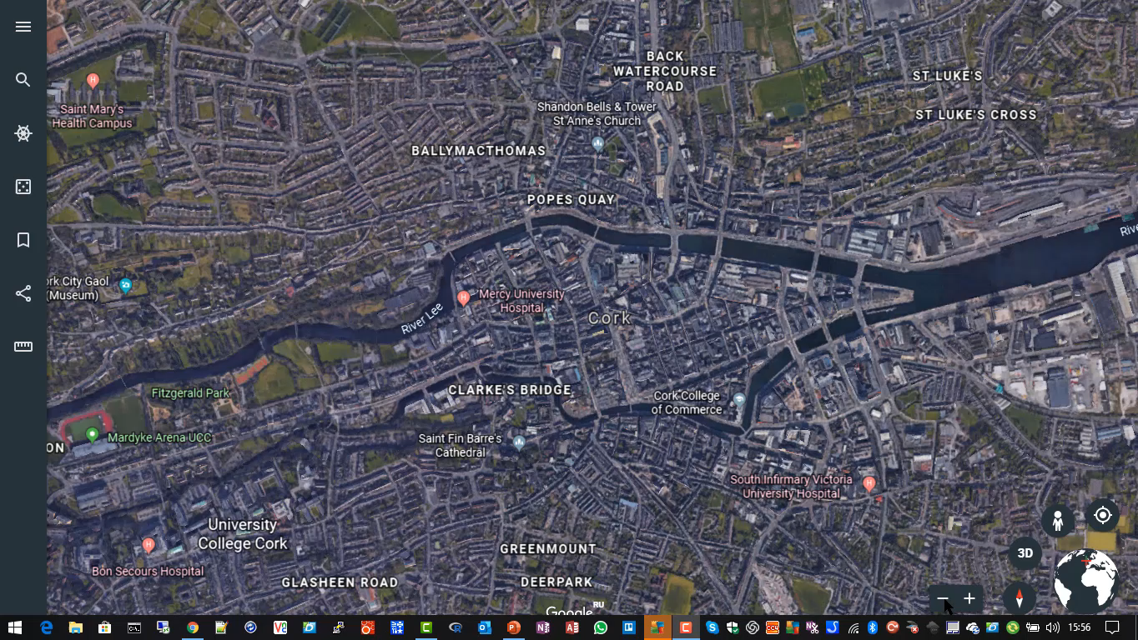
Cork is Ireland’s second city

Slide 22
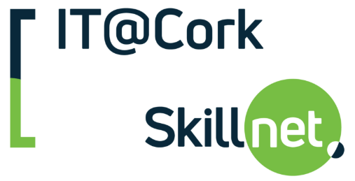

Developing Testing Skills to Address Product Quality Challenges
Date: Thursday 29th November 2018
Time: 9:30am – 2:00pm
Around twenty Software Product and Development businesses. (No training providers!)

Slide 23
Existential crisis for testers
Testing is obsolete
Replaced by automation
How do you add value to the team?
Titles changing – evolution of sdet role
We’re all engineers; everyone must write code
Once highly respected skillset / mindset no longer valued
Technology changing at unprecedented rate

Slide 24
What can we do?
Leaving the bigger problems aside for now…
Identify OUR skills gaps
Identify OUR training needs
Develop a Future Skills Programme

Slide 25
Vision
A comprehensive skills inventory
Skills dependencies/road map
Foundation, Advanced and Master syllabuses
Hybrid online/classroom courses
A model, customisable “Invitation to Tender” for organisations to evaluate/hire training suppliers

Slide 26
Progress
Capture
Capture current testing challenges
Identify
Identify required skills
Assign
Assign skills to a ‘level’ to collate syllabus topics
Build
Build a hybrid classroom/online course (Foundation)
Pilot
Pilot the course
April-July 2019

Slide 27
Tester Skills Program – FOUNDATION
Roadmap version 0.3 15 May 2019
Core Modules
1. Essentials (180)
Motivation (60)
Fundamentals (120)
2. Designing Tests (300)
Challenging Requirements (90)
Basic Techniques (150)
Business Process (60)
3. Applying Tests (360)
Planned Testing (90)
Exploratory Testing (270)
4. People (150)
Collaboration (60)
Communication (60)
Testing in Teams (30)
Supplementary Modules
6. Model-Based Test Design (450)
Model-Based (90)
Domain (90)
State-Based (60)
Logic (60)
Purposeful Activity (150)
8. Technical (120)
Developer Testing (30)
Instrumentation (30)
Non-Functional Testing (60)
5. Thinking (270)
Systems Thinking (60)
Modelling (90)
Critical thinking (120)
7. Method (330)
Testing and Stakeholders (60)
Test Approaches (60)
Agile Testing (120)
Adapting Testing (90)
9. Managing (240)
Testability (30)
Risk Management (60)
Process Improvement (60)
Planning (30)
Test Assurance (60)

Slide 28
TSP Foundation
Around 40 hours and classroom and online classes
Offline assignments 60-80 hours…
Discussion with peers and managers
Reading and further research
Modelling (requirements, stories, software, usage, tests)
Practical test assignments (exploration, test design and bug-finding)
Training gives learners the questions to ask
The answers come from your peers and organisation or from PRACTICE

Slide 29
Tester Skills Program v Certification
The TSP does not compete with certification
TSP teaches testing to a deeper level so you can ultimately master your craft, be a coach/mentor or consultant
100-120 hours DEVELOPMENT, not just 18 hours lecturing

Slide 30
Skills focus
Focus on non-logistics (little overlap with ISTQB)
Teams that use pervasive automation for environments, builds, tests
Teams where continuous, event-driven processes are emerging
Test has broader role of assurance, spanning requirements right through to customer experience optimization (CXO)
Testers are usually part of a mixed, multidisciplinary team
We encourage more outward-facing, collaborative, pro-active behavior

Slide 31
New tester behaviours
To think more analytically (modelling, systems and critical thinking)
Move from passive to active collaboration; to challenge and refine requirements
Understand CXO, and other predictive models and align testing to these models
Act like a pathfinder or navigator (rather than a ‘follower’)
Operate at technical and business/stakeholder levels
A goal of testing is to increase definition and delivery understanding

Slide 32

TSP challenges you to think for yourself…
To excel in your craft; To teach others to excel too

Slide 33
To follow progress join our mailing list…
Send an email to:
updates@testerskills.com
With ‘subscribe’ in the subject line
OR… email
paul@gerrardconsulting.com
Connect with Paul on LinkedIn
https://linkedin.com/in/paulgerrard
Any
Questions?`

Slide 34
Building a Software Community-Driven Tester Skills Programme
Thank-you!
Paul Gerrard
paul@gerrardconsulting.com
Web: gerrardconsulting.com
@paul_gerrard
LinkedIn: linkedin.com/in/paulgerrard

