Slide 1

First 100 days of successful leadership
Shushan Aspaturyan / PicsArt Yerevan

Slide 2

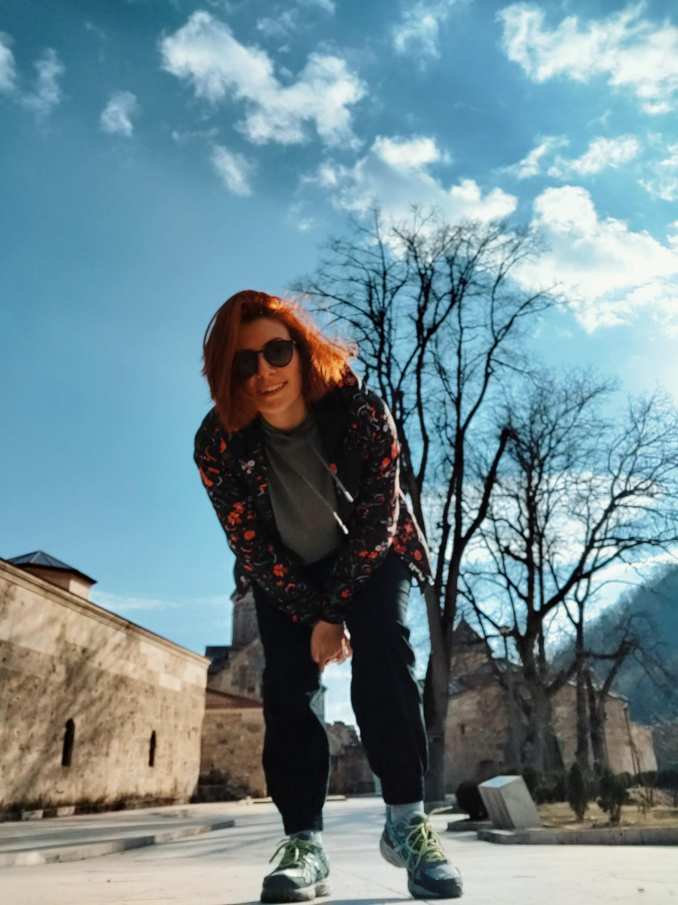
About me
What to do after accepting a leadership offer
QA Team Lead at PicsArt
1.5 years experience in Leadership
2+ years experience in Lecturing
8+ years experience in QE
shushan.aspaturyan@gmail.com
Notes:
Add contact details

Slide 3

What to do after accepting a leadership offer
What to do after accepting a leadership offer
Creating a draft plan of actions
Communication with hiring manager
First meetings with team members
Reading relevant articles/ books
Relaxing Into it

Slide 4

Actions to be done before meeting the team
What do you have to know before meeting the team
What do you have to know before meeting the team members
Gathering information on team members
Getting team history and background
Conflict history
What do you have to know before meeting the team members

Slide 5

Trust Building
Trust building
Trust Building
Trust is a two way road
Understanding leverage and motivation of every team member
Establishing teamwork
Getting to a fully functional team
Setting goals for team members

Slide 6
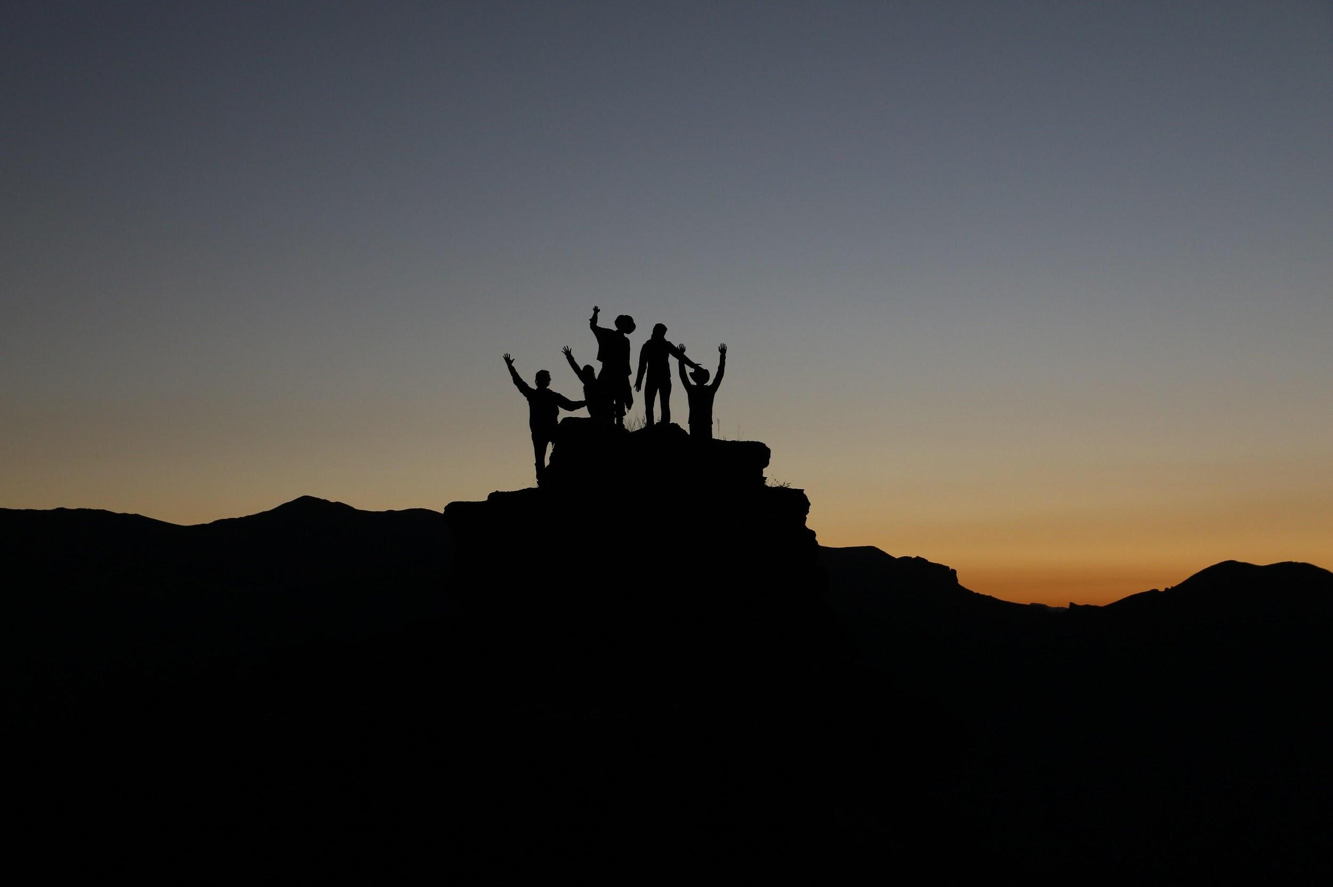
Team Goals
Team Goals
Team unity
Having 1 on 1 meetings
Getting team to set their own goals
Getting consensus on goals
Junction of personal goals with team goals
Notes:
Too much time for team goals and motivation

Slide 7

Motivation
Motivation
Motivation
Participation in daily work
Emotional intelligence
Positive attitude
Team buildings
Team member career building

Slide 8

Conclusion
Motivation
Motivation
Planning
Trust building with the team
Team goals
Motivation of each team member
Fully functional team in 3 months

Slide 9
Thank you!
Notes:
Contact information and company

