Slide 1
How Methods of Natural Sciences Can Help in Testing
Some notes on how to become a better tester
Aliaksandr Martsinovich
QA Engineer

Slide 2
How is software testing similar to experimental science?

Slide 3
How to become a better tester?

Slide 4
Let’s learn from scientists!

Slide 5
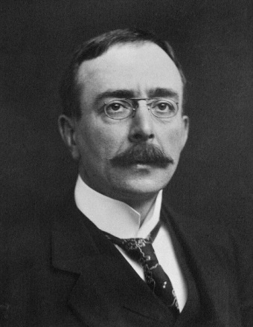
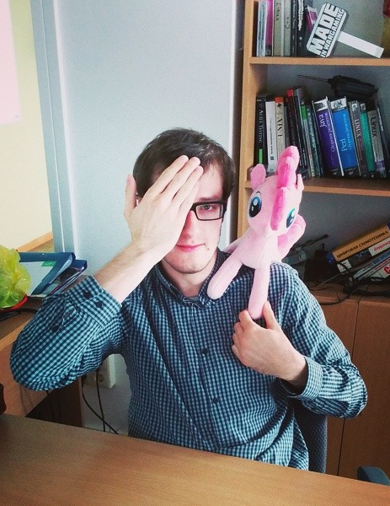
Because we have so much in common

Slide 6

Tests
Phenomenon
Hypothesis
describes

Slide 7
Tests
Software
Requirements
describe

Slide 8
Both hypothesis and requirements are supposed to be testable.

Slide 9
Lessons learned from one experiment
of sir Charles Sherrington

Slide 10

Sir Charles Scott Sherrington

Slide 11
Phenomenon: Sense Fusion

Slide 12




Stage 1: Isolate and Simplify
…

Slide 13
Lesson 1: Decompose Everything

Slide 14
Lesson 1.1: Read the Code

Slide 15
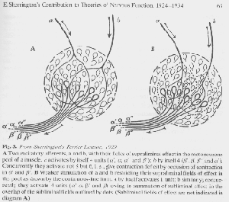
Reading the Code
Scientists won’t have mercy upon black boxes.
Neither should you.

Slide 16
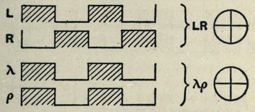
Stage 2: Draw a Plan

Slide 17
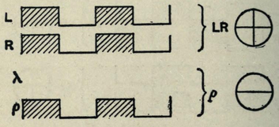
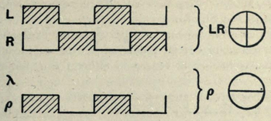
More Plans

Slide 18
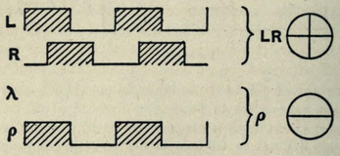
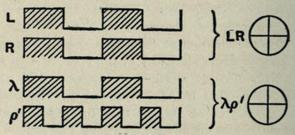
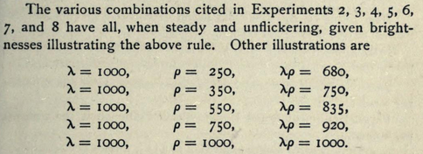
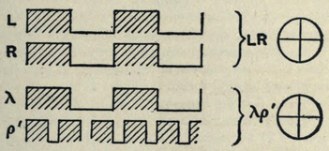
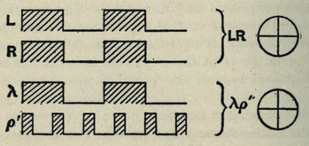
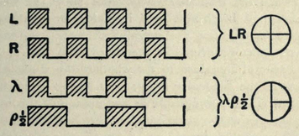
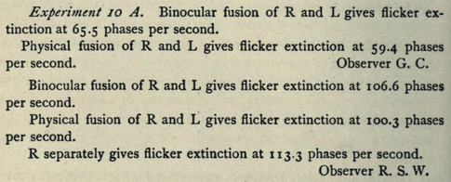
TONS OF PLANS
Just to make sure lol

Slide 19
Lesson 2: Do Thought Experiments

Slide 20
Thought Experiments
Working test environment
Working software
Test data
Courage
You need nothing of the above to do thought experiments!

Slide 21
Stage 3: Set Up a Laboratory
So sir Sherrington needs to send some visual images to the very identical areas of the eyes' retina...

Slide 22
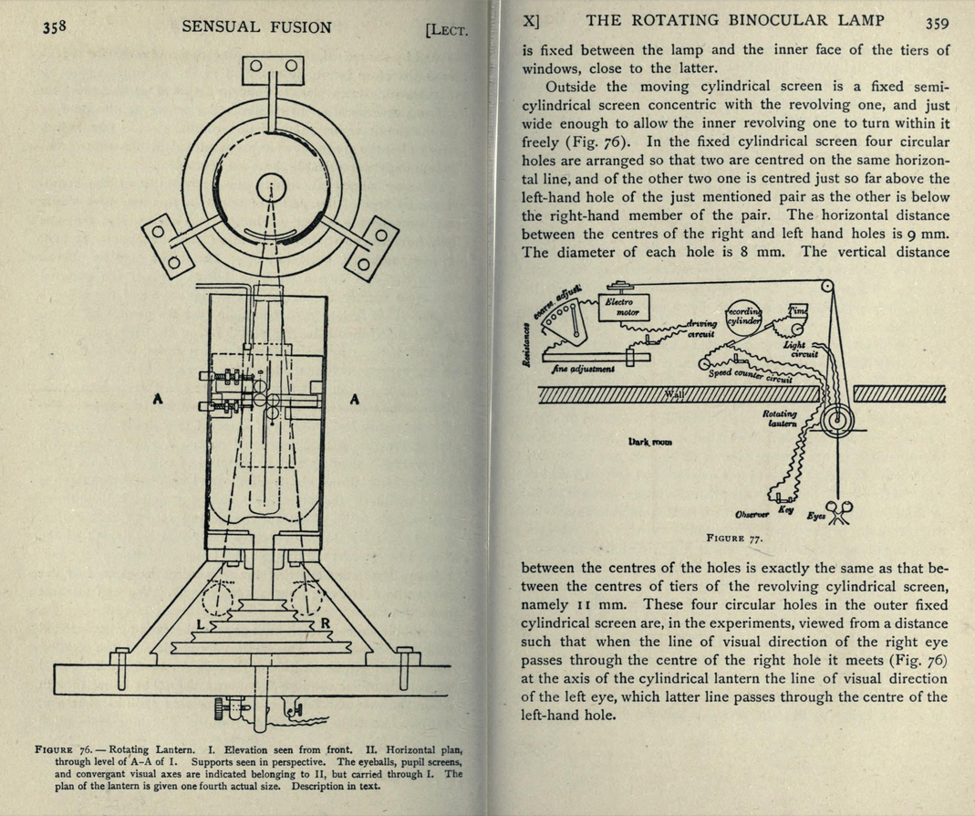

Slide 23
Lesson 3: Build Your Own Tools

Slide 24

Can you pls write a script for us?

Slide 25
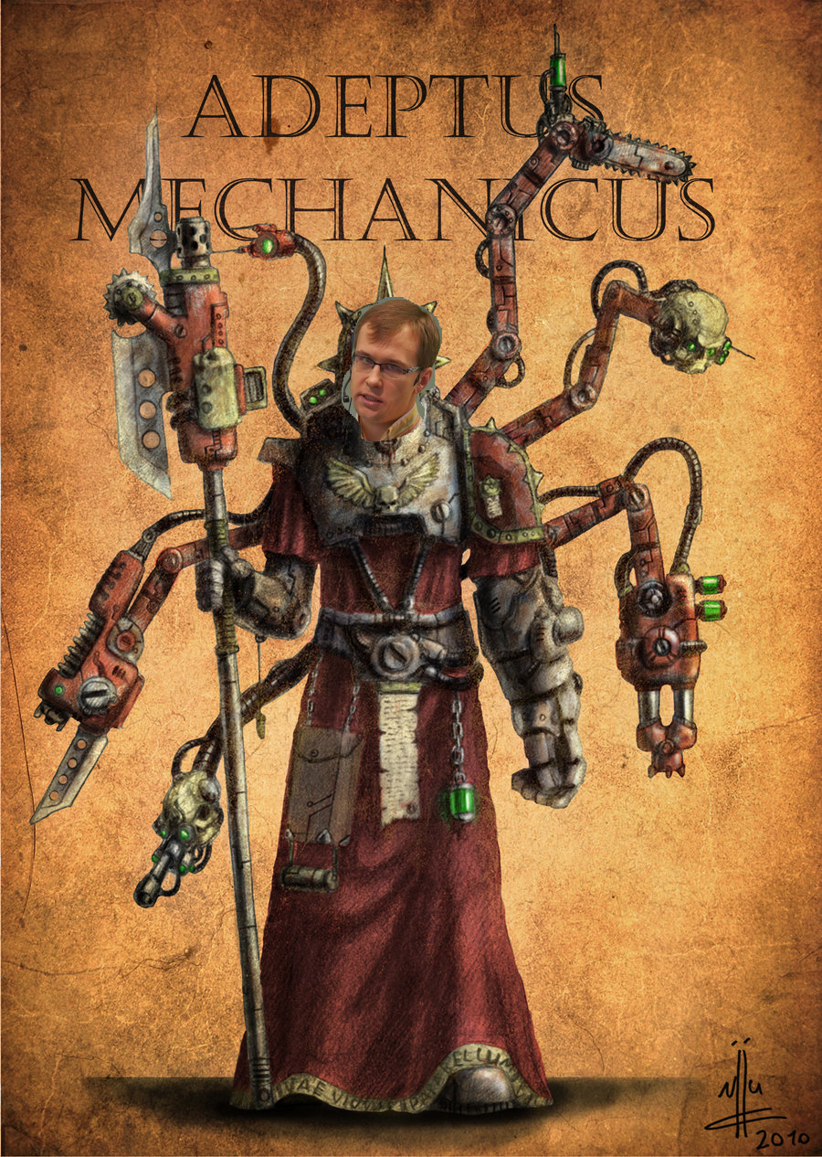
Tools Matter
Join QA Automation Order

Slide 26
Stage 4: Run an Experiment…

Slide 27
Done

Slide 28
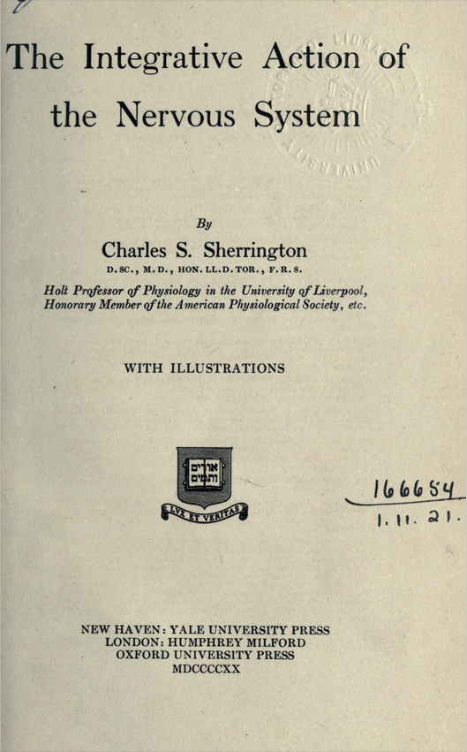
Stage 5: Publish
And sir Sherrington presents his results to the world.

Slide 29
Lesson 4: Share with Colleagues

Slide 30
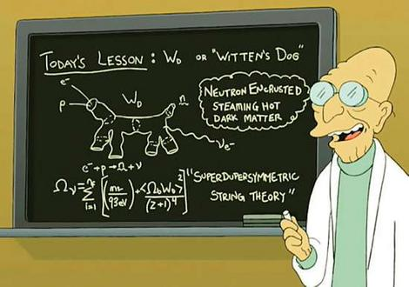
Sharing
Make a 15-minute speech of how your well-tested feature works.
And let your mates prove you wrong.

Slide 31
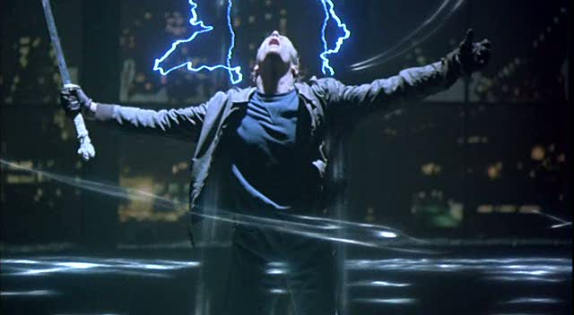
Inevitable Consequence
One day you’ll start to hear voices.
Voices of your friends inside.

Slide 32
What have we learned?

Slide 33
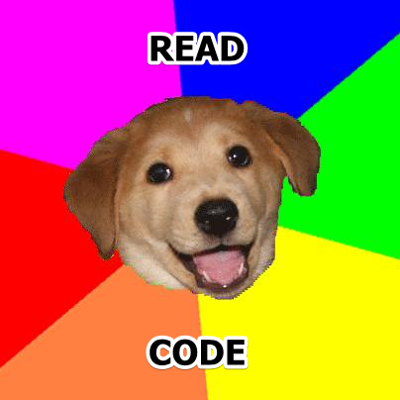
Lesson 1
(because no one loves black boxes)

Slide 34

Lesson 2
Imagine your test before you actually test
(because thought experiments are dirt cheap)

Slide 35
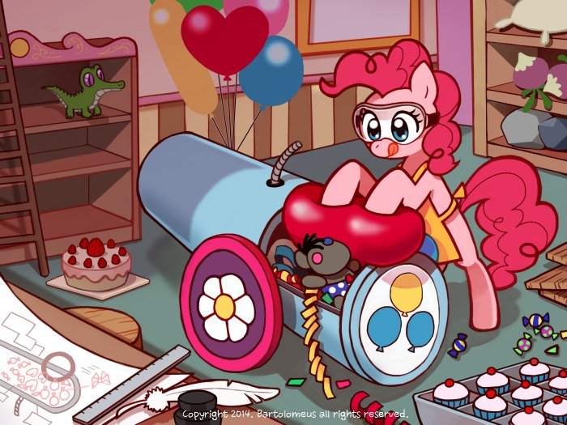
Lesson 3
Set up your very own testing laboratory
(because tools matter)

Slide 36

Lesson 4
Provoke your fellow colleagues to criticize
(to make a better job and absorb their power)

Slide 37
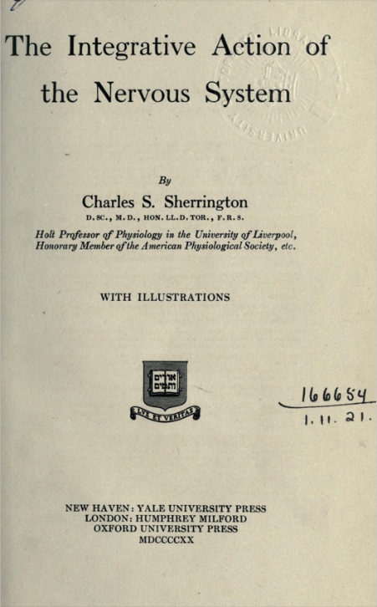

Used Sources
C.S Sherrington The integrative action of the nervous system
Imre Lakatos Philosophical Papers, Volume 1: The Methodology of Scientific Research Programmes

Slide 38




Recommended Sources

Slide 39
Thanks for testing these slides
Aliaksandr Martsinovich
a_martsinovich@wargaming.net
QA Engineer

