Slide 1

The Future of Software Testing

Slide 2
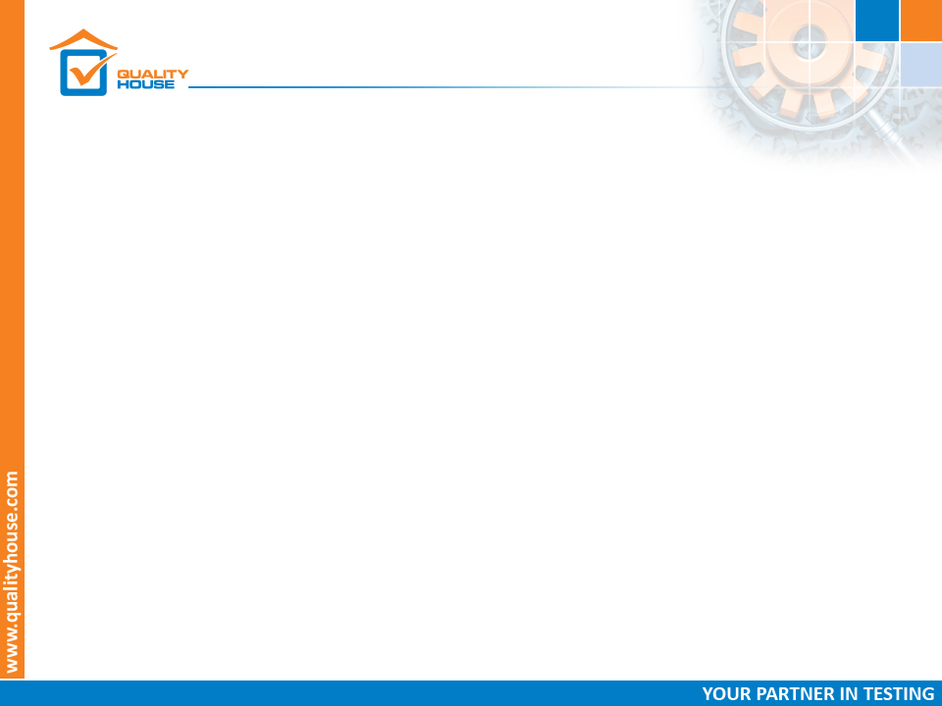
The future of Software
By 2020…
Agile and DevOps – up to 75%
Cloud computing – 6 times growth
Big Data – fear of “Data Autonomy”
IoT – 4 times growth
Mobile – everyone is connected
Security – global challenge
Artificial Intelligence - ?
Notes:
DevOps and Agile initiatives will force at least 75% of enterprises to implement test automation
providers unable to automate around 60% of test executions will risk not surviving in the testing service marketplace;
Smart Home Market will be worth 137.91 Billion USD;
cloud computing spending will grow 6 times faster than the IT spending
65% of experts: security will be a top priority in testing;

Slide 3
The future of Software
By 2020…
Technical complexity of software systems keeps increasing.
While software complexity is growing, delivery cycles have decreased just as dramatically;
Notes:
For example, what used to be a simple web app is now often a highly complex system working with hundreds of web services, mobile devices, and more;
It is a challenge to keep up with today’s rates of change and even more challenging is to ensure that each release is consistent with the expectations of the customers;

Slide 4
DevOps
The adoption of DevOps will continue
Aim to reduce the time from development (Dev) to operation (Ops) while ensuring the quality of the software;
DevOps practices emphasize on automation and integration;
More practices and tools are introduced in the project;
Notes:
https://dzone.com/articles/software-testing-trends-for-2018-and-beyond

Slide 5
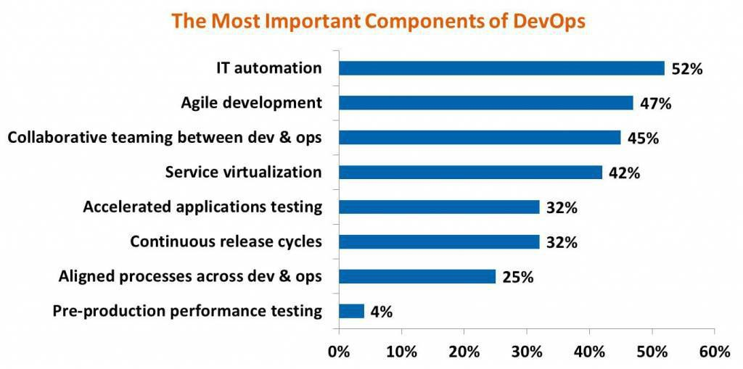
DevOps
DevOps components
Notes:
https://dzone.com/articles/software-testing-trends-for-2018-and-beyond

Slide 6
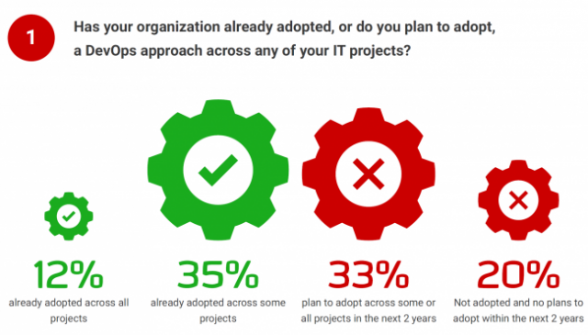
DevOps
Notes:
https://dzone.com/articles/software-testing-trends-for-2018-and-beyond

Slide 7
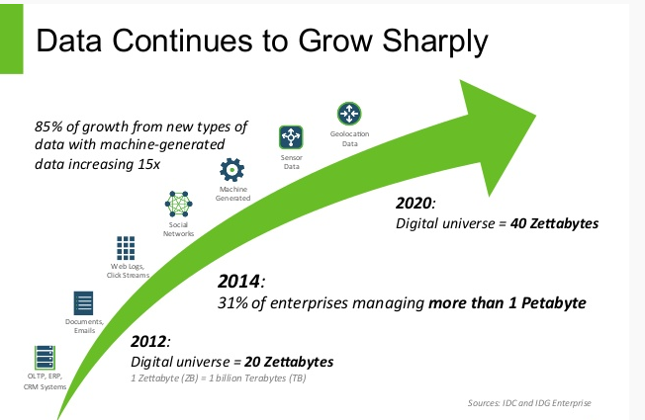
Big Data
The rise of the Big Data won’t stop any soon
Notes:
http://www.edu-art.in/software-testing-trends-2020/

Slide 8
Big Data
Data is on the rise
Expected by 2020 to grow by 400%;
Will eventually be a day to day affair for every IT company;
Today - testing data storage, management and maintenance of Big Data.
That will change in the future;
Notes:
http://www.edu-art.in/software-testing-trends-2020/

Slide 9
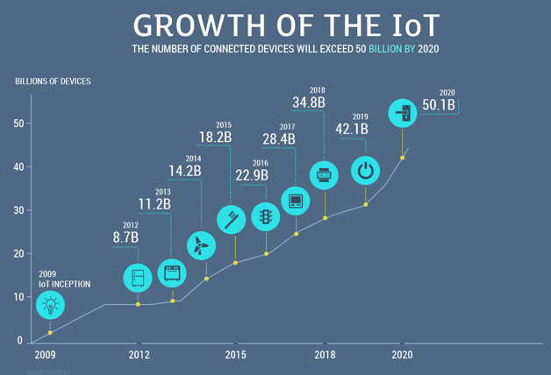
IoT
Notes:
https://www.resourcifi.com/blog/top-5-emergent-software-testing-trends-2018/

Slide 10
IoT
IoT
HP: 70% of the devices are prone to security threats:
Unencrypted Communications;
Software Security Hazards;
Confidentiality Concerns;
Authorization Issues;
IoT has introduced changes in testing
connectivity is with a larger variety of devices,
increased number of scenarios – beyond computers, smartphones, etc.
Notes:
http://www.algoworks.com/blog/7-software-qa-practices-testing-trends-now-trending/

Slide 11
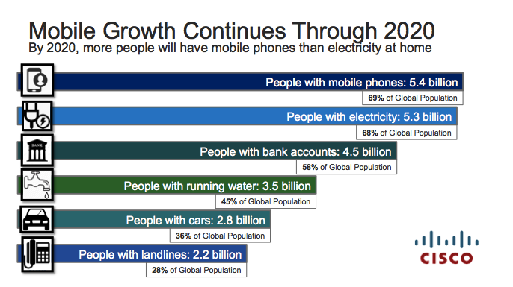
Mobile
Everyone is connected
Notes:
https://testfort.com/articles/testing-automation-trends-2018

Slide 12
Mobile
Increasing need of Mobile Testing
User experience – how to ensure quality and user friendliness
Apps request access to our contact lists, photos, identity - sensitive personal information;
Smartphones become our wallets.
Lots of platforms and dependencies - thus, the future belongs to mobile test automation;
Notes:
https://adobe.cioreview.com/cxoinsight/software-quality-trends-predicting-the-future-nid-24194-cid-191.html

Slide 13
Security
Security is also on the rise
Security breaches everywhere, security testing is on the rise;
Websites have access to social network credentials and confidential information;
The more information being collected, the more difficult it is to protect it;
Notes:
https://qarea.com/blog/web-development-in-2018-trends-and-predictions

Slide 14
Security
The statistics of security breaches:
Cybercrimes exceeded 600 billion US dollars worldwide in 2017;
200+ malware threats are being captured every single day;
In 2021 - cyber attacks will cost more than 3 trillion US dollar;
Nobody is protected – nearly 43% of the attacks target small and medium business;
Notes:
https://qarea.com/blog/web-development-in-2018-trends-and-predictions

Slide 15
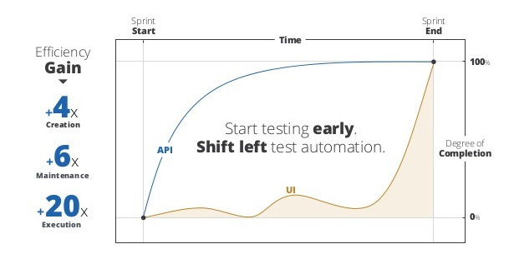
API and Services
API and Services Test Automation
Notes:
Test Automation now focuses on functional UI testing;
A majority of API and services testing is now currently performed by developers manually;
The trend will be an increasing application of automating API and services testing processes, at a greater pace than automating the UI testing process;

Slide 16
AI
AI and Machine learning techniques
Self learning
Predicting algorithms
Robotic automation tools that will ease the workload
24/7 work
Notes:
http://testorigen.com/bots-and-ai-the-future-of-software-testing-and-development/

Slide 17
Bots and AI
AI and Machine learning techniques
Appdiff is bringing machine learning “bots” online as QAs.;
dinCloud announced “James”, a virtual robot QA;
Infostretch announced it will offer artificial intelligence in software testing through a brand new service called Predictive and Prescriptive QA;
Notes:
https://aitrends.com/ai-software/software-development/artificial-intelligence-software-testing-arrived/

Slide 18
Appdiff Case
Appdiff Case
Machine learning algorithms how to know if the result of a given activity was likely to uncover a deformity;
Appdiff tests about 90% of the surface area of a typical mobile application;
Human testers don’t cover as much as 90%
10% left – too costly or too complex to invest testing it;
Notes:
https://chatbotslife.com/ai-bots-are-coming-for-your-testing-jobs-66d5cb32b693

Slide 19
Bots
You have to be smarter…not to be replaced…
Bots can interact with both people and machines.
Still, testing requires more than just interaction:
Testers have an understanding of the business domain
Testers pay attention to the client’s needs and have understanding of the solution purpose
Notes:
https://chatbotslife.com/ai-bots-are-coming-for-your-testing-jobs-66d5cb32b693

Slide 20
AI and Machine Learning
Some bad experience
Microsoft’s Tay (bot) – March 2016;
Designed to be a teen – talking AI chatbot built to mimic and converse with users in real time;
But, people took advantage of Tay’s machine learning capabilities and coaxed it into saying racist, sexist and generally bad things;
Tay started posting racist tweets on Twitter;
So, the Microsoft had to take it down just a few days after release;
Notes:
http://www.infosysblogs.com/testing-services/2018/03/future_is_intelligent_systems.html

Slide 21
Testing is…dead
How many times have you heard somebody tell you that “Testing is dead”?
Every year ☺
Notes:
The defenders if that position usually argue that due to modern software development techniques as test automation, micro-services, continuous integration, delivery systems, production monitoring systems, and build rollback capabilities, in the near future the role of the software tester will become obsolete…

Slide 22
The future of Software Testing
The future of testing…
… with the AI development and the idea for robot process automation,
some of the activities of the tester might become redundant
but the profession of the QA specialist will continue to exist and definitely, evolve…
Notes:
http://qablog.practitest.com/the-future-of-testing/

Slide 23
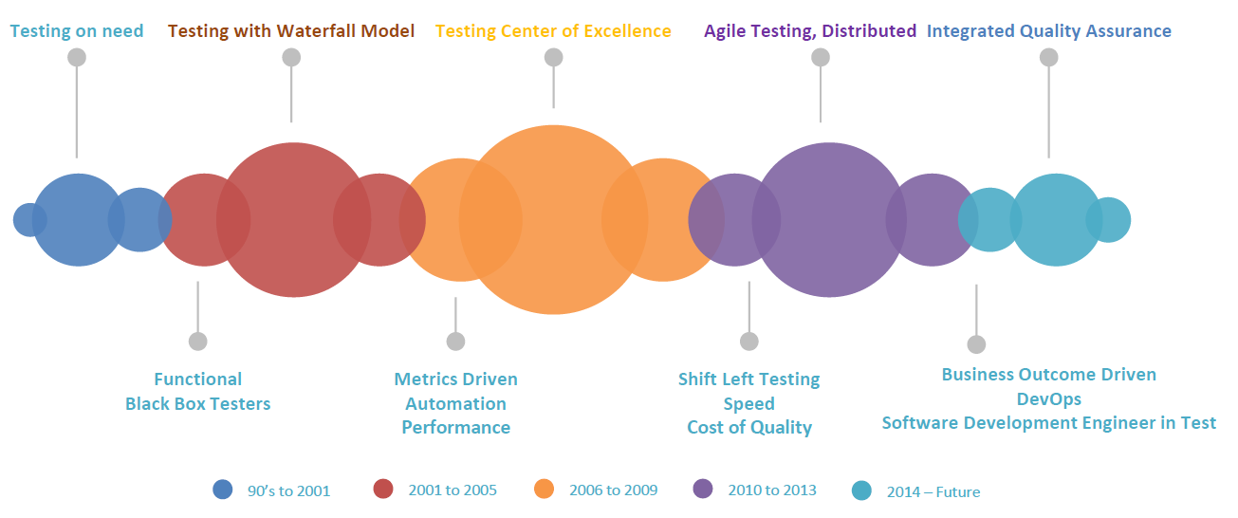
The future of Software Testing
Testing evolution
Notes:
https://www.tricentis.com/blog/2018/02/05/why-the-future-of-testing-requires-disruption/

Slide 24
Testing Trends
A report by Sauce Labs, Inc.
Following trends:
1: The value of automated testing is clear;
2: Agile and DevOps adoption increases, but bugs are not getting fixed faster;
3: The desire to deploy even more quickly appears to be slowing down;
Notes:
https://jaxenter.com/testing-trends-2018-survey-142098.html

Slide 25
Roles
Roles will get blurrier, then clearer
Agile - confusion and misconceptions regarding the role of the software tester;
Everyone in the team is a tester
As agile methodology becomes clearer and more understandable in every company, so will the tester’s role.
Notes:
https://dzone.com/articles/the-future-of-software-testing-3-predictions

Slide 26
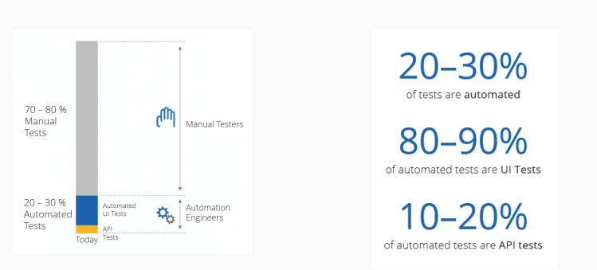
Test automation
More utilization of the Test Automation
Notes:
According to the World Quality report, 2017 – 2018, the test automation only accounts 20% of the software testing activities;
Now, organizations mainly focus on automating the regression testing the functional part of the UI;
Test Automation is seen as the main approach to shortening the delivery time and the testing time;

Slide 27
Test automation
Notes:
http://www.logigear.com/magazine/survey/survey-results-testing-essentials/

Slide 28
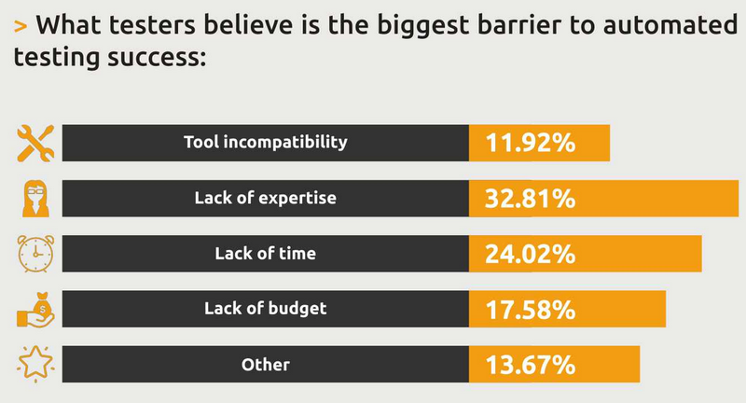
Test automation
Notes:
http://www.logigear.com/magazine/survey/survey-results-testing-essentials/

Slide 29
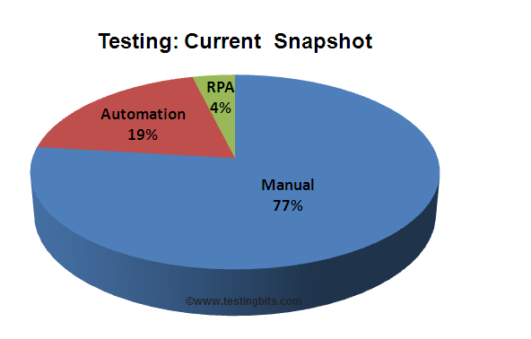
Manual Testing
Combining Manual and Automation Testing
RPA – Robotic Process Automation
Notes:
https://dzone.com/articles/software-testing-trends-for-2018-and-beyond

Slide 30
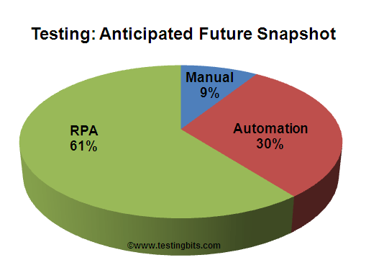
Manual Testing
Combining Manual and Automation Testing
RPA – Robotic Process Automation
Notes:
https://dzone.com/articles/software-testing-trends-for-2018-and-beyond

Slide 31
Skills needed
Relevant skills for the future
Strategic and Content Thinking – testers understand:
frameworks, networks, API integration, code structures and therefore can talk to developers and architects effectively;
risks and exposure, business growth and therefore can communicate naturally with the customers and business owners;
Notes:
https://www.enhanceconsulting.co.nz/future-of-testing/

Slide 32
Skills needed
Relevant skills for the future
Business Objectives – applying the right metrics for monitoring the success of the goals will be crucial in the future;
User Flows – understanding the user behavior and being able to simulate it will be a very important skill;
Notes:
https://www.enhanceconsulting.co.nz/future-of-testing/

Slide 33
Skills needed
Relevant skills for the future
Automation – more and more automation in functional testing, performance testing and of course, continue with the automation in the regression testing;
Metrics and Analytics – accurate ways and means to measure the effectiveness of an initiative or project are invaluable.
Notes:
https://www.enhanceconsulting.co.nz/future-of-testing/

Slide 34
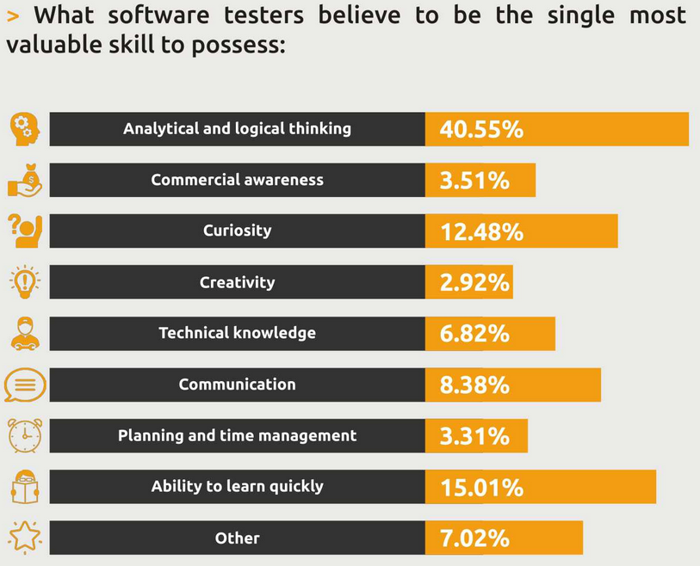
Skills needed
Relevant skills for the future
Notes:
https://www.enhanceconsulting.co.nz/future-of-testing/

Slide 35
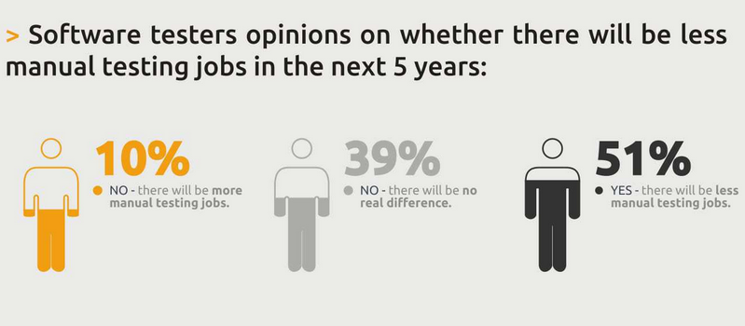
Skills needed
Manual vs. Automation Testing Positions
Notes:
https://dzone.com/articles/software-testing-trends-for-2018-and-beyond

Slide 36
SDET
Software Development Engineer in Test
A role proposed by Microsoft;
SDET are both adept in testing and developing;
A good indicator of the way the future of software testing
Test automation will provide the bulk of coverage,
Manual testing will cover the more complex scenarios that involve a lot of human judgment and decision making;
Notes:
https://medium.com/qasymphony/duo-security-director-of-qas-thoughts-on-the-future-of-software-testing-b27b8074b30e , https://softwaretester.careers/future-software-testing-jobs/

Slide 37
QA Manager
The future of testers is to grow as QA Managers
22nd best job – according to the rank of Glassdoor
Reasons to become a QA Manager:
Its role is growing – considering the IoT;
Its role is expanding – taking into account the DevOps practices and the continuous models;
It’s at the center of the action;
It’s varied and flexible
It regularly tops job happiness lists
Notes:
https://medium.com/qasymphony/6-reasons-why-qa-manager-is-the-job-of-the-future-60c423640569

Slide 38
Still…
Machine Learning will conquer Software Development first, before it will conquer Testing
Jason Arbon, Appdiff
Notes:
http://www.hexacta.com/2017/09/11/software-testing-is-the-functional-tester-doomed-to-disappear/

Slide 39
Questions?

