Slide 1

RICE IN THE EYE – WILL CHINA’S WORK ETHIC AFFECT PROPTECH?
Marcin sikorski

Slide 2



PLAN
CHINA
ETHICS
DOMINATION

Slide 3
WHAT DO WE KNOW?

Slide 4
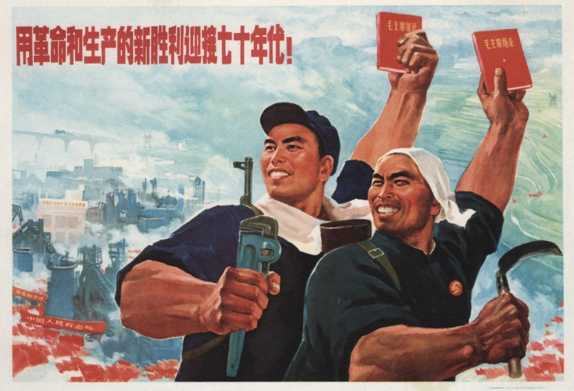
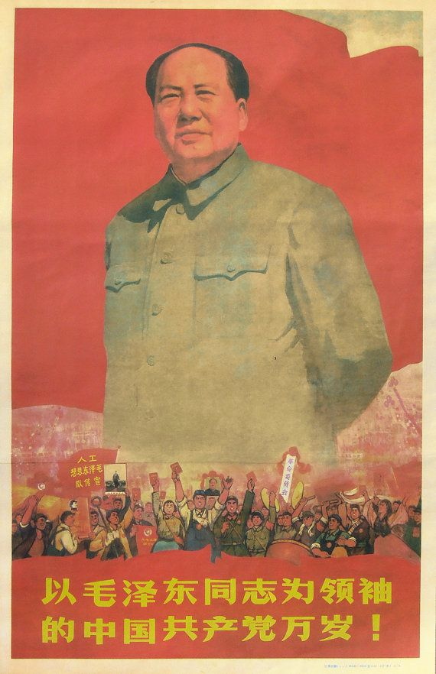
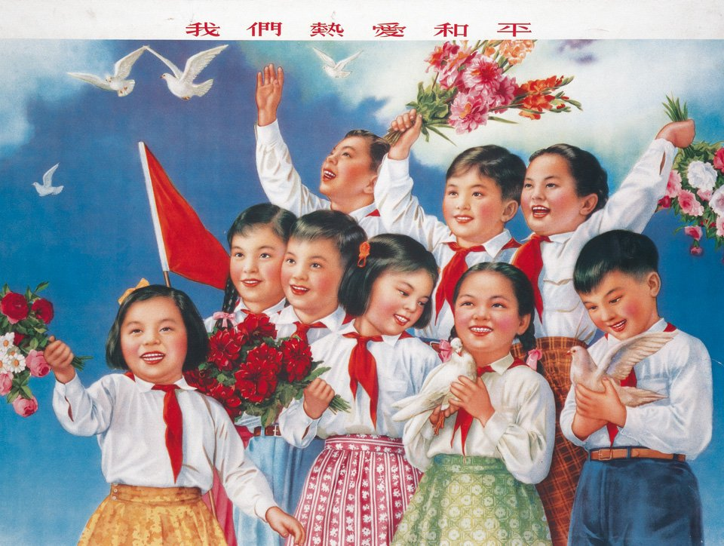

Slide 5
WHAT WE DON’T KNOW?

Slide 6
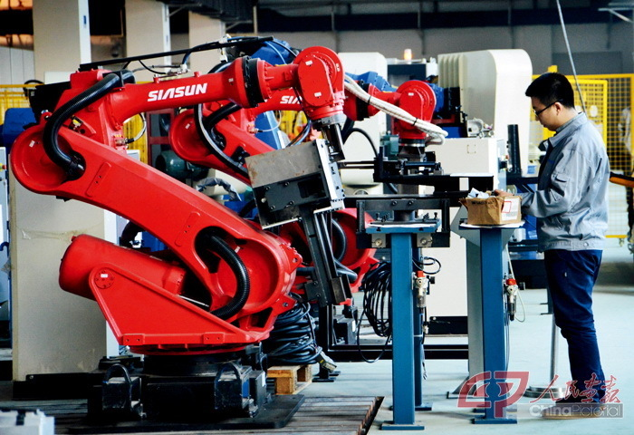






Slide 7
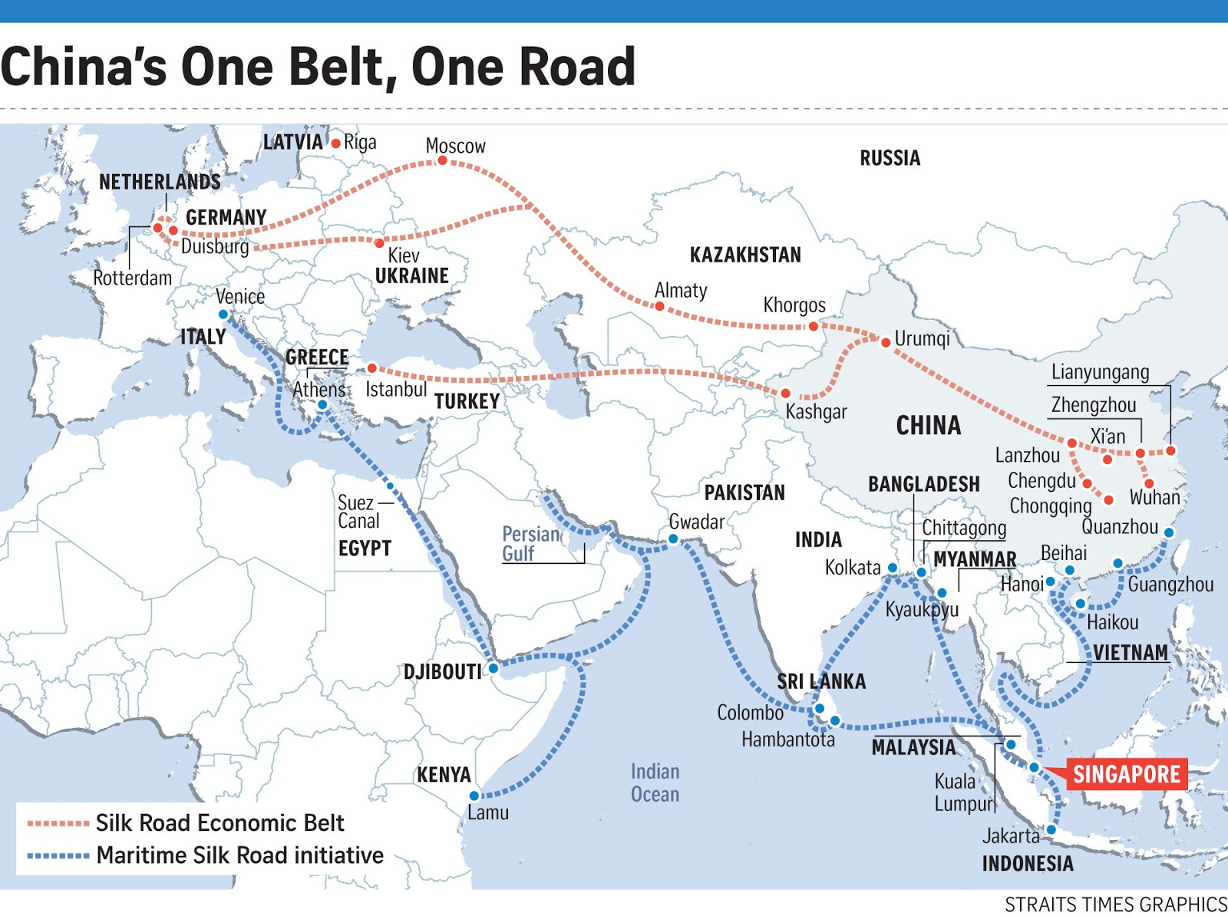

Slide 8
WHAT IS CHINA?

Slide 9



When I was growing up my parents told me to always finish my dinner because children in China and India are hungry for my meal.
When I'm a parent myself I tell my daughters to finish their homework. Children in China and India are hungry for their work.
Thomas Friedman

Slide 10
CONFUCIANISM (水)

Slide 11
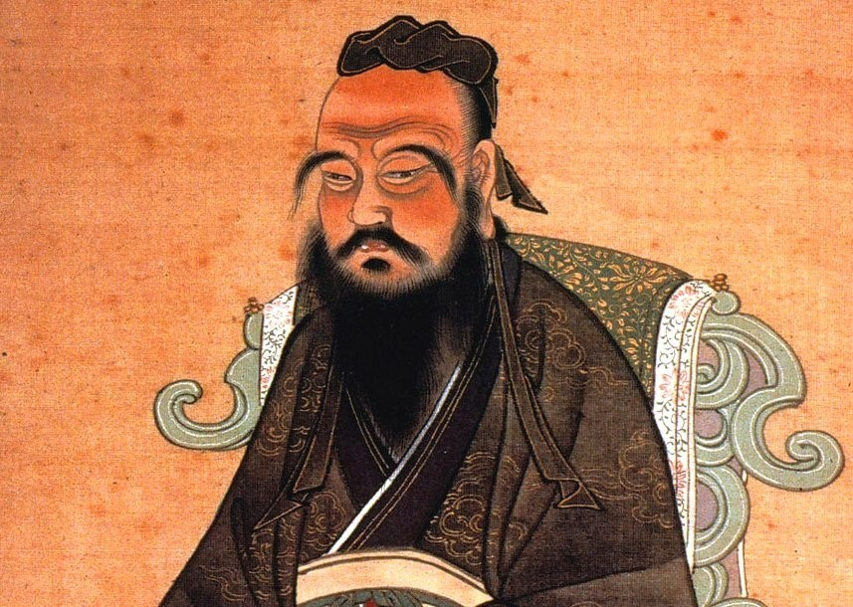






Slide 12
MIANZI (面子)

Slide 13

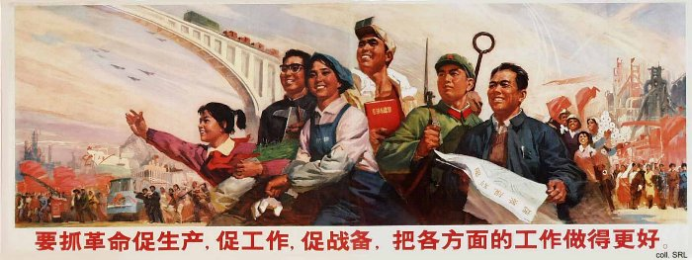
„You can’t define mianzi. It is an intangible abstract and an unwritten norm that regulates Chinese’ relations..”
Lin Yutang

Slide 14

TRUTH
HURTS
LOSING
FACE
KNOWLEDGE AND
COMPETENCE
SHAME
TO SAY
FACE OF
THE NATION

Slide 15
GUANXI (关系)

Slide 16
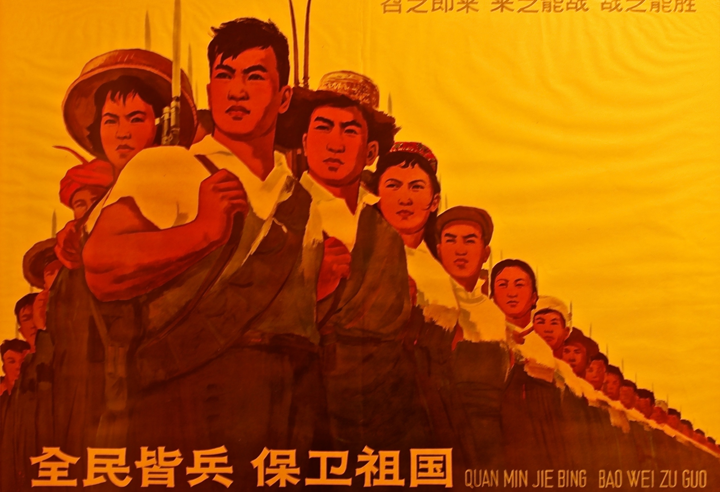





Slide 17
CHINESE’ ETHICS

Slide 18

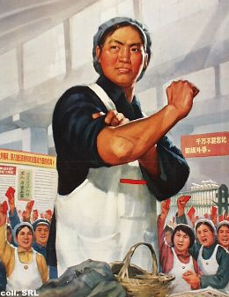
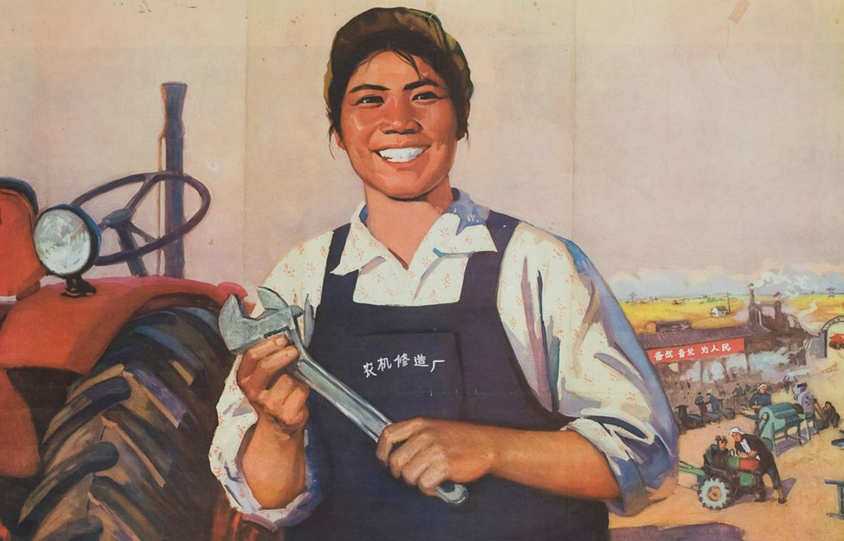

Slide 19
STRONG PILLARS

Slide 20
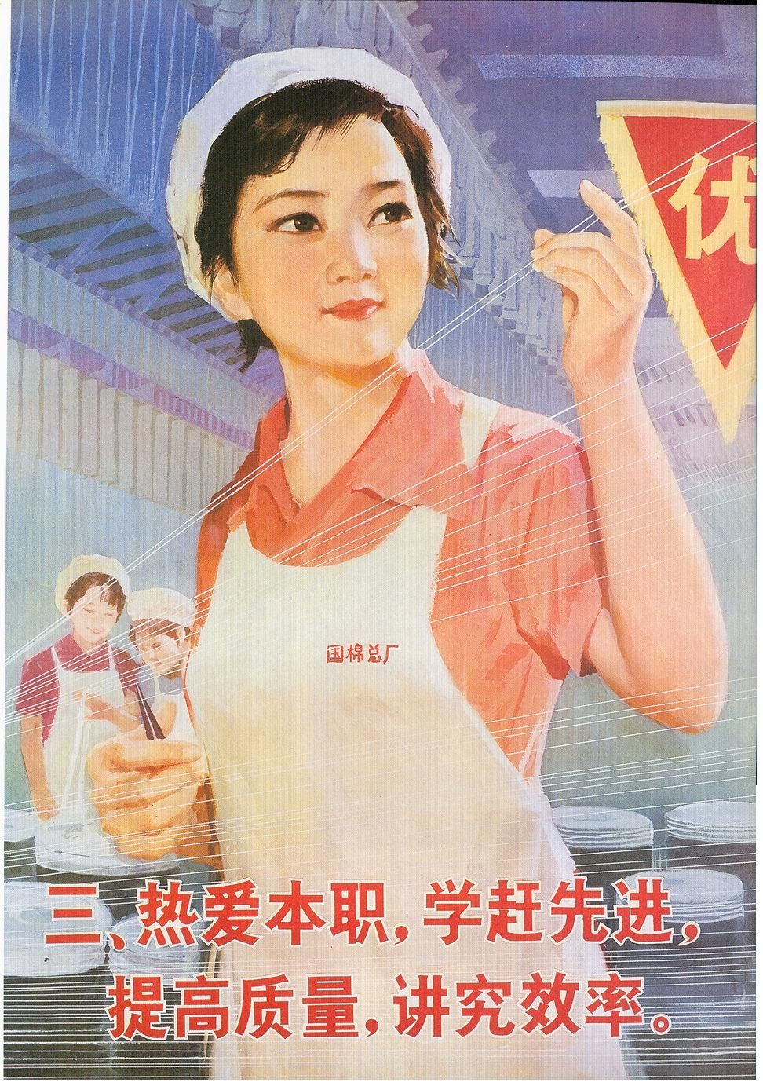
GOVERNMENT SUPPORT
BUSINESS ANGELS
NO-TAX DEVELOPMENT ZONES
INCUBATORS
CREATIVITY AREAS
DIGITAL COMMUNITIES FOR YOUNG PEOPLE
MENTORING

Slide 21







Slide 22
GOVERNMENT WITH VISION

Slide 23
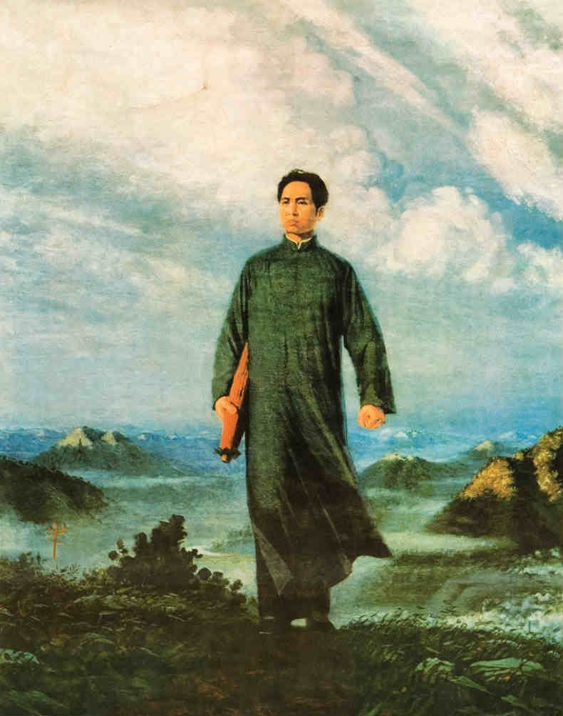






Slide 24
WE VS THEM

Slide 25
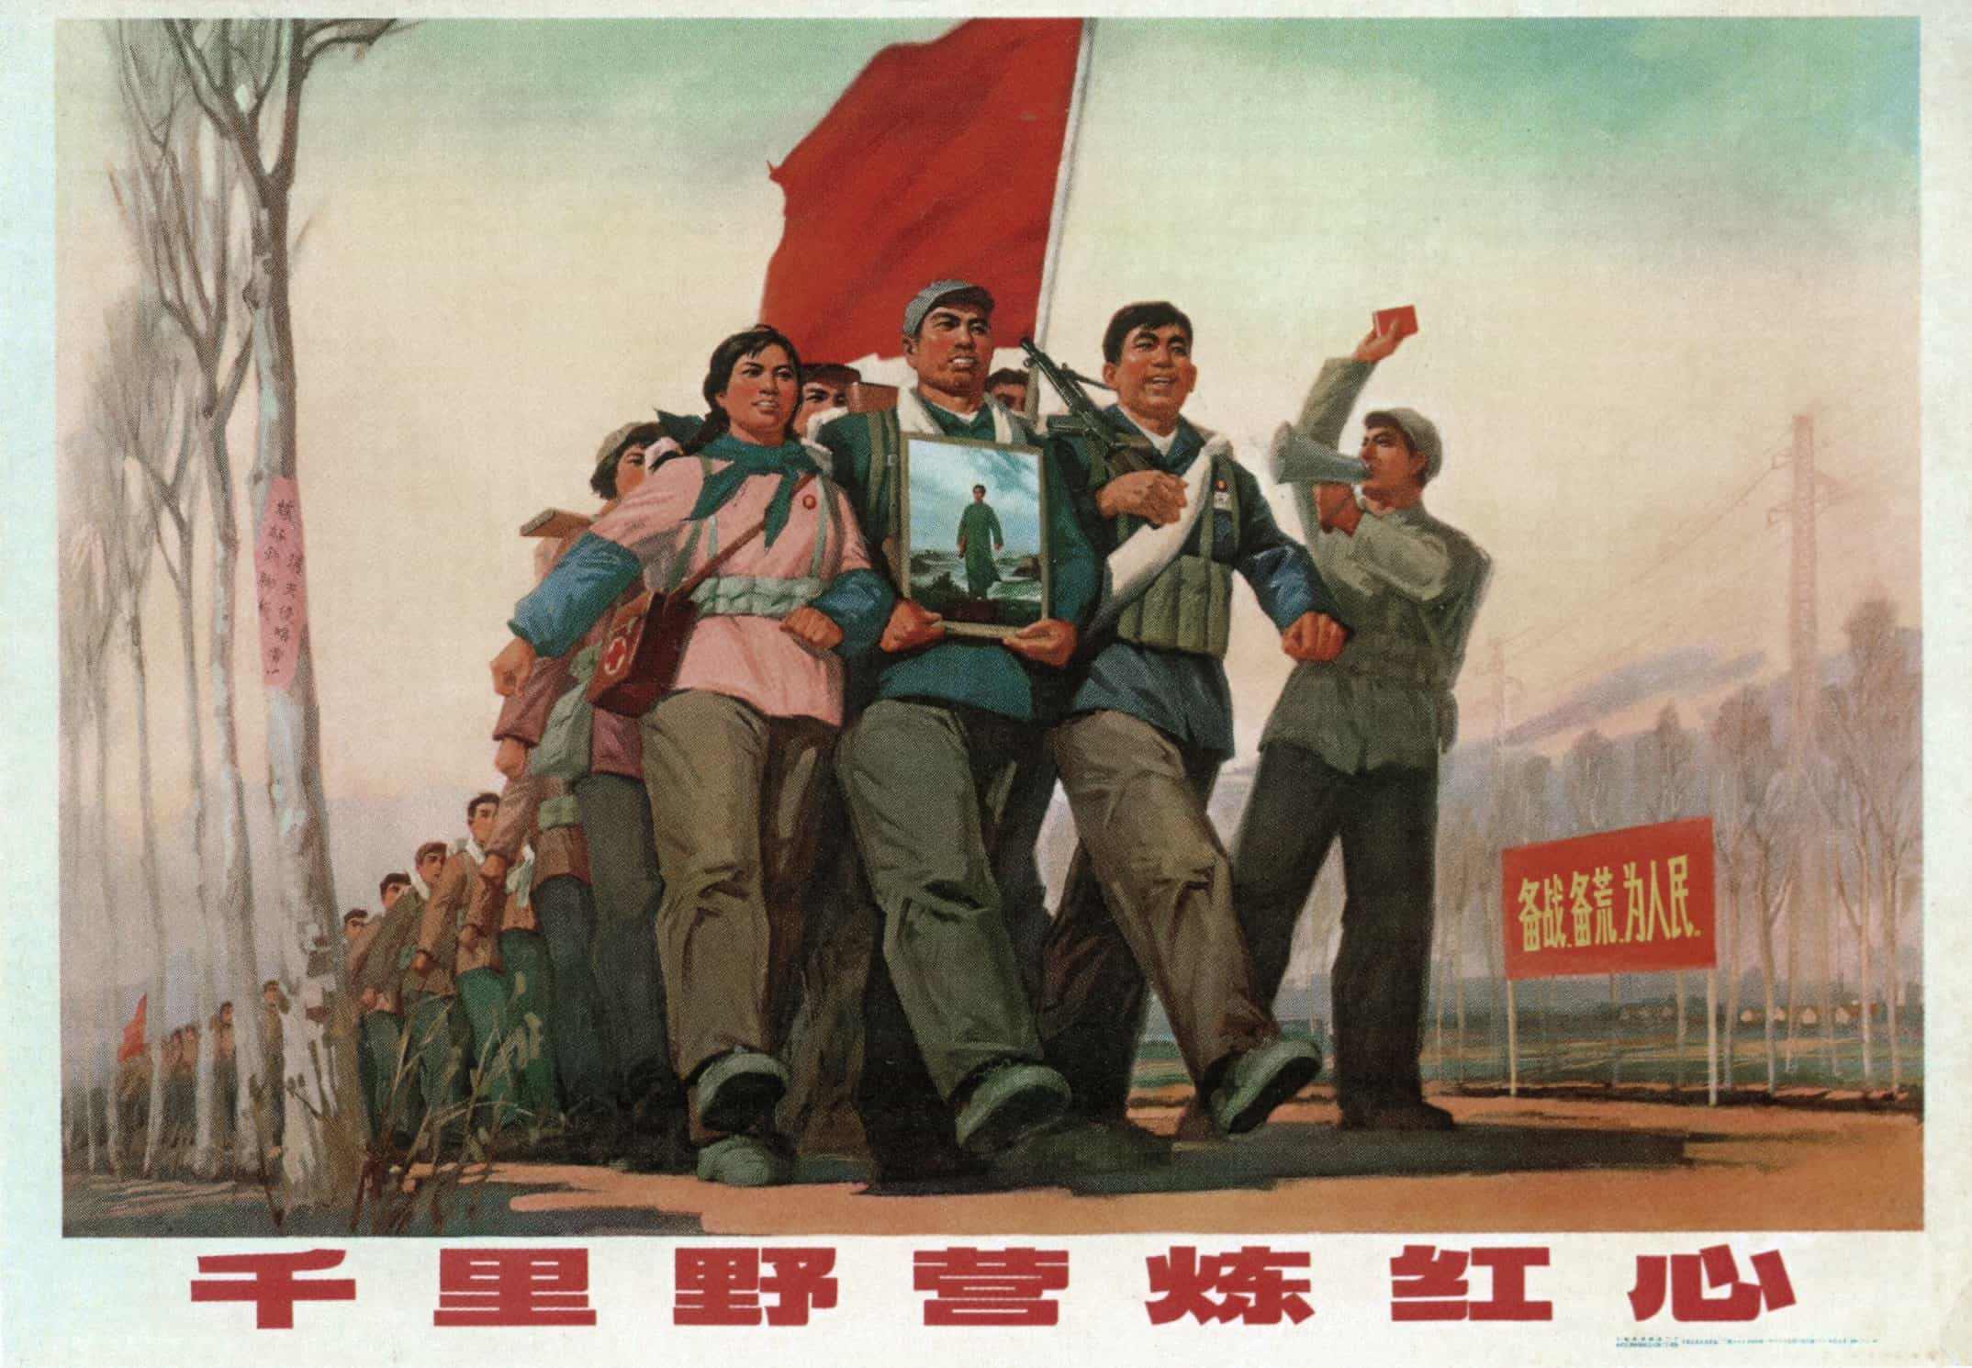
CHINESE ROOTS
PROUD TO BE CHINESE
CHINESE LANGUAGE
CONSTRUCTION OF ECOSYSTEMS
SUPPORT OF THE COMMUNITY
UNDERSTANDING THE NEEDS

Slide 26
CHINESE DOMINATION

Slide 27
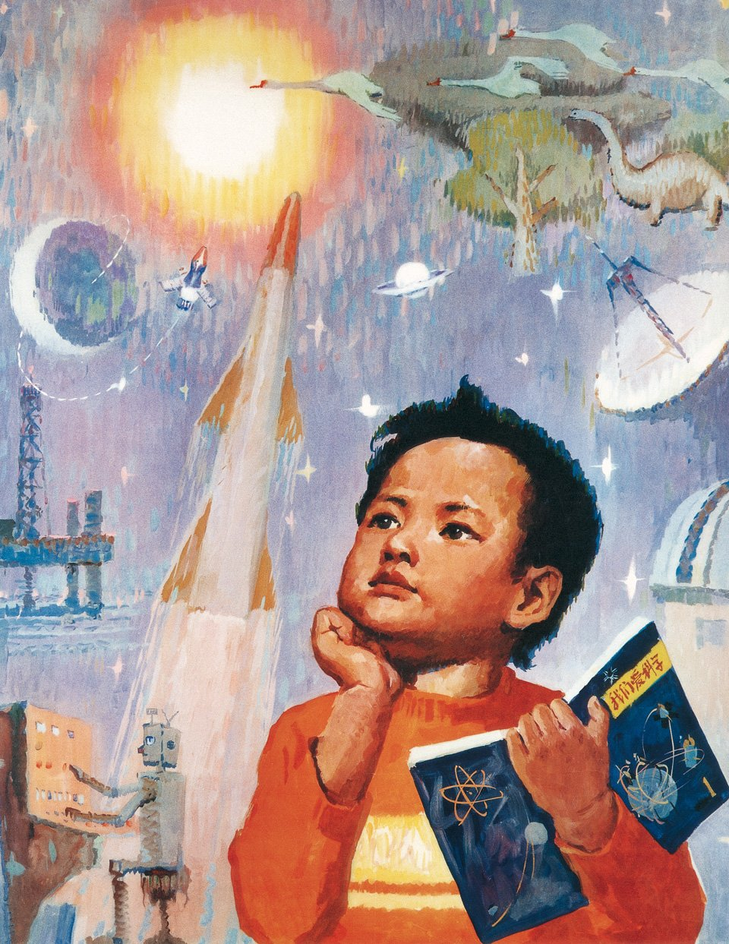







Slide 28
WHAT’S NEXT?

Slide 29
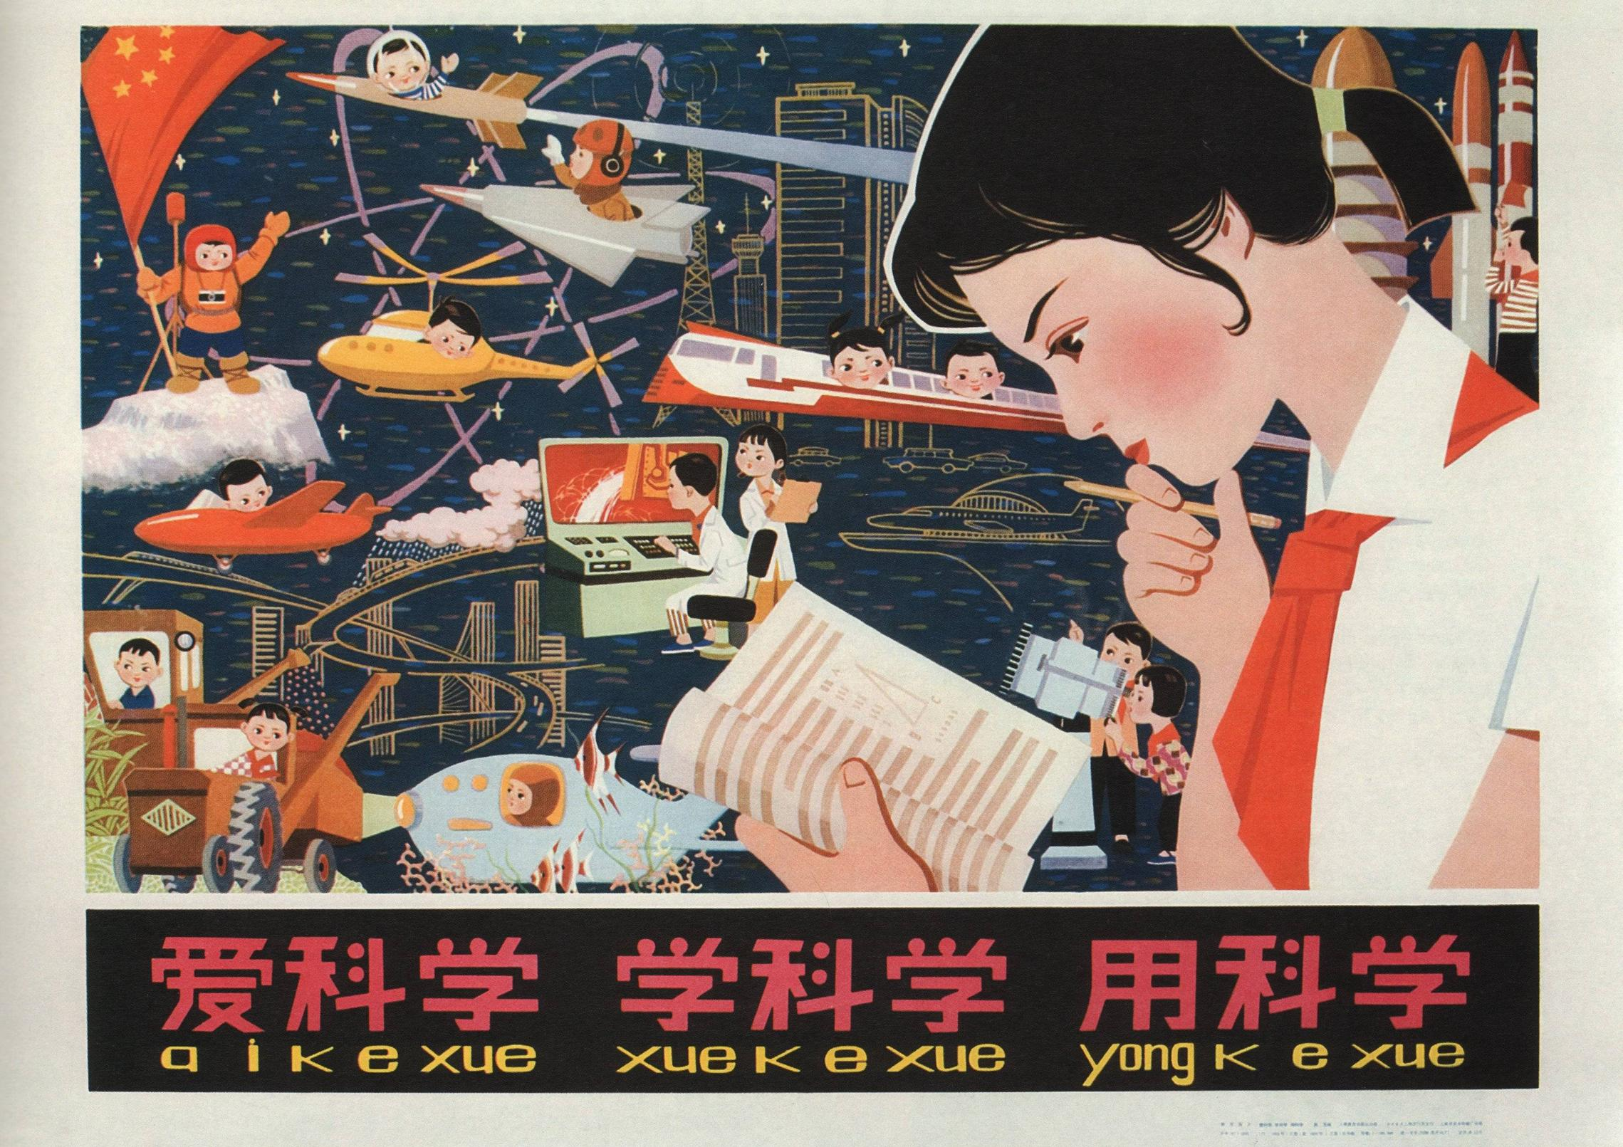
LOVE KNOWLEDGE
STUDY
KNOWLEDGE
PRACTICE
KNOWLEDGE

Slide 30
STUDY PAST TO
PREDICT THE FUTURE

Slide 31
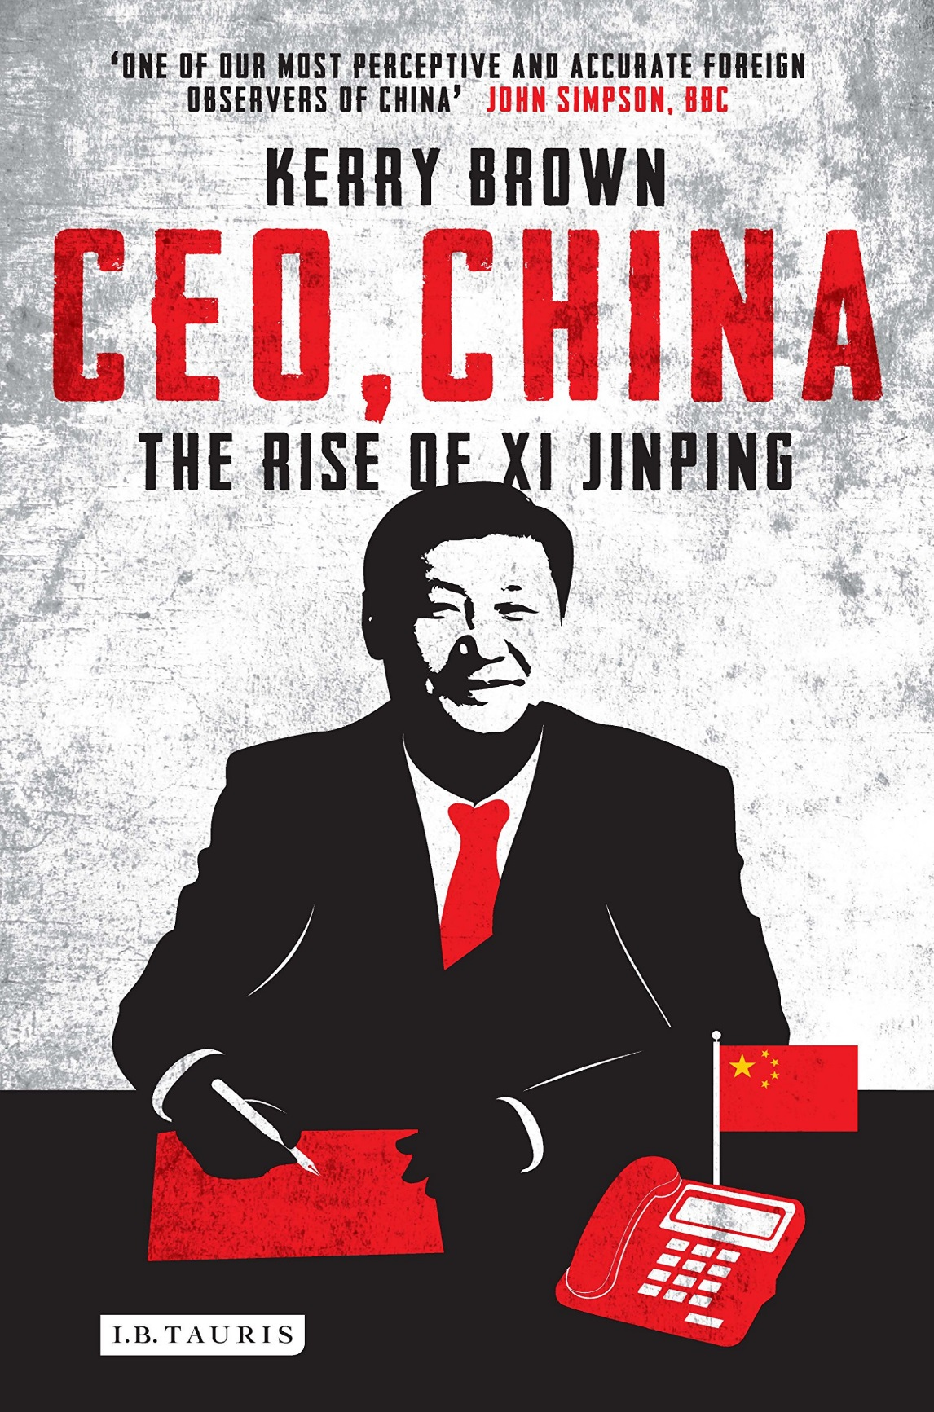


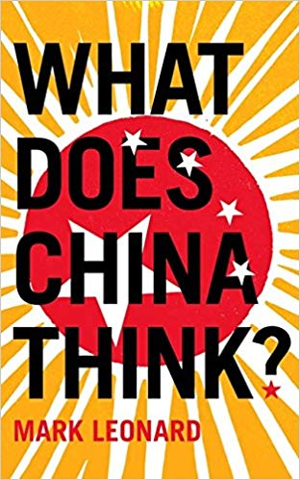




marcin.sikorski@test-engineer.pl
@testengineerpl

