Slide 1
A practical introduction to consumer contract tests with c#
Alexander Henze, MaibornWolff GmbH

Slide 2
Agenda
Welcome & Theory
Practice I:
Consumer Tests
Practice II:
Provider
Tests
Feedback & Good Bye

Slide 3


Software evolves from monolith to microservices

Slide 4
Testpyramide in Monolithic applications
Integration Tests
Unit Tests
E2E Tests

Slide 5
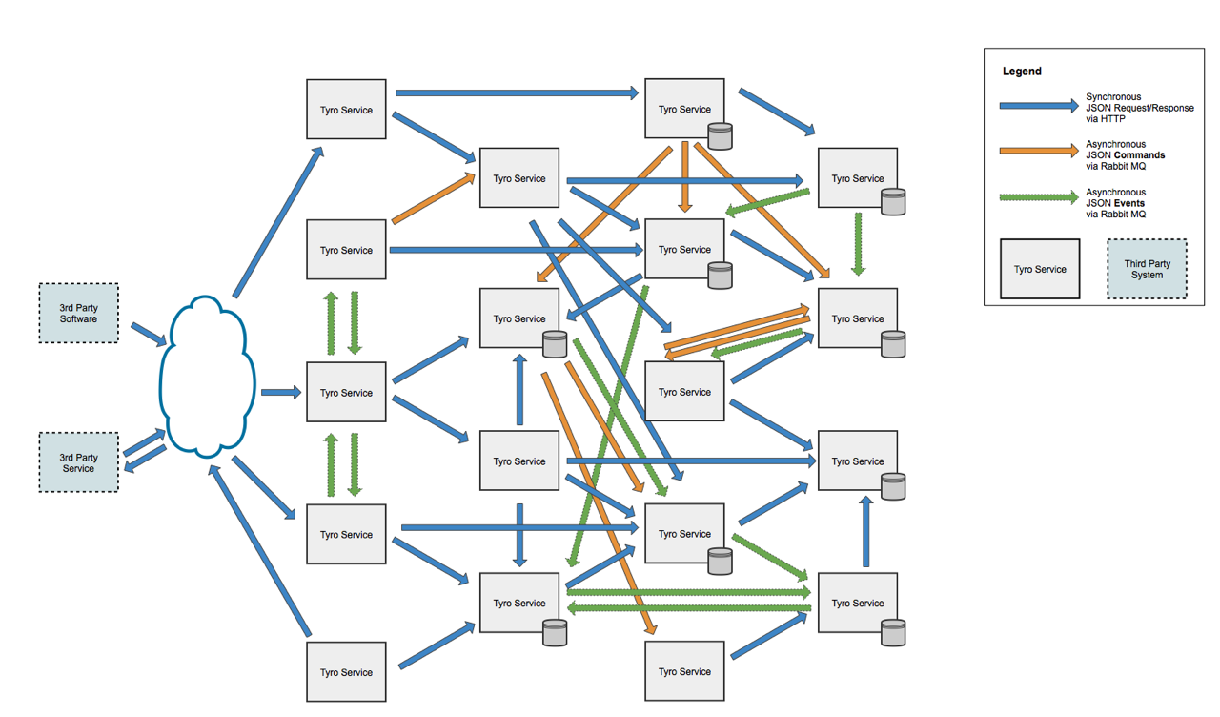
Where is the bug?

Slide 6


Contracts define the interfaces
Consumer Service
Provider
Service
GET
“id“ : 1,
“name“ : “John“,
age: 42

Slide 7
Testpyramide in microservice architecture
Integration Tests
Unit Tests
E2E Tests
Contract Tests

Slide 8

introducing pact
§ Framework for many platforms (Java, .NET, Python, more...)
§ Allows versioning and administration of contracts
§ Easy integration into the pripelines
§ Automatical documentation of system architecture

Slide 9

Let‘s Start

Slide 10
Architecture
GET /sqadays/{name}/speakers
GET /speakers?id={id1, id2,…}
SQA Speaker Service
SQA Conference Service
[{
“id“ : “x“,
“name“: “John“,
“surname“ : “Myer“,
“company“ : “IBM“
}]
{
“id“ : “x“,
“name“: “John“,
“surname“ : “Myer“,
“company“ : “IBM“
}

