Slide 1






Slide 2
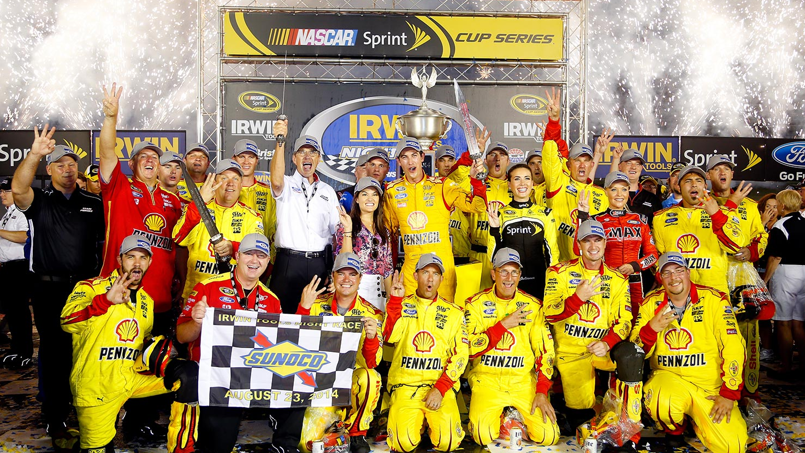


Slide 3
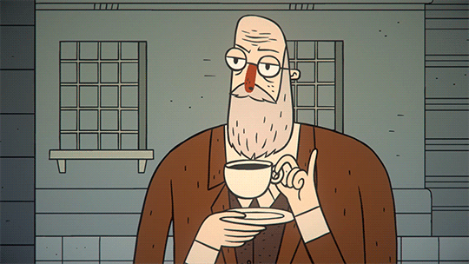
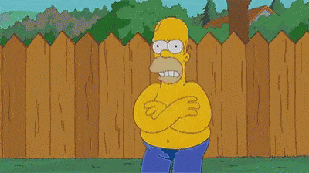
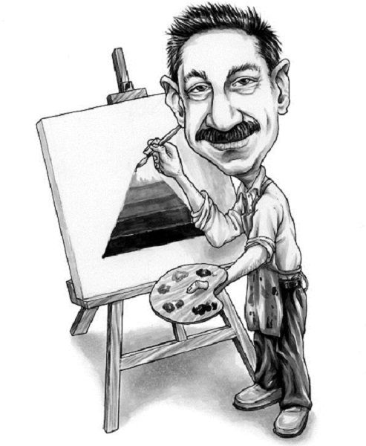
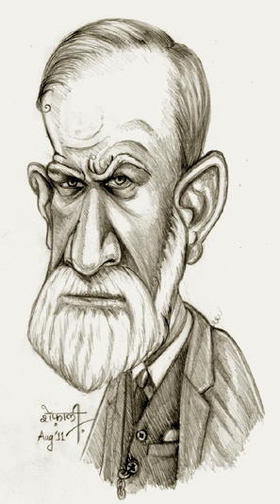
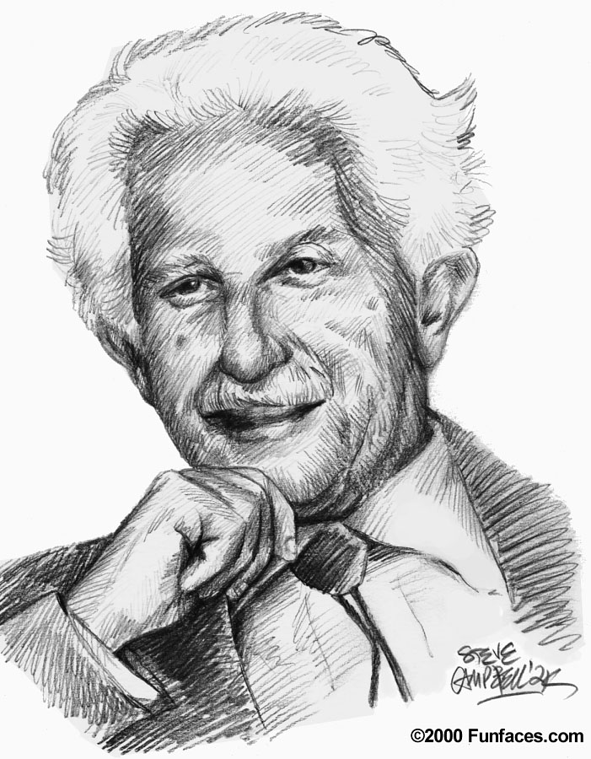
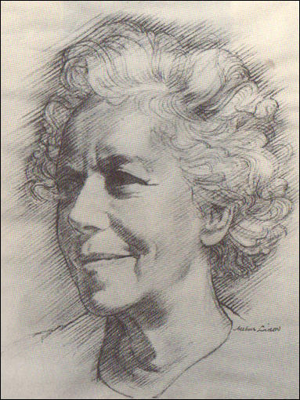
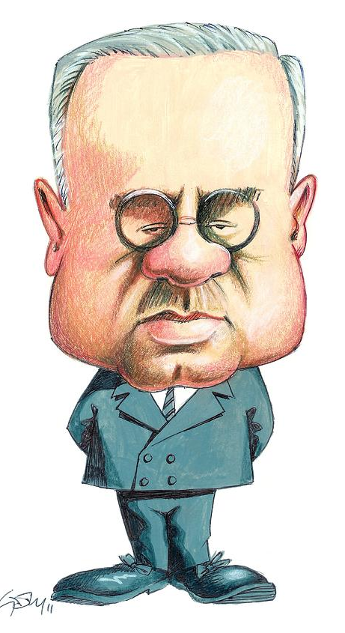
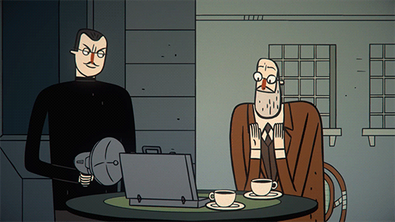
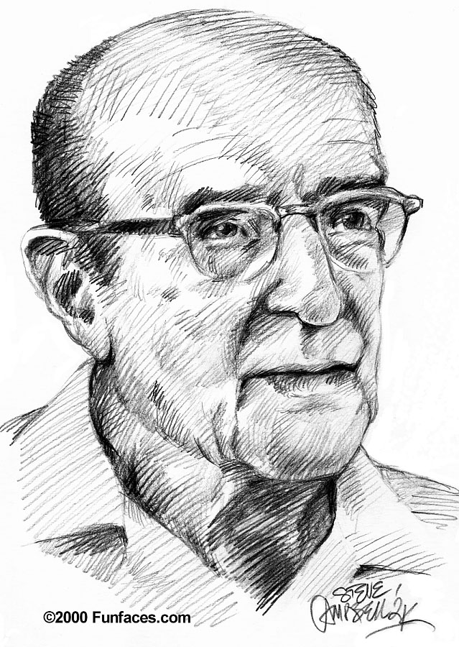
You are
totally yellow!

Slide 4

Insights
Discovery

Slide 5




You will know answers!
Why some testers report bugs in JIRA, then call you and then even hipchat you?
Why are some testers too afraid to go into a conflict with developers and others fight like lions?
Who becomes a Micromanager under stress and who suffers a burnout?
Why are some testers reporting even minor bugs in such detail that it takes forever?

Slide 6




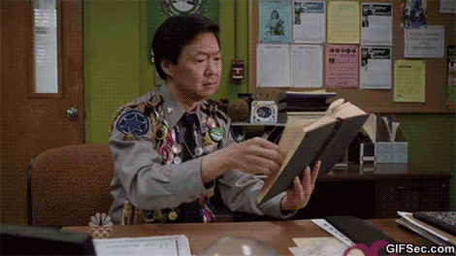
Get to know yourself
Tailor your communication style
Case Study 1+2

Slide 7

Get to know yourself!
Thinking
20
0
20
20
Introversion
Extroversion
20
Feeling

Slide 8

Bull‘s red
Detailed blue
Cautious
Deliberate
Formal
Questioning
Precise
Competitive
Strong-willed
Purposeful
Task-focused
Goal-oriented
Harmonic green
Enthusiastic yellow
Caring
Encouraging
Patient
Sharing
Relaxed
Sociable
Dynamic
Demonstrative
Enthusiastic
Persuasive

Slide 9

Stuffy
Indecisive
Suspicious
Cold
Reserved
Aggresive
Controlling
Driving
Overbearing
Intolerant
Docile
Bland
Plodding
Reliant
Stubborn
Excitable
Frantic
Indiscreet
Flamboyant
Hasty

Slide 10
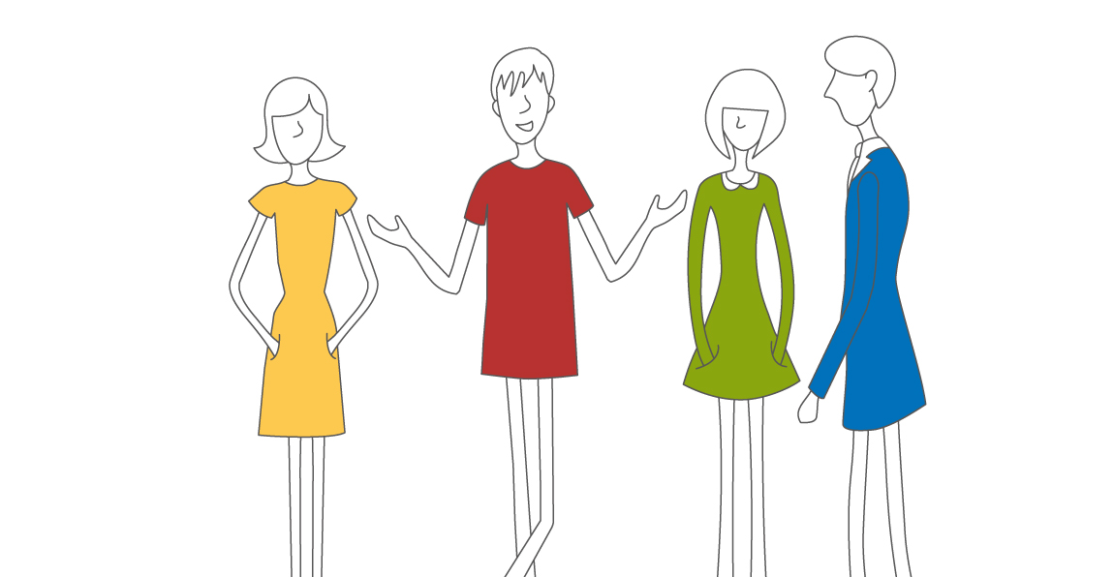





Cautious
Deliberate
Formal
Questioning
Precise
Aggresive
Controlling
Driving
Overbearing
Intolerant
Competitive
Strong-willed
Purposeful
Task-focused
Goal-oriented
Stuffy
Indecisive
Suspicious
Cold
Reserved
Excitable
Indiscreet
Flamboyant
Frantic
Hasty
Caring
Encouraging
Patient
Sharing
Relaxed
Sociable
Dynamic
Demonstrative
Enthusiastic
Persuasive
Docile
Bland
Plodding
Reliant
Stubborn
bouskovap@gmail.com
petrabouskova
bouskovap

Slide 11
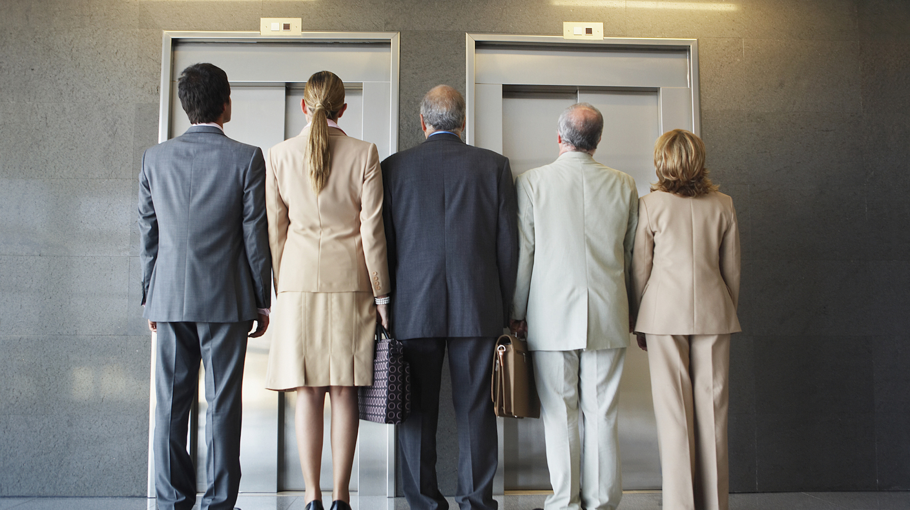
How do colours behave when
they wait for an elevator?

Slide 12

They need details
They prefer written form
Be prepared with data
Give them time to ask
Be logical
Get to the point
Move quickly
Show clear results
Focus
Challenge them
Don‘t dare to touch them!
Don‘t be reckless.
Inform them before you change anything.
Don‘t hesitate too long!
Don‘t be too emotional.
Accept the problem, find a solution, move on.
bouskovap@gmail.com
bouskovap
petrabouskova

Slide 13

Nodding – agree listening
Listen and support them.
Understand them
Slow down and ask.
Be friendly and flexible
Be aware they talk a lot
Be positive
Focus on emotions
Be visual
Don‘t dive into details!
Don‘t give them a routine job.
Don‘t be cold.
Don‘t push them into a quick decision!
Don‘t surprise them.
Don‘t abuse their peaceful nature.
bouskovap@gmail.com
bouskovap
petrabouskova
Notes:
GREEN generally: Show them that you care! YELLOW generally: Involve them!

Slide 14

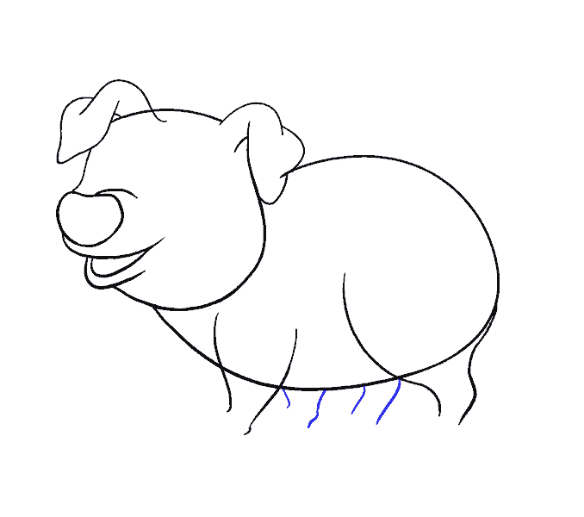


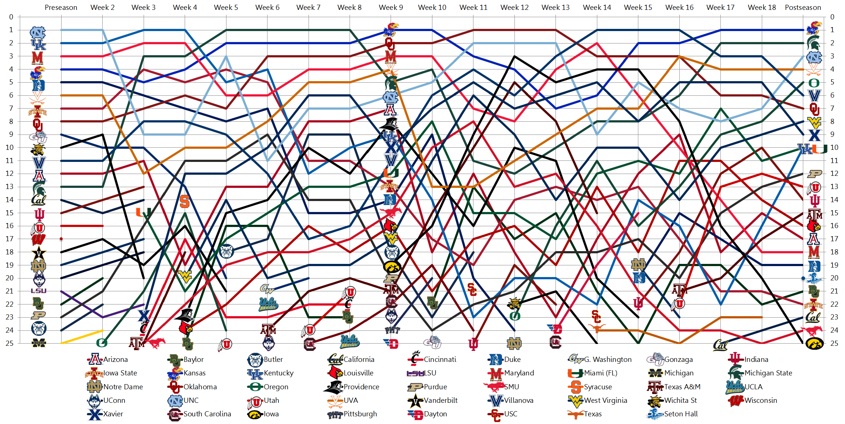

WHAT STRESS THEM
REMEDY
Allow for fast action.
Put them in control.
Take decision
or time out.
Responsibility for accuracy.
Push their feedback.
Analyze more carefully.

Slide 15
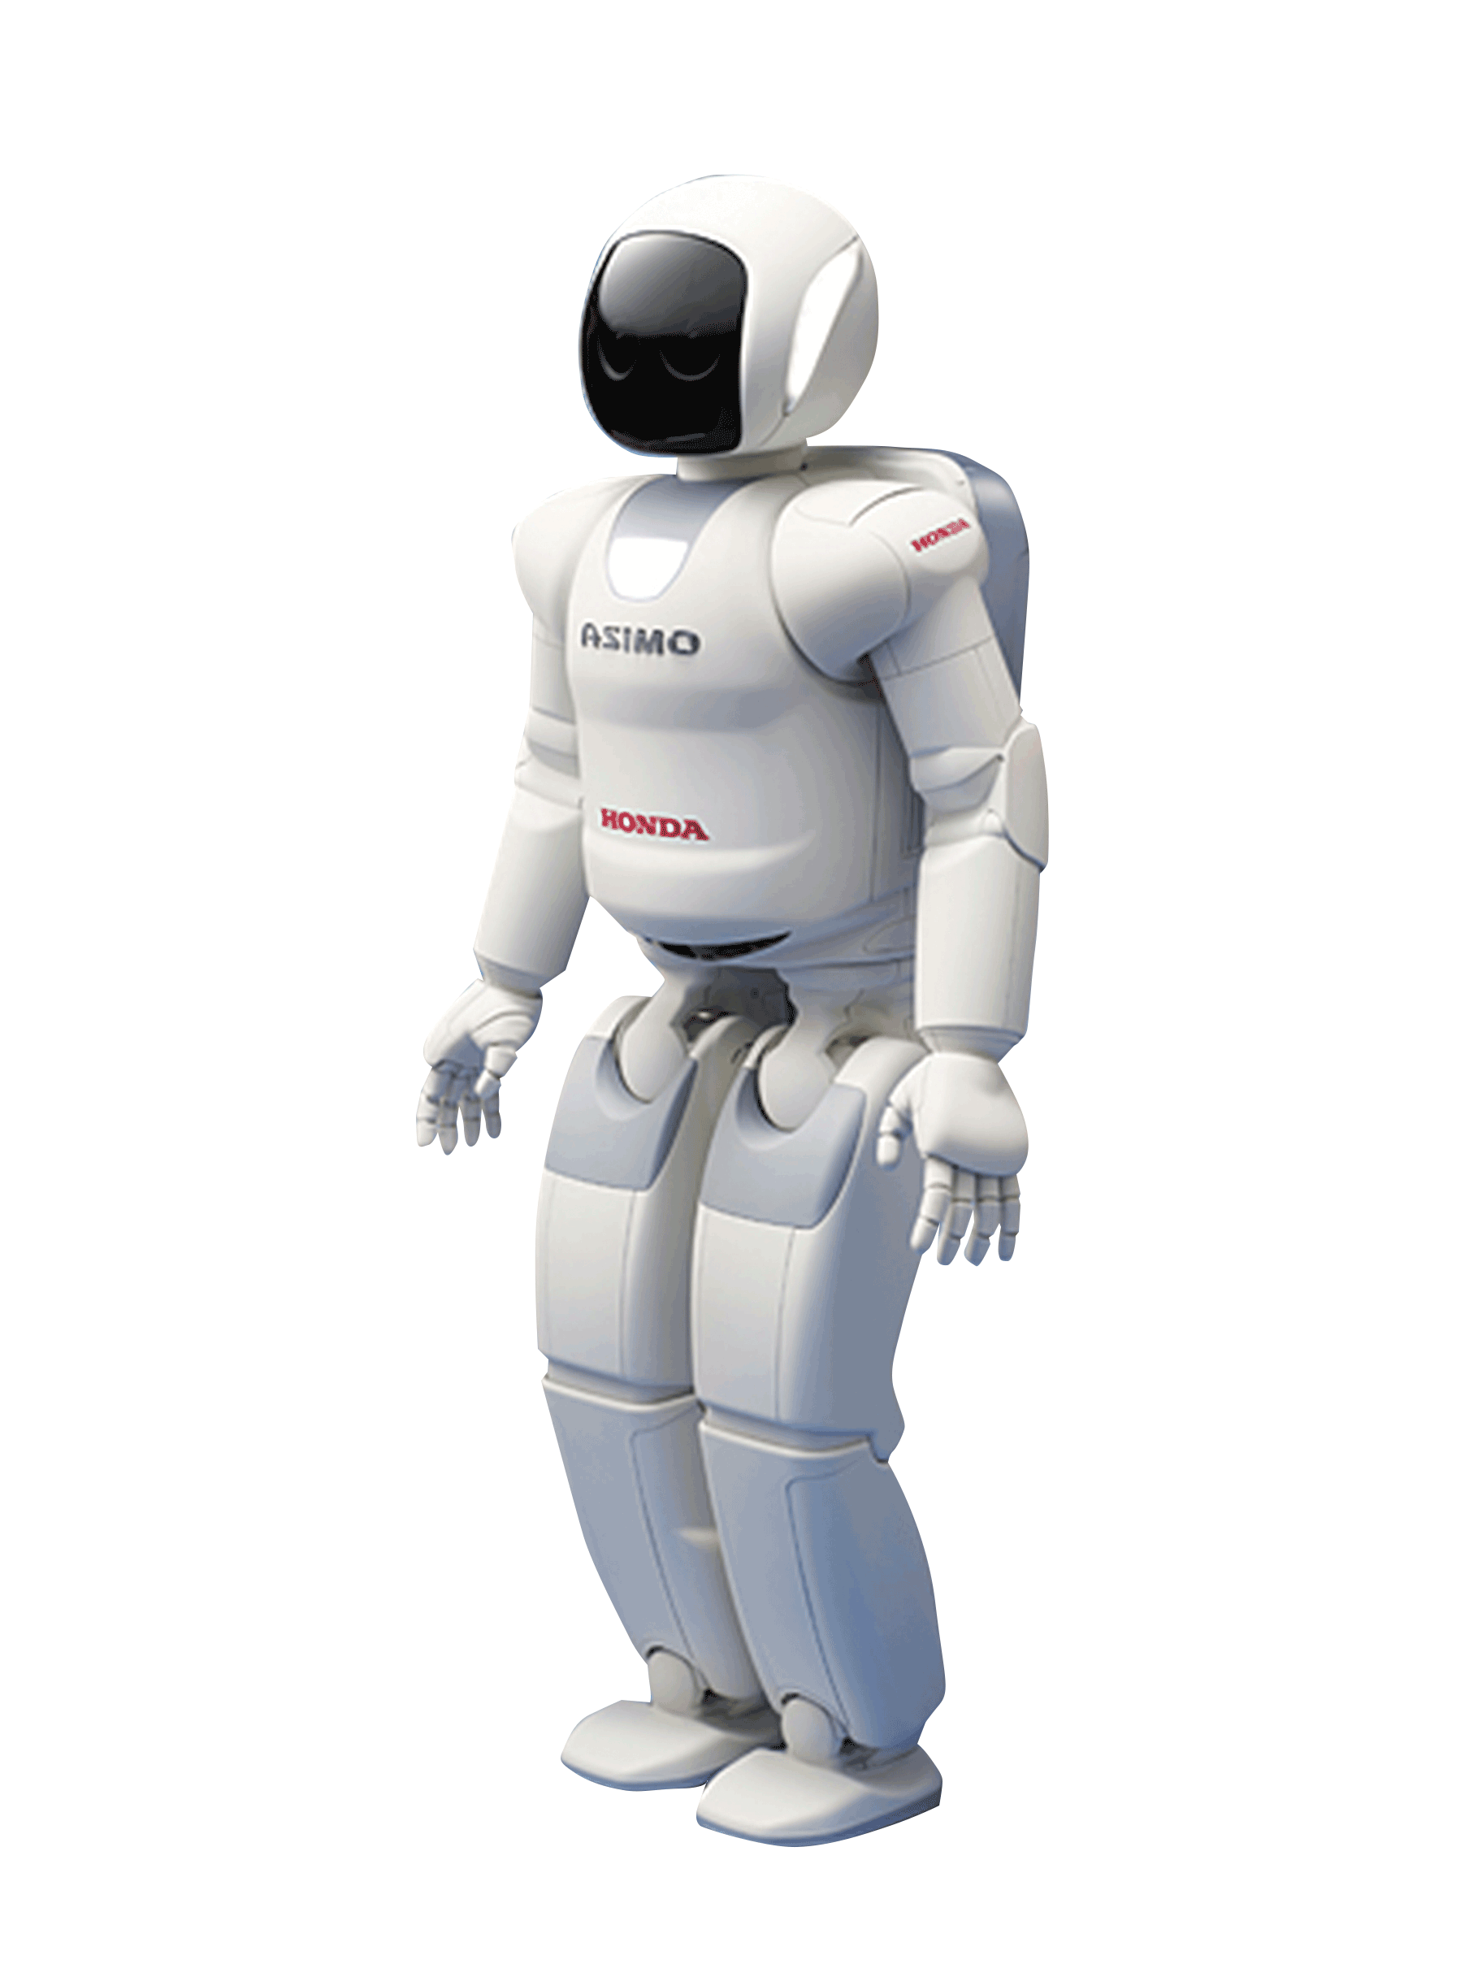



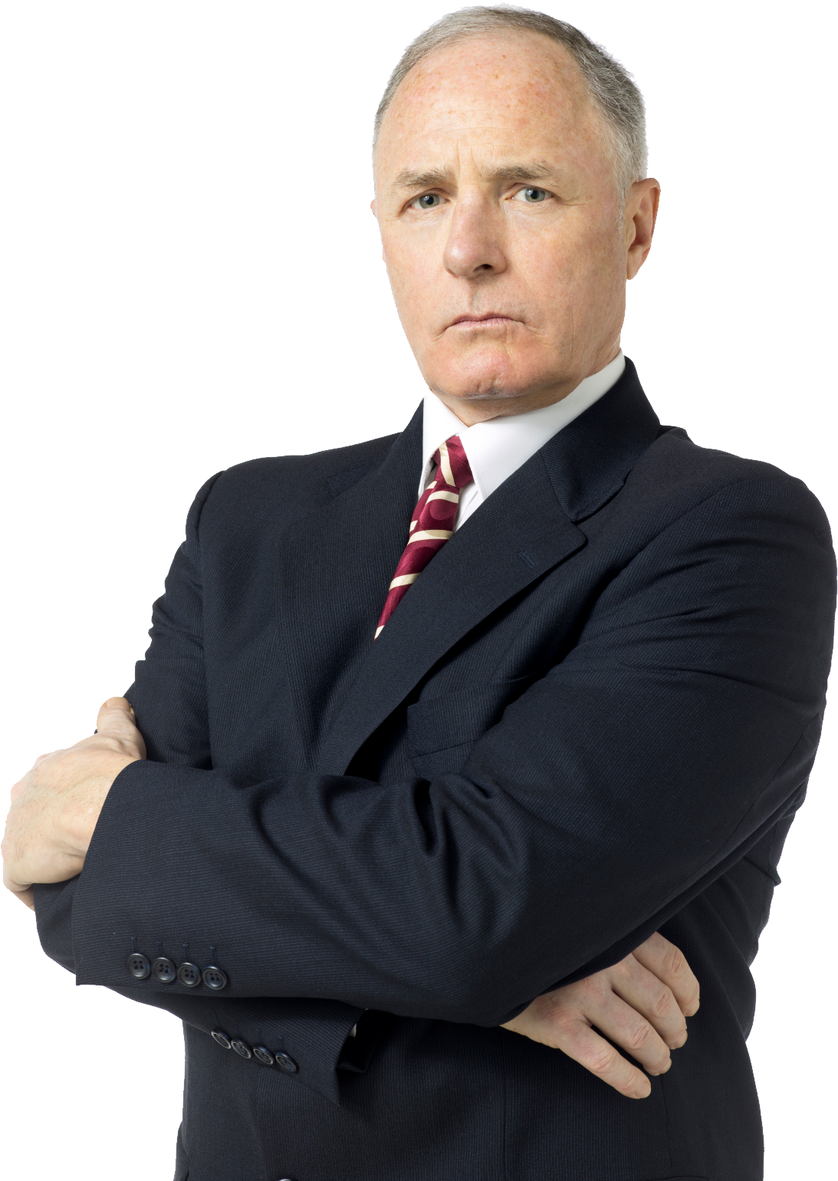

WHAT STRESS THEM
REMEDY
Personal contact to
restore a trust.
Understand them. Time out to discuss.
Distract them.
Creativity, freedom. Save face.

Slide 16

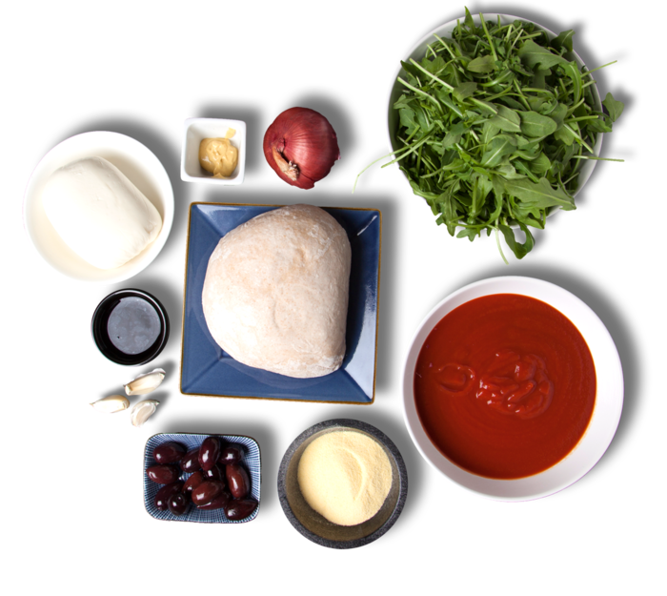

SCHEDULE A MEETING
Making a pizza with friends.

Slide 17
Good morning, I would like to invite you to a meeting focused on …
EMAIL
Purpose is to: discuss/get agreement/suggest..
Result of this meeting:
Participants will be and their roles are:
Thank you very much in an advance for
your time and support. With respect..
Notes:
And what to write to this damn email? ☺
Don‘t forget that you have to be efficient and you, as a LEADER, you have to hit all 4 colours. You want them all there, correct? Then let‘s do it.
Good morning, I would like to invite you… Be polite. Be different. Be inspirative. Be kind. Yellow love meetings, brainstorming, everywhere where they can be invove, they are going.
Purpose of this meeting is: Be clear, red people don‘t like wasting their time at all. They need to know. Why do they going somewhere. The best is even write there a method of leading this meeting: brainstorming, suggestion topic by topic…
What will be a result? Document? Agreement? Requrements? Table? Give me something what I can measure. And imagine that people are working 8,5hours, they are focusing on their job and now..you want to steel their focus for 30min or more. Give theym WHY they should come. What will be outcome.
This is new and modern, I love that part. We care about people and invite only people who should participate, we know their roles and we work together. As well its highly effective – if I know in a advance – Who is how, i can better ask people. I can after a meeting find them a discuss specific questions.
Once I started to thank to people for their time and support. Even more, I thanked them with a respect, magic started to happen. And as well yellow want to feel like VIP, something special, they need attention…if you appreciate their help – they will happily dance around and ask what they could help with!

Slide 18
1. Describe situation
PIZZA solves
PROBLEMS
8. Agreement & action!
2. Use data, facts
7. Tasks & deadlines
6. Consequences
3. If I understand well..
4. Listen and ask
5. What do you
suggest?!
bouskovap@gmail.com
bouskovap
petrabouskova

Slide 19





Reflective LISTENING
COMMUNICATION PROBLEM
“Let me say back to you what I think you just said,
so that I can be sure I understood you correctly…”
2. “Please correct me if I am wrong.
I understood you to say…“
3. “If I hear you correctly, you are saying…”
4. “I hear you saying…“
5. “It sounds to me like you feel/think…”
Notes:
The single biggest problem in communication is the illusion that it has taken place.”
If you look closely at each question, you will see a common thought: if a miscommunication happened, it’s my problem and not the other person’s.
“Would you please say what you heard me say, so I can be sure that I was clear?”
“So that I can make sure I communicated clearly, would you please tell me what you heard me say?”
“I just want to make sure that I am clear. Would you please tell me what you understood me to say?”
“I’d like to make sure I said that clearly. Please tell me what you heard?”
“I’m not sure that I am conveying my idea the best way. What have you heard me say?”
“I may have said that in a way that does not really communicate what I’m trying to say. If I did, I’d like a chance to rephrase it. What message did you hear?”

Slide 20
Case Study
Solve a PROBLEM
1. Make pairs, choose a boss and a team member.
2. Read a Case Study on the next slide.
3. Listen to my instructions for individual ….preparation.
4. Prepare for your role for 30 seconds
5. Start with face-to-face meeting.

Slide 21

1. Describe situation
Boss, solve the PROBLEM!
Your team member wears unppropriate clothes to work,
not following work rules.
Colleagues are complaining.
8. Agreement & action!
2. Use data, facts
7. Tasks & deadlines
6. Consequences
3. If I understand well..
4. Listen and ask
5. What do you
suggest?!

Slide 22
1. Describe situation
Boss: Prepare data, FACTS of
this situation and your potential
solution.
30sec
8. Agreement & action!
7. Tasks & deadlines
2. Use data, facts
Team member: Find
your reason WHY
you are doing it and think of a potentional solution.
6. Consequences
3. If I understand well..
4. Listen and ask
5. What do you
suggest?!

Slide 23
1. Describe situation
Boss, solve the PROBLEM!
Your team member wears unppropriate clothes to work,
not following work rules.
Colleagues are complaining.
8. Agreement & action!
2. Use data, facts
7. Tasks & deadlines
6. Consequences
3. If I understand well..
4. Listen and ask
5. What do you
suggest?!

Slide 24

Boss, solve the PROBLEM!
Your team member was always late
to work last month. Customers and
Colleagues are complaining.
1. Describe situation
8. Agreement & action!
2. Use data, facts
7. Tasks & deadlines
6. Consequences
3. If I understand well..
4. Listen and ask
5. What do you
suggest?!

Slide 25
You will know answers!
Why some testers report bugs in JIRA, then call you and then even hipchat you?
Why are some testers too afraid to go into a conflict with developers and others fight like lions?
Who becomes a Micromanager under stress and who suffers a burnout?
Why are some testers reporting even minor bugs in such detail that it takes forever?

Slide 26




FIND YOUR COLOUR!

Slide 27

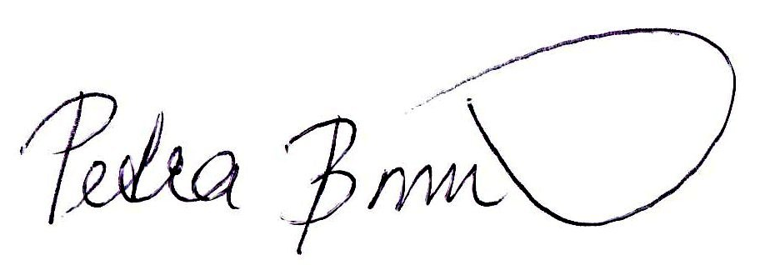



Stop communicating with your team in the way
you like to receive information. Talk to people
in a way they would communicate with themselves.
petrabouskova
bouskovap
bouskovap@gmail.com
petra.bouskova
petrabouskova.com
bouskovapetra

