Slide 1

Appium Dockerization: from Scratch to Advanced Implementation
Sargis Sargsyan

Slide 2


Welcome!
Sargis Sargsyan
Director, Quality Assurance at PicsArt Inc

Slide 3
Agenda
Appium Dockerization: from scratch to advanced implementation
Introduction
Getting started with Appium Docker for Android
Appium Docker
Setup docker-appium in Mac

Slide 4
Run Tests on Real Device
Run Android test suite on real devices using Appium Docker
Setup Using Docker Compose
Faster setup with docker-compose
Android Emulator in Docker
Setup android emulator with docker
SMS Simulation
Simulate receiving SMS

Slide 5
Selenium Hub
Introduction to Selenium Hub
Connect Appium host to Hub
Register Appium host in Selenium grid
Run Tests in Emulator
Running Appium test in Emulator
Q&A

Slide 6
Why we need this approach
Quick & easier setup of automation environment
Speed up Appium test suite run
The automation setup steps will be done Automatically
Run on Real Devices and Emulators

Slide 7
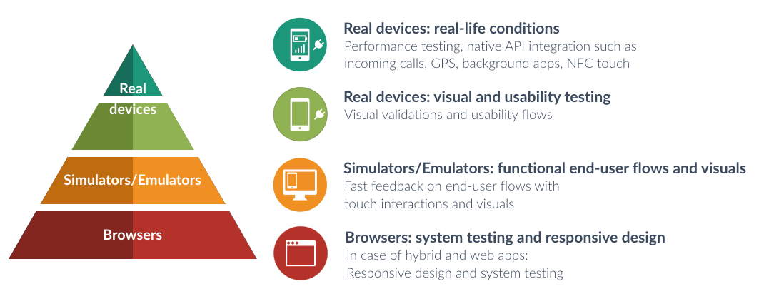

Slide 8
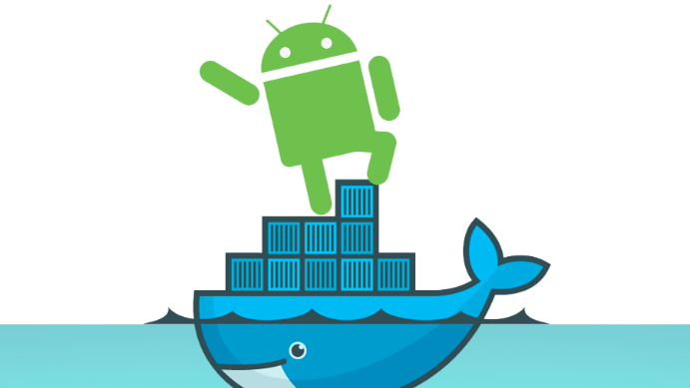
What is Appium?
Appium is a powerful framework that help us test our mobile applications
It supports both native and hybrid applications
It is open-source and cross-platform, giving us the ability to run test against
multiple platforms with the same API, avoiding code refactoring
It’s drive iOS , Android and Windows apps using the WebDriver protocol

Slide 9





Appium Architecture
How Appium is working
USB connect
Appium
ADB
HTTP
Test Runner
USB connect
Appium
ADB

Slide 10
Appium Docker Architecture
docker-machine-1
USB connect
Appium
ADB
HTTP
docker-machine-2
Test Runner
USB connect
Appium
ADB

Slide 11
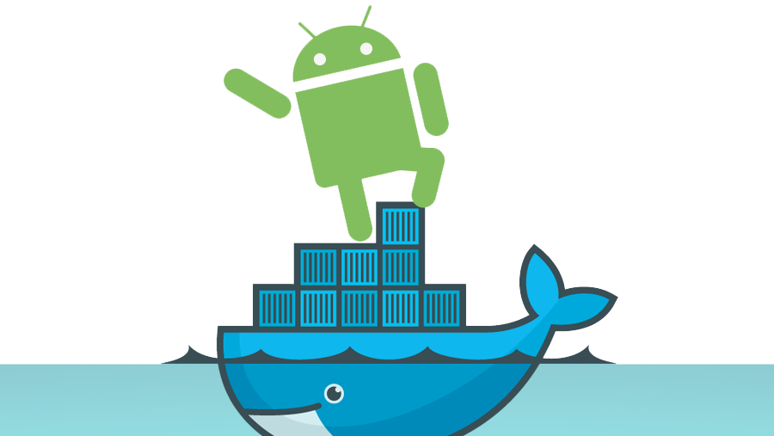
Getting started with docker-appium
Steps for Mac OSX

Slide 12
docker-machine version
$ docker-machine --version

Slide 13
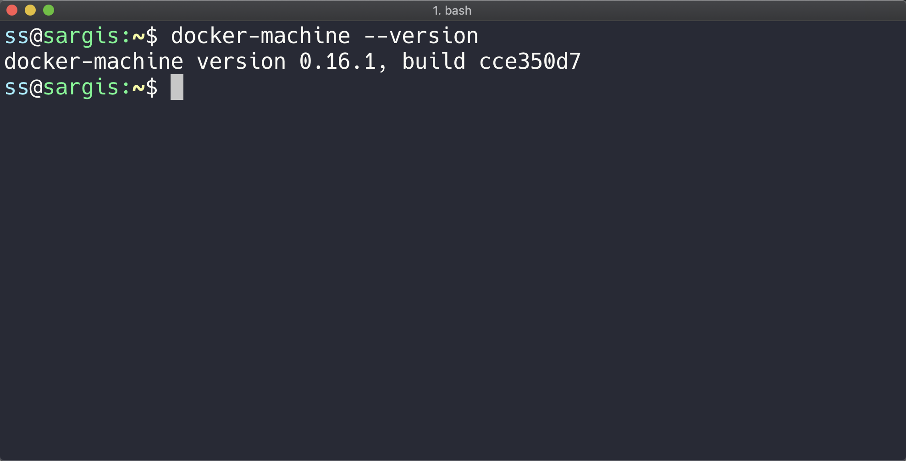

Slide 14
Create a docker-machine
$ docker-machine create --driver virtualbox appium-test-machine

Slide 15
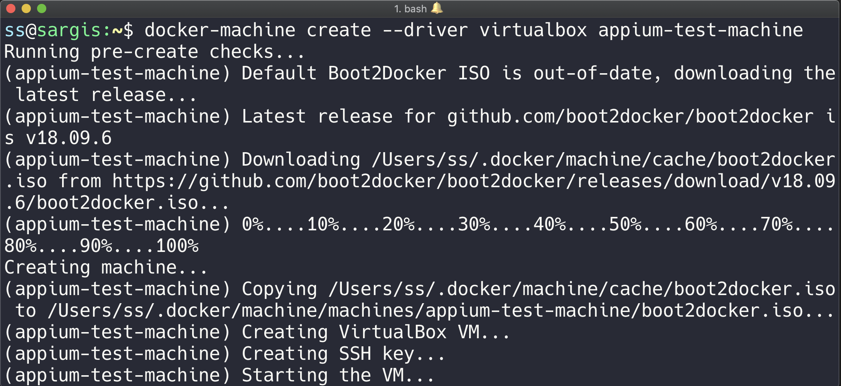

Slide 16
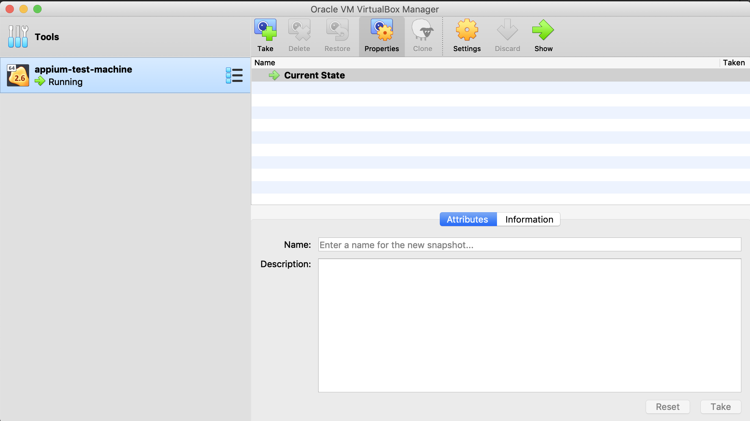

Slide 17
Enable USB in created docker-machine
$ docker-machine stop appium-test-machine

Slide 18
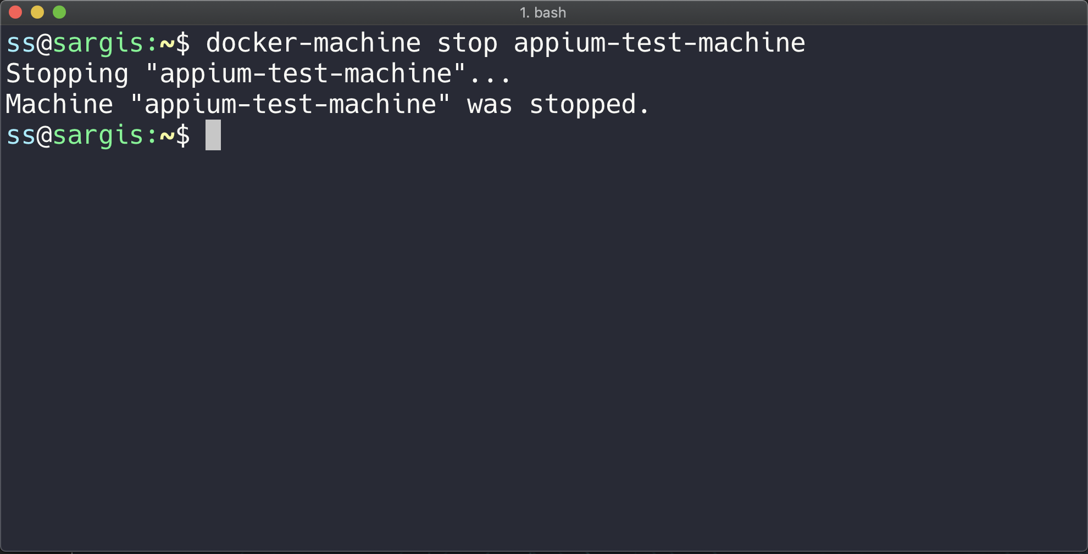

Slide 19
Enable USB in created docker-machine
$ vboxmanage modifyvm appium-test-machine --usb on --usbehci on
* You need to install Extension Pack depends on your virtualbox version, in case you get an Error "Implementation of the USB 2.0 controller not found"

Slide 20
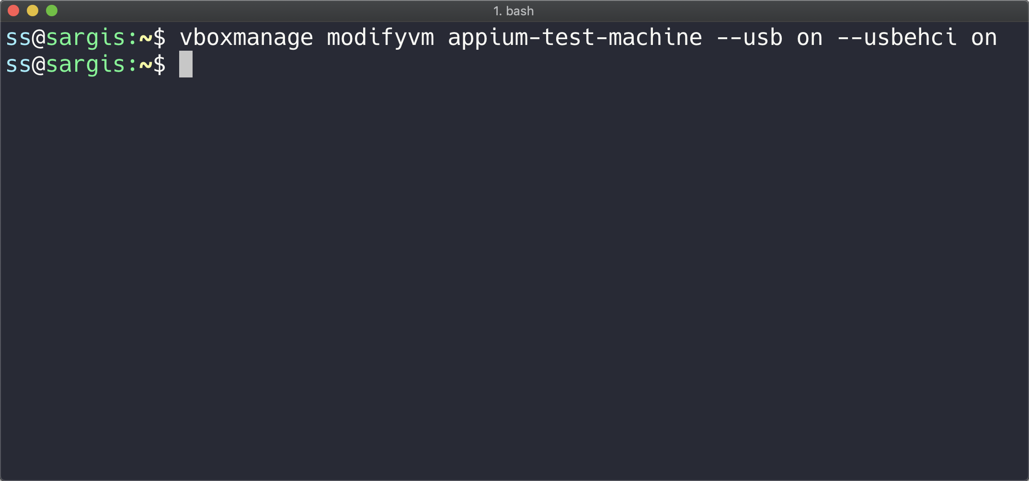

Slide 21
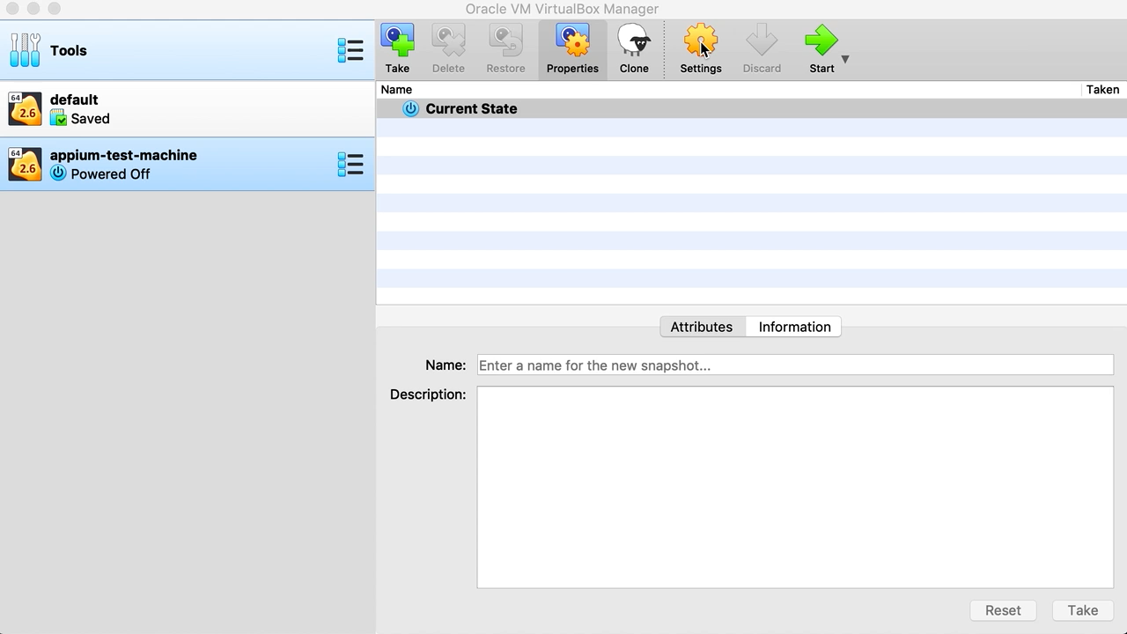

Slide 22
Start docker-machine
$ docker-machine start appium-test-machine

Slide 23
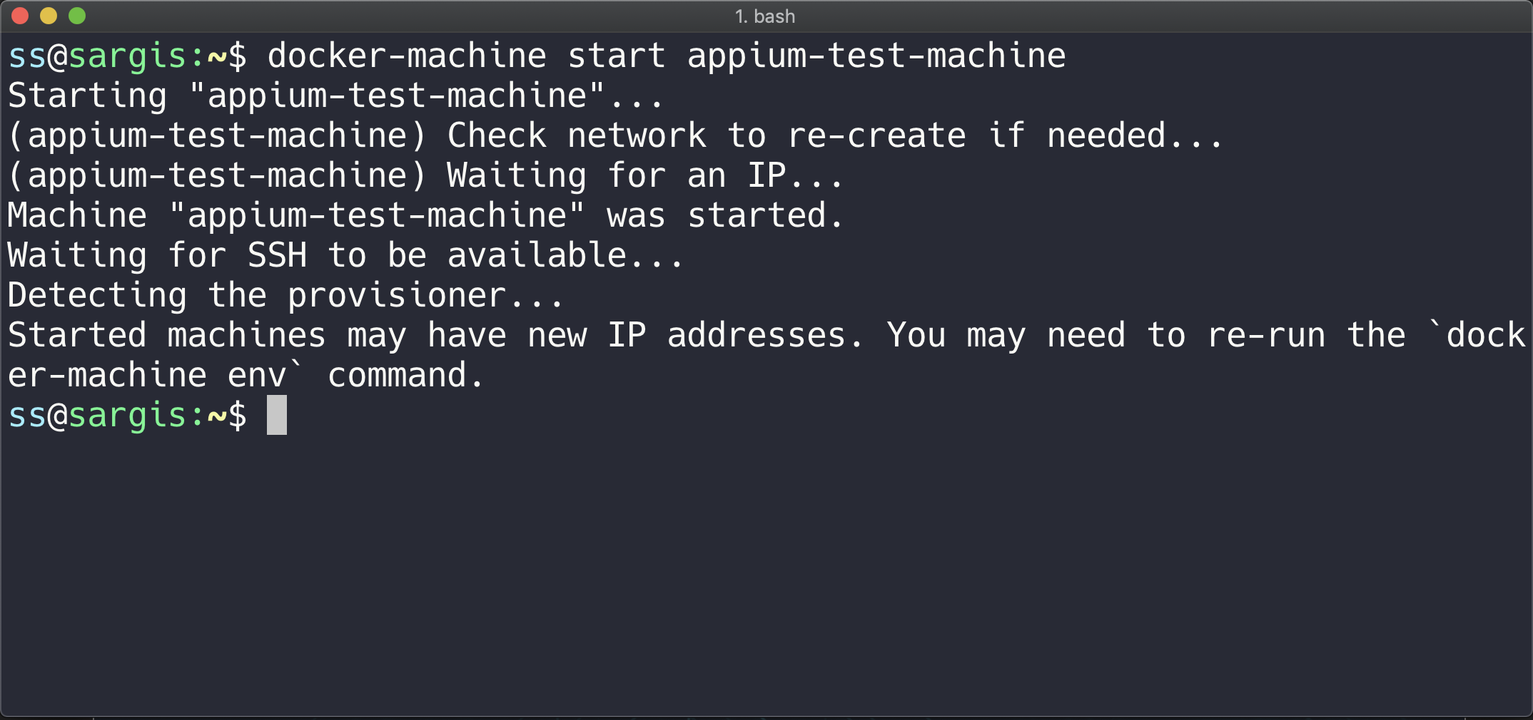

Slide 24
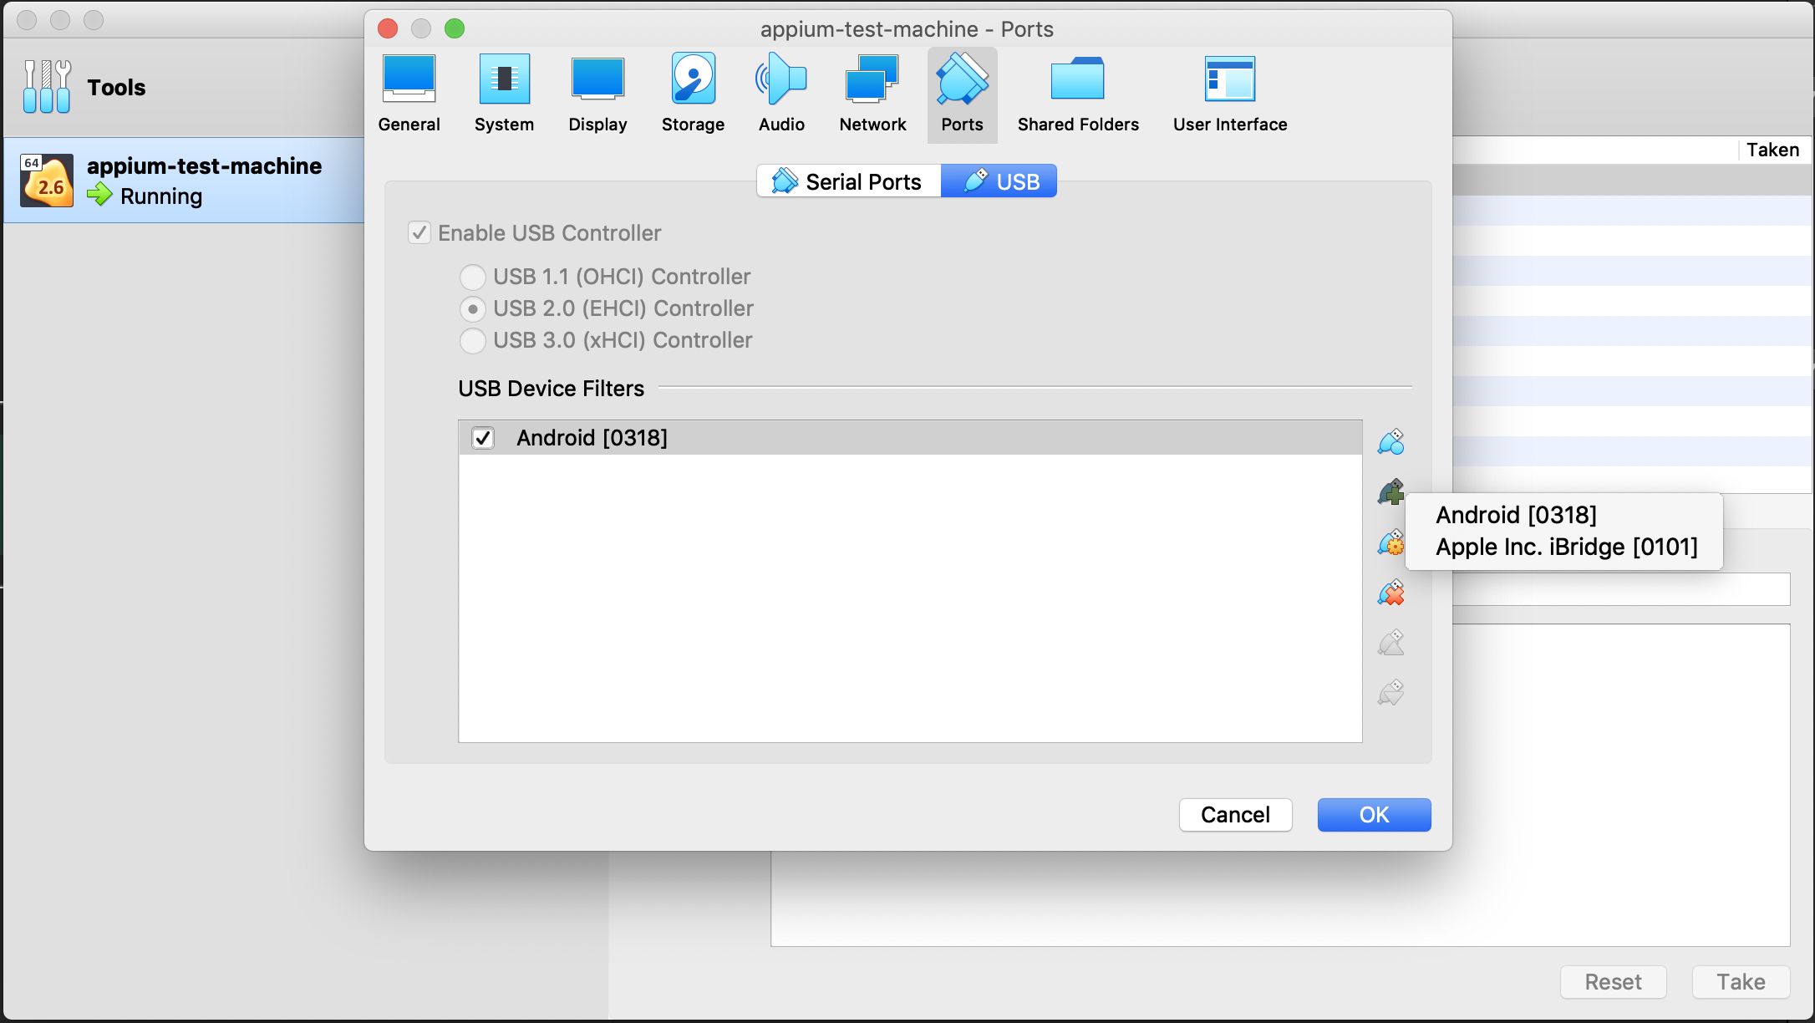
Add Android device and Host Controller

Slide 25
Kill base machine adb
$ adb kill-server

Slide 26
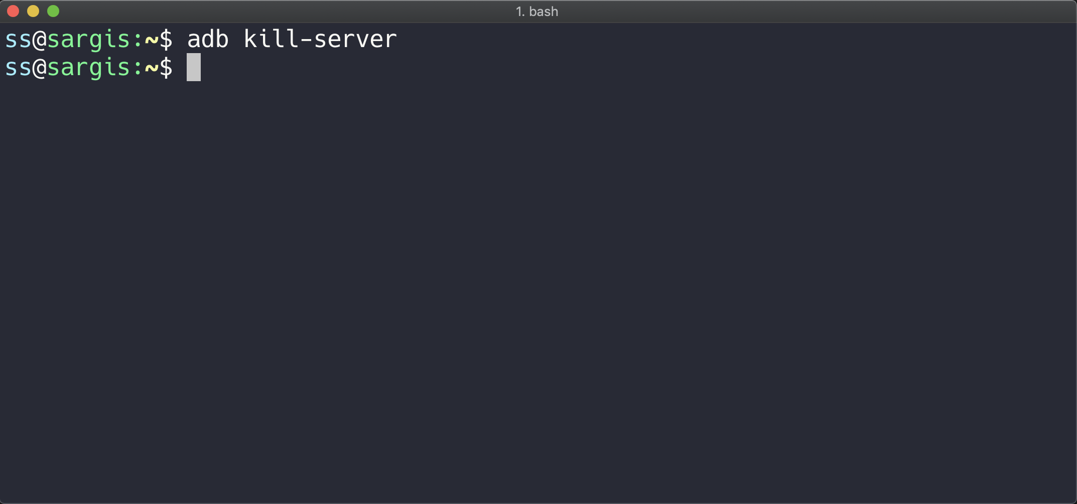

Slide 27
SSH to docker-machine
$ docker-machine ssh appium-test-machine

Slide 28
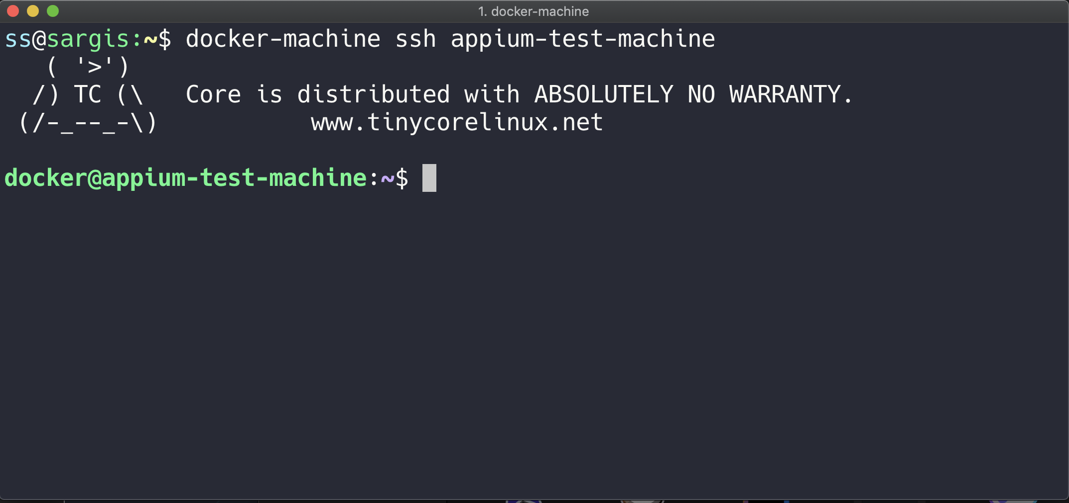

Slide 29
Connect the device and run
$ docker exec -it container-appium adb devices

Slide 30
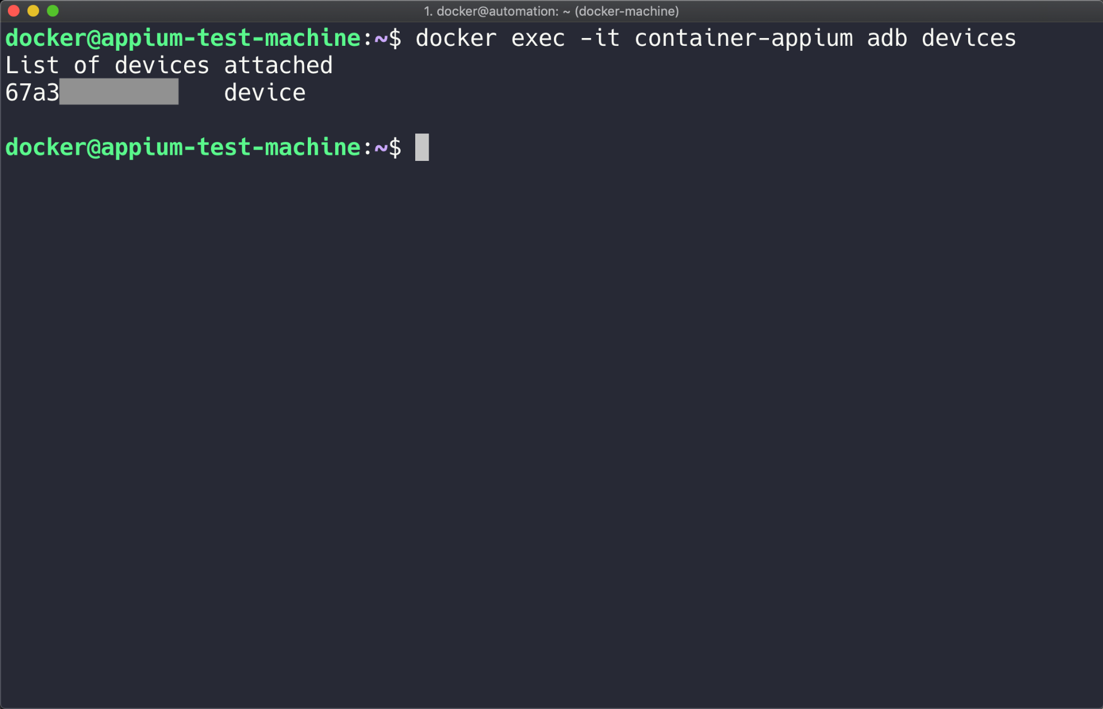

Slide 31
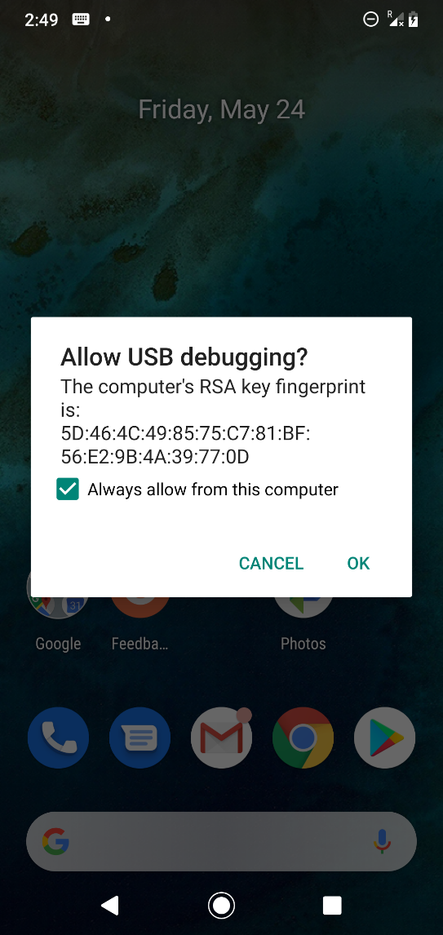
On the mobile you should see this dialog

Slide 32
Run Appium-docker in the docker-machine
$ docker run --privileged -d -p 4723:4723 -v /dev/bus/usb:/dev/bus/usb --name container-appium appium/appium

Slide 33
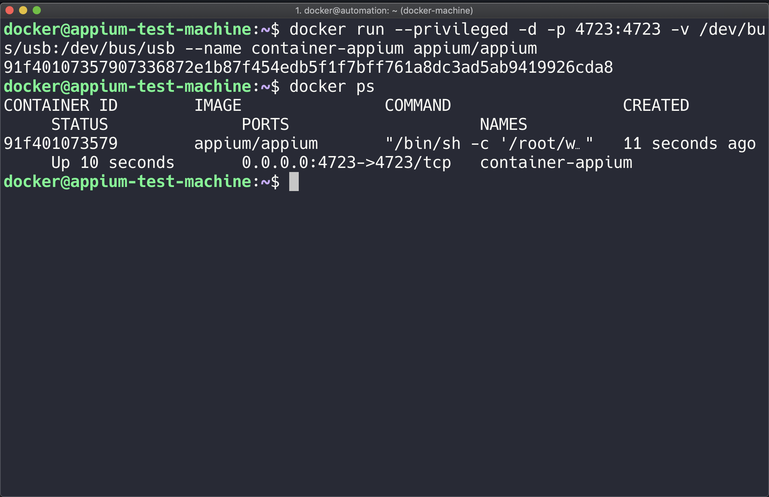

Slide 34
Copy Application to Container
$ docker cp <path>/picsart.apk container-appium:/opt

Slide 35
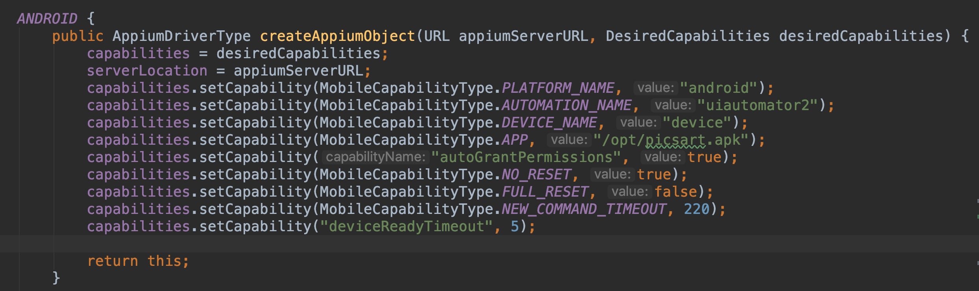

Slide 36
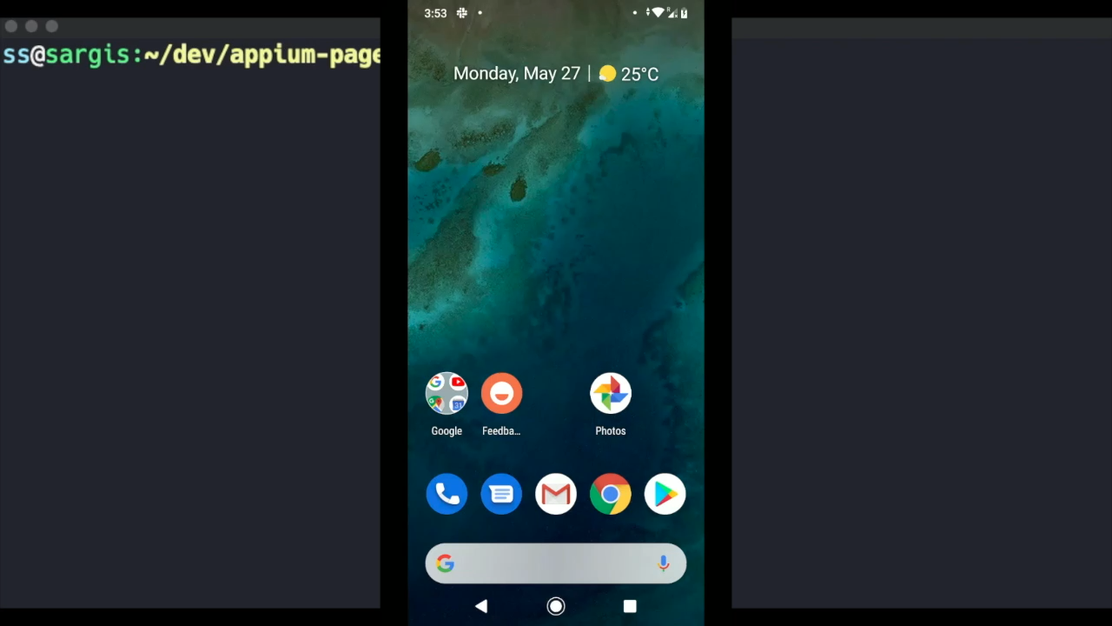

Slide 37
Register in Selenium Grid
Appium-Docker-Android can be connected with Selenium Grid You just need to pass the following paraments
CONNECT_TO_GRID=true
APPIUM_HOST=<appium_server_host>
APPIUM_PORT=<appium_server_port>
SELENIUM_HOST=<selenium_hub_host>
SELENIUM_PORT=<selenium_hub_port>

Slide 38
The command will look like
$ docker run --privileged -d -p 4723:4723
-e CONNECT_TO_GRID=true
-e APPIUM_HOST="127.0.0.1"
-e APPIUM_PORT=4723
-e SELENIUM_HOST="172.17.0.1" -e SELENIUM_PORT=4444 -v /dev/bus/usb:/dev/bus/usb --name container-appium appium/appium

Slide 39
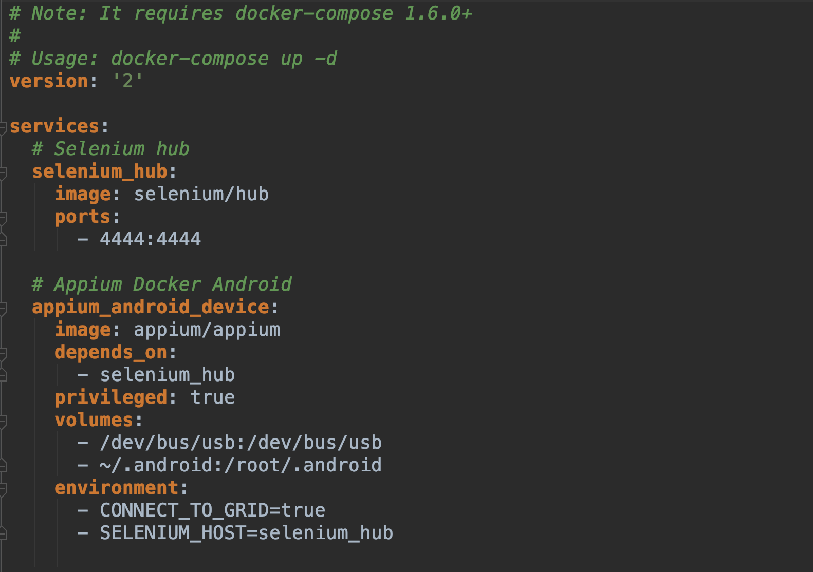
Using Docker Compose

Slide 40
Run with docker-compose
$ docker-compose up -d

Slide 41
Connect adb via Wi-Fi

Slide 42
Connect device via Wi-Fi
Set the target device to listen for a TCP/IP connection on port 5555.
adb tcpip 5555
Connect to the device by its IP address
adb connect <ip-of-mobile-device>
Confirm that your host computer is connected to the target device
adb devices

Slide 43
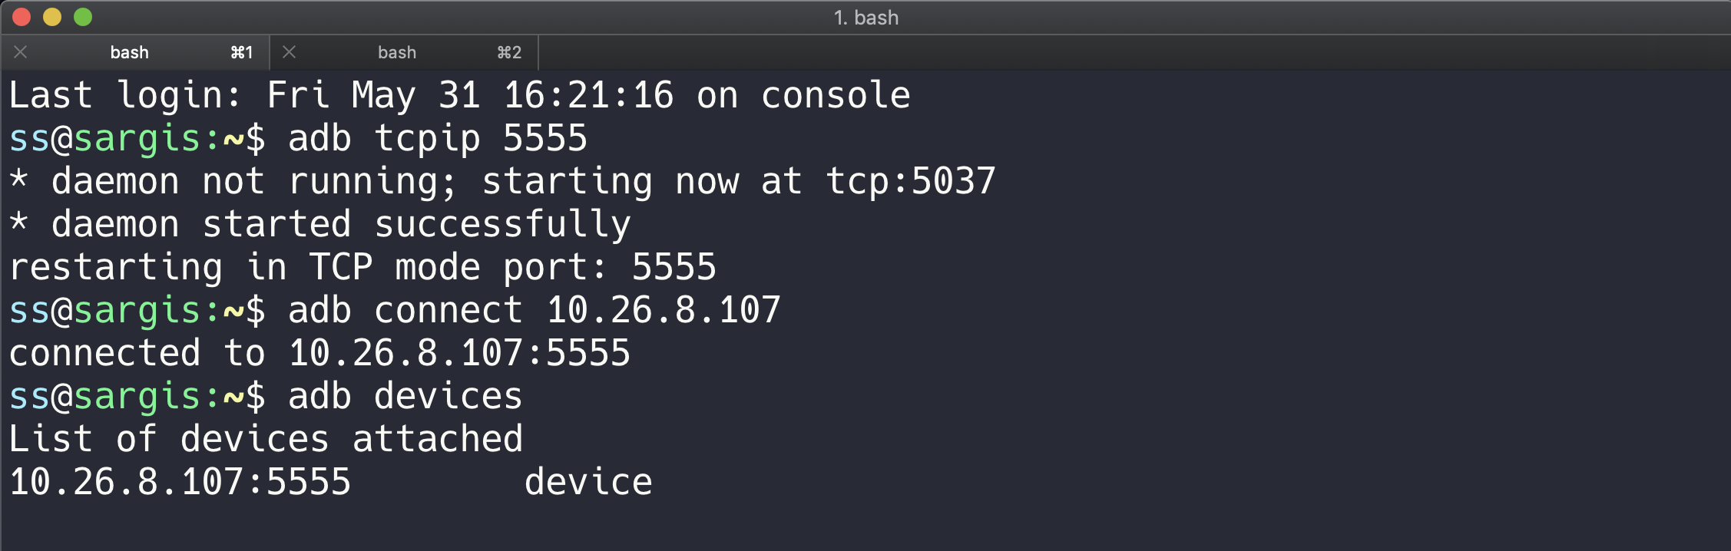

Slide 44
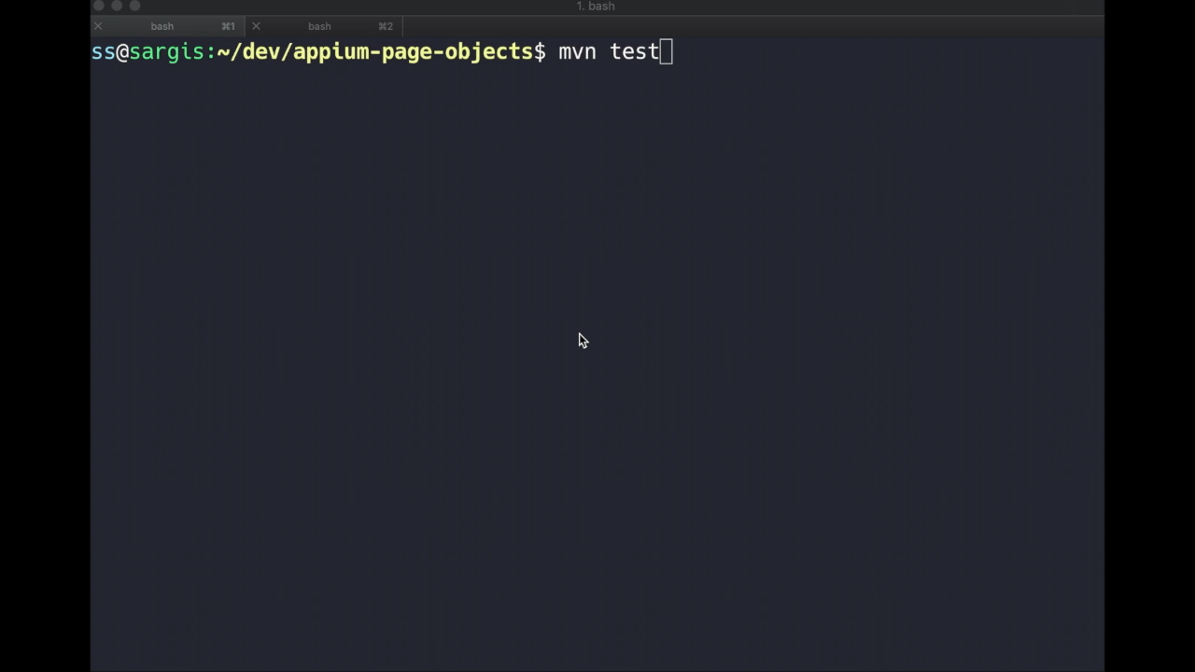

Slide 45
Android Emulator in Docker

Slide 46
Why?
What are the Purposes of Docker Android
Run UI tests for mobile websites with Appium
Build Android project and run unit tests with the latest build-tools
Run UI tests for Android applications with different frameworks (appium, espresso, robotium, etc.)
Run monkey / stress tests
SMS testing
*https://github.com/budtmo/docker-android

Slide 47
Advantages
What are the Advantages of Docker Android
noVNC to see what happen inside docker container
Ability to connect to Selenium Grid
Support real devices with screen mirroring
Ability to record video during test execution for debugging
Integrated with other cloud solutions, e.g. Genymotion Cloud
OPEN SOURCE!
*https://github.com/budtmo/docker-android

Slide 48
Supported Devices
Nexus S
Samsung Galaxy S7
Nexus 4
Nexus One
Samsung Galaxy S7 Edge
Nexus 7
Samsung Galaxy S6
Nexus 5

Slide 49
Getting started!
Running Samsung Galaxy S6 Emulator
$ docker run --privileged -d -p 6080:6080 -p 5554:5554 -p 5555:5555 -e DEVICE="Samsung Galaxy S6" --name android-container budtmo/docker-android-x86-8.1

Slide 50
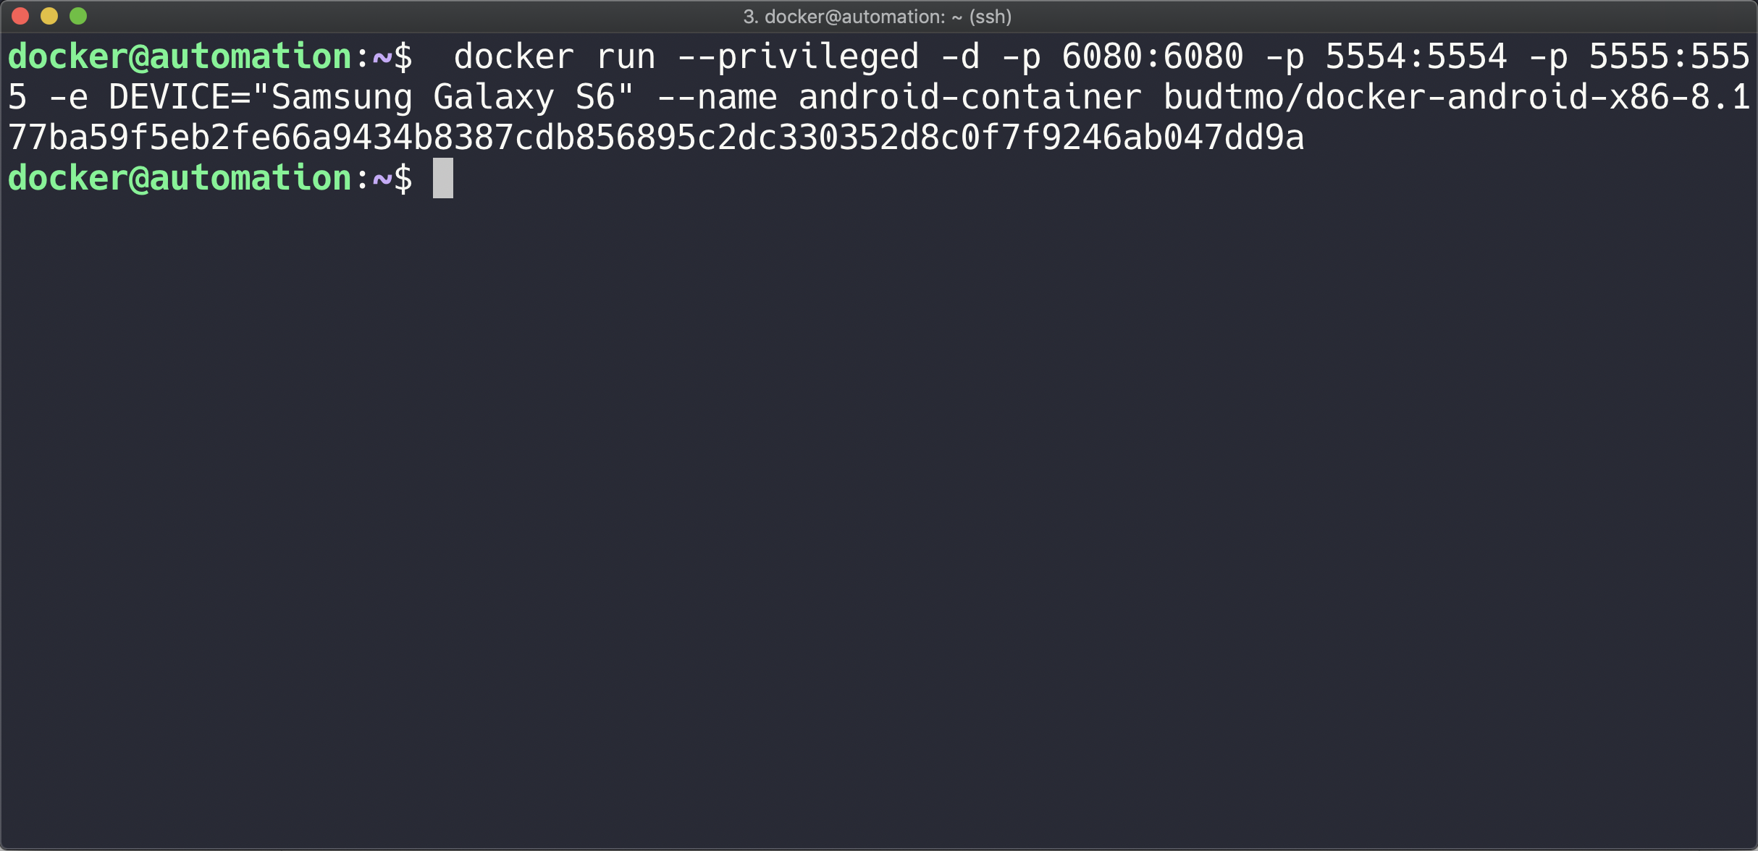

Slide 51
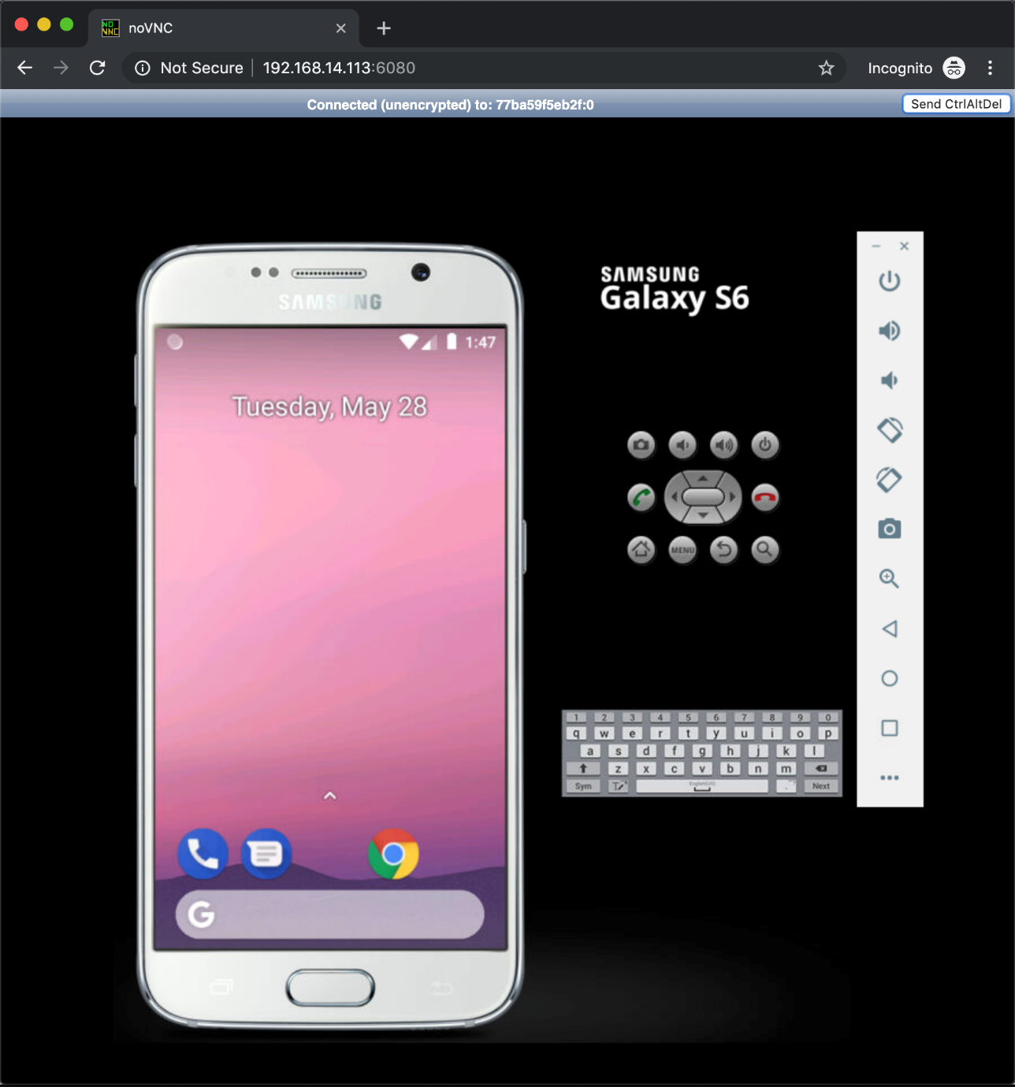

Slide 52
Control Real Device Connected to the Host
$ docker run --privileged -d -p 6080:6080 -p 5554:5554 -p 5555:5555 -p 4723:4723 --name android-container-appium budtmo/docker-android-real-device

Slide 53
Connect to ADB of the Host
$ adb -H host.docker.internal -P 5037 devices

Slide 54

SMS Simulation

Slide 55
SMS Simulation
Find the auth_token and copy it.
docker exec -it android-container cat /root/.emulator_console_auth_token
Access emulator using telnet and login with auth_token
telnet <docker-machine-ip-address> 5554
Login with auth_token
auth <auth_token>
Send the sms
sms send <phone_number> <message>

Slide 56
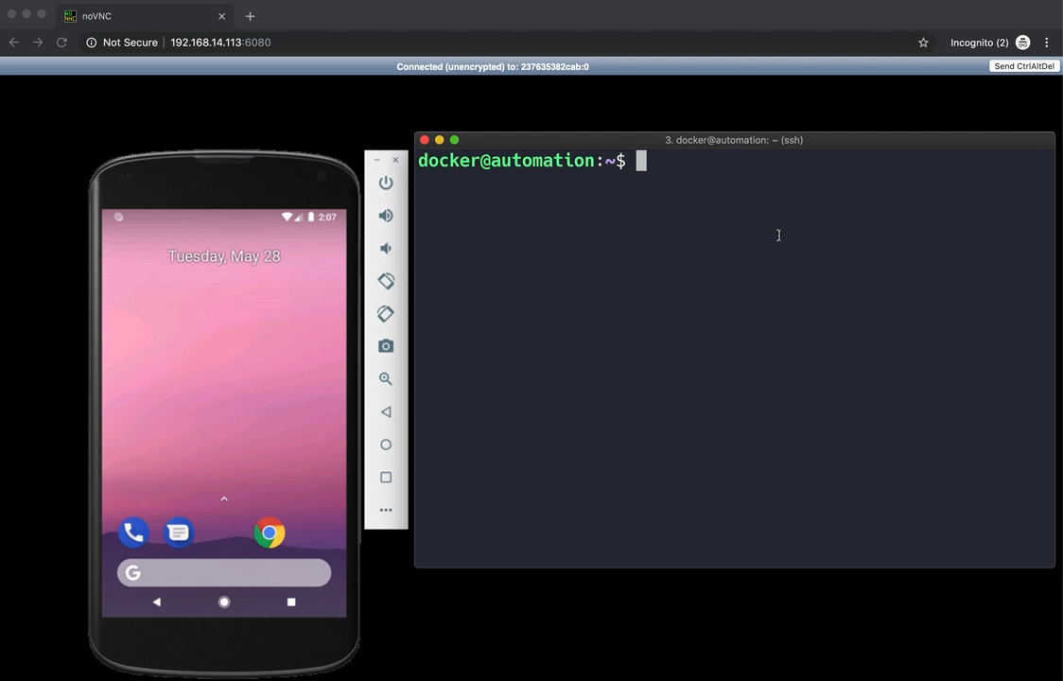

Slide 57

Selenium Hub

Slide 58
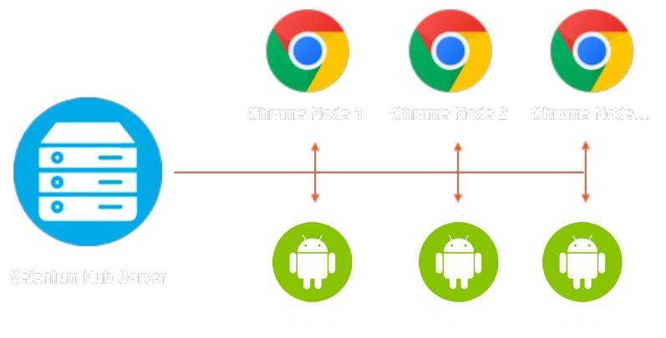
Selenium Grid
Selenium grid is a smart proxy server
*https://www.seleniumhq.org

Slide 59
Run Selenium Grid in Docker
$ docker run -d -p 4444:4444 -v /dev/shm:/dev/shm selenium/hub:3.14.0-curium

Slide 60
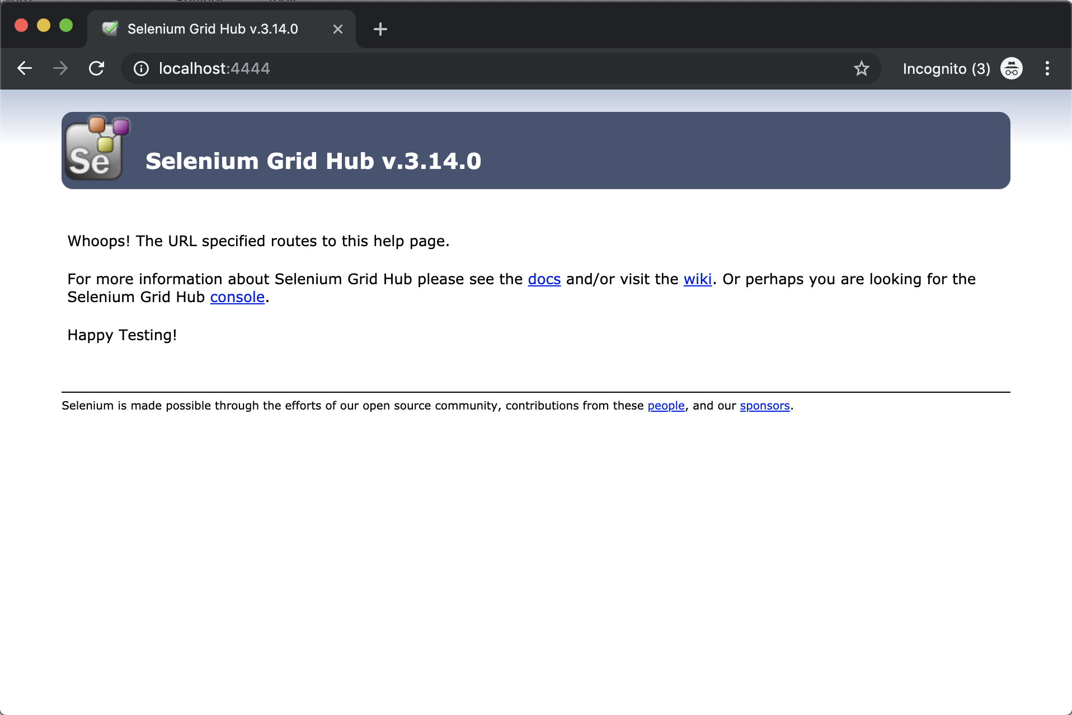

Slide 61


Let’s combine all these solutions
Docker
Emulator
Appium
Selenium Grid

Slide 62
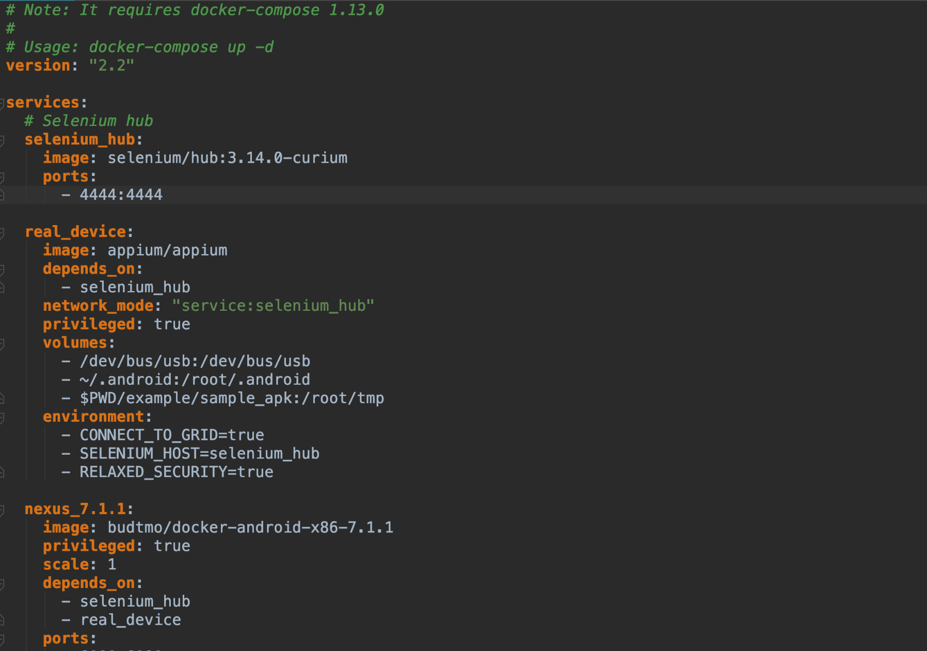

Slide 63
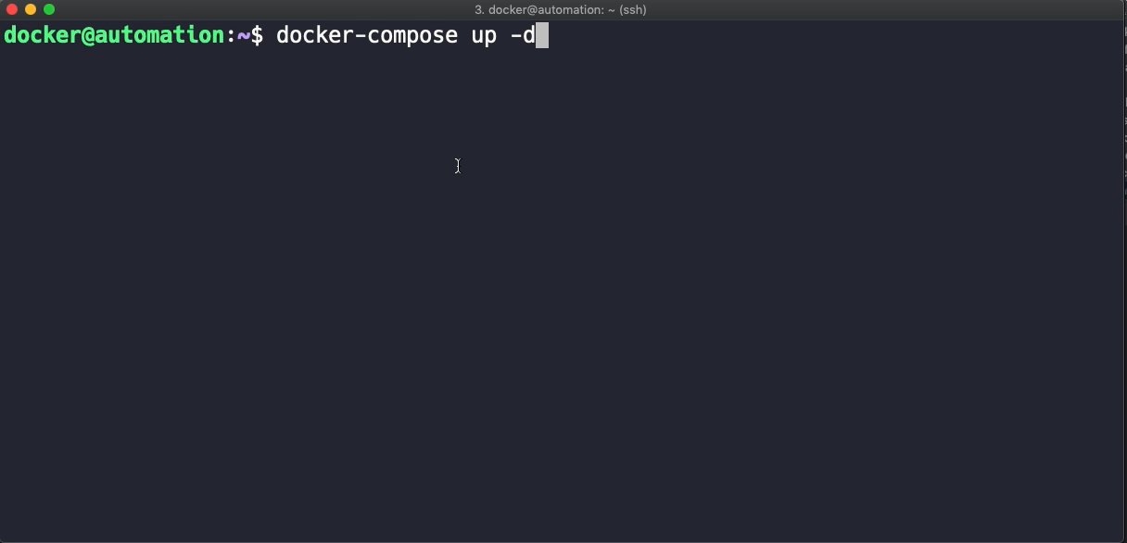

Slide 64
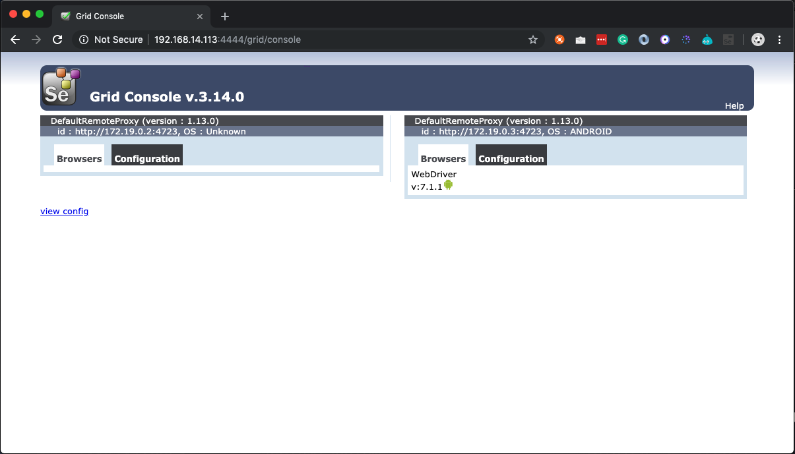

Slide 65
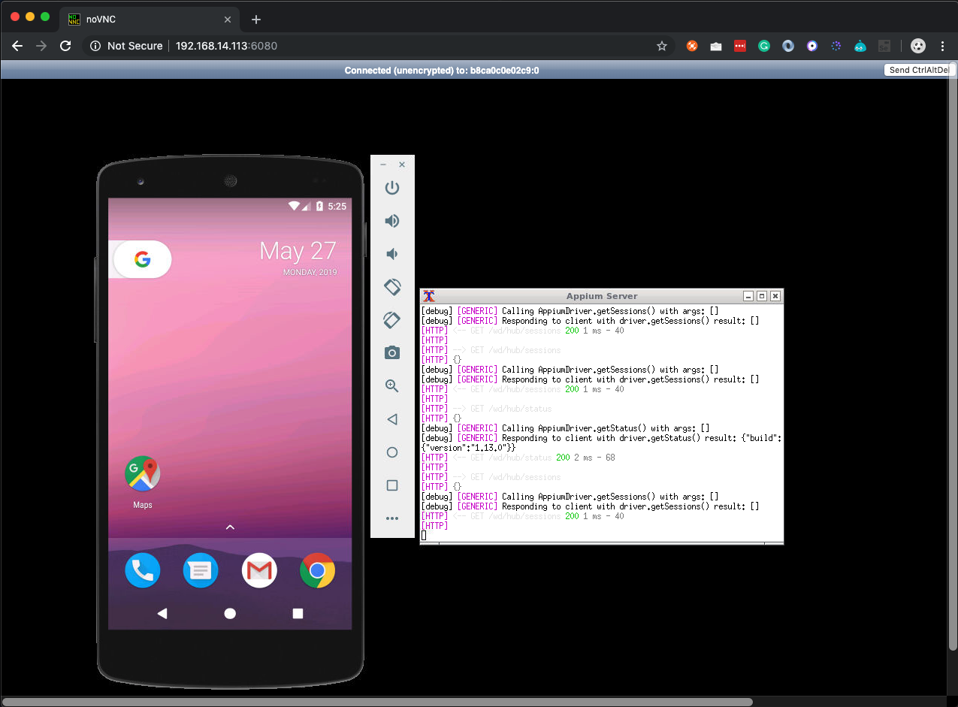

Slide 66
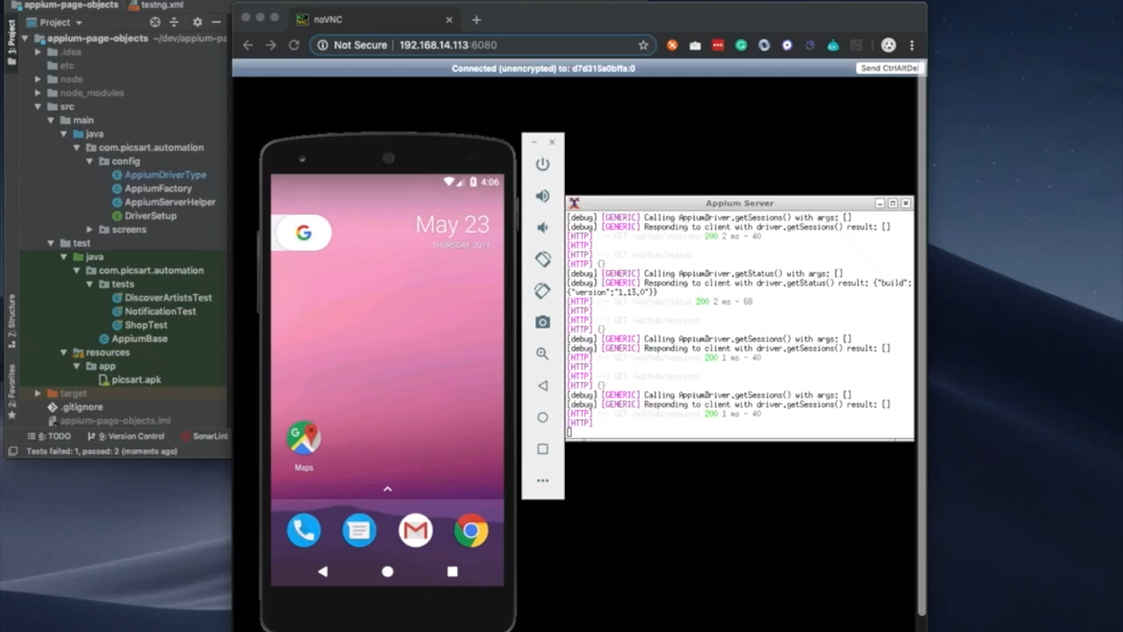

Slide 67

Thank You
Feel free to Contact me!

