Slide 1
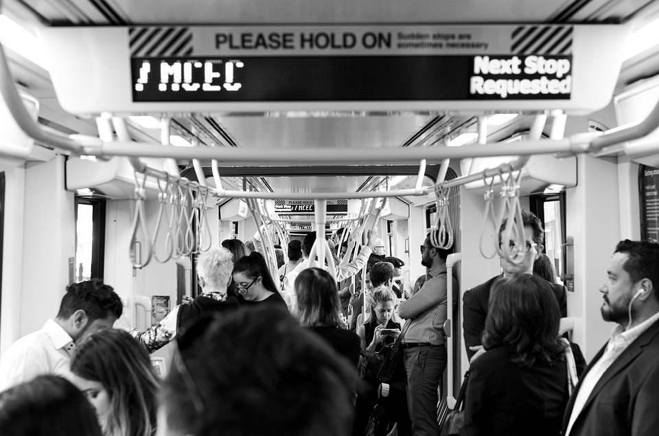

Whtvr srs Wnt
Whatever users want
Notes:
Funny to see how full of resources we are

Slide 2
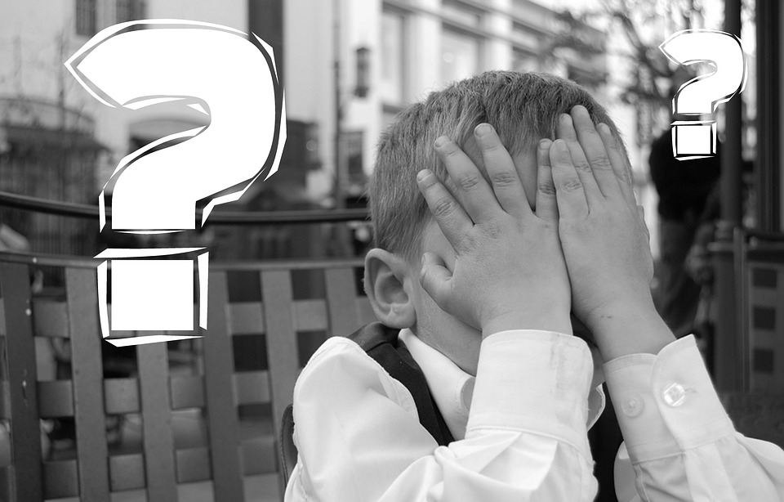
Why Startups Fail
No Market Need (42%)
-
-
-
-
User unfriendly products (17%)
-
-
Ignore customers (14%)
CB Insights 2017
Notes:
3 reasons in the top 10 can be addressed by Business Analysts and testers
They are dealing with requirements and users and with usability to some extent

Slide 3
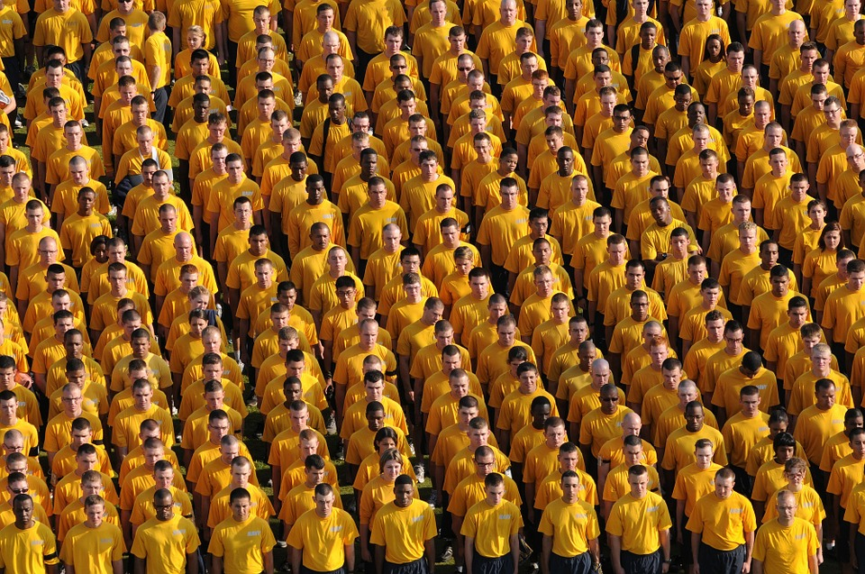

USERS
What the Hell do you want…
Notes:
This would be so easy to consider that we’re all the same – we’re all Humans after all
But life is not so easy – we are old, young, believers, Asian, black, men, women…we are all unique!

Slide 4
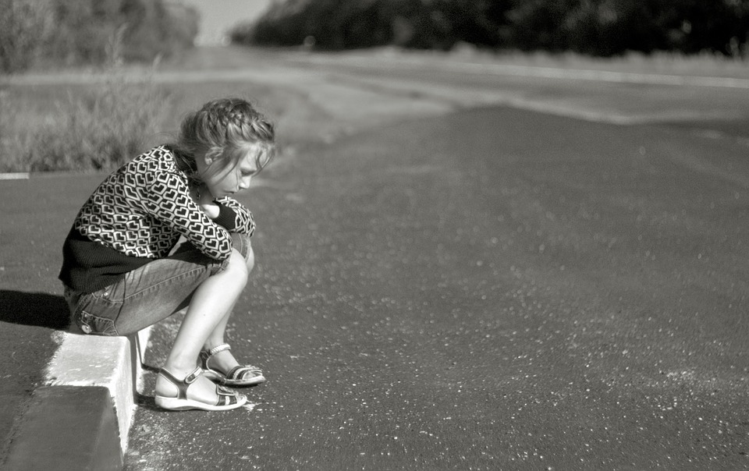
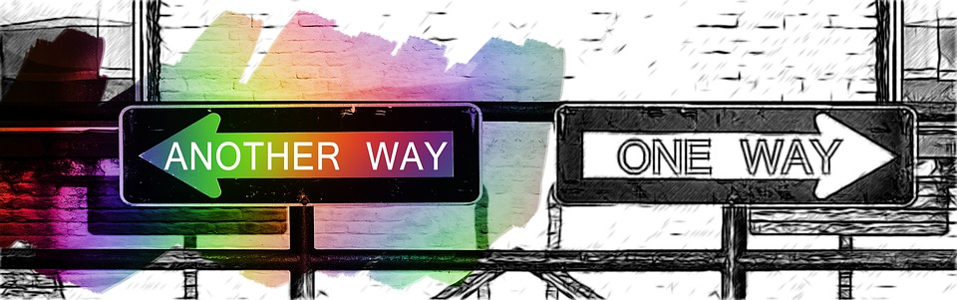
Contradictions
Notes:
We want it fast, but good (tinder, uber…)
We want it Agile…but green
We want premium service but we don’t want to pay

Slide 5
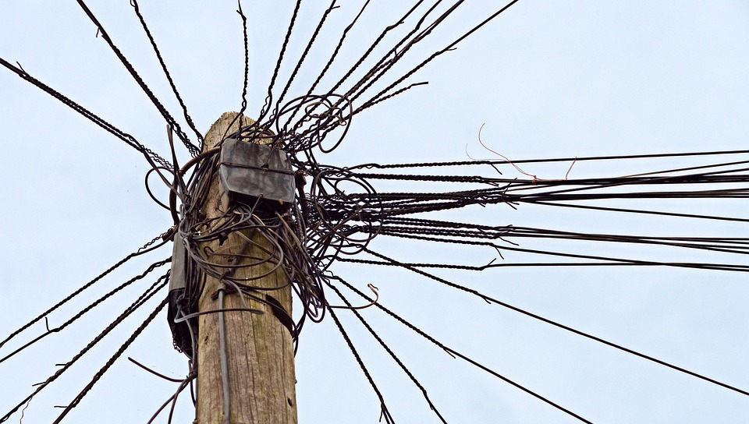
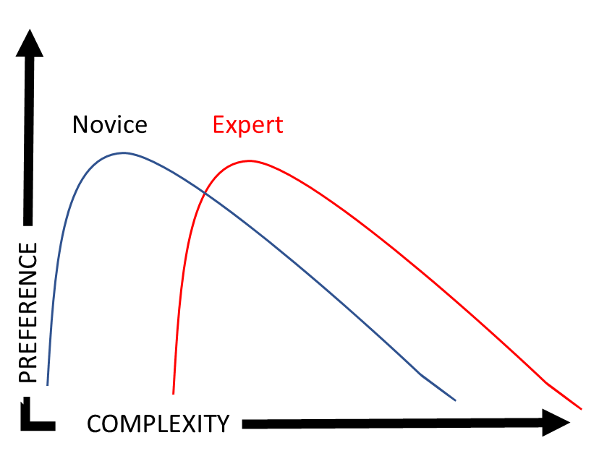
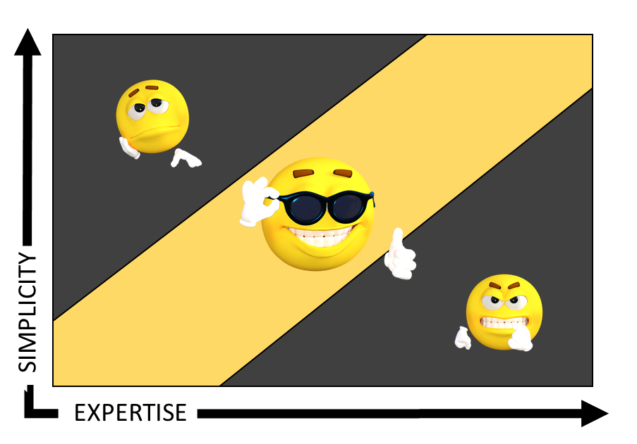
Complex OK, Complicated KO
Notes:
Boring – OK – Frustrating = Don Norman
Your ability evolves with time and experience = Don Norman
We love complex things but « don’t make me think » = Steve Krug

Slide 6
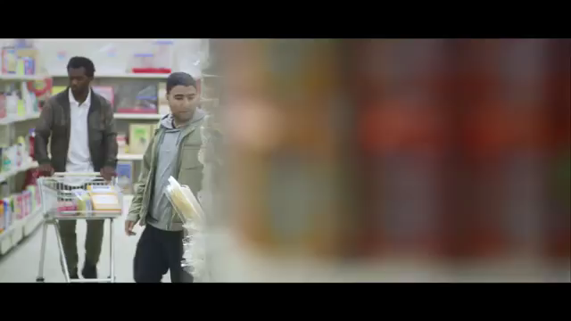

Slide 7

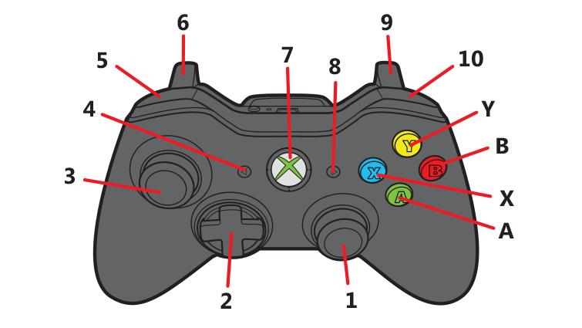
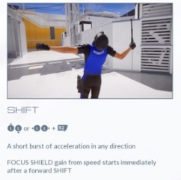
Mirror’s edge catalyst
I can’t (special) move anymore?
6 LLT + 5 ULT = wall rush
Move = 3 LS
Camera = 1 RS
Non customizable commands
Notes:
I just can’t do it – I want to run on the wall but it would be much simpler if I could get right + left instead of all Left

Slide 8
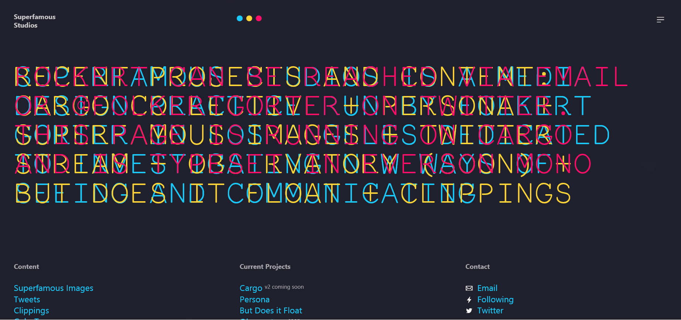
Notes:
A real web site animation – it goes too fast to read along and when it gets clustered like this….

Slide 9
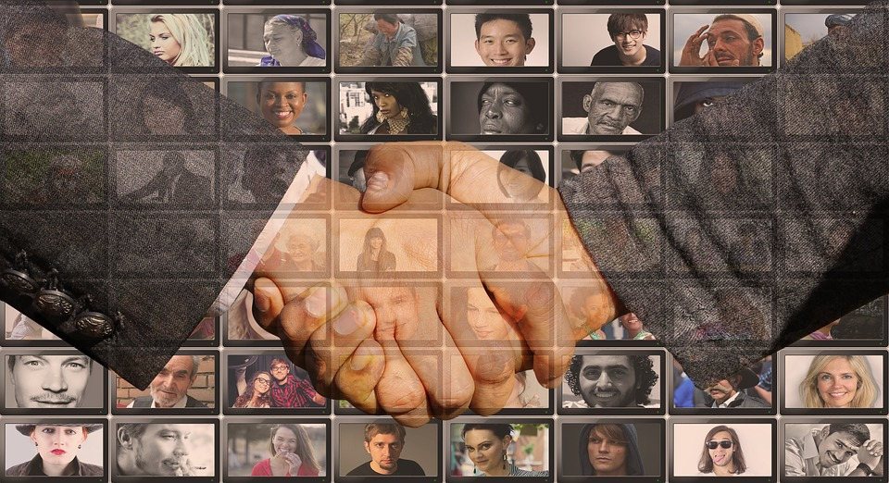
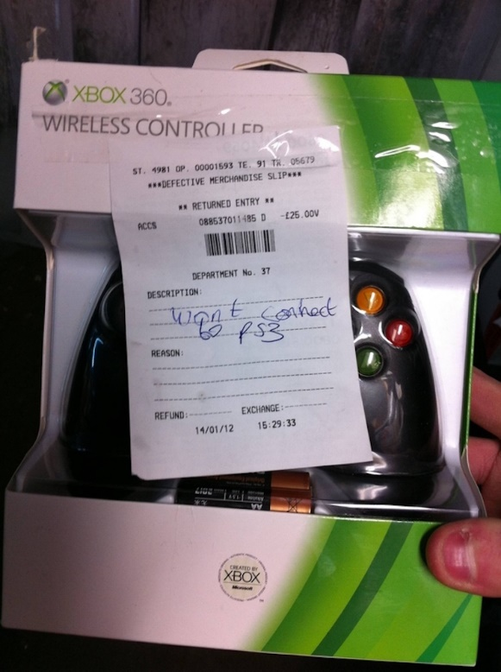
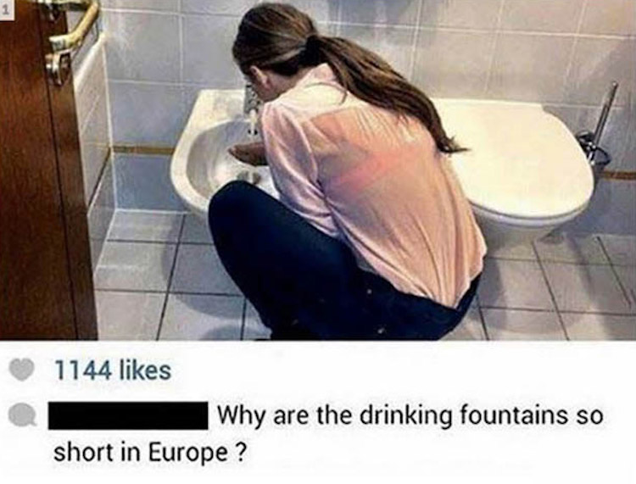
Keep Your Promises

Slide 10
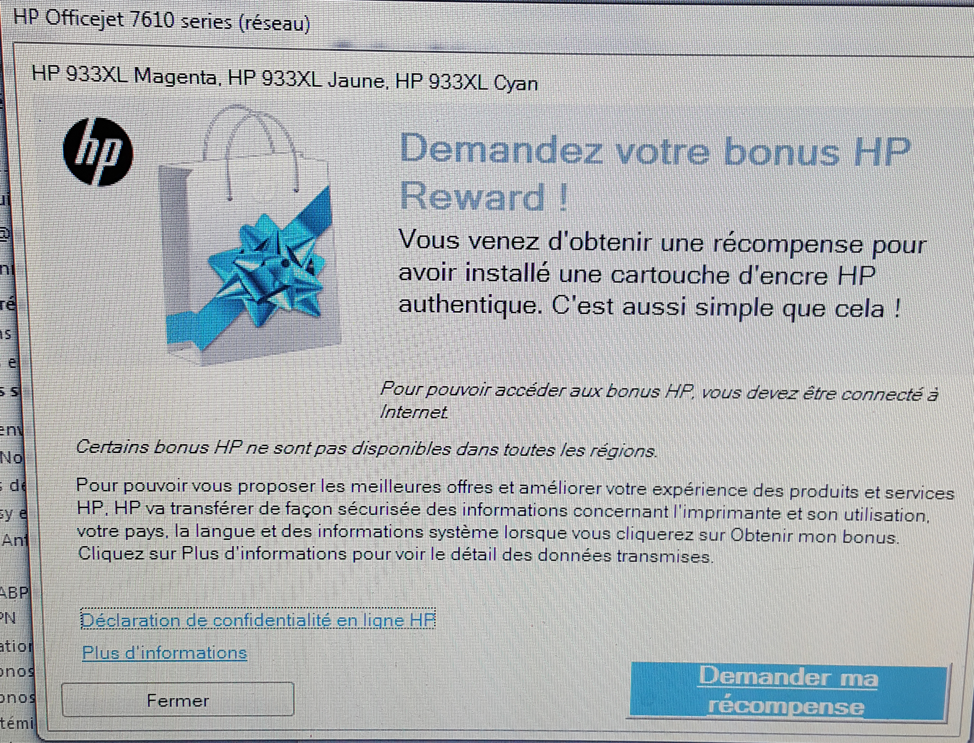
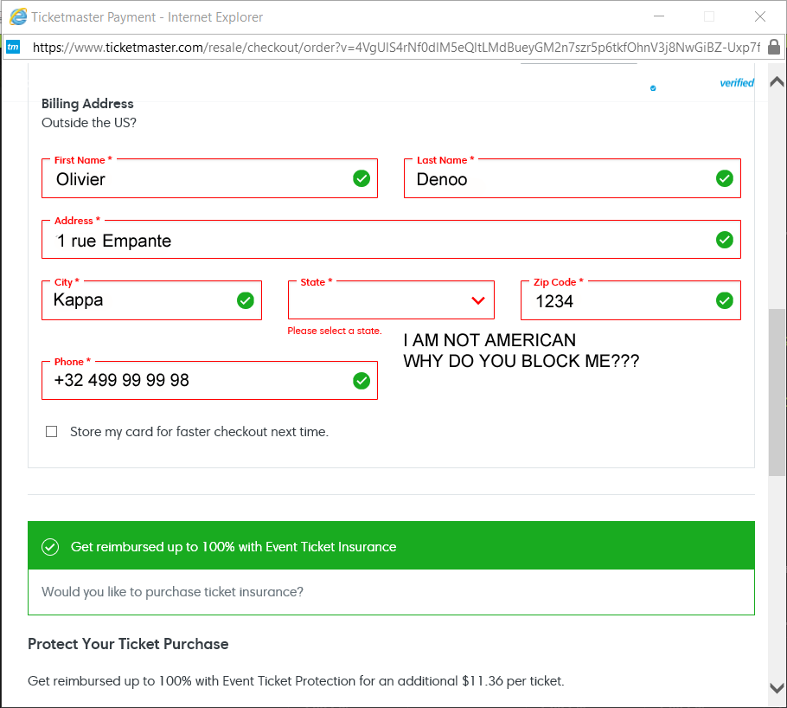
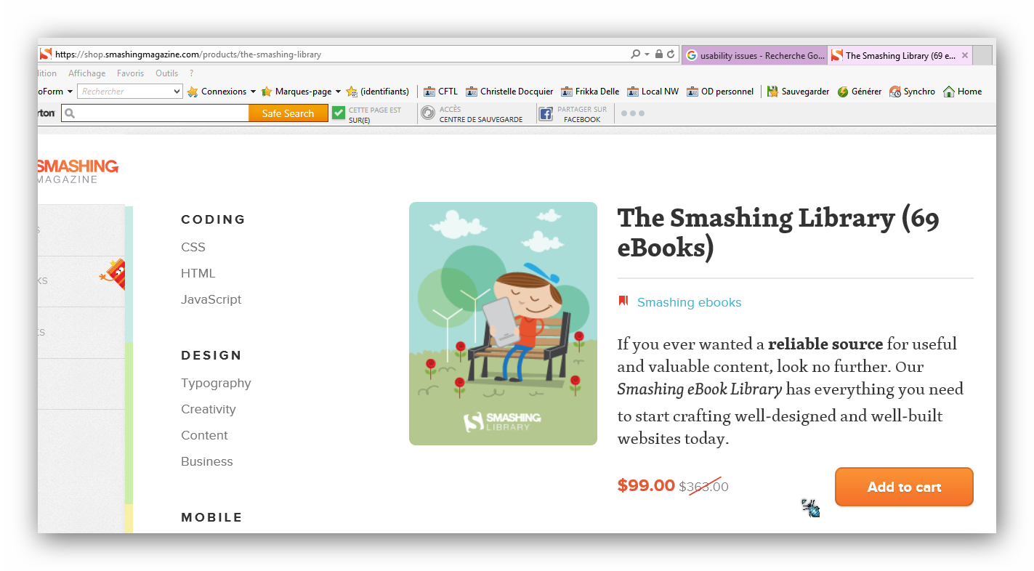
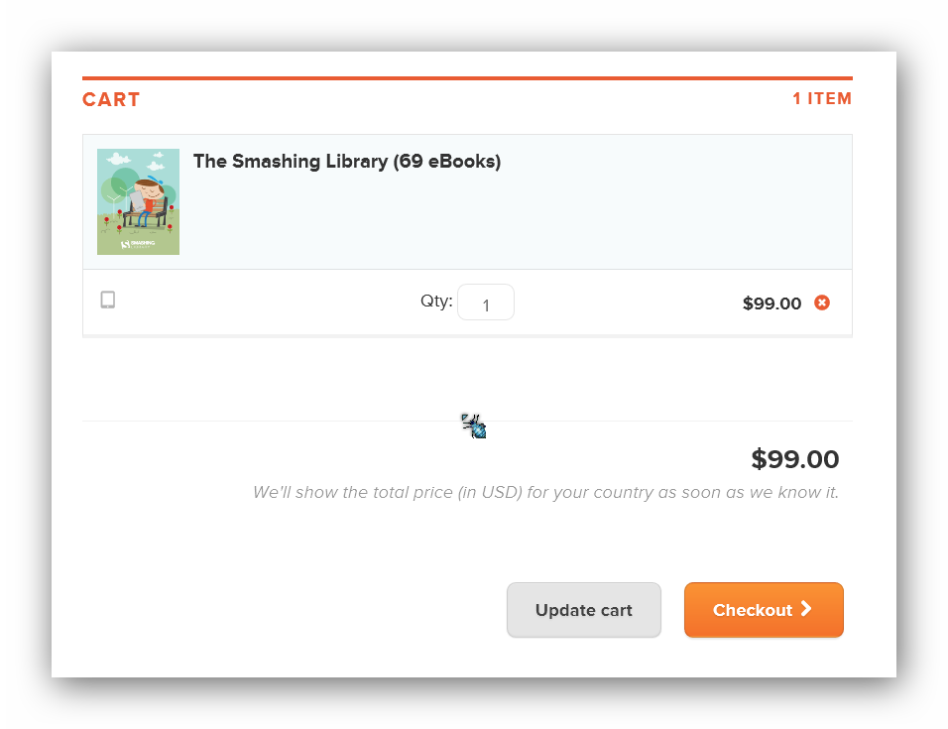
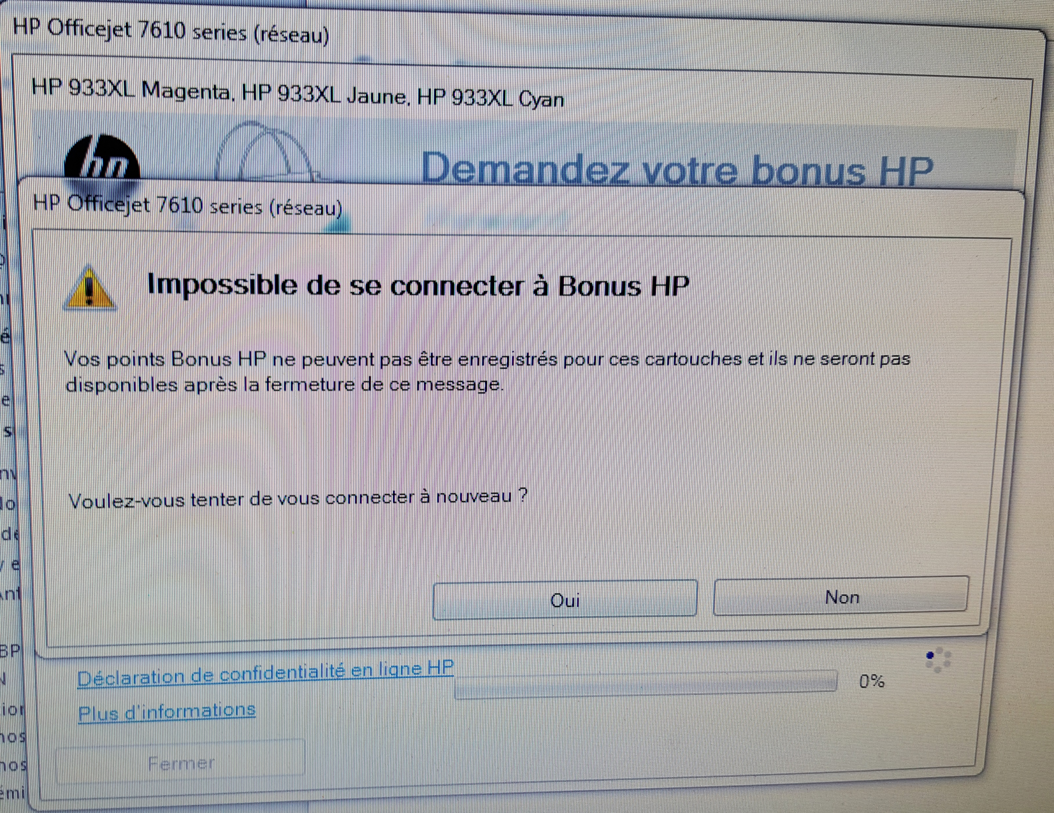
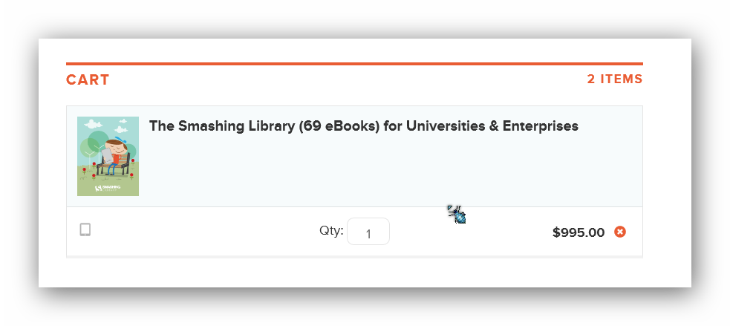
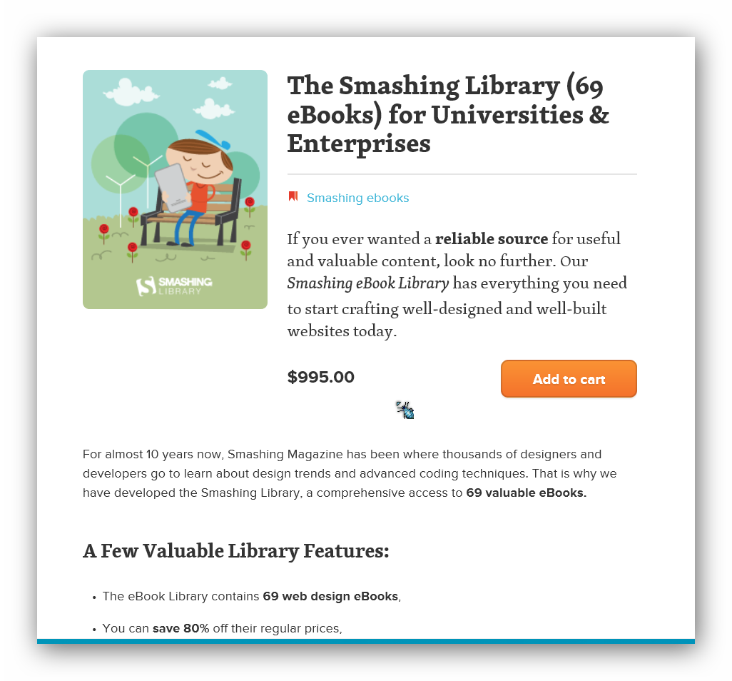
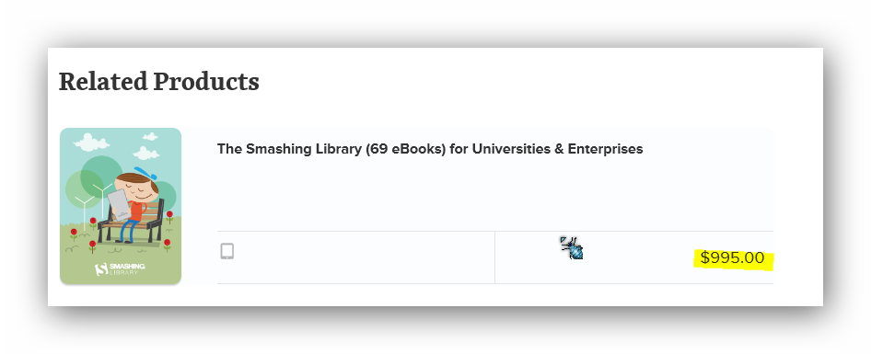
Notes:
Because I use genuine cartriges I’m entitled to get a bonus – but I cannot connect / THEIR service is down – and I cannot claim anymore (don’t expect to get the fun twice huh!)
Smashing the prices…or not…or maybe…well who cares!

Slide 11
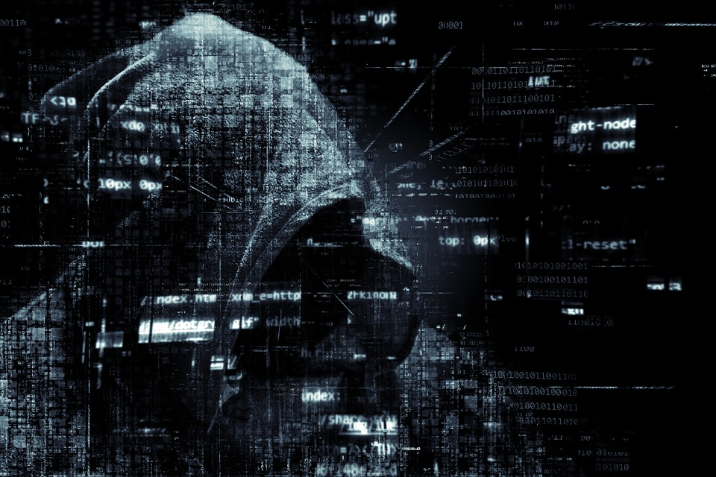
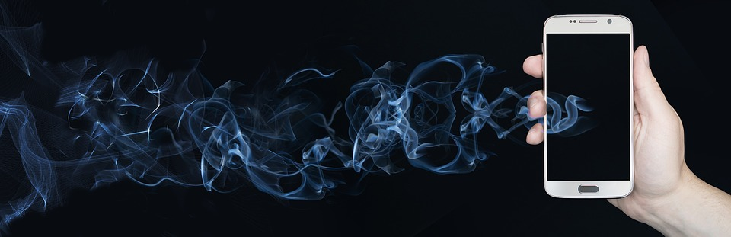

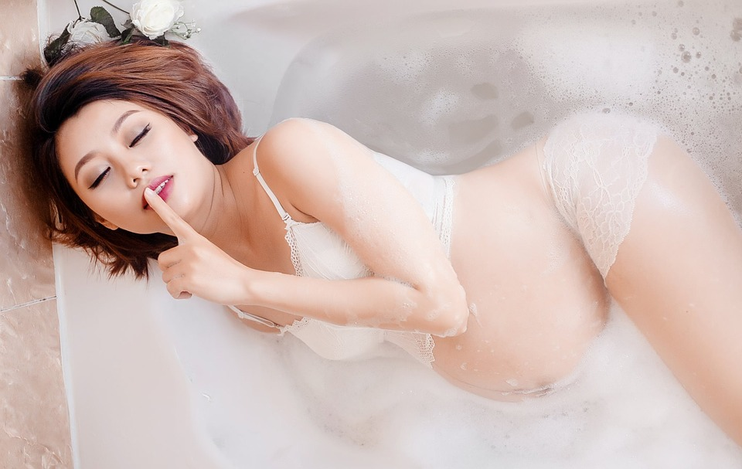
Trust Me if You Dare
Notes:
Strava is an App for smartphone – it publishes your running itinerary and share them on a world map…who’s running in Afghanistan and Soudan and want to show their performance? US troops of course…now guess how to identify their camps
Big data shows that US pregnant women buy more unscented lotions, vitamins and minerals (Mg…) during their 3rd to 6th months (even before you notice)
Target sent a coupon to a teenager and her father noticed
Cardiac rythm increases when being pregnant – Apple watch detected it

Slide 12
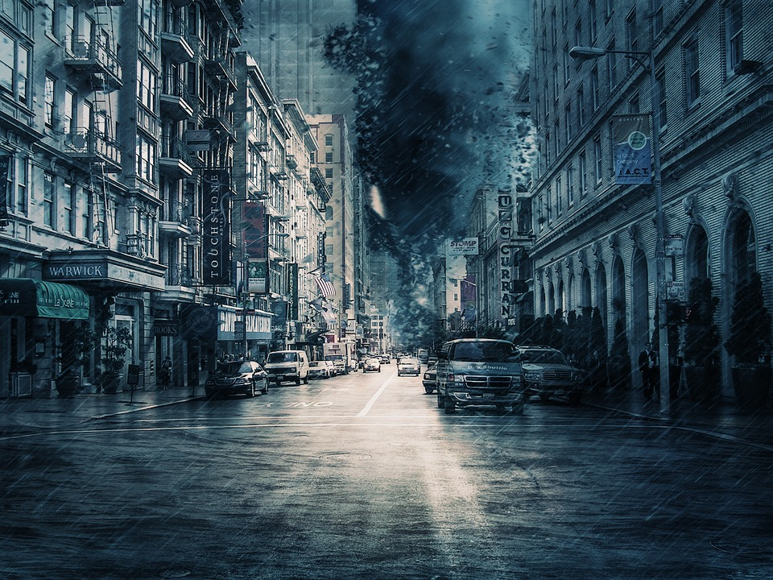
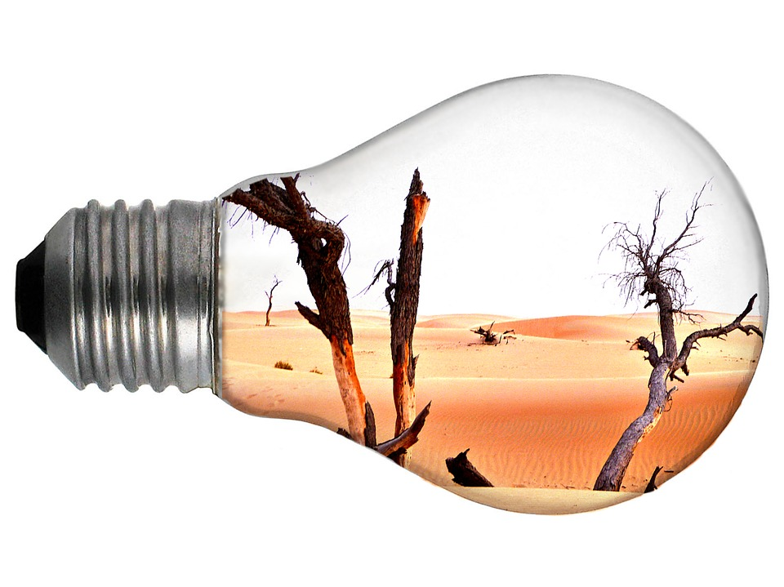
Never Assume their In-Use Context
Cold
Obscurity
Light conditions
Stress
Fatigue, tiredness
Noisy background
Humidity, dust
Shocks, hazardous
Substances
Notes:
Reduced mobility, fat / non-conducting fingers (gloves), computer functionning limits (T°C)
Color / details blindness, total blindness
Screen contrasts are hard to perceive, bedazzled by light conditions
Limited Creativity / ability to think rationally
Low level sounds are not perceived anymore
Reduced capacity of thinking, increased reaction time, low concentration, reduced mobility

Slide 13
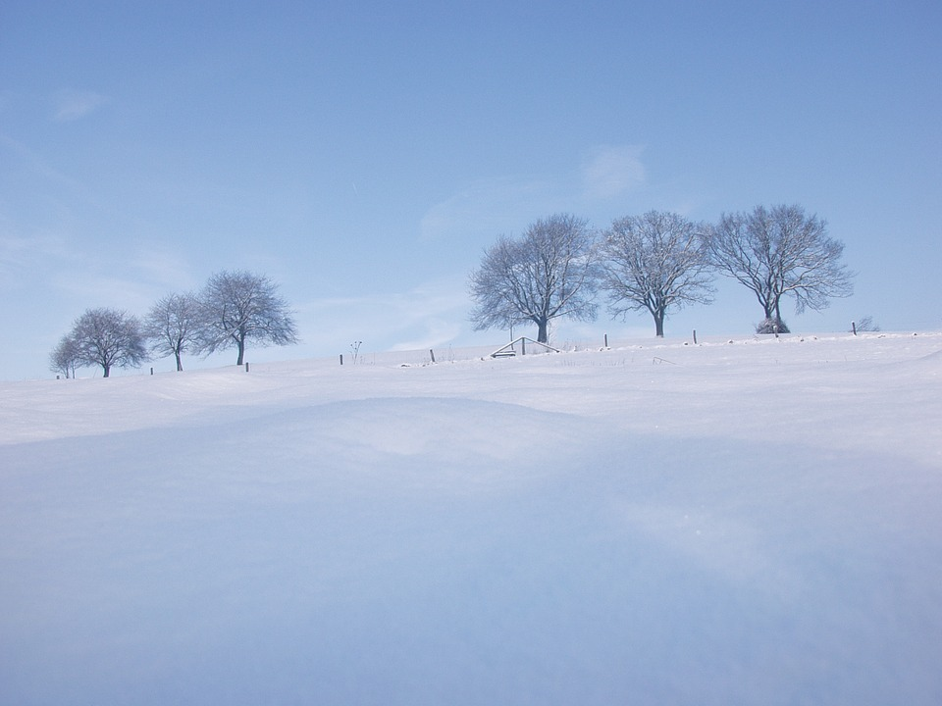
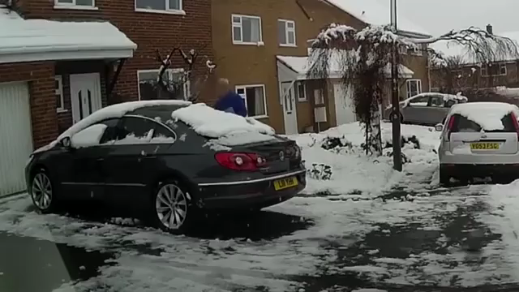

Slide 14
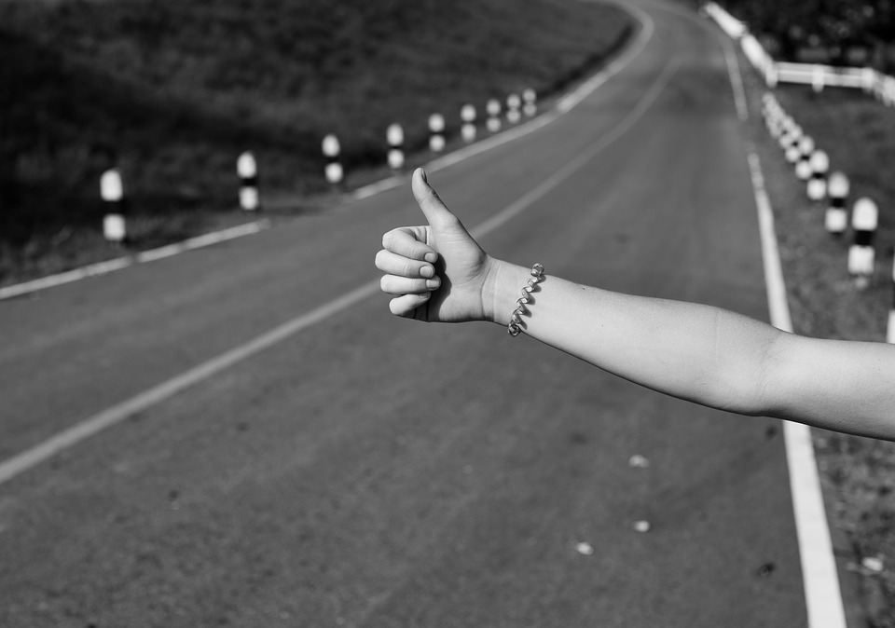
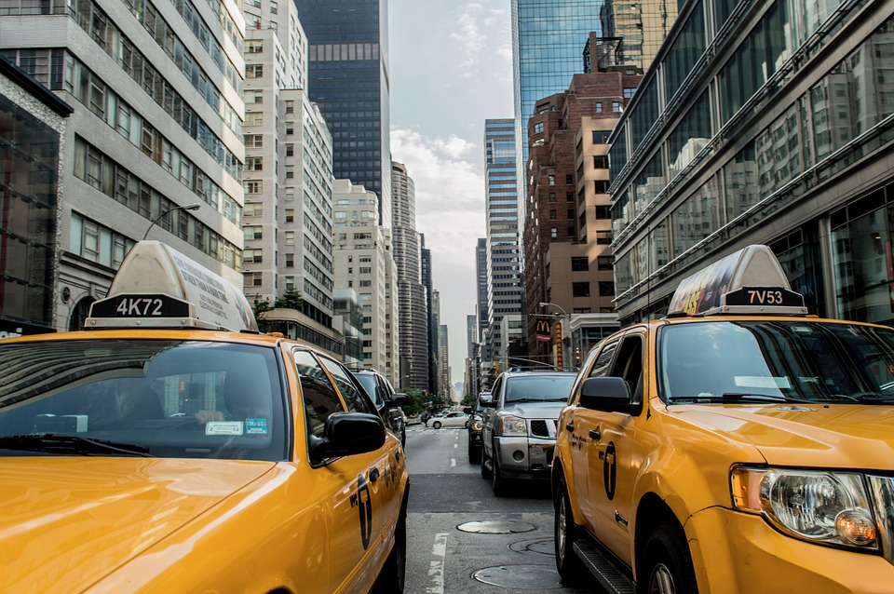
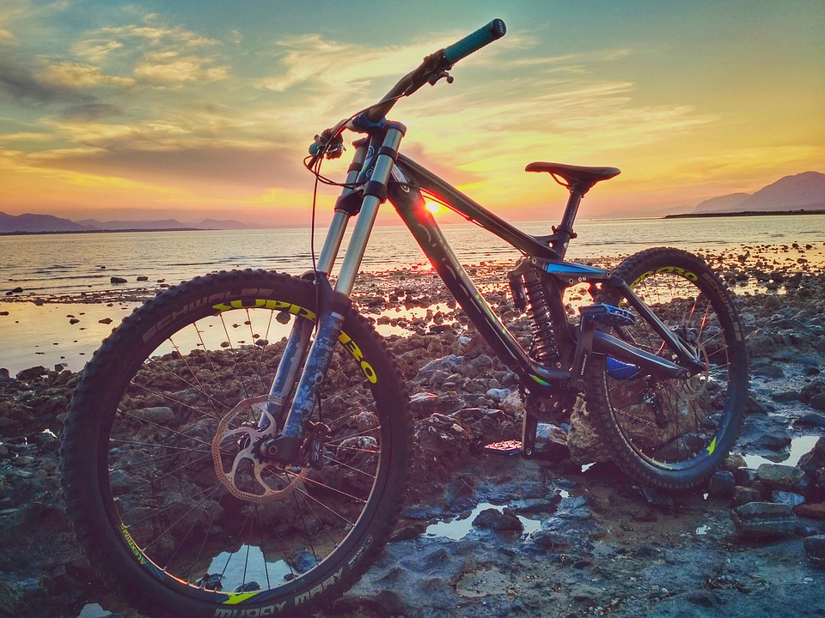
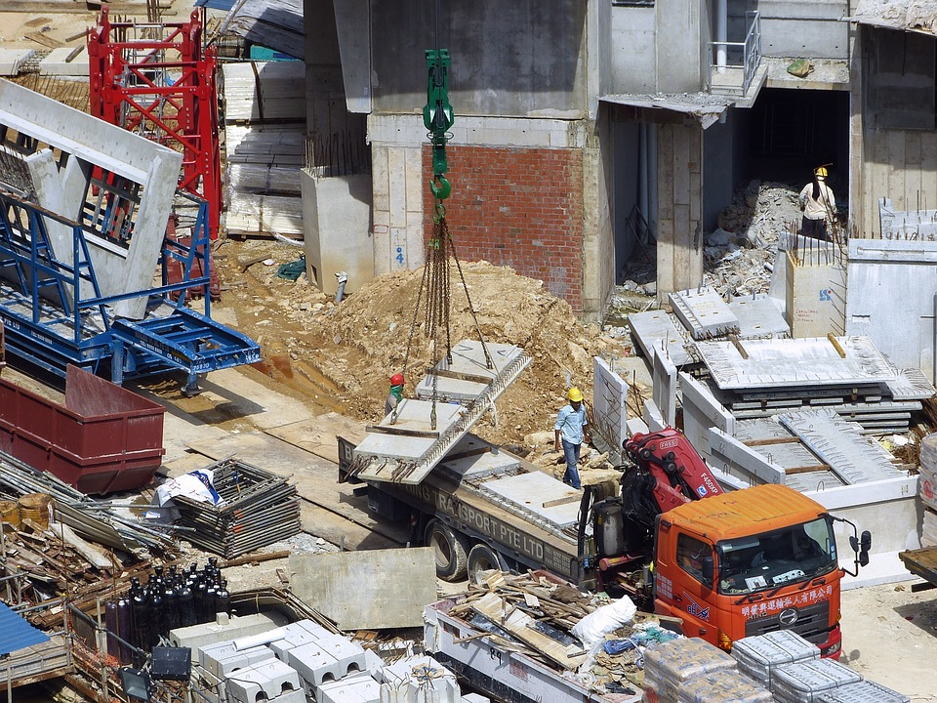
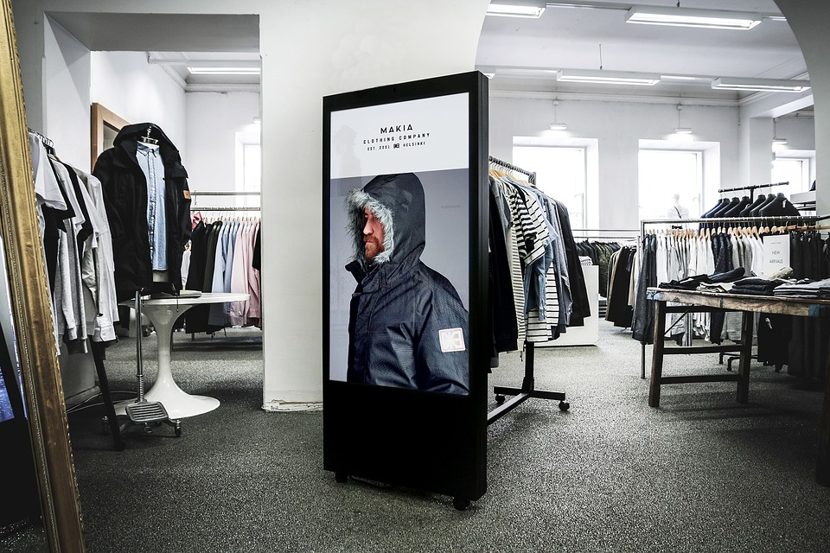
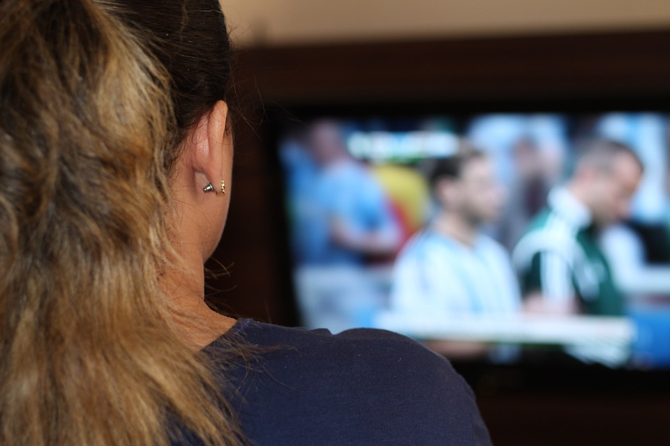
Notes:
We never know when and where our software and applications will be used
To a lesser extent, we don’t even know how it will be used

Slide 15

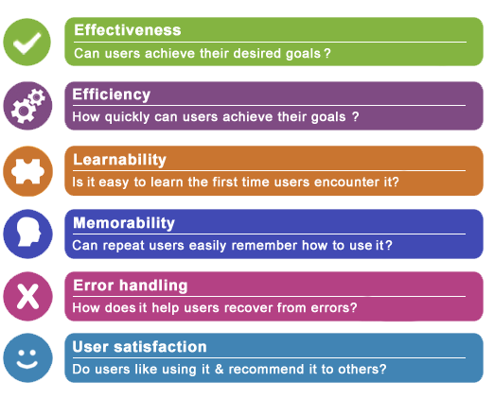
Ux Heuristics
Notes:
That is what most users want = Jakob Nielsen

Slide 16
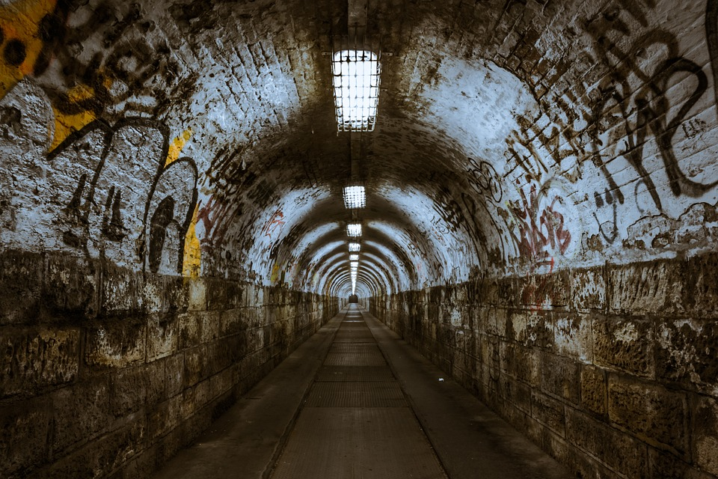




Status Feedback
27%
Notes:
Percentage
On/off
Achievement, time remaining, progress, validity
Wrong or missing entry

Slide 17

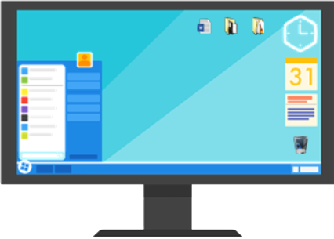


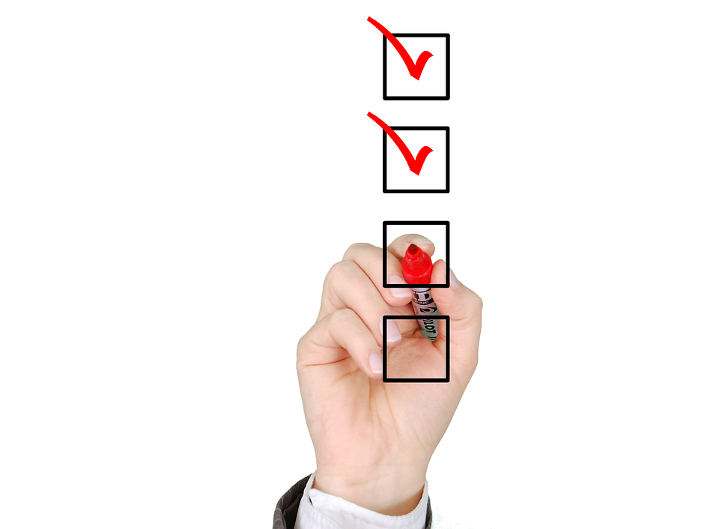
Matching with « Real » World
Notes:
Desktop concept (recycle bin, files, folders…) = use images that user can understand and relate to in real world
Bug
Tick boxes
Padlock = security / password

Slide 18
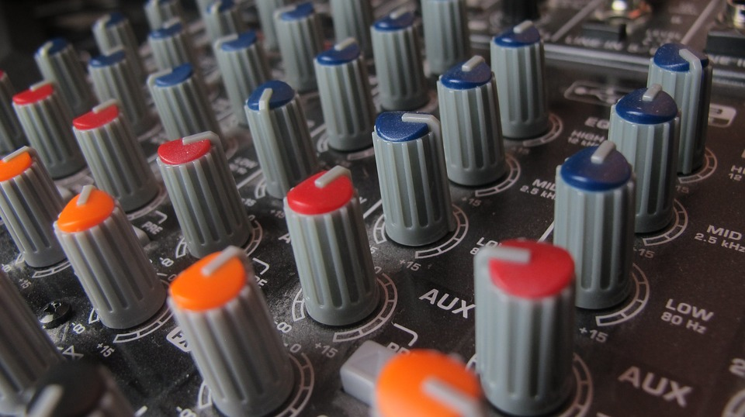
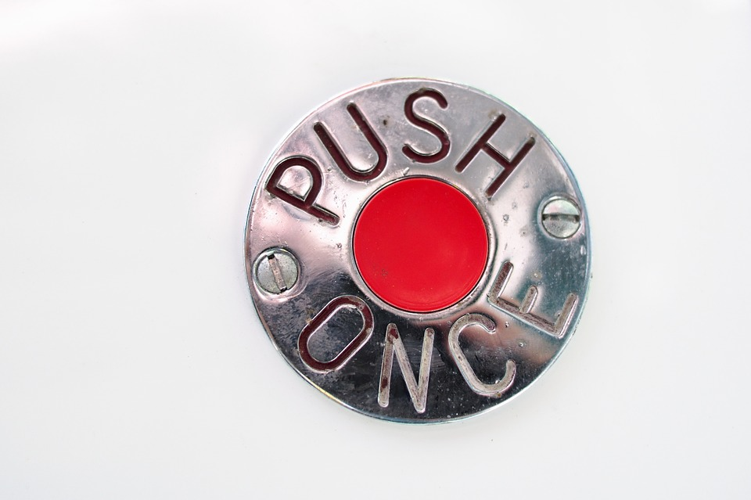
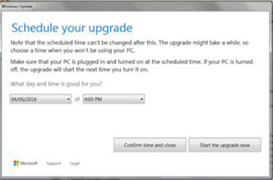
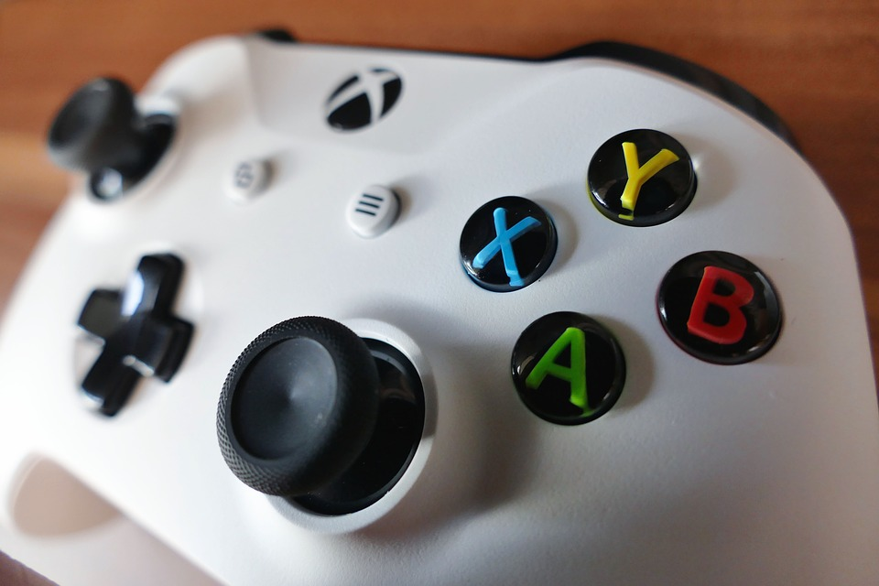
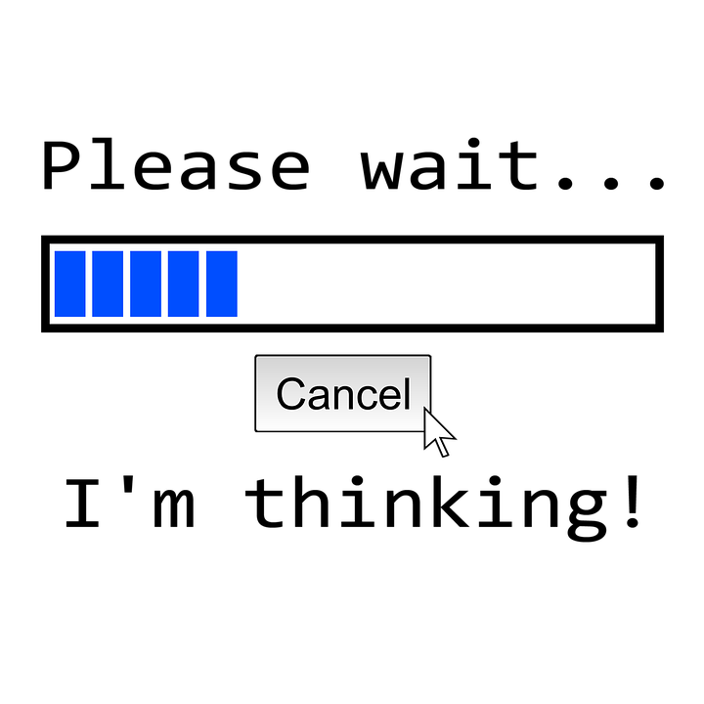
User is In-Control

Slide 19
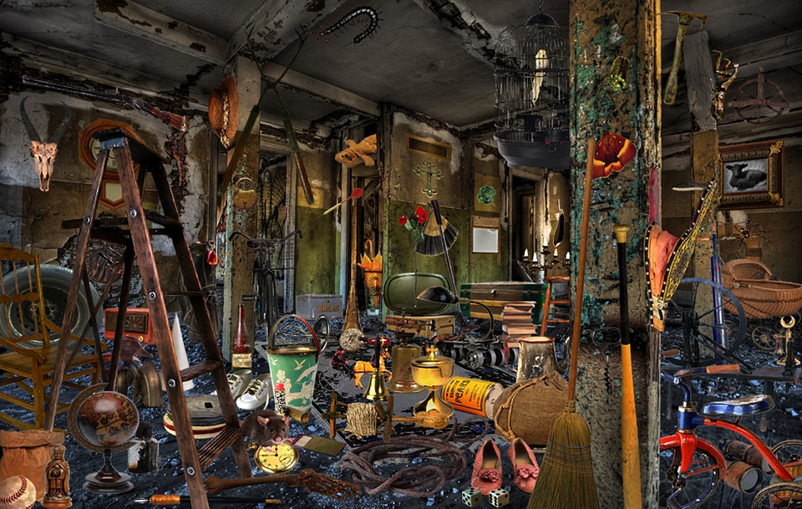
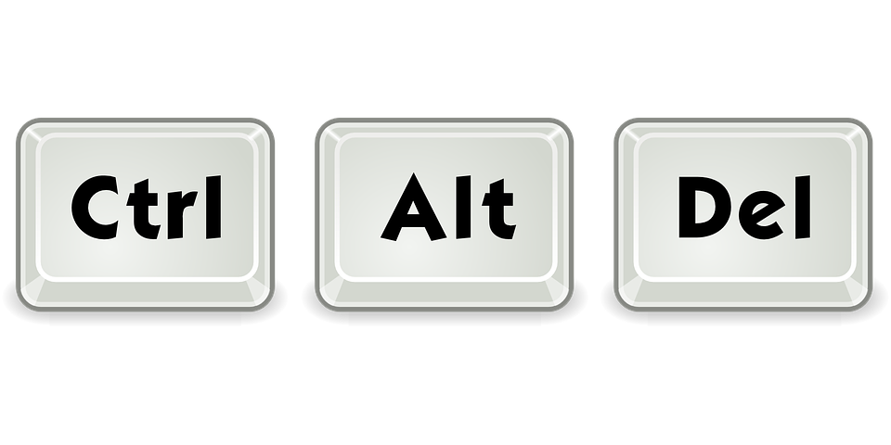
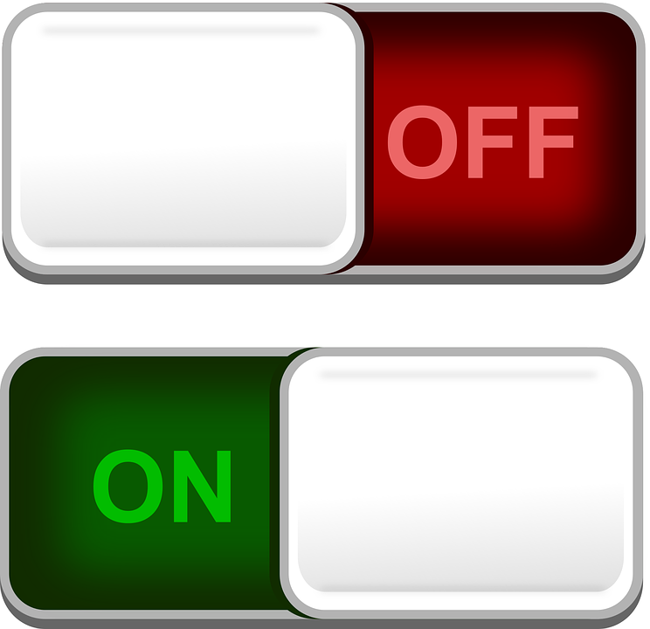
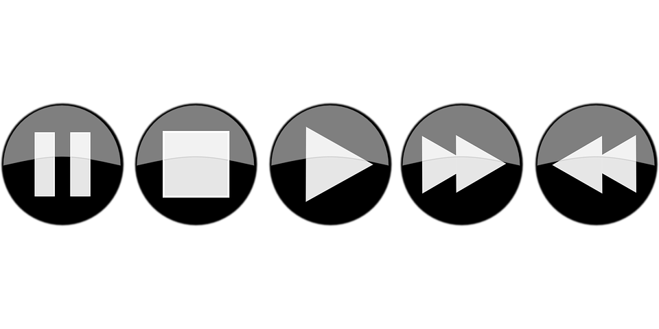
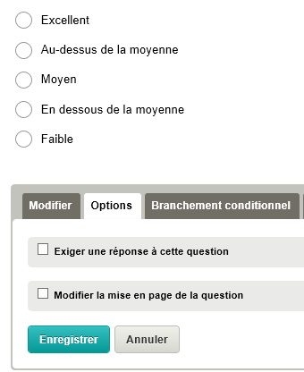


Coherent - Standard

Slide 20






Error Prevention

Slide 21







Recognizable - Memorizable
iPhone
MySQL
WeTransfer
YouTube

Slide 22


Slide 23






Flexibility – In-Use Efficiency

Slide 24




Aestetics - Zenitude

Slide 25




Identify / Correct Errors

Slide 26





Help & Documentation

Slide 27


So, Ask the Right Question(s)

Slide 28





