Slide 1

XXVI International Conference of
Software Quality Assurance
«Software Quality Assurance Days»
Gjore Zaharchev
Seavus. Skopje, Macedonia
https://gjorezaharchev.blogspot.com/
Testing Beyond the Obvious
Minsk. November 15–16, 2019
sqadays.com

Slide 2
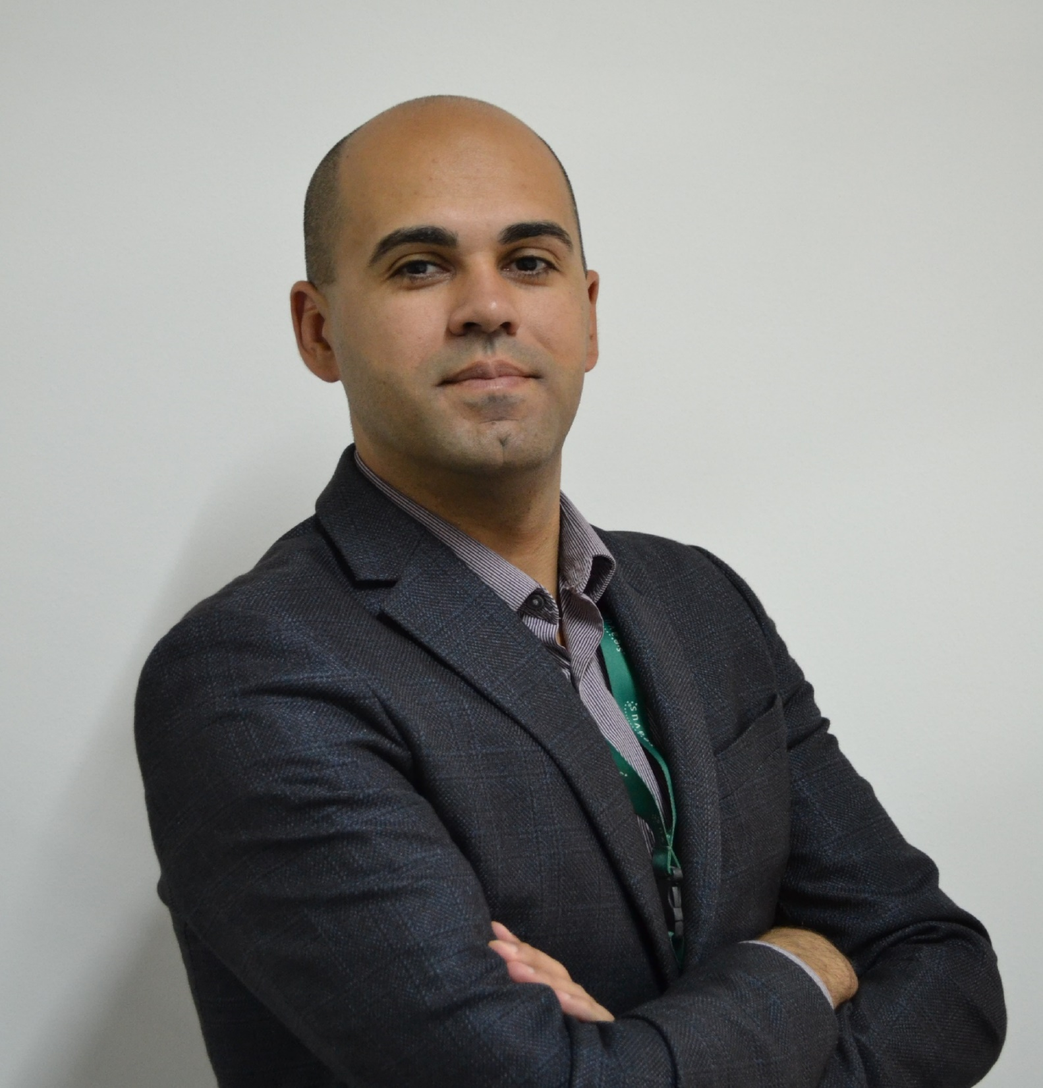

Gjore Zaharchev
Quality Assurance Coordinator at Seavus Group
XXVI International Conference of
Software Quality Assurance
«Software Quality Assurance Days»
Software Testing Consultant
13 Years hands on experience
Teach Software Testing
Conference and Testing Meetup's Speaker
Test Automation and Agile Testing Evangelist
Testing Beyond the Obvious
sqadays.com

Slide 3
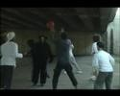

Slide 4
Agenda
How we do Software Testing?
Challenges?
Beyond the Obvious!
Recap
Testing Beyond the Obvious
sqadays.com

Slide 5
How we do software testing?
Minsk. November 15–16, 2019
sqadays.com

Slide 6
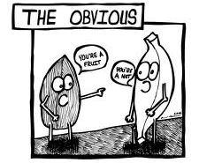
Testing Beyond the Obvious
sqadays.com

Slide 7
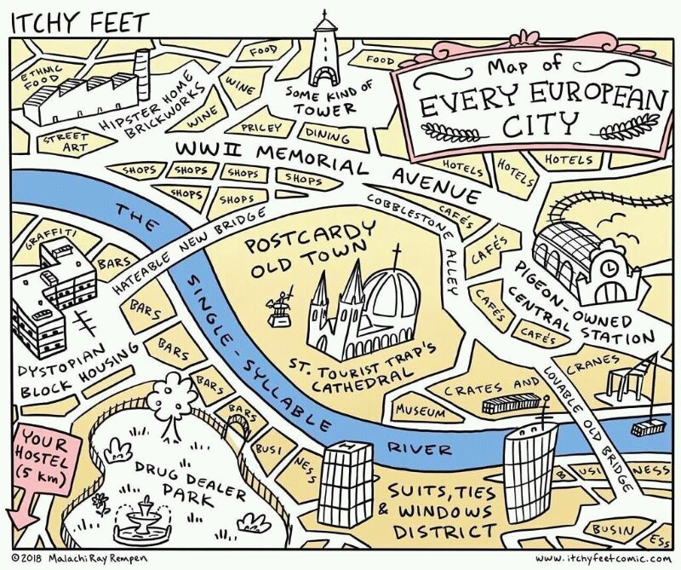
Testing Beyond the Obvious
sqadays.com
Notes:
Tours

Slide 8
6U1N
Useless Test Process
Useless Test Strategy
Useless Test Plans
Useless Test Estimations
Useless Test Cases
Useless Test Automation
No Testing Techniques nor Heuristics used
Testing Beyond the Obvious
sqadays.com

Slide 9
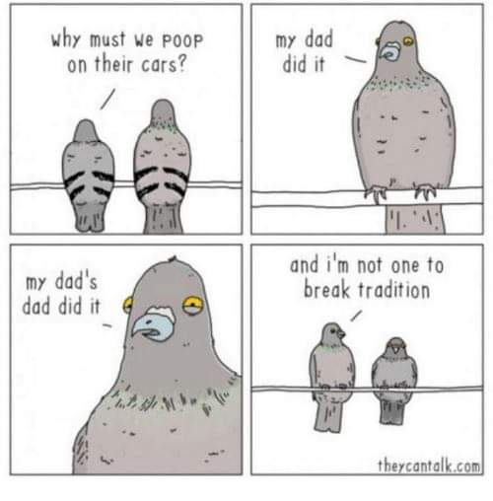
Testing Beyond the Obvious
sqadays.com
Notes:
Traditions

Slide 10
Challenges
Minsk. November 15–16, 2019
sqadays.com

Slide 11
Challenges
Distributed Teams
Faster time to market
Unpredictable competitors
Cloud solutions
Increasing number of devices and platforms
Demanding number of professionals
System of Systems platform
Testing Beyond the Obvious
sqadays.com

Slide 12
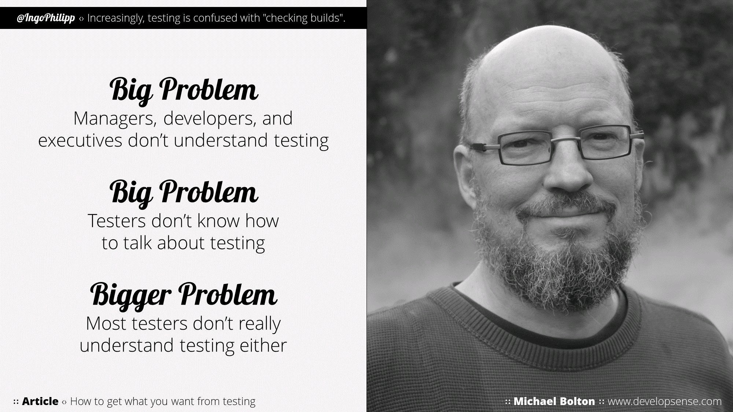
Testing Beyond the Obvious
sqadays.com

Slide 13
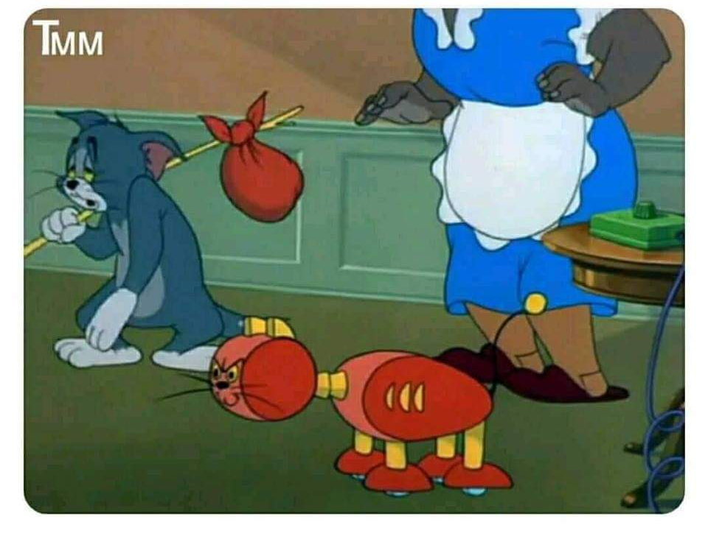
Testing Beyond the Obvious
sqadays.com
Notes:
Worlds first victim of automation

Slide 14
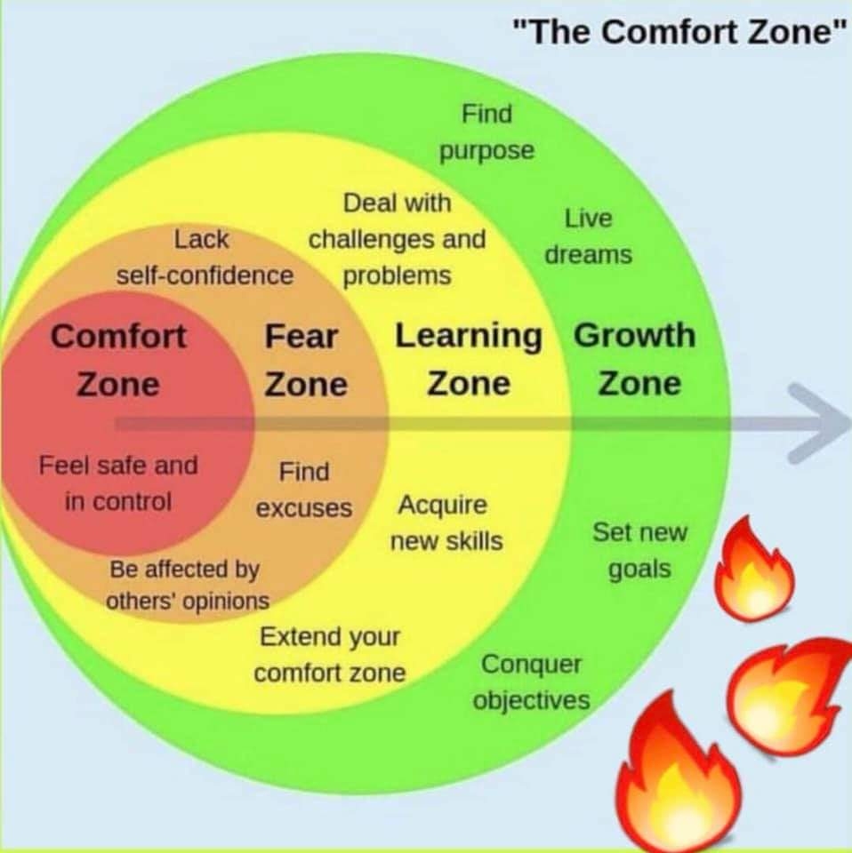
Testing Beyond the Obvious
sqadays.com

Slide 15
Beyond the Obvious
Minsk. November 15–16, 2019
sqadays.com

Slide 16
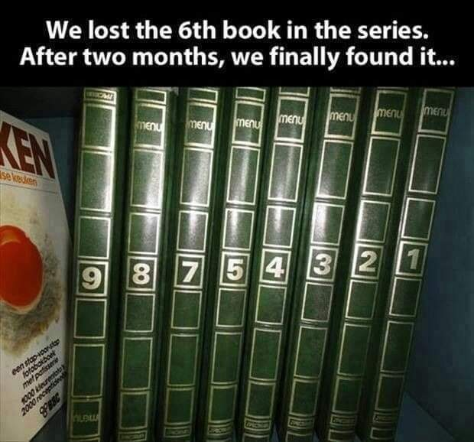
Testing Beyond the Obvious
sqadays.com

Slide 17
“The electric light did not come from the continuous improvement of candles”
Oren Harari
Testing Beyond the Obvious
sqadays.com

Slide 18
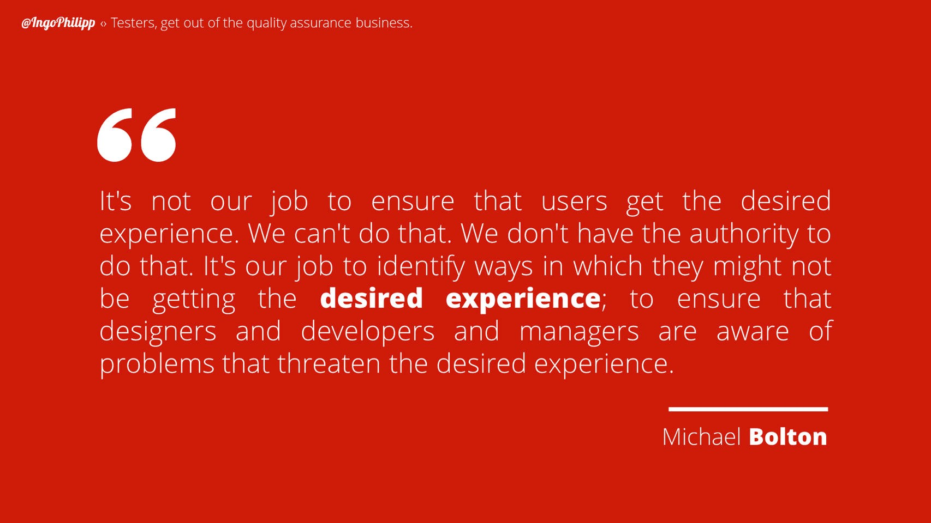
Testing Beyond the Obvious
sqadays.com

Slide 19

Testing Beyond the Obvious
sqadays.com

Slide 20
Skilled and motivated tasters can identify majority of the risks as earliest as possible!
Testing Beyond the Obvious
sqadays.com

Slide 21
First Law of Software Quality
errors = (more code)2
e = mc2
Testing Beyond the Obvious
sqadays.com

Slide 22
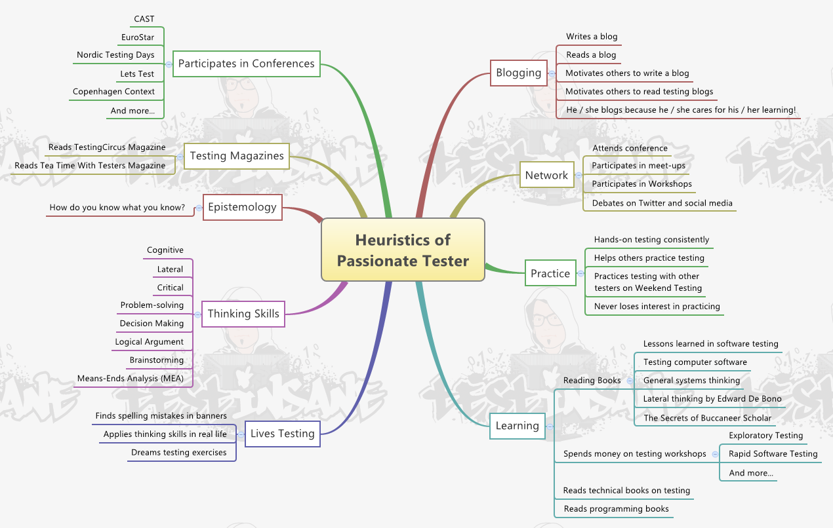
Testing Beyond the Obvious
sqadays.com

Slide 23
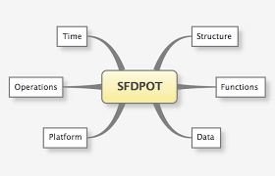
Testing Beyond the Obvious
sqadays.com
Notes:
Test what it’s made of. (What if the memory card is filled, removed or changed? )
Test what it does. (Does the app direct me to turn on necessary related services such as location services if those services are shut off?)
Test what it does it to. (Does the app find time related data (if relevant, such as movie show times) based on the device time?)
Test what it depends upon. (Does the app depend on any device settings?)
Test how it’s used. (What happens when a mobile interruption occurs such as an incoming call or text message?)
Test how it’s affected by time. (What happens if the time zone is switched?)

Slide 24
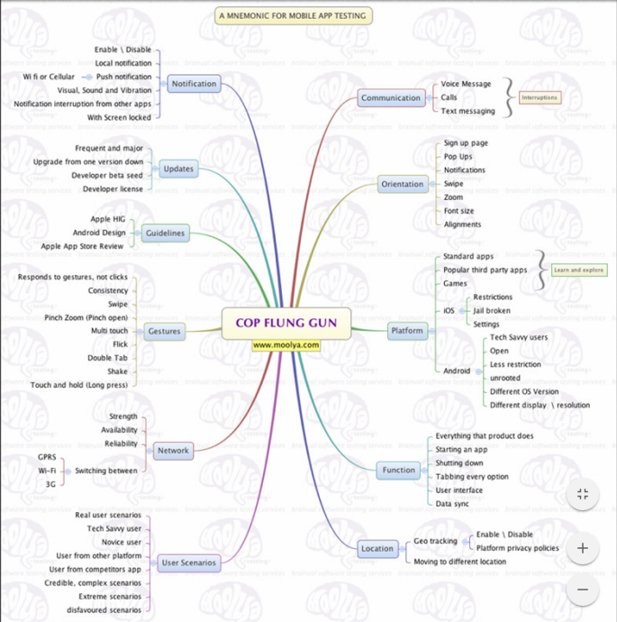
Testing Beyond the Obvious
sqadays.com

Slide 25
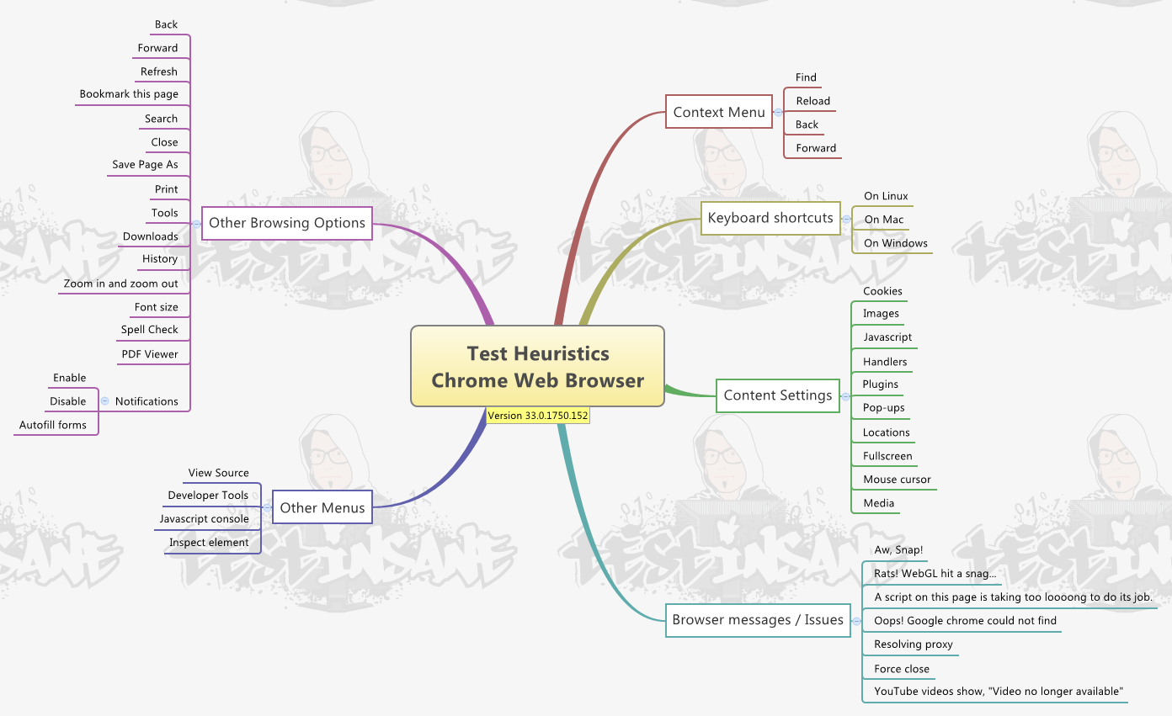
Testing Beyond the Obvious
sqadays.com

Slide 26
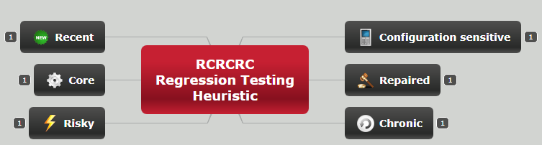
Agenda
Testing Beyond the Obvious
sqadays.com

Slide 27
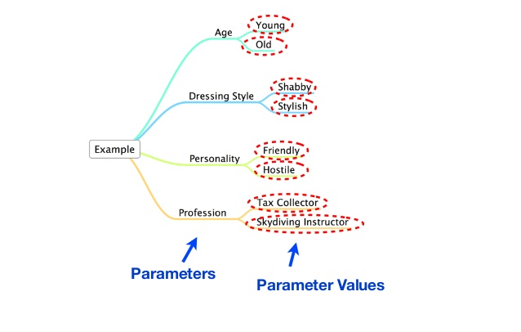
Pairwise
Testing Beyond the Obvious
sqadays.com

Slide 28
Testing concepts
Session-Based Exploratory Testing
Cheat Sheets
Testing Techniques
Checklists
Tours
Mind Maps
Testing Beyond the Obvious
sqadays.com

Slide 29
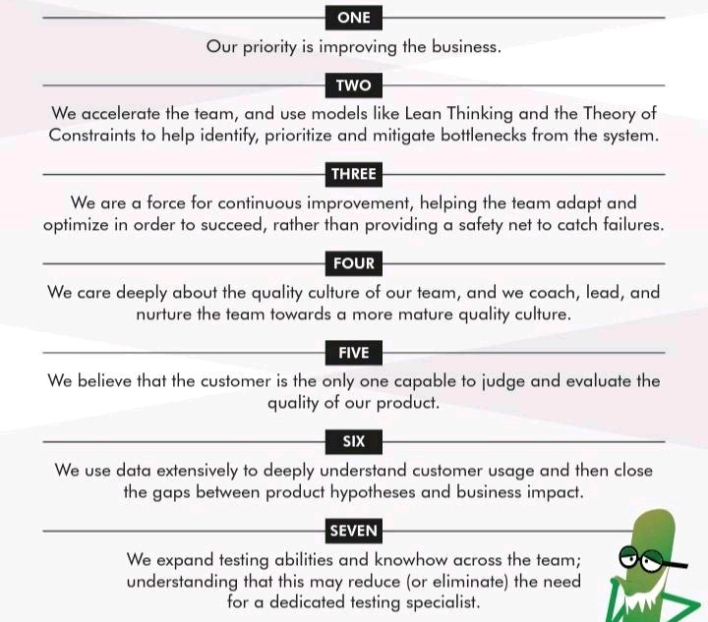
Testing Beyond the Obvious
sqadays.com

Slide 30
Recap
Minsk. November 15–16, 2019
sqadays.com

Slide 31
Testers Job is not to detect defects but instead to prevent them!
Testing Beyond the Obvious
sqadays.com

Slide 32
Recap
Current testing process is not designed for the demanding environment in 2019.
Better testing can be achieved by highly skilled and constantly trained professionals.
Obvious defects can be noticed by anyone our job is to detect defects that can lead to bad experience.
Testing Beyond the Obvious
sqadays.com

