Slide 1

Software quality assurance days
International Conference of
Software Quality Assurance
sqadays.com
Rakesh Kondreddy
Ellucian. Bangalore, India
Manual And Automated Accessibility Testing Implementation
Moscow Nov 23–24, 2018

Slide 2

About Me
Senior Software Test Engineer
@Ellucian, Ex- Oracle
Exploratory QA
Named 3rd in Test Automation Expert of year In world as per Tricentis Survey 2018
Open Source Enthusiast
Certified Scrum Master
Testing Freak online Meetup Organizer
Blog contest Winner
Reach me @+91- 8142772717 /
rakeshkmr516@gmail.com
Manual And Automated Accessibility Testing Implementation

Slide 3
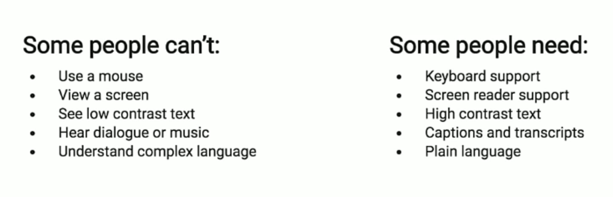
Web Accessibility
“Inclusive practice of removing barriers
that prevent interaction,
or access to websites,
by all users
Software is tested to validate the accessibility of the software to all users including differently abled / having special needs
Manual And Automated Accessibility Testing Implementation

Slide 4

Bad Example of Physical Accessibility
Manual And Automated Accessibility Testing Implementation

Slide 5
Good Example of Physical Accessibility
Manual And Automated Accessibility Testing Implementation

Slide 6
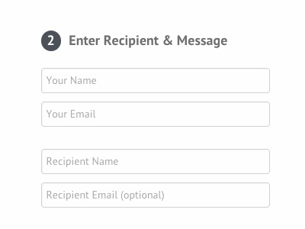
Bad Example of Software Accessibility
Manual And Automated Accessibility Testing Implementation

Slide 7
Why Accessibility Testing
Abide by Accessibility Legislations
Avoid Potential Law Suits
Cater to market for Differently abled people
Customer policies
Manual And Automated Accessibility Testing Implementation

Slide 8
Differently abled users & Scenarios
Visual :- Blindness, Low vision, Color blindness
Online shopper with color blindness
Hearing :- Deafness, Hard of hearing
Deaf student
Physical disabilities :- Motor disabilities
Multiple disabilities
Cognitive and neurological disabilities :-
Dyslexia, Attention Deficit Disorder Intellectual impairments, Memory impairments, Mental health disabilities Seizure disorders
Manual And Automated Accessibility Testing Implementation

Slide 9
Manual And Automated Accessibility Testing Implementation

Slide 10
Standards and Guidelines
WCAG (Web Content Accessibility Guidelines)
Collection of guidelines, which states the
accessibility standards for web software.
4 principles which consists of 12 guidelines.
Within the guidelines,
success criteria Classified into 3 different levels:
Manual And Automated Accessibility Testing Implementation

Slide 11
WCAG Principles
Manual And Automated Accessibility Testing Implementation

Slide 12
Manual And Automated Accessibility Testing Implementation

Slide 13
Manual And Automated Accessibility Testing Implementation

Slide 14
Assistive Technologies
VoiceOver ScreenReader
https://tinyurl.com/y7ck4nxp
Screen magnifiers
Screen readers
Speech recognition
Tabbing through structural elements
Manual And Automated Accessibility Testing Implementation

Slide 15

VoiceOver ScreenReader Demo

Slide 16
Manual Review - Accessibility Tree
Demo
Link : https://tinyurl.com/jbcnrfx
Manual And Automated Accessibility Testing Implementation

Slide 17

Accessibility Toolbars/ plugins -1
Demo
Link : Axe Plugin: https://tinyurl.com/n6g5ozj
Manual And Automated Accessibility Testing Implementation

Slide 18
Accessibility Toolbars/ plugins -2
Demo
Colour blindness analyzer : https://colororacle.org/
Manual And Automated Accessibility Testing Implementation

Slide 19
Online Evaluation Tools
Demo
Link : https://tinyurl.com/y83hodx6
Manual And Automated Accessibility Testing Implementation

Slide 20
WAI-ARIA
Web Accessibility Initiative – Accessible Rich Internet Applications
WAI-ARIA role | Native element
button | button
checkbox | input type=”checkbox”
radiogroup and radio | fieldset/legend and input type=”radio”
combobox | select size=”1″
listbox | select with a size greater than 1
option | option
list | ul or ol
spinbutton | input type=”number”
link | a with href attribute
form | form

Slide 21
Automated Accessibility Testing
Demo
Stats :
Reduce 70% of manual efforts through automation
Team utilized automation said they got violations in 5 mins whereas they have spent 60 days in performing accessibility testing manually
Link : https://tinyurl.com/y9g3nswc
Manual And Automated Accessibility Testing Implementation

Slide 22
Automated Accessibility Demo

Slide 23
Accessibility Adoption across Org
➤ Establish an Org commitment with key stakeholders responsible for Accessibility.
➤ A checklist/questionnaire to include Accessibility for both new and existing apps
➤ Establish a benchmark (Say Level A, AA )
➤ Establish a standards for UX designers, (UI)Developers & Testers
➤ Start As early as possible from UX GEL(Global Experience Language)
➤ Color contrast
➤ Conduct usability, User testing session outside org.
Manual And Automated Accessibility Testing Implementation

Slide 24
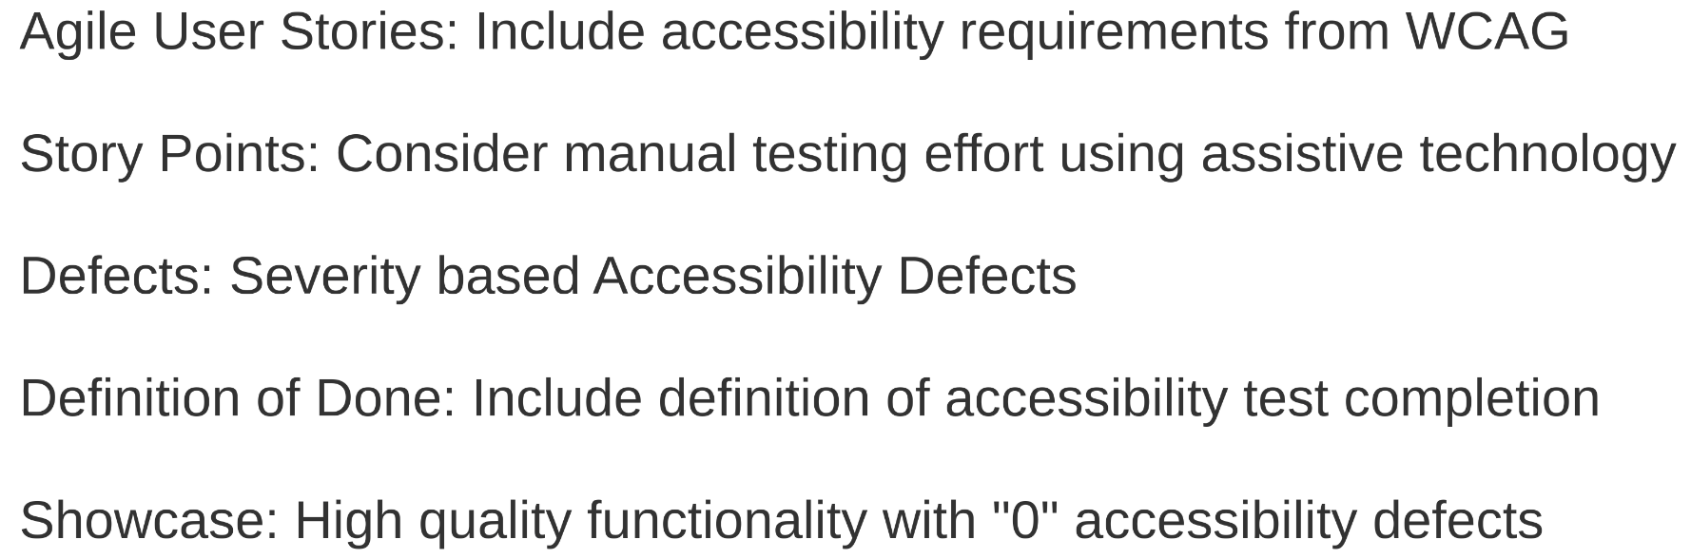
Technical Agility
Manual And Automated Accessibility Testing Implementation

Slide 25
Manual And Automated Accessibility Testing Implementation

Slide 26
References
https://www.w3.org/WAI/standards-guidelines/wcag/
http://squizlabs.github.io/HTML_CodeSniffer/
https://wave.webaim.org/
https://www.deque.com/axe/
https://prezi.com/2p0metbinudn/agile-accessibility-tester/
https://www.slideshare.net/Applitools/automating-accessibility-tests-web-is-for-everyone-by-manoj-kumar
https://dojo.ministryoftesting.com/dojo/lessons/30-days-of-accessibility-testing
https://www.npmjs.com/package/protractor-accessibility-plugin
Manual And Automated Accessibility Testing Implementation

Slide 27
Rakesh Kondreddy
+91 8142772717
rakeshkmr516@gmail.com
Twitter : @rakeshkmr516
Manual And Automated Accessibility Testing Implementation

