Slide 1
Test case-as-code via BDD
How to collaborate manual
and automation testing
Andrei Brovko

Slide 2
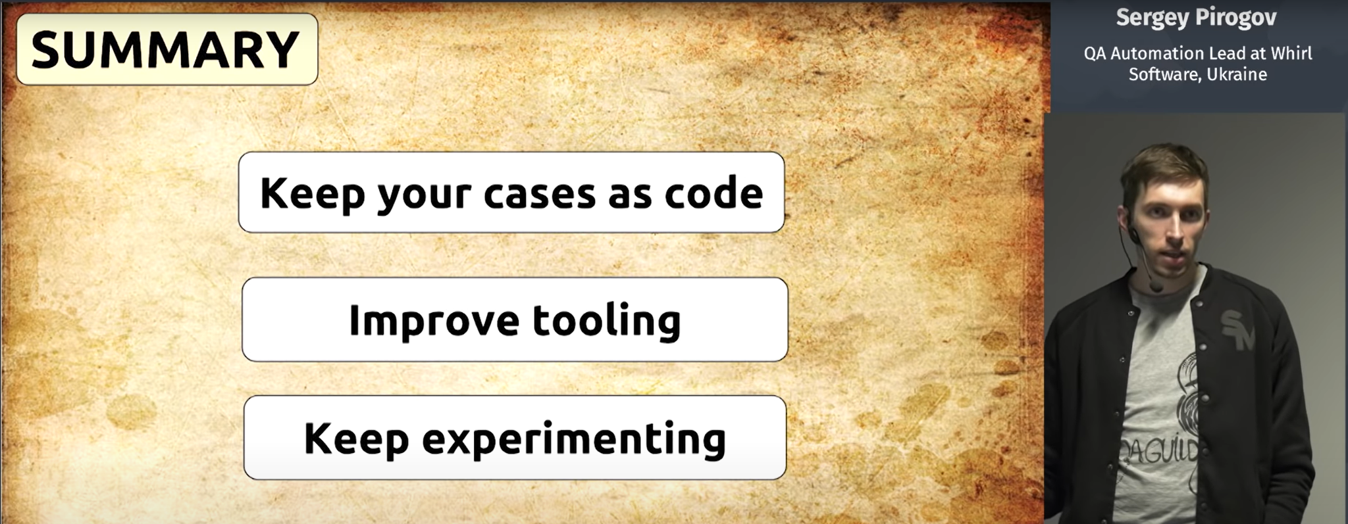
Sergey Pirogov

Slide 3
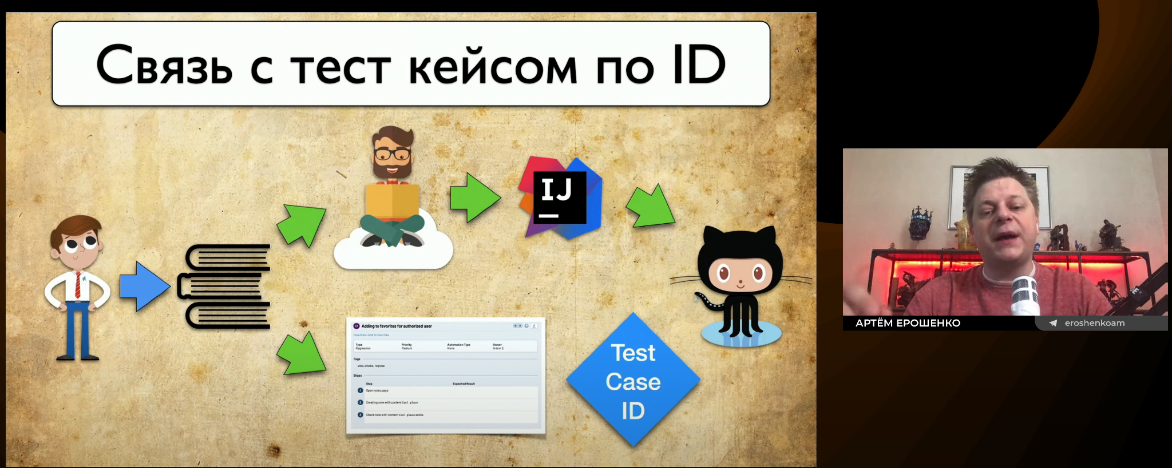
Artem Eroshenko

Slide 4
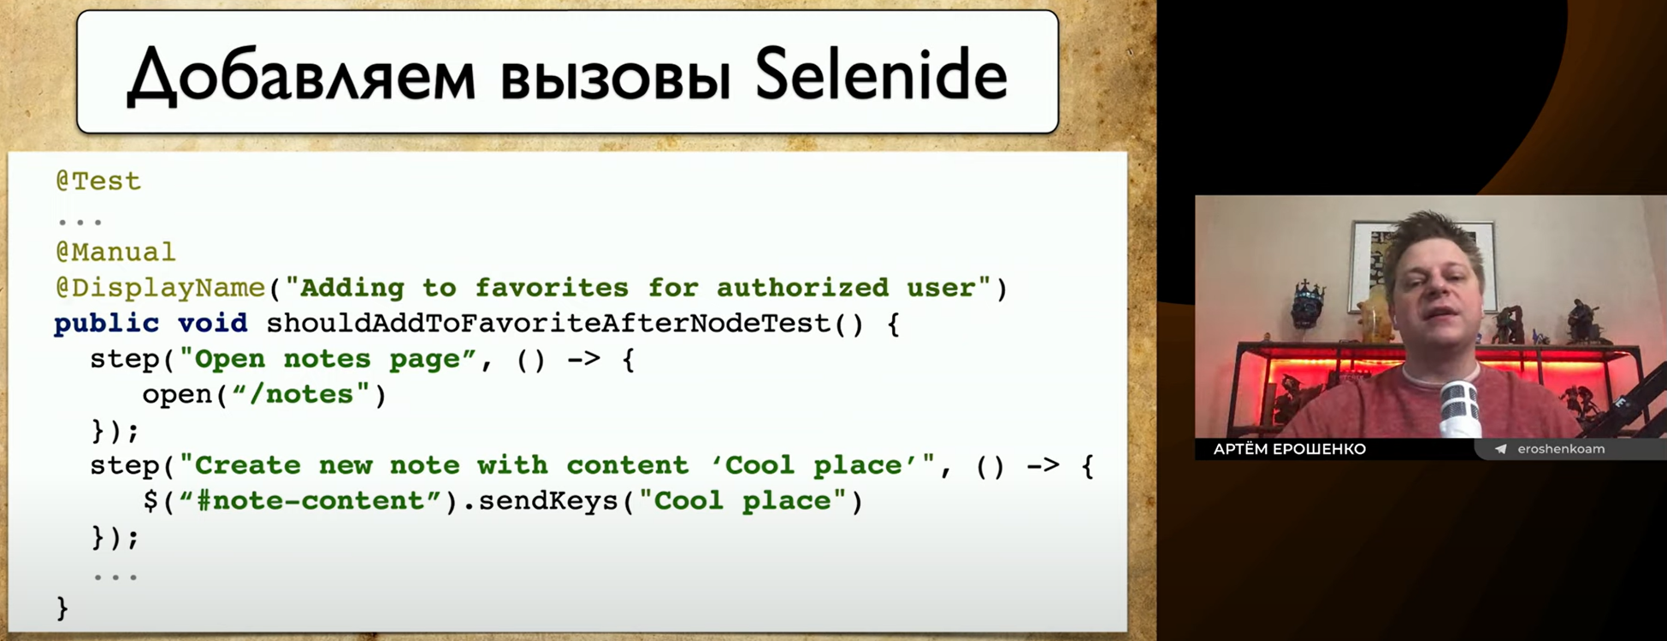
Artem Eroshenko

Slide 5

BDD test scenario
@Manual
Scenario: Adding to favorites for authorized user
Given open notes page
When user creates new note with content 'Cool place'
Then confirmation message should be displayed
Artem Eroshenko

Slide 6
Step binding
[Given("open notes page")]
public void GivenOpenNotesPage()
{
_driverService.Navigate("https://quantori.com/notes");
}

Slide 7



Problematic
Test automation lag
Version control
Review

Slide 8

Collaboration

Slide 9



Test Automation Ecosystem
Quantori Behavioral.Automation
Quantori GherkinSyncTool
Given. When. Then.
CI/CD
Test Management System
BA, Developer, QA
Test Reporting
Autotests analyze
Manual test execution
Confidence in quality

Slide 10
Test Automation Ecosystem
Quantori Behavioral.Automation
Quantori GherkinSyncTool
Given. When. Then.
CI/CD
Test Management System
BA, Developer, QA
Test Reporting
Autotests analyze
Manual test execution
Confidence in quality

Slide 11
Test Automation Ecosystem
Quantori Behavioral.Automation
Quantori GherkinSyncTool
Given. When. Then.
CI/CD
Test Management System
BA, Developer, QA
Test Reporting
Autotests analyze
Manual test execution
Confidence in quality

Slide 12
GherkinSyncTool architecture
GherkinSyncTool
<<interface>>
IFeatureFilesGrabber
Take Files()
<<interface>>
ISynchronizer
Sync()
TestRail
Gherkin files
File system
Azure DevOps
Gherkin files
Any other source
Any other
Test Management
System
High-level architecture diagram

Slide 13
GherkinSyncTool architecture
GherkinSyncTool
<<interface>>
IFeatureFilesGrabber
Take Files()
<<interface>>
ISynchronizer
Sync()
TestRail
Gherkin files
File system
Azure DevOps
Gherkin files
Any other source
Any other
Test Management
System
High-level architecture diagram

Slide 14
GherkinSyncTool architecture
GherkinSyncTool
<<interface>>
IFeatureFilesGrabber
Take Files()
<<interface>>
ISynchronizer
Sync()
TestRail
Gherkin files
File system
Azure DevOps
Gherkin files
Any other source
Any other
Test Management
System
High-level architecture diagram

Slide 15
Configuration
{
"BaseDirectory": "TestCases",
"TagPrefix": "@tc:",
"Formatting Settings": {
"Tag Indentation": 2
},
"TestRail Settings": {
"ProjectId": 2,
"SuiteId": 77,
"TemplateId": 2
}

Slide 16
Demo

Slide 17
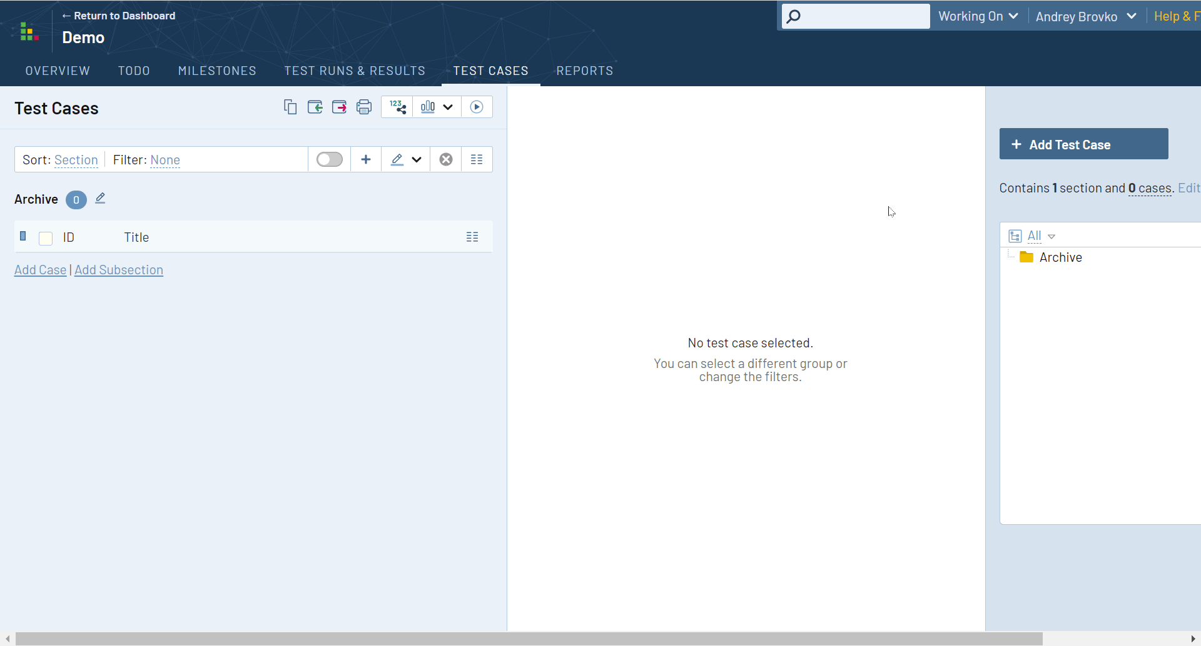

Slide 18
Run in pipeline
Open PR’s?
Changeset “Features/**”
git checkout gherkin-sync-tool
git rebase origin/main --strategy-option theirs
Run GherkinSyncTool
No
if git commit -am \\"Gherkin_Sync_\$(git rev-parse --short HEAD)\\";
then git push --set-upstream origin gherkin-sync-tool --force-with-lease
Yes
Finish
Open PR

Slide 19


Performanse
TestRail
Azure DevOps
1266 tests,
155 files created for
7 - 8 min
1266 tests,
155 files created for
30 - 40 sec

Slide 20



Benefits
Code agnostic
Breaks down barriers
Automation coverage

Slide 21

GitHub repository
Andrei Brovko
Quality Architect
andrey.brovko@quantori.com
https://t.me/brov_ko
https://github.com/quantori/GherkinSyncTool

